Slide 1
Accounting for Real-Exchange Rates using Micro-Data
Crucini, Mario J. and Landry, Anthony. 2019. "Accounting for real exchange rates using micro-data.” Journal of International Money and Finance 91 (C): 86-100.
https://doi.org/10.1016/j.jimonfin.2018.11.002

Slide 2
Introduction
→ Introduction
Microeconomic Decomposition
The Intermediate Inputs Model
Macroeconomic Decomposition
Conclusion
Supplemental Material

Slide 3
Introductory Motivation,
Classical Dichotomy
Theory:
Non-traded good prices account for all aggregate real exchange rate (RER) volatility. Harrod (1933), Salter (1959), Swan (1960), Balassa (1964), Samuelson (1964).
Final goods are non-traded, trade is in intermediate inputs. Sanyal and Jones (1982), Either (1983), Burstein, Eichanbaum and Rebelo (2003).
Differentiate traded goods, prices are sticky in local currency in the short-run. Dornbusch (1976), Obstfeld and Rogoff (2000).
Evidence:
Long-run, classical dichotomy is compelling. Summer and Heston work on Penn World Tables.
Time series variation, traded and non-traded good prices behave similarly. Mussa (1986), Engel (1999), Betts and Kehoe (2006), Popper and Parsley (2006).

Slide 4
Introductory Motivation (Continued),
Classical Dichotomy
Most existing work uses aggregate price indices:
Sub-indices are not designed to distinguish traded and non-traded goods (e.g., food contains both groceries and restaurant meals)
All goods involve traded and non-traded inputs (the median good in our sample has a non-traded input share of 41%)
This paper uses microeconomic price data:
This allows the researcher to control the aggregation process
Focus on the distinction between traded and non-traded goods to the level of intermediate inputs

Slide 5
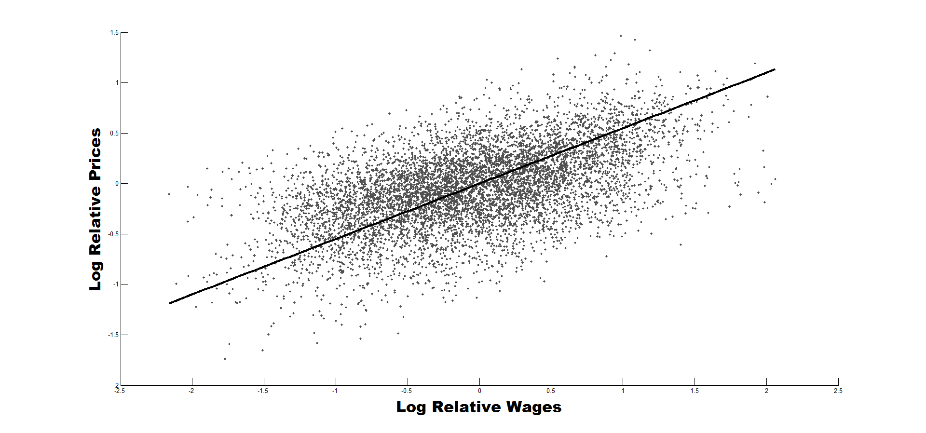
Log Relative Wages vs. Log Relative Prices
The above graph shows part of the motivation for these slides. The graph depicts thousands of data points which represent the relationship between the log-relative wages and log-relative prices of different goods across US-Canada city pairs. As is evidence by the upward sloping line of best fit, the prices of goods are not independent of local inputs.

Slide 6
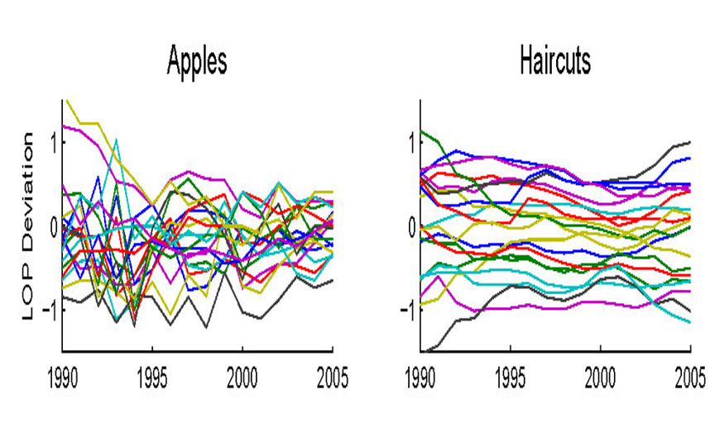
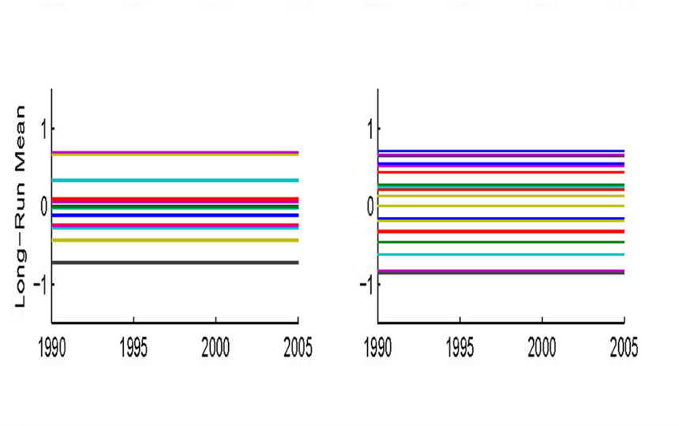
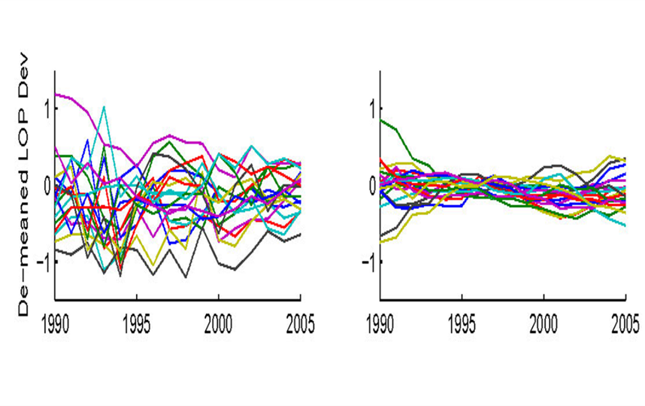
Why Micro-Price Data Matters, an Example
Apples and Haircuts (EIU price survey)​. Below are displayed figures using Canada-U.S. city pairs
Each line: one Canada–U.S. city pair, one good
0 means the same price in both cities
Gaps are large, and they never close
Each pair's average gap across the whole period
The spread between lines is the persistent gap
A price index sets every one of these lines to zero
All that survives once the average is removed
Apples keep bouncing; haircuts go nearly flat
This is everything a price index can ever show you

Slide 7
Crucini and Landry (2019, JIE),
Reassess the Validity of the Classical Dichotomy
Key elements of the exercise:
Use micro-price data
  Recall that this is what allows researchers to control the aggregation process, and distinguish between goods which are genuinely distinct but which are reported together in indices (e.g. restaurants vs. groceries).
Applying the classical dichotomy at the level of intermediate inputs
Results
Variance contribution of non-traded inputs is 4 times that of traded inputs
Variance contribution of non-traded goods is equal to that of traded goods, consistent with Engel

Slide 8
Key Take-Away
The classical dichotomy is a useful theory when applied at the level of intermediate inputs.
Its conceptual value is largely obscured when applied to final goods.

Slide 9
Microeconomic Decomposition
Introduction
Microeconomic Decomposition
  Methodology
  Data
  Final goods contribution to RER volatility
The Intermediate Inputs Model
Macroeconomic Decomposition
Conclusion
Supplemental Material

Slide 10
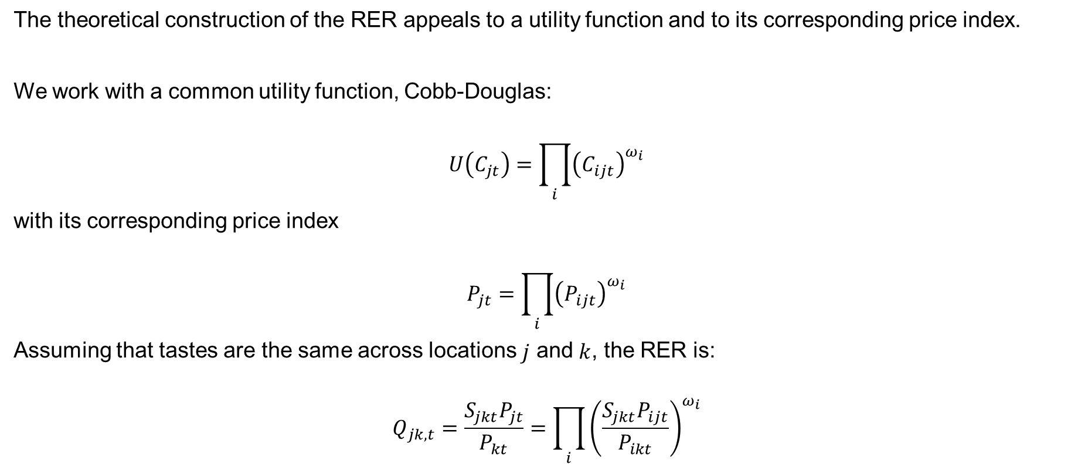
Microeconomic Decomposition
Method 1
The theoretical construction of the RER appeals to a utility function and to its corresponding price index.
We work with a common utility function, Cobb-Douglas:
$$U\left(C_{jt}\right)=\prod_{i}{{\left(C_{ijt}\right)}^{ω_{i}}}$$
with its corresponding price index
$$P_{jt}=\prod_{i}{{\left(P_{ijt}\right)}^{ω_{i}}}$$
Assuming that tastes are the same across locations $j$ and $k$, the RER is:
$$Q_{jk,t}=\frac{S_{jkt}P_{jt}}{P_{kt}}=\prod_{i}{{\left(\frac{S_{jkt}P_{ijt}}{P_{ikt}}\right)}^{ω_{i}}}$$

Slide 11
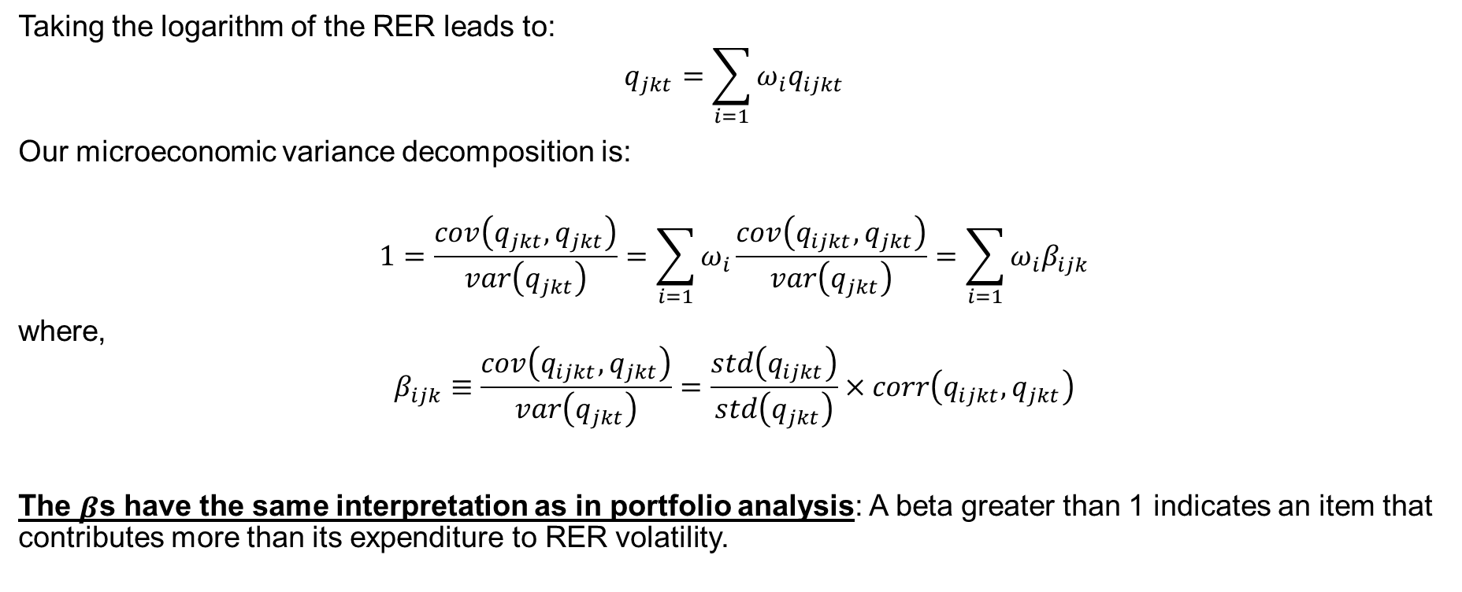
Microeconomic Decomposition
Method 2
Taking the logarithm of the RER leads to:
$$q_{jkt}=\sum_{i=1}{ω_{i}q_{ijkt}}$$
Our microeconomic variance decomposition is:
$$1=\frac{cov\left(q_{jkt},q_{jkt}\right)}{var\left(q_{jkt}\right)}=\sum_{i=1}{ω_{i}\frac{cov\left(q_{ijkt},q_{jkt}\right)}{var\left(q_{jkt}\right)}}=\sum_{i=1}{ω_{i}β_{ijk}}$$
where,
$$β_{ijk}≡\frac{cov\left(q_{ijkt},q_{jkt}\right)}{var\left(q_{jkt}\right)}=\frac{std\left(q_{ijkt}\right)}{std\left(q_{jkt}\right)}×corr\left(q_{ijkt},q_{jkt}\right)$$
The $β$s have the same interpretation as in portfolio analysis: A beta greater than 1 indicates an item that contributes more than its expenditure to RER volatility.

Slide 12
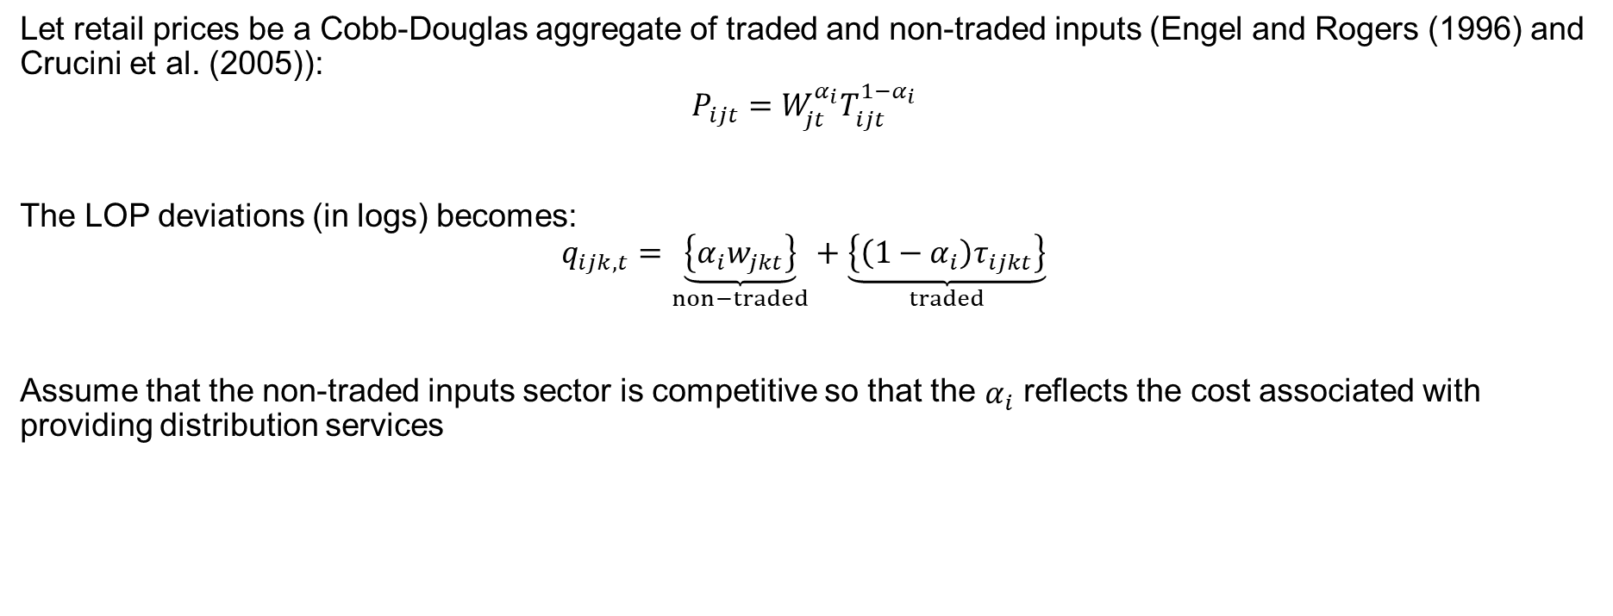
Intermediate Inputs Model
2-Factors
Let retail prices be a Cobb-Douglas aggregate of traded and non-traded inputs (Engel and Rogers (1996) and Crucini et al. (2005)):
$$P_{ijt}=W_{jt}^{α_{i}}T_{ijt}^{1−α_{i}}$$
The LOP deviations (in logs) becomes:
$$q_{ijk,t}=\underset{non−traded}{\underbrace{\left\{α_{i}w_{jkt}\right\}}}+\underset{traded}{\underbrace{\left\{\left(1−α_{i}\right)τ_{ijkt}\right\}}}$$
Assume that the non-traded inputs sector is competitive so that the $α_{i}$ reflects the cost associated with providing distribution services

Slide 13
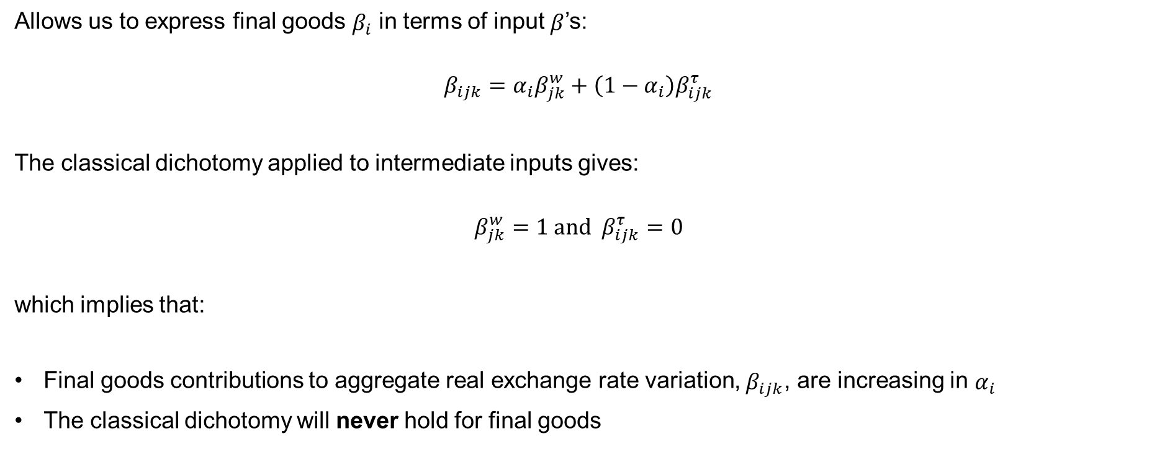
Intermediate Inputs Model
Variance Decomposition
Allows us to express final goods $β_{i}$ in terms of input $β$’s:
$$β_{ijk}=α_{i}β_{jk}^{w}+\left(1−α_{i}\right)β_{ijk}^{τ}$$
The classical dichotomy applied to intermediate inputs gives:
$$β_{jk}^{w}=1 and β_{ijk}^{τ}=0$$
which implies that:
Final goods contributions to aggregate real exchange rate variation, $β_{ijk}$, are increasing in $α_{i}$
The classical dichotomy will never hold for final goods

Slide 14
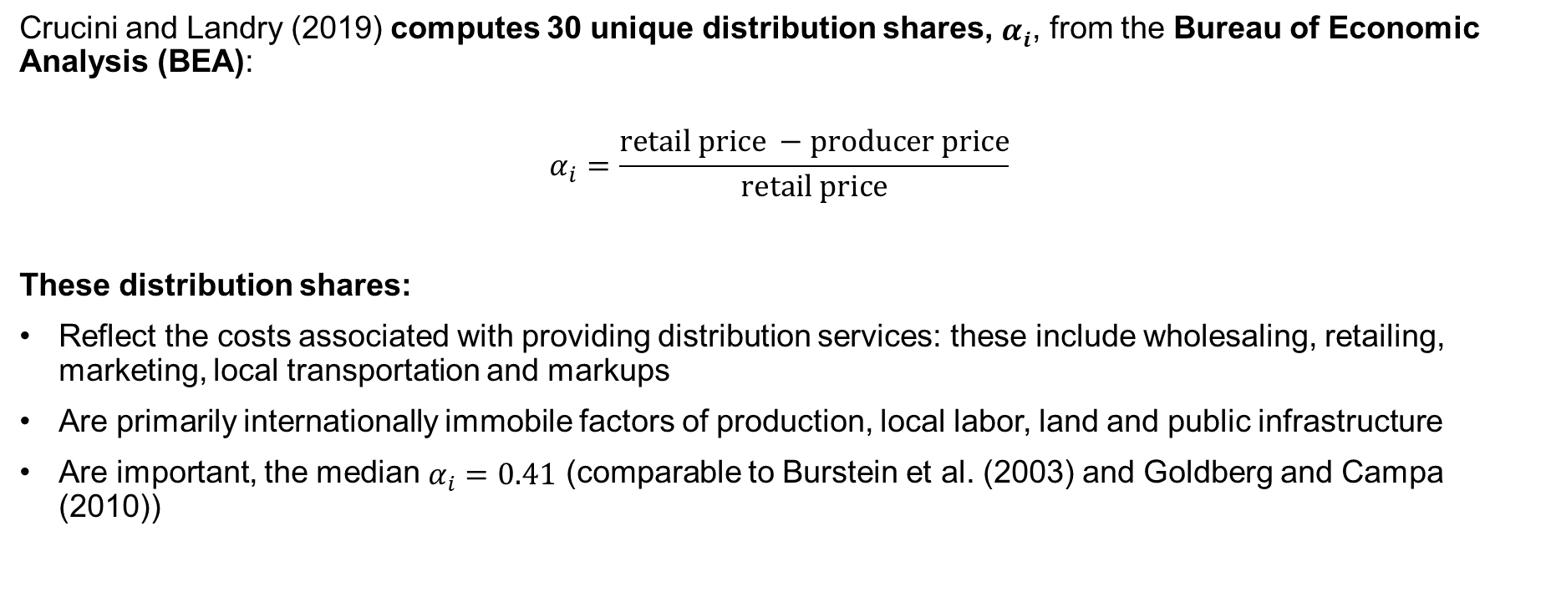
Microeconomic Decomposition
Distribution Shares
Crucini and Landry (2019) computes 30 unique distribution shares, $α_{i}$, from the Bureau of Economic Analysis (BEA):
$$α_{i}=\frac{retail price −producer price}{retail price}$$
These distribution shares:
Reflect the costs associated with providing distribution services: these include wholesaling, retailing, marketing, local transportation and markups
Are primarily internationally immobile factors of production, local labor, land and public infrastructure
Are important, the median $α_{i}=0.41$ (comparable to Burstein et al. (2003) and Goldberg and Campa (2010))
→ Example of Distribution Shares
→ Example of Goods

Slide 15
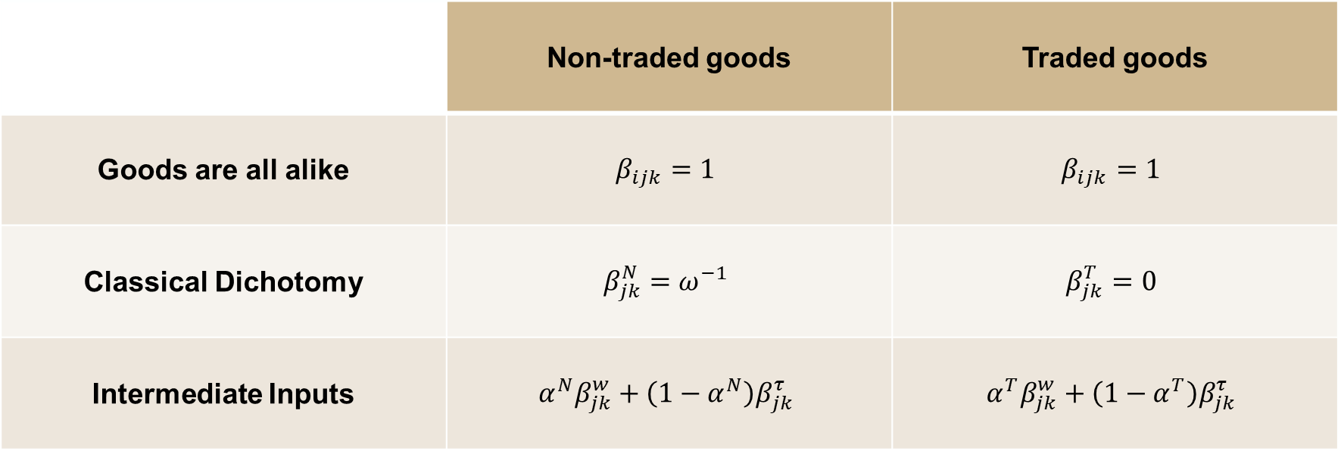
Microeconomic Decomposition
Three Benchmark Views
 | Non-traded goods | Traded goods
Goods are all alike | $$β_{ijk}=1$$ | $$β_{ijk}=1$$
Classical Dichotomy | $$β_{jk}^{N}=ω^{−1}$$ | $$β_{jk}^{T}=0$$
Intermediate Inputs | $$α^{N}β_{jk}^{w}+\left(1−α^{N}\right)β_{jk}^{τ}$$ | $$α^{T}β_{jk}^{w}+\left(1−α^{T}\right)β_{jk}^{τ}$$

Slide 16
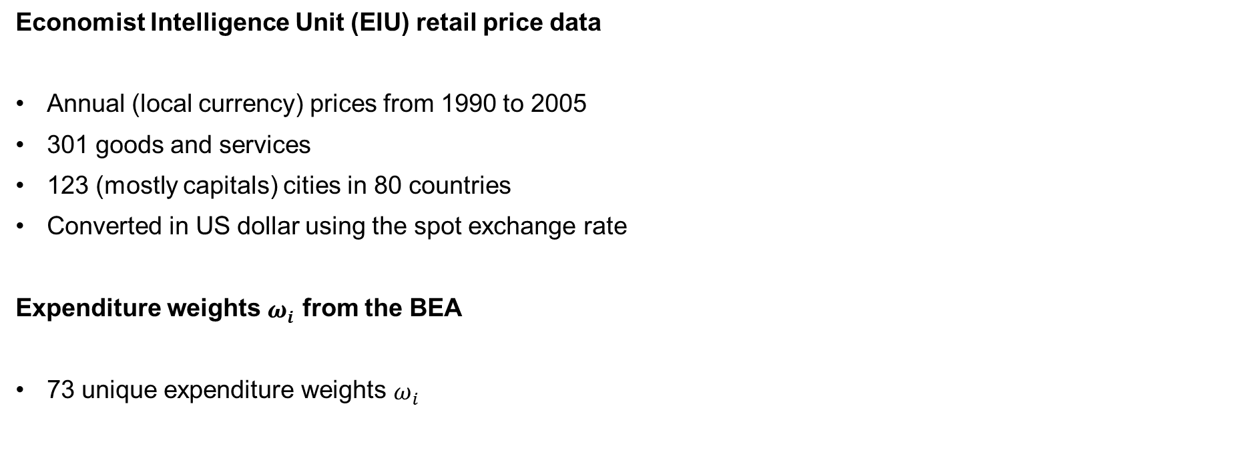
Microeconomic Decomposition
Prices and Expenditure Weights
Economist Intelligence Unit (EIU) retail price data
Annual (local currency) prices from 1990 to 2005
301 goods and services
123 (mostly capitals) cities in 80 countries
Converted in US dollar using the spot exchange rate
Expenditure weights $ω_{i}$ from the BEA
73 unique expenditure weights $ω_{i}$

Slide 17
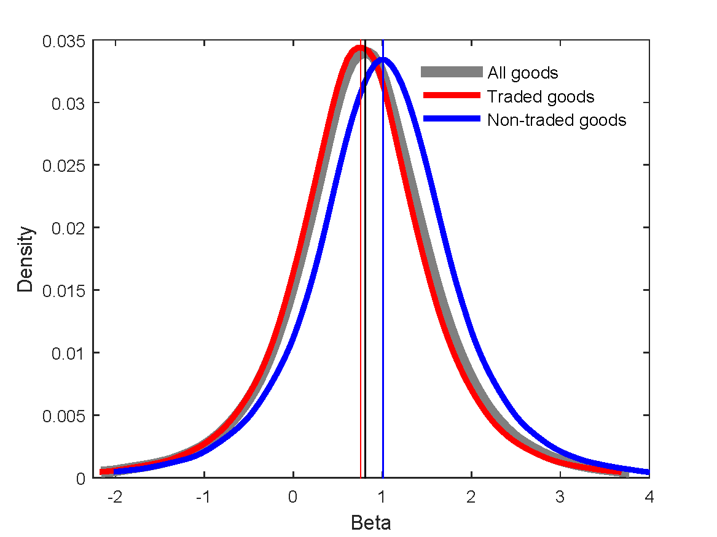
Macroeconomic Decomposition,
Classical Dichotomy Is Very Muted
Traded goods average 0.76
Non-traded average 1.03
→ Stats

Slide 18
Possible Sources of Heterogeneity
Dichotomous classification is too coarse
  Arguably, a continuous distribution of tradability or other facets of market segmentation in final goods
LOP deviations may respond in a heterogeneous fashion to common shocks
  Search theory
  Good-specific Calvo parameters
Classical dichotomy at the level of intermediate inputs (this paper)
  Final goods betas are a mixture of two underlying distributions with good-specific weights

Slide 19
The Intermediate Inputs Model
Introduction
Microeconomic Decomposition
The Intermediate Inputs Model
  Two-factor model
  Estimation
  Intermediate-inputs contribution to RER volatility
Macroeconomic Decomposition
Conclusion
Supplemental Material

Slide 20
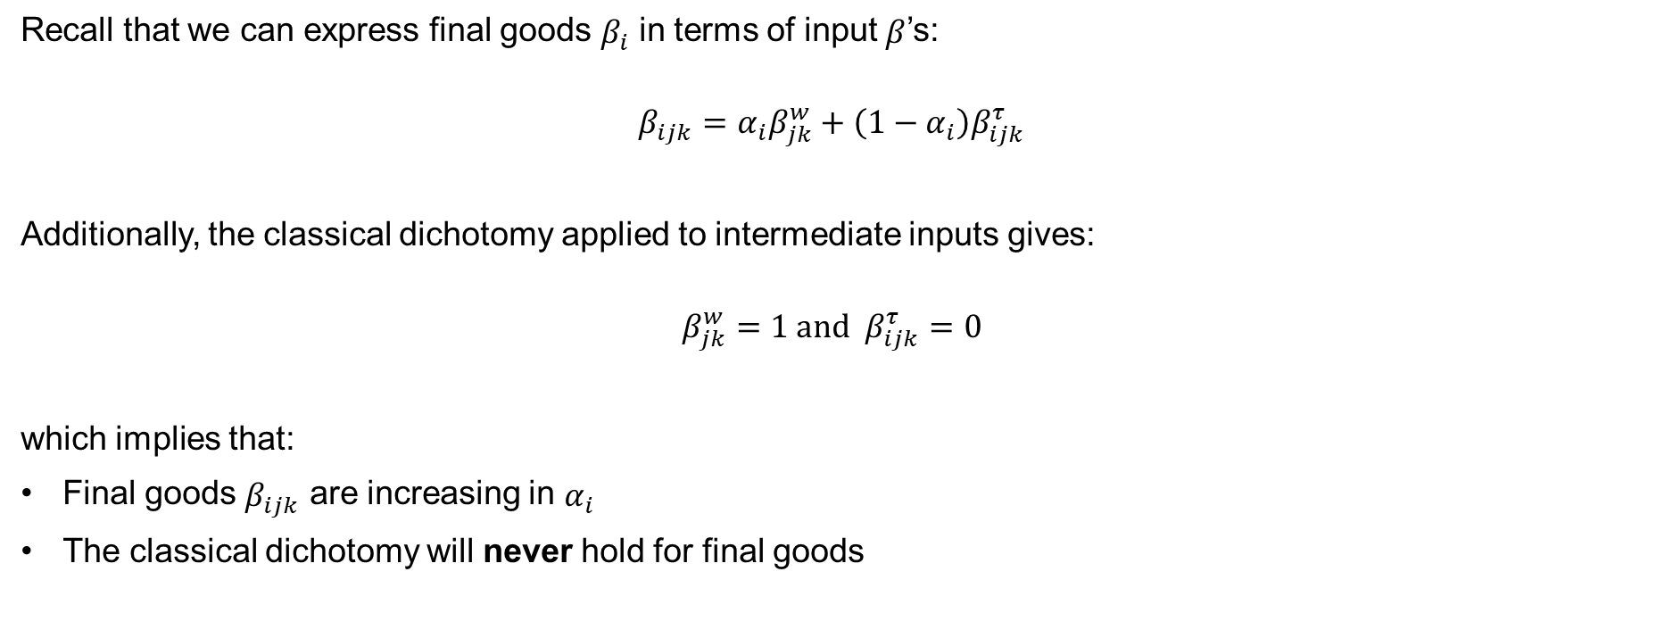
Intermediate Inputs Model,
The 2-Factor Model 3
Recall that we can express final goods $β_{i}$ in terms of input $β$’s:
$$β_{ijk}=α_{i}β_{jk}^{w}+\left(1−α_{i}\right)β_{ijk}^{τ}$$
Additionally, the classical dichotomy applied to intermediate inputs gives:
$$β_{jk}^{w}=1 and β_{ijk}^{τ}=0$$
which implies that:
Final goods $β_{ijk}$ are increasing in $α_{i}$
The classical dichotomy will never hold for final goods

Slide 21
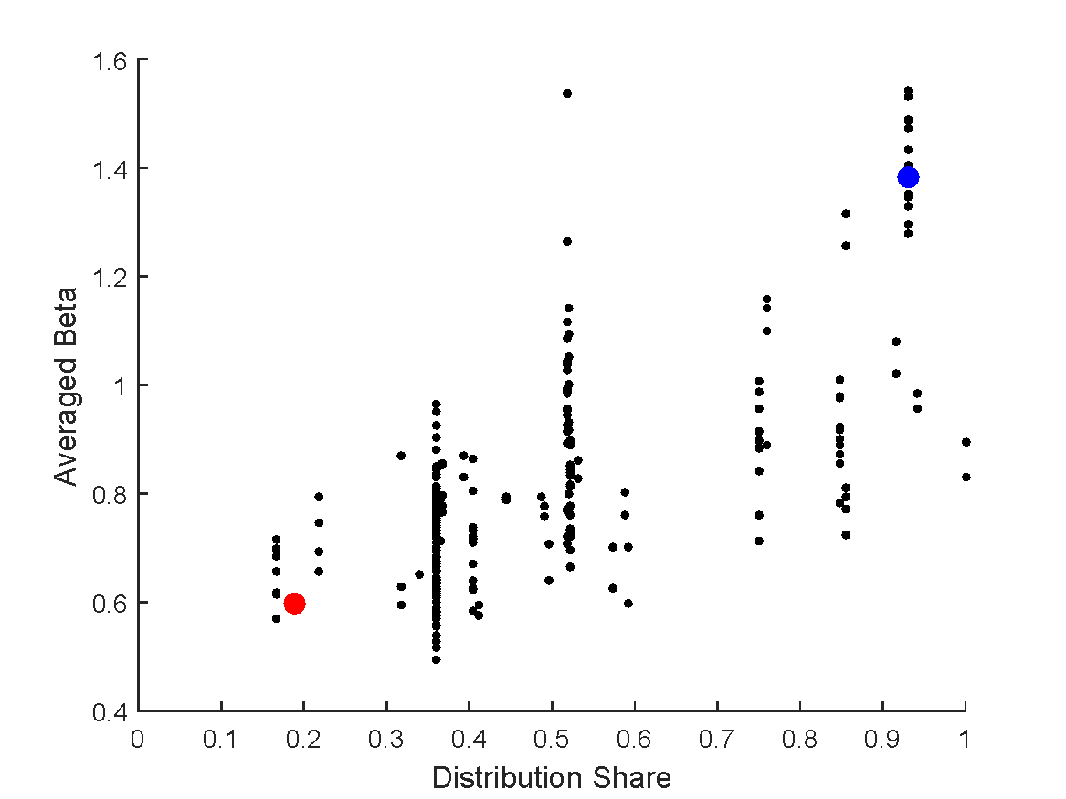
Microeconomic Decomposition,
Betas, the Distribution Share and Anecdotes
2-bedroom apartment
1 liter of gasoline

Slide 22
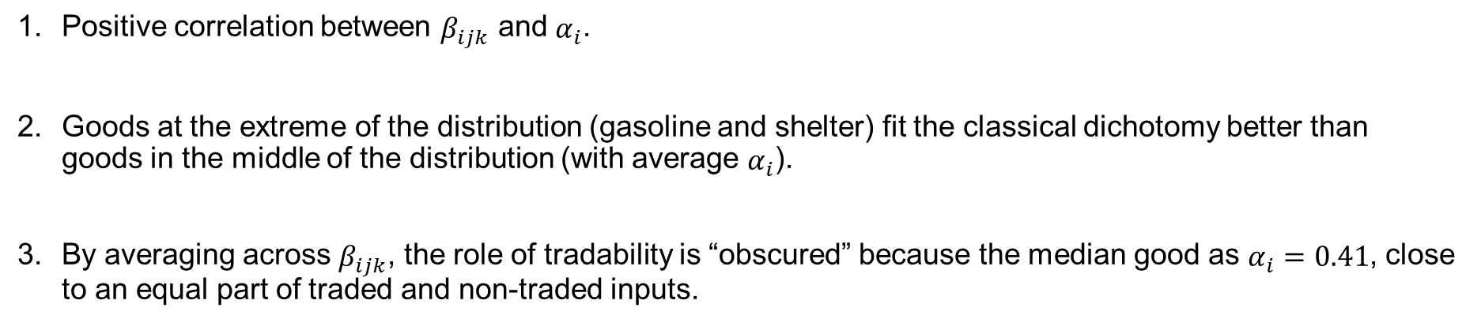
Microeconomic Decomposition Summary
Positive correlation between $β_{ijk}$ and $α_{i}$.
Goods at the extreme of the distribution (gasoline and shelter) fit the classical dichotomy better than goods in the middle of the distribution (with average $α_{i}$).
By averaging across $β_{ijk}$, the role of tradability is “obscured” because the median good as $α_{i}=0.41$, close to an equal part of traded and non-traded inputs.

Slide 23
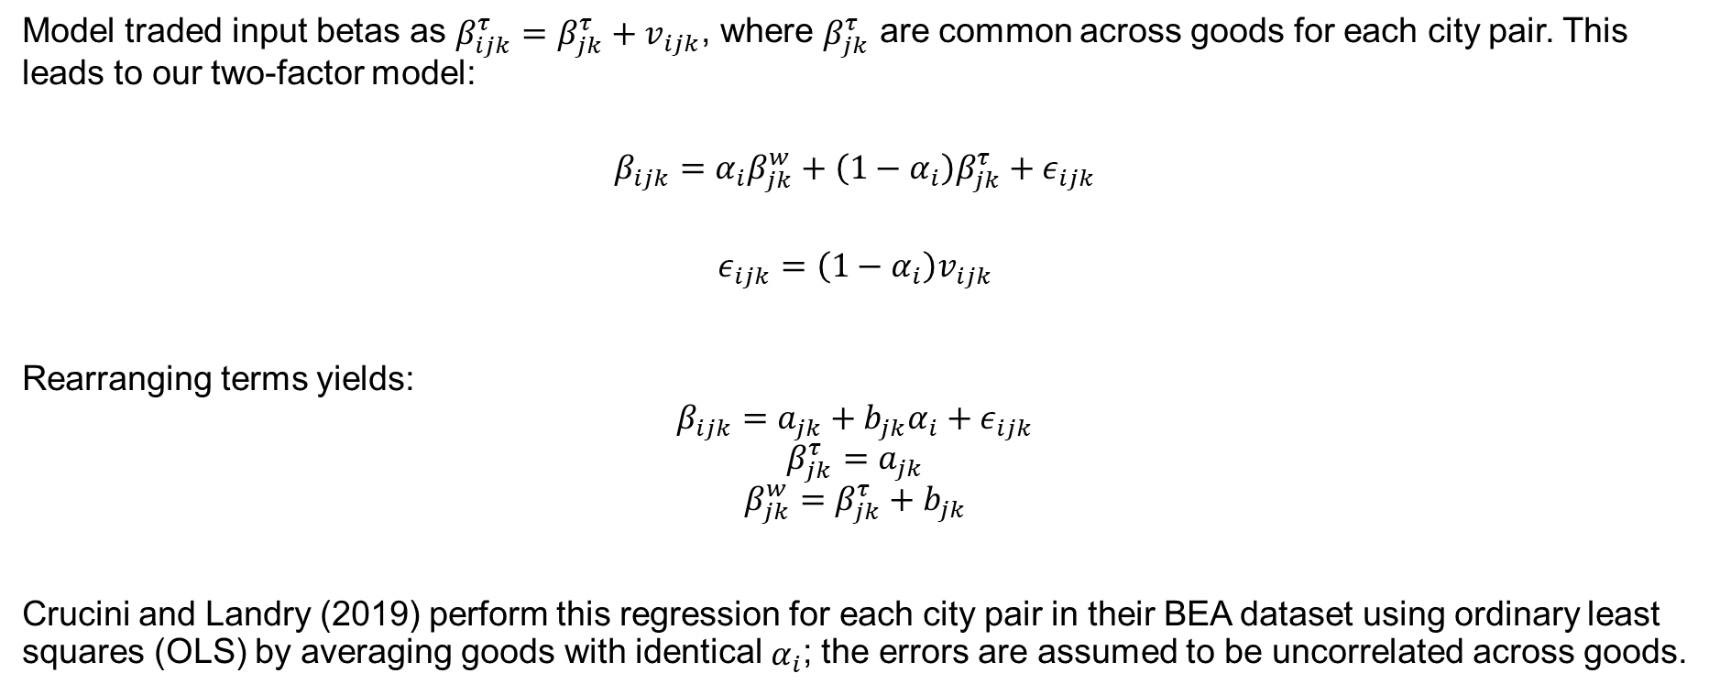
Intermediate-Inputs Model
Estimation
Model traded input betas as $β_{ijk}^{τ}=β_{jk}^{τ}+v_{ijk}$, where $β_{jk}^{τ}$ are common across goods for each city pair. This leads to our two-factor model:
$$β_{ijk}=α_{i}β_{jk}^{w}+\left(1−α_{i}\right)β_{jk}^{τ}+ε_{ijk}$$
$$ε_{ijk}=\left(1−α_{i}\right)v_{ijk}$$
Rearranging terms yields:
$$β_{ijk}=a_{jk}+b_{jk}α_{i}+ε_{ijk}$$
$$β_{jk}^{τ}=a_{jk}$$
$$β_{jk}^{w}=β_{jk}^{τ}+b_{jk}$$
Crucini and Landry (2019) perform this regression for each city pair in their BEA dataset using ordinary least squares (OLS) by averaging goods with identical $α_{i}$; the errors are assumed to be uncorrelated across goods.

Slide 24
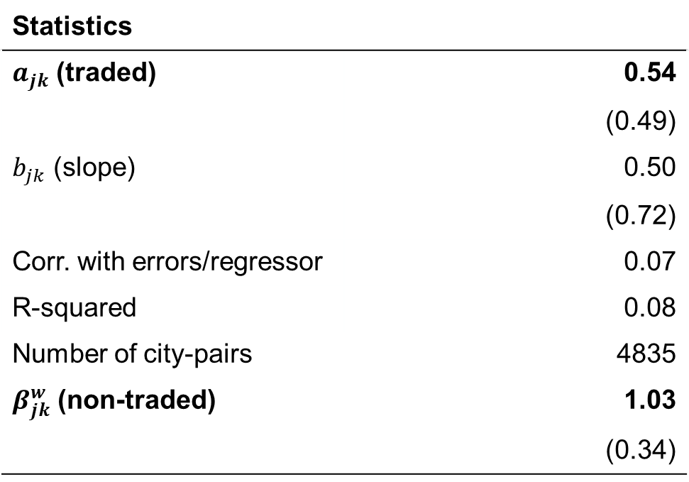
Intermediate-Inputs Model
OLS Regressions, Means
$$β_{ijk}=a_{jk}+b_{jk}α_{i}+ε_{ijk}$$
Statistics
$a_{jk}$ (traded) | 0.54
 | (0.49)
$b_{jk}$ (slope) | 0.50
 | (0.72)
Corr. with errors/regressor | 0.07
R-squared | 0.08
Number of city-pairs | 4835
$β_{jk}^{w}$ (non-traded) | 1.03
 | (0.34)
→ Figure

Slide 25

Intermediate Inputs Model
Aggregation
The betas can be aggregated using the variance decomposition identity defined by Crucini and Landry (2019):
$$1=\sum_{i}{ω_{i}β_{ijk}} \\ =\sum_{i}{ω_{i}\left[α_{i}β_{ijk}^{w}+\left(1−α_{i}\right)β_{jk}^{τ}+ε_{ijk}\right]} \\ =\left(\sum_{i}{ω_{i}α_{i}}\right)β_{ijk}+\left(\sum_{i}{ω_{i}\left(1−α_{i}\right)}\right)β_{jk}^{τ}+\sum_{i}{ω_{i}ε_{ijk}} \\ =πβ_{jk}^{w}+\left(1−π\right)β_{jk}^{τ}+\sum_{i}{ω_{i}ε_{ijk}}$$
→ Individual goods contributions

Slide 26
Intermediate Inputs Model
Traded and Non-Traded Input Contributions
 | All pairs | OECD | Non-OECD | US-CA
Non-traded share | 0.69 | 0.69 | 0.69 | 0.68
std. error | (.02) | (.20) | (.02) | (.02)
Variance Contributions:
Traded | 0.17 | 0.20 | 0.10 | 0.21
std. error | (.15) | (.14) | (.16) | (.17)
Non-traded | 0.71 | 0.66 | 0.78 | 0.56
std. error | (.23) | (.22) | (.25) | (.18)
Errors | 0.12 | 0.14 | 0.12 | 0.23
std. error | (.20) | (.22) | (.21) | (.21)
Number of pairs | 4835 | 1543 | 856 | 52

Slide 27
Macroeconomic Decomposition
Introduction
Microeconomic Decomposition
The Intermediate Inputs Model
Macroeconomic Decomposition
  Aggregation into traded and non-traded goods baskets
  Compositional bias when using aggregate price indices
  Relation with existing literature
Conclusion
Supplemental Material

Slide 28
Macroeconomic Decomposition,
Introduction
Most studies use aggregate price indices constructed from the consumer price index (CPI)
This section does the following:
Explains how to aggregate final goods into 2 indices: traded and non-traded goods baskets
Show (composition) bias when using aggregate price indices
Relates the method developed by Crucini and Landry (2019) to existing methods
Shows the results from Crucini and Landry are consistent with previous studies when aggregating up, but the implications are very different.
This all implies that a successful theory of RER movements must incorporate traded and non-traded sector prices, where the sectors are inputs not outputs.

Slide 29
Traded and Non-Traded Goods Baskets
Aggregating LOP deviations into sub-indices for traded and non-traded goods
$$q_{jk,t}\&=ω\sum_{i∈N}{\frac{ω_{i}}{ω}}q_{ijkt}+\left(1−ω\right)\sum_{i∈T}{\frac{ω_{i}}{1−ω}}q_{ijkt}$$
$$\&=ωq_{jkt}^{N}+\left(1−ω\right)q_{jkt}^{T}$$
leads to the variance decomposition
$$1=ωβ_{jk}^{N}+\left(1−ω\right)β_{jk}^{T}$$
US non-traded weight $ω=\sum_{i∈N}{ω_{i}=0.57}$
This leads to the question: How should one place goods into traded and non-traded baskets?

Slide 30
Compositional Bias
For the non-traded basket, the bias is:
$$\underset{Bias}{\underbrace{πβ_{jk}^{w}−ωβ_{jk}^{N}}}=\underset{Non−traded factor content of traded goods}{\underbrace{\left(\sum_{i∈T}{ω_{i}α_{i}}\right)β_{jk}^{w}}} − \underset{traded}{\underbrace{\left(\sum_{i∈N}{ω_{i}\left(1−α_{i}\right)}\right)β_{jk}^{τ}}}$$
Since $β_{jk}^{w}>β_{jk}^{τ}$, composition bias is positive when the non-traded factor content of traded goods exceeds the traded factor content of non-traded goods on an expenditure weighted basis.

Slide 31
The Compositional Bias is Severe
 | Aggregate using final goods | Aggregation using Intermediate inputs
Non-traded share | 0.57 | 0.69
Contribution
Traded | 0.34 (34%) | 0.17 (19%)
Non-Traded | 0.66 (66%) | 0.71 (81%)

Slide 32
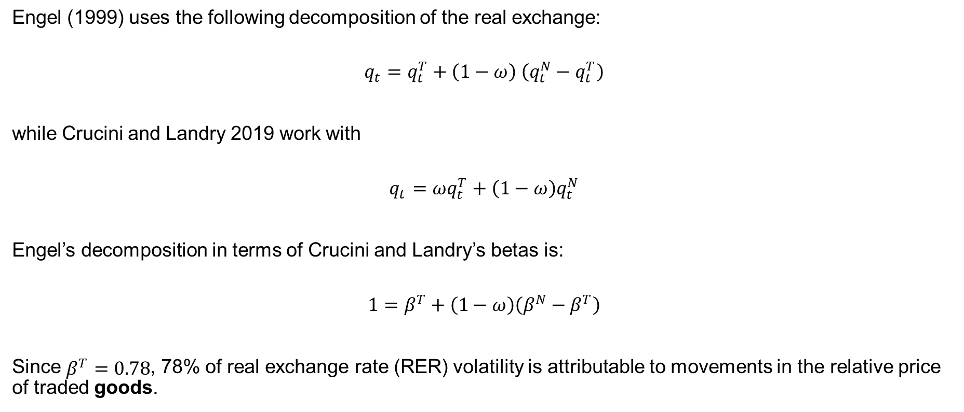
Relation with the Existing Literature,
Engel’s Decomposition
Engel (1999) uses the following decomposition of the real exchange:
$$q_{t}=q_{t}^{T}+\left(1−ω\right) \left(q_{t}^{N}−q_{t}^{T}\right)$$
while Crucini and Landry 2019 work with
$$q_{t}=ωq_{t}^{T}+\left(1−ω\right)q_{t}^{N}$$
Engel’s decomposition in terms of Crucini and Landry’s betas is:
$$1=β^{T}+\left(1−ω\right)\left(β^{N}−β^{T}\right)$$
Since $β^{T}=0.78$, 78% of real exchange rate (RER) volatility is attributable to movements in the relative price of traded goods.

Slide 33
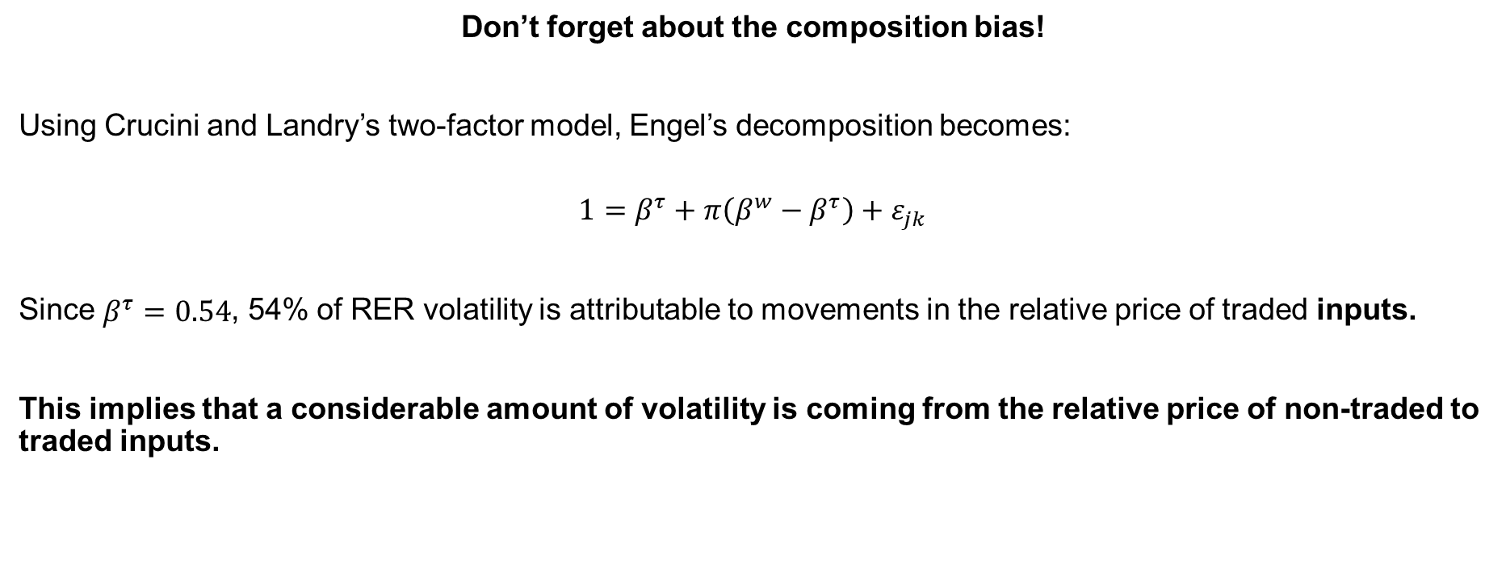
Relation with the Existing Literature,
Engel’s Decomposition (Continued)
Don’t forget about the composition bias!
Using Crucini and Landry’s two-factor model, Engel’s decomposition becomes:
$$1=β^{τ}+π\left(β^{w}−β^{τ}\right)+ε_{jk}$$
Since $β^{τ}=0.54$, 54% of RER volatility is attributable to movements in the relative price of traded inputs.
This implies that a considerable amount of volatility is coming from the relative price of non-traded to traded inputs.

Slide 34
Conclusion
Introduction
Microeconomic Decomposition
The Intermediate Inputs Model
Macroeconomic Decomposition
Conclusion
Supplemental Material

Slide 35
Concluding Remarks
Crucini and Landry (2019) revisits the usefulness of the classical dichotomy using micro data:
Develops a novel variance decomposition
Applies the classical dichotomy to intermediate inputs
The classical dichotomy is a useful theory when applied to intermediate inputs. Its conceptual value is largely obscured when applied to final goods.

Slide 36
Supplemental Material
Introduction
Microeconomic Decomposition
The Intermediate Inputs Model
Macroeconomic Decomposition
Conclusion
→ Supplemental Material

Slide 37
Goods Distribution Example,
Mattel’s Barbie Doll
Step | Cost
Production
Labor | 0.35
Material | 0.65
Transportation | 1.00
Profit | 1.00
Distribution | 7.00
Marketing
Retail Service
Total/Retail | 10.00
→ Back

Slide 38
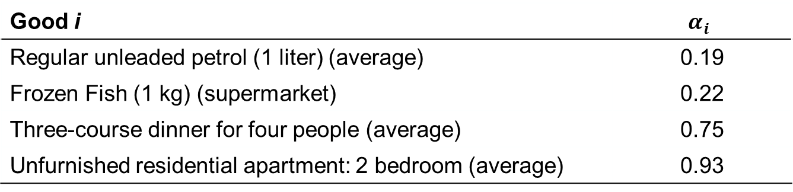
Goods Examples
Good i | $$α_{i}$$
Regular unleaded petrol (1 liter) (average) | 0.19
Frozen Fish (1 kg) (supermarket) | 0.22
Three-course dinner for four people (average) | 0.75
Unfurnished residential apartment: 2 bedroom (average) | 0.93
→ Back

Slide 39
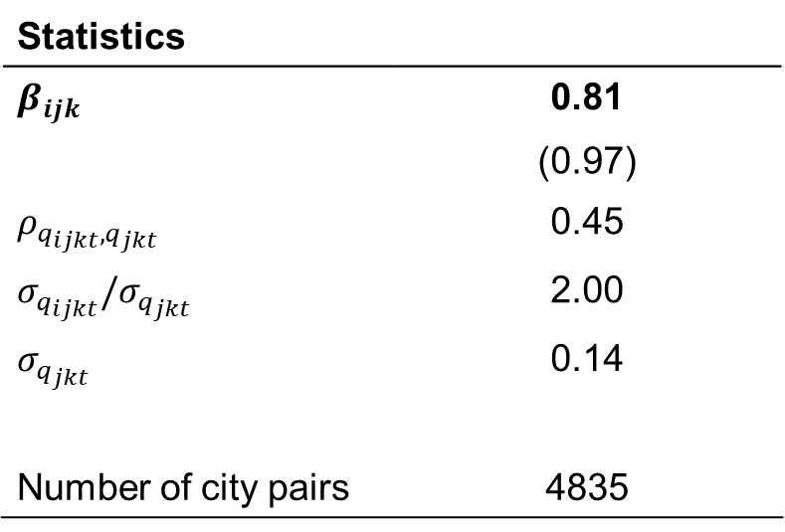
Microeconomic Decomposition,
Variance Decomposition of RER, Means
$$β_{ijk}=\frac{std\left(q_{ijkt}\right)}{sted\left(q_{jkt}\right)}×corr\left(q_{ijkt},q_{jkt}\right)=\frac{σ_{q_{ijkt}}}{σ_{q_{jkt}}}×ρ_{q_{ijkt},q_{jkt}}$$
Statistics
$$β_{ijk}$$ | 0.81
 | (0.97)
$$ρ_{q_{ijkt},q_{jkt}}$$ | 0.45
$$σ_{q_{ijkt}}/σ_{q_{jkt}}$$ | 2.00
$$σ_{q_{jkt}}$$ | 0.14
Number of city pairs | 4835
→ Back

Slide 40
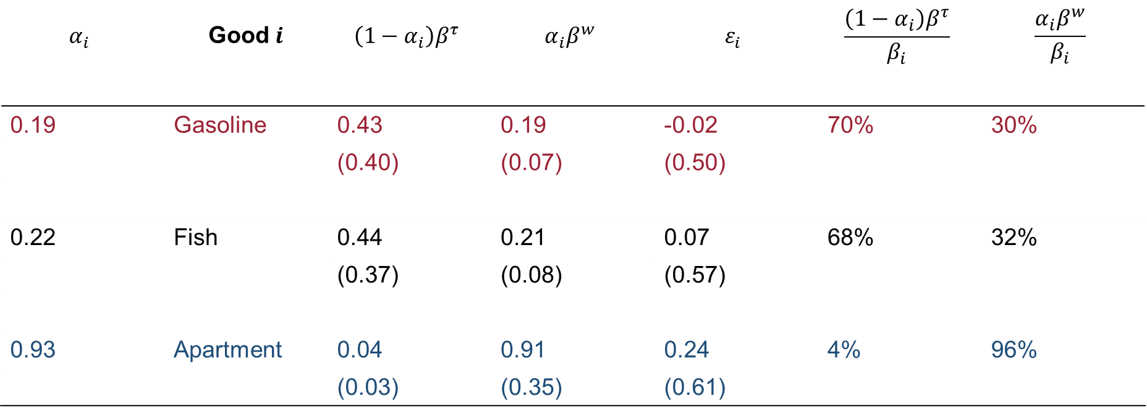
Intermediate Inputs Model,
Intermediates Contribution to Final Goods, Means
$$α_{i}$$ | Good $i$ | $$\left(1−α_{i}\right)β^{τ}$$ | $$α_{i}β^{w}$$ | $$ε_{i}$$ | $$\frac{\left(1−α_{i}\right)β^{τ}}{β_{i}}$$ | $$\frac{α_{i}β^{w}}{β_{i}}$$
0.19 | Gasoline | 0.43 | 0.19 | -0.02 | 70% | 30%
 |  | (0.40) | (0.07) | (0.50)
0.22 | Fish | 0.44 | 0.21 | 0.07 | 68% | 32%
 |  | (0.37) | (0.08) | (0.57)
0.93 | Apartment | 0.04 | 0.91 | 0.24 | 4% | 96%
 |  | (0.03) | (0.35) | (0.61)
→ Back

Slide 41
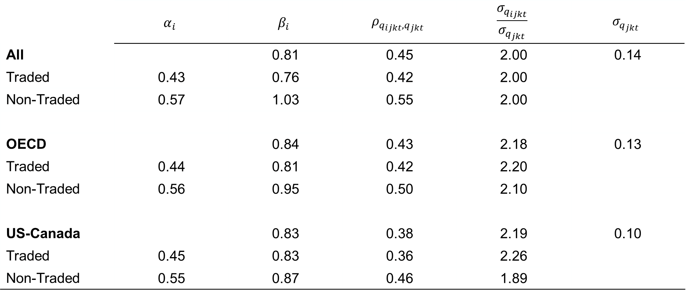
Microeconomic Decompositions,
Expenditure Weights
Variance analysis of RERs, Means
 | $$α_{i}$$ | $$β_{i}$$ | $$ρ_{q_{ijkt},q_{jkt}}$$ | $$\frac{σ_{q_{ijkt}}}{σ_{q_{jkt}}}$$ | $$σ_{q_{jkt}}$$
All |  | 0.81 | 0.45 | 2.00 | 0.14
Traded | 0.43 | 0.76 | 0.42 | 2.00
Non-Traded | 0.57 | 1.03 | 0.55 | 2.00
OECD |  | 0.84 | 0.43 | 2.18 | 0.13
Traded | 0.44 | 0.81 | 0.42 | 2.20
Non-Traded | 0.56 | 0.95 | 0.50 | 2.10
US-Canada |  | 0.83 | 0.38 | 2.19 | 0.10
Traded | 0.45 | 0.83 | 0.36 | 2.26
Non-Traded | 0.55 | 0.87 | 0.46 | 1.89
→ Back

Slide 42
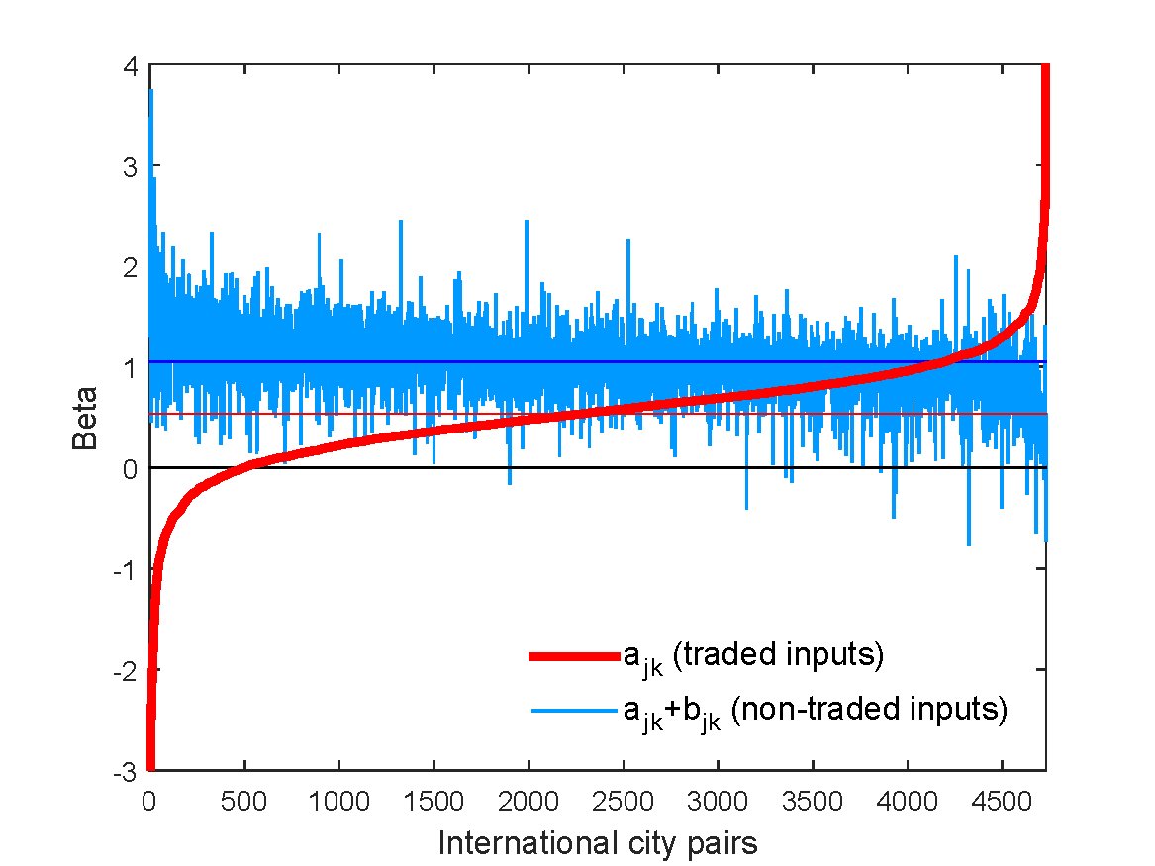
Intermediate Inputs Model,
Traded and Non-Traded Inputs Regressions, Means
$$β_{ijk}=a_{jk}+b_{jk}α_{i}+ε_{ijk}$$
→ Back

Slide 43

Macroeconomic Decompositions,
Expenditure Weights
Variance analysis of RERs, Means
 | $$α_{i}$$ | $$β_{i}$$ | $$ρ_{q_{ijkt},q_{jkt}}$$ | $$\frac{σ_{q_{ijkt}}}{σ_{q_{jkt}}}$$ | $$σ_{q_{jkt}}$$
All |  | 0.97 | 0.91 | 1.06 | 0.14
Traded | 0.43 | 0.78 | 0.86 | 0.91
Non-Traded | 0.57 | 1.17 | 0.96 | 1.22
OECD |  | 0.98 | 0.92 | 1.06 | 0.13
Traded | 0.44 | 0.82 | 0.88 | 0.94
Non-Traded | 0.56 | 1.14 | 0.96 | 1.18
US-Canada |  | 0.99 | 0.94 | 1.05 | 0.10
Traded | 0.45 | 0.88 | 0.92 | 0.96
Non-Traded | 0.55 | 1.10 | 0.96 | 1.15
→ Back

