Slide 1
Understanding Real Exchange Rates
Based on "Understanding Real Exchange Rates Using Micro-Data: New Approaches to Enduring Puzzles," by Mario J. Crucini (Purdue University and NBER), IEFS-Korea inaugural meeting, Seoul National University, 2016.

Slide 2
Motivation
→ Motivation
Why Micro-Price Data?​
Trade in Middle Products
Empirical Implications​

Slide 3
Introductory Motivation
Prices are just as important as quantities for research in international trade and macroeconomics​
We know more about quantities than about prices​
Put differently: we know more about the volume of trade than the terms of trade​
  Volume of trade: the quantity of units of a good traded between countries
  Terms of trade: the price a country gets for what it sells, relative to the price it pays for what it buys
General equilibrium links the terms of trade to the trade balance
  General equilibrium: prices and quantities are determined together, not one at a time
  The trade balance depends on both how much a country ships, and what those shipments are worth
  Thus, we need information on both the quantities and prices of traded goods
Micro-price research helps to fill this gap​

Slide 4
The Law-of-One-Price
​
Three Definitions:​
“Common currency prices should be equal.”​
“Common currency prices should differ only by the extent of natural and official barriers to trade.”​
“A price is indexed by an exact description of the object traded, the date at which it is to be delivered, the location of the source and destination and may be state-contingent.”​

Slide 5
The Law-of-One-Price (Continued)
Three Definitions:​
“Common currency prices should be equal.”​ Almost universally rejected.​ Why? Because there exist barriers to trade, which leads us to …
“Common currency prices should differ only by the extent of natural and official barriers to trade.”​ Very challenging to test. Why?
Natural barriers can be hard to measure. For example, the distance between Santiago, Chile and Buenos Aires, Argentina is roughly the same as the distance between Montevideo, Uruguay and Buenos Aires.
  But transporting a good from Santiago to Buenos Aires requires crossing the Andes mountains.
Some goods are more easily traded than others. Apples are easily traded, but haircuts are not
Debreu’s Theory of Value: “A price is indexed by an exact description of the object traded, the date at which it is to be delivered, the location of the source and destination and may be state-contingent.”​ Conceptual: never intended to be tested.​

Slide 6
The Law of One Price (Continued)
With prices what appears to be a step back is a leap forward: careful measurement before estimation and testing.​
As often turns out to be the case when theory gets ahead of measurement, we know far less than our models suggest that we do.​

Slide 7
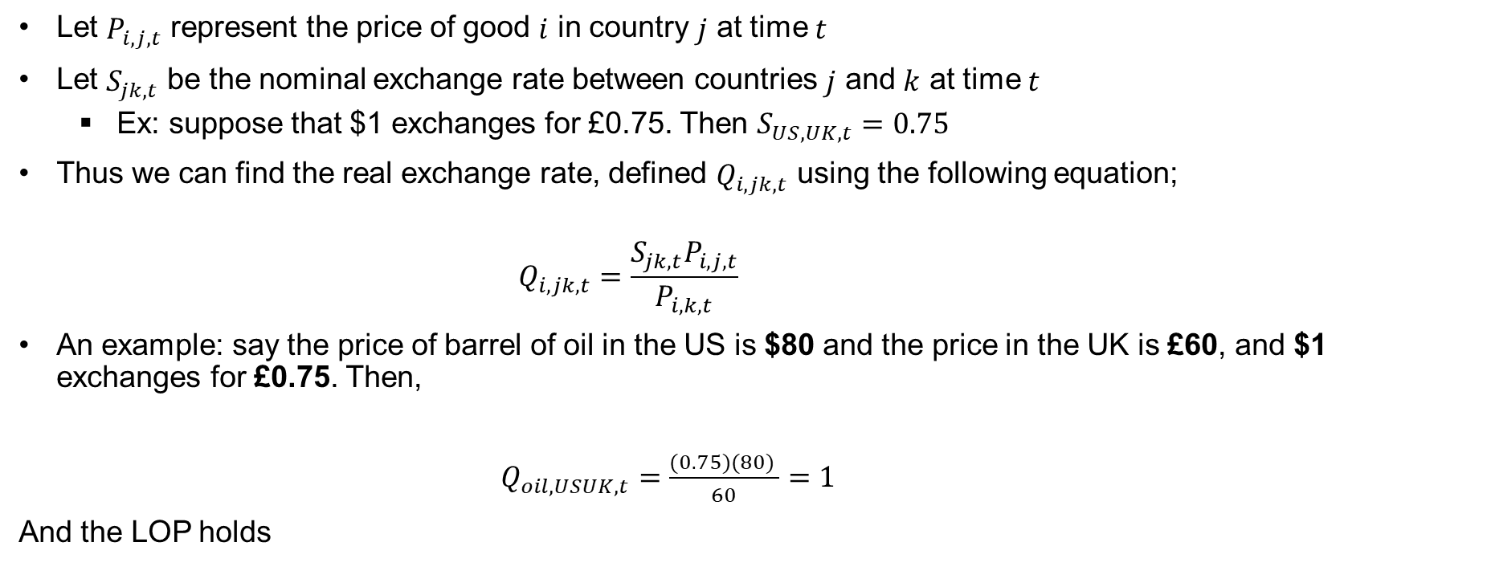
The Real Exchange Rate and Relative Price
Let $P_{i,j,t}$ represent the price of good $i$ in country $j$ at time $t$
Let $S_{jk,t}$ be the nominal exchange rate between countries $j$ and $k$ at time $t$
  Ex: suppose that $1 exchanges for £0.75. Then $S_{US,UK,t}=0.75$
Thus we can find the real exchange rate, defined $Q_{i,jk,t}$ using the following equation;
        $$Q_{i,jk,t}=\frac{S_{jk,t}P_{i,j,t}}{P_{i,k,t}}$$
An example: say the price of barrel of oil in the US is $80 and the price in the UK is £60, and $1 exchanges for £0.75. Then,
        $Q_{oil,USUK,t}=\frac{(0.75)(80) }{60}=1$
And the LOP holds

Slide 8
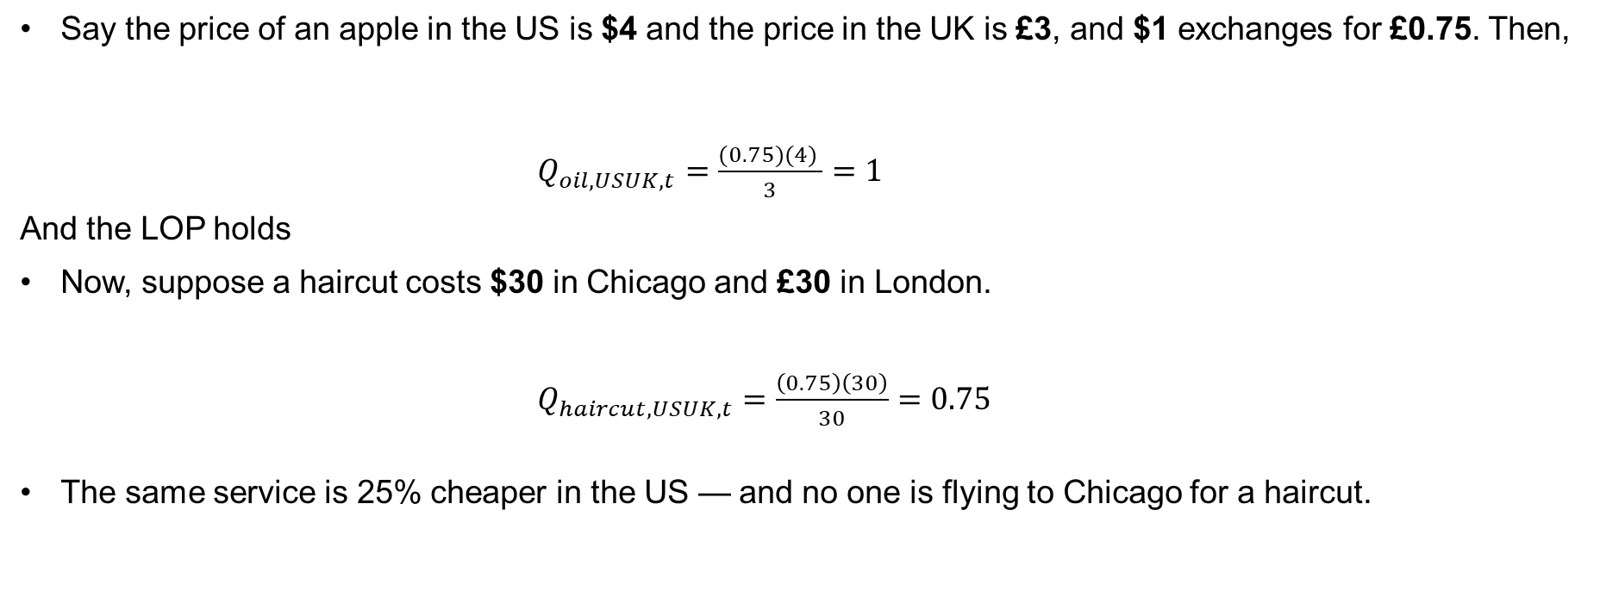
The Real Exchange Rate and Relative Price (Continued)
Say the price of an apple in the US is $4 and the price in the UK is £3, and $1 exchanges for £0.75. Then,
        $Q_{oil,USUK,t}=\frac{(0.75)(4) }{3}=1$
And the LOP holds
Now, suppose a haircut costs $30 in Chicago and £30 in London.
$Q_{haircut, USUK,t}=\frac{\left(0.75\right)\left(30\right)}{30}=0.75$
The same service is 25% cheaper in the US — and no one is flying to Chicago for a haircut.

Slide 9
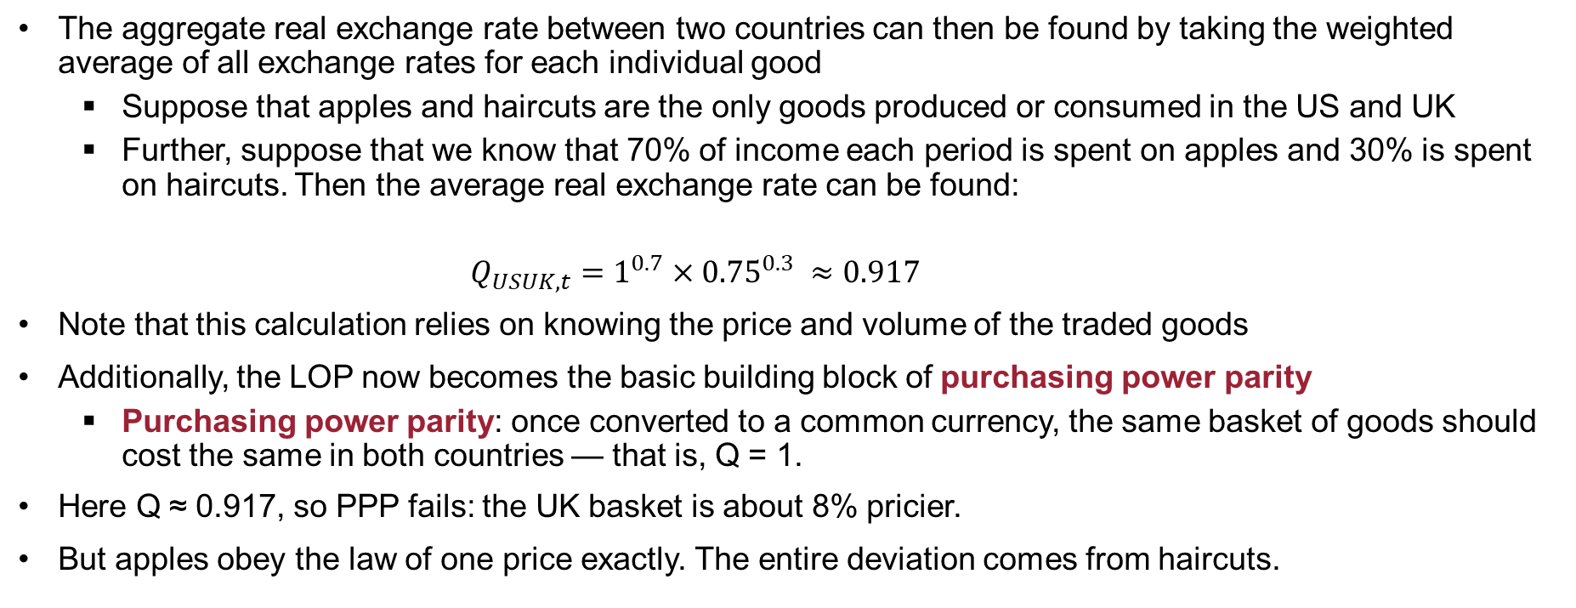
The Aggregate Real Exchange Rate
The aggregate real exchange rate between two countries can then be found by taking the weighted average of all exchange rates for each individual good
  Suppose that apples and haircuts are the only goods produced or consumed in the US and UK
  Further, suppose that we know that 70% of income each period is spent on apples and 30% is spent on haircuts. Then the average real exchange rate can be found:
      $$Q_{USUK,t}=1^{0.7}×{0.75}^{0.3} ≈0.917$$
Note that this calculation relies on knowing the price and volume of the traded goods
Additionally, the LOP now becomes the basic building block of purchasing power parity
  Purchasing power parity: once converted to a common currency, the same basket of goods should cost the same in both countries — that is, Q = 1.
Here Q ≈ 0.917, so PPP fails: the UK basket is about 8% pricier.
But apples obey the law of one price exactly. The entire deviation comes from haircuts.

Slide 10
Why Micro-Price Data?​
Motivation
→ Why Micro-Price Data?​
Trade in Middle Products​
Empirical Implications

Slide 11
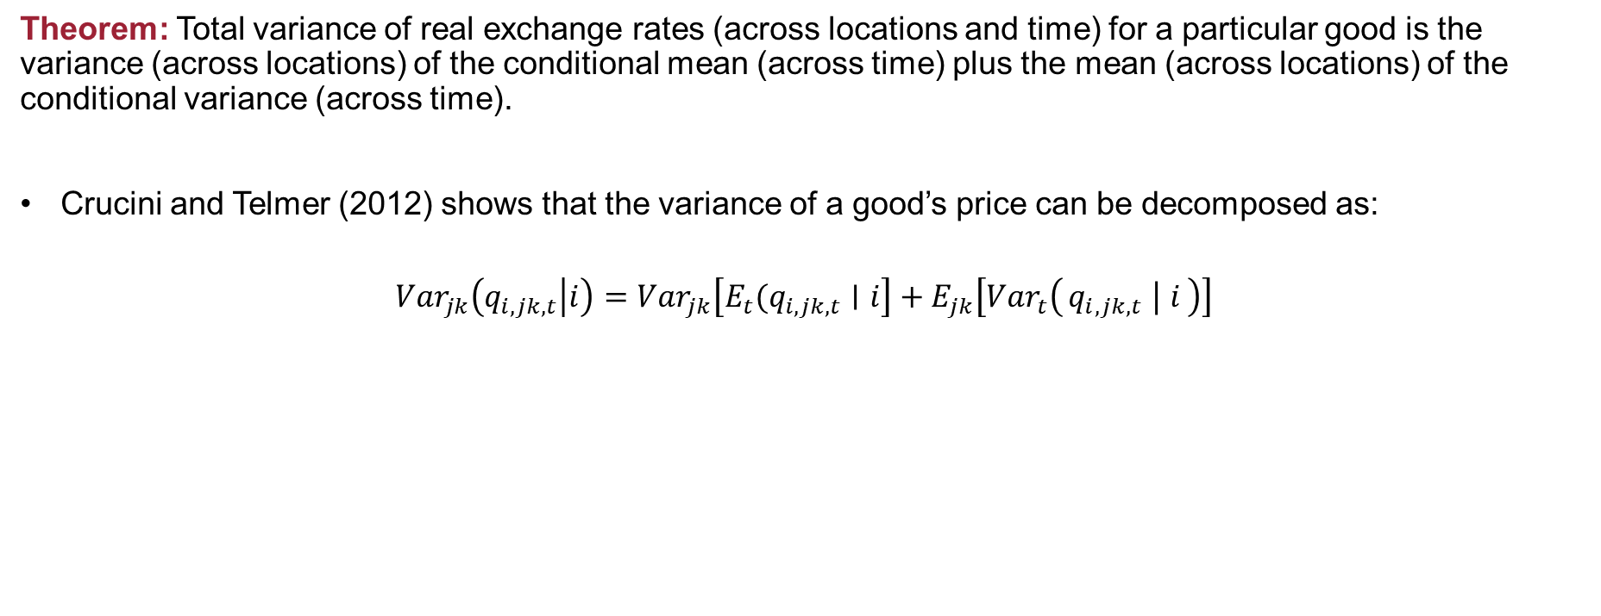
Price Variance Decomposition
Theorem: Total variance of real exchange rates (across locations and time) for a particular good is the variance (across locations) of the conditional mean (across time) plus the mean (across locations) of the conditional variance (across time).
Crucini and Telmer (2012) shows that the variance of a good’s price can be decomposed as:
$${Var}_{jk}\left(q_{i,jk,t} | i\right)=Var_{jk}\left[E_{t}(q_{i,jk,t}∣i\right]+E_{jk}\left[Var_{t}\left(q_{i,jk,t} ∣ i\right)\right]$$

Slide 12
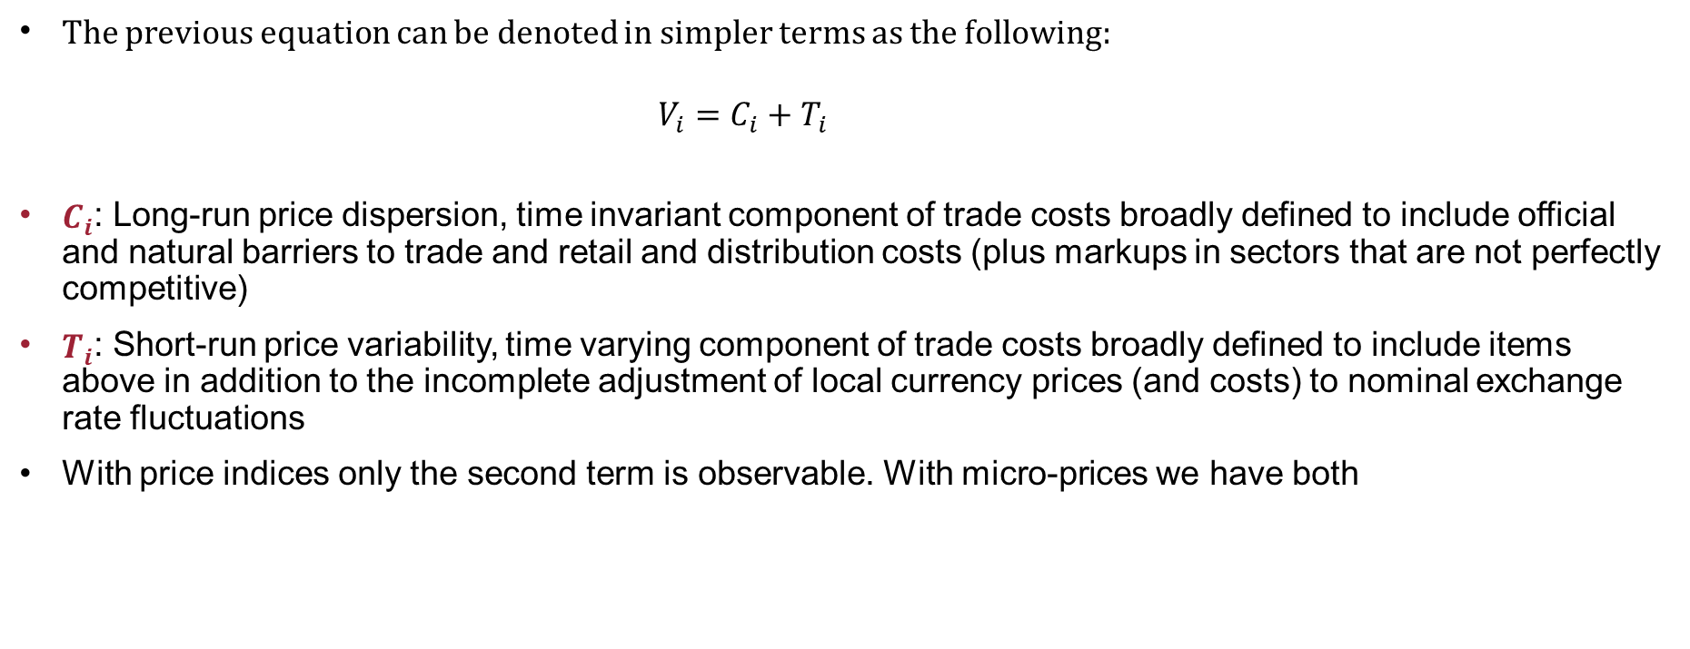
Price Variance Decomposition (Continued)
The previous equation can be denoted in simpler terms as the following:
      $$V_{i}=C_{i}+T_{i}$$
$C_{i}$: Long-run price dispersion, time invariant component of trade costs broadly defined to include official and natural barriers to trade and retail and distribution costs (plus markups in sectors that are not perfectly competitive)
$T_{i}$: Short-run price variability, time varying component of trade costs broadly defined to include items above in addition to the incomplete adjustment of local currency prices (and costs) to nominal exchange rate fluctuations
With price indices only the second term is observable. With micro-prices we have both

Slide 13
How Micro-Price Data Captures what Price Indices Alone Cannot
A price gap between two cities does two things: it sits somewhere, and it moves.
The level (C): haircuts cost 25% more in London than Chicago
The movement (T): that gap widens and narrows as exchange rates change
  So if the dollar appreciates so that $1 now exchanges for £0.8
Price indices see only the movement.
Every index starts at 100 in a base year, so the measured gap starts at zero for every city pair, by construction
Apples and haircuts therefore look identical: both report no gap, both wobble with the exchange rate
Micro-prices see both.
Haircuts: $30 vs £30 → the 25% gap is right there in the numbers
Apples: $2.00 vs £1.50 → no gap, correctly
Micro-prices capture non-tradability: the barriers story. Apples can cross the Atlantic. Haircuts can't.

Slide 14
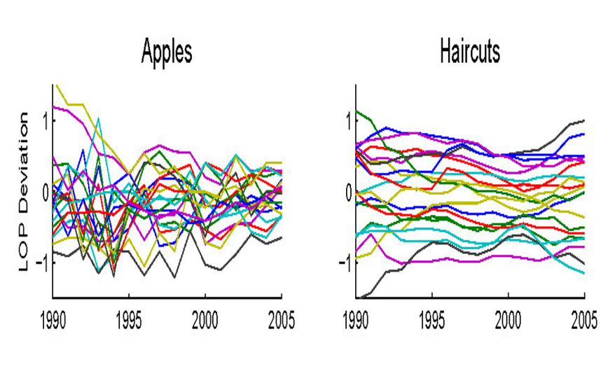
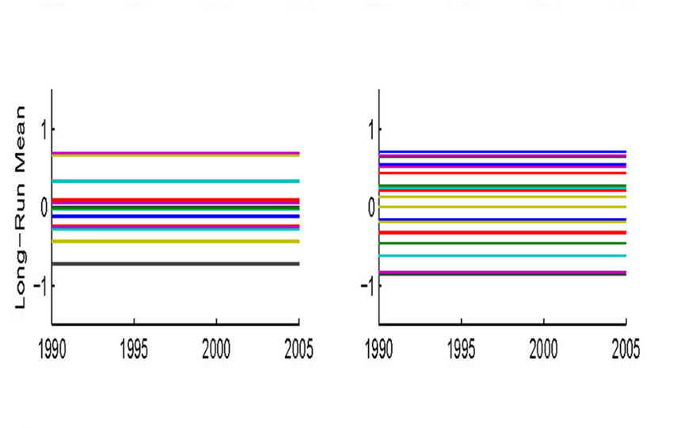
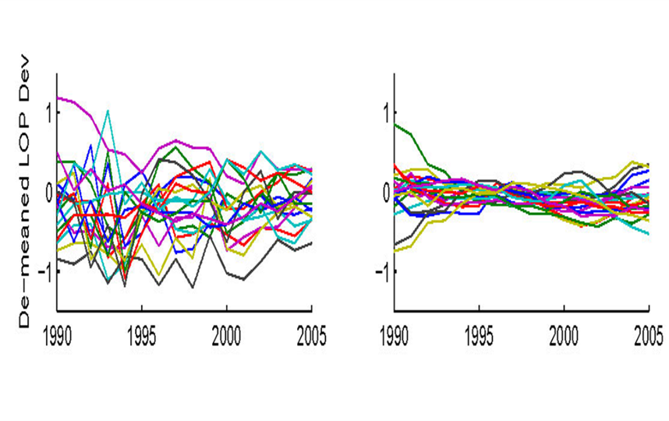
An Empirical Example
Apples and Haircuts (EIU price survey)​. Below are displayed figures using Canada-U.S. city pairs
Each line: one Canada–U.S. city pair, one good
0 means the same price in both cities
Gaps are large, and they never close
Each pair's average gap across the whole period
The spread between lines is the persistent gap
A price index sets every one of these lines to zero
All that survives once the average is removed
Apples keep bouncing; haircuts go nearly flat
This is everything a price index can ever show you

Slide 15
Trade in Middle Products​
Motivation
Why Micro-Price Data?​
→Trade in Middle Products
Empirical Implications

Slide 16
Local Inputs and Imported Inputs​ Conceptual Ideas​
Price theory, inspired by model of trade in middle products by Sanyal and Jones (1982)​
Retail goods are not traded (limited secondary markets for consumers)​
Retails goods are composites of local inputs related to retail and distribution and traded inputs (imports and exports)​
Even though a small country may have no market power in its export market, this is not likely to be true of local inputs of labor, structures and land​
Cost share of retail and distribution differs across goods and services (important source of heterogeneity)​

Slide 17
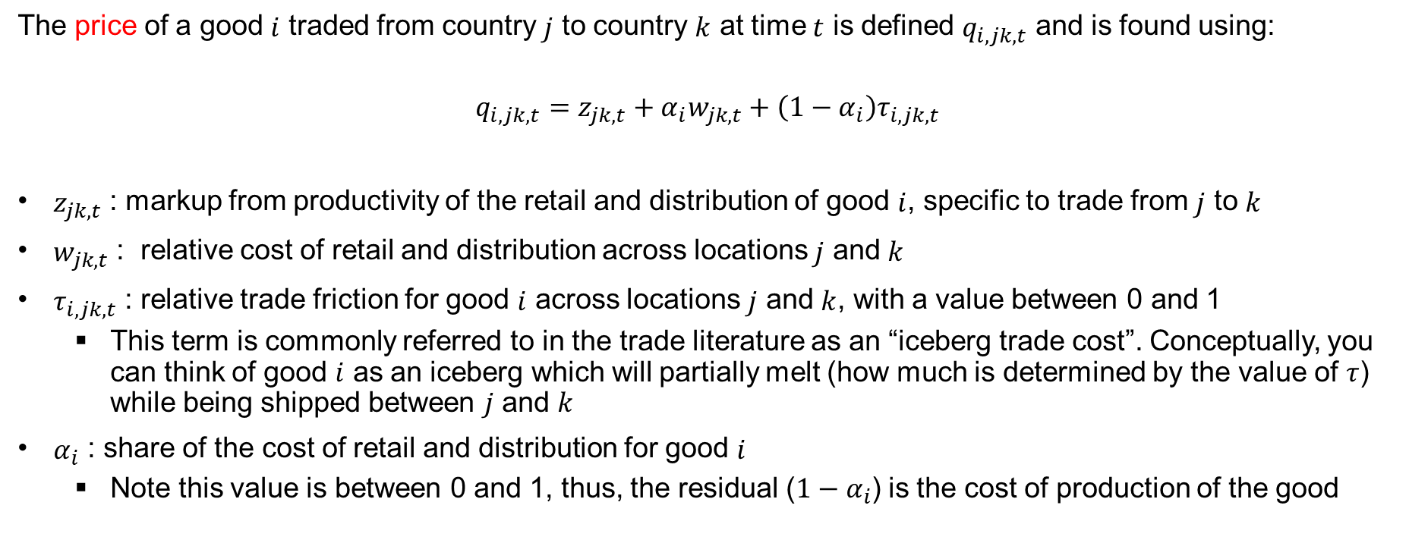
Price Theory Applied to International Micro Data
The price of a good $i$ traded from country $j$ to country $k$ at time $t$ is defined $q_{i,jk,t}$ and is found using:
$$q_{i,jk,t}=z_{jk,t}+α_{i}w_{jk,t}+\left(1−α_{i}\right)τ_{i,jk,t}$$
$z_{jk,t}$ : markup from productivity of the retail and distribution of good $i$, specific to trade from $j$ to $k$
$w_{jk,t}$ : relative cost of retail and distribution across locations $j$ and $k$
$τ_{i,jk,t}$ : relative trade friction for good $i$ across locations $j$ and $k$, with a value between 0 and 1
  This term is commonly referred to in the trade literature as an “iceberg trade cost”. Conceptually, you can think of good $i$ as an iceberg which will partially melt (how much is determined by the value of $τ$) while being shipped between $j$ and $k$
$α_{i}$ : share of the cost of retail and distribution for good $i$
  Note this value is between 0 and 1, thus, the residual ($1−α_{i}$) is the cost of production of the good

Slide 18
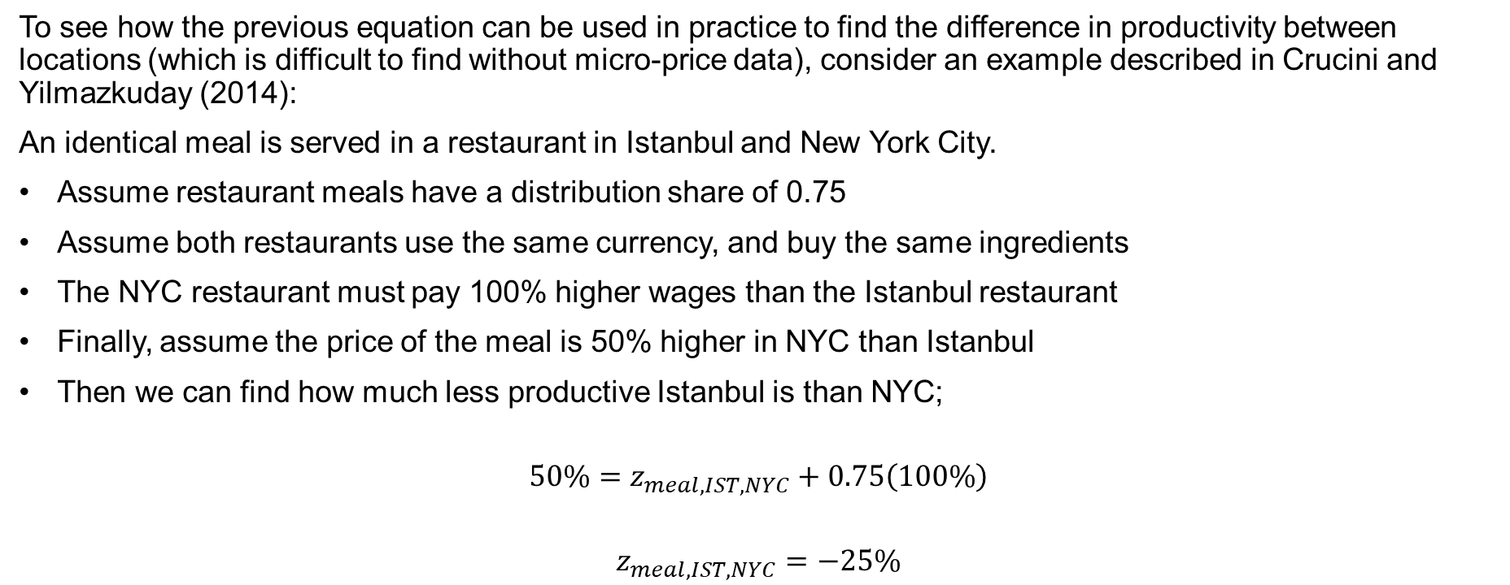
Price Theory Applied to International Micro Data: an Example
To see how the previous equation can be used in practice to find the difference in productivity between locations (which is difficult to find without micro-price data), consider an example described in Crucini and Yilmazkuday (2014):
An identical meal is served in a restaurant in Istanbul and New York City.
Assume restaurant meals have a distribution share of 0.75
Assume both restaurants use the same currency, and buy the same ingredients
The NYC restaurant must pay 100% higher wages than the Istanbul restaurant
Finally, assume the price of the meal is 50% higher in NYC than Istanbul
Then we can find how much less productive Istanbul is than NYC;
$$50\%=z_{meal,IST,NYC}+0.75\left(100\%\right)$$
$$z_{meal,IST,NYC}=−25\%$$

Slide 19
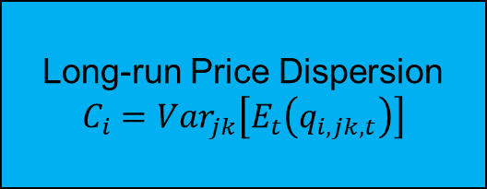
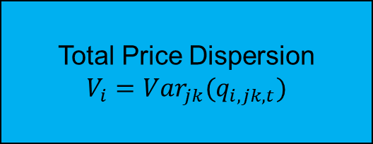
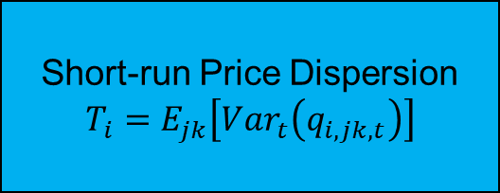
Variance Decomposition Graphically
Total Price Dispersion
$$V_{i}=Var_{jk}(q_{i,jk,t})$$
Long-run Price Dispersion
$$C_{i}=Var_{jk}\left[E_{t}\left(q_{i,jk,t}\right)\right]$$
Short-run Price Dispersion
$$T_{i}=E_{jk}\left[Var_{t}\left(q_{i,jk,t}\right)\right]$$

Slide 20
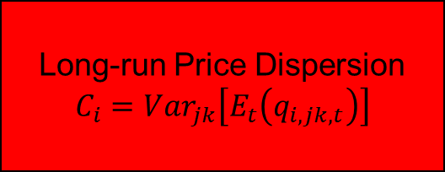
Long-Run Price Dispersion Decomposed
Long-run Price Dispersion
$$C_{i}=Var_{jk}\left[E_{t}\left(q_{i,jk,t}\right)\right]$$
Distribution Inputs
Traded Inputs
Retail Productivity
Unskilled Wages
Borders
Distance

Slide 21
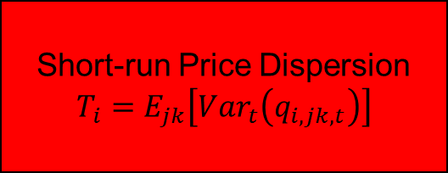
Short-Run Price Dispersion Decomposed
Short-run Price Dispersion
$$T_{i}=E_{jk}\left[Var_{t}\left(q_{i,jk,t}\right)\right]$$
Distribution Inputs
Traded Inputs
Changes in retail productivity/market (e.g. Walmart, internet)
Adjustment of relative wages to exchange rates and migration
Changes in formal tariff barriers or transportation infrastructure
Change rate pass-through into traded inputs

Slide 22
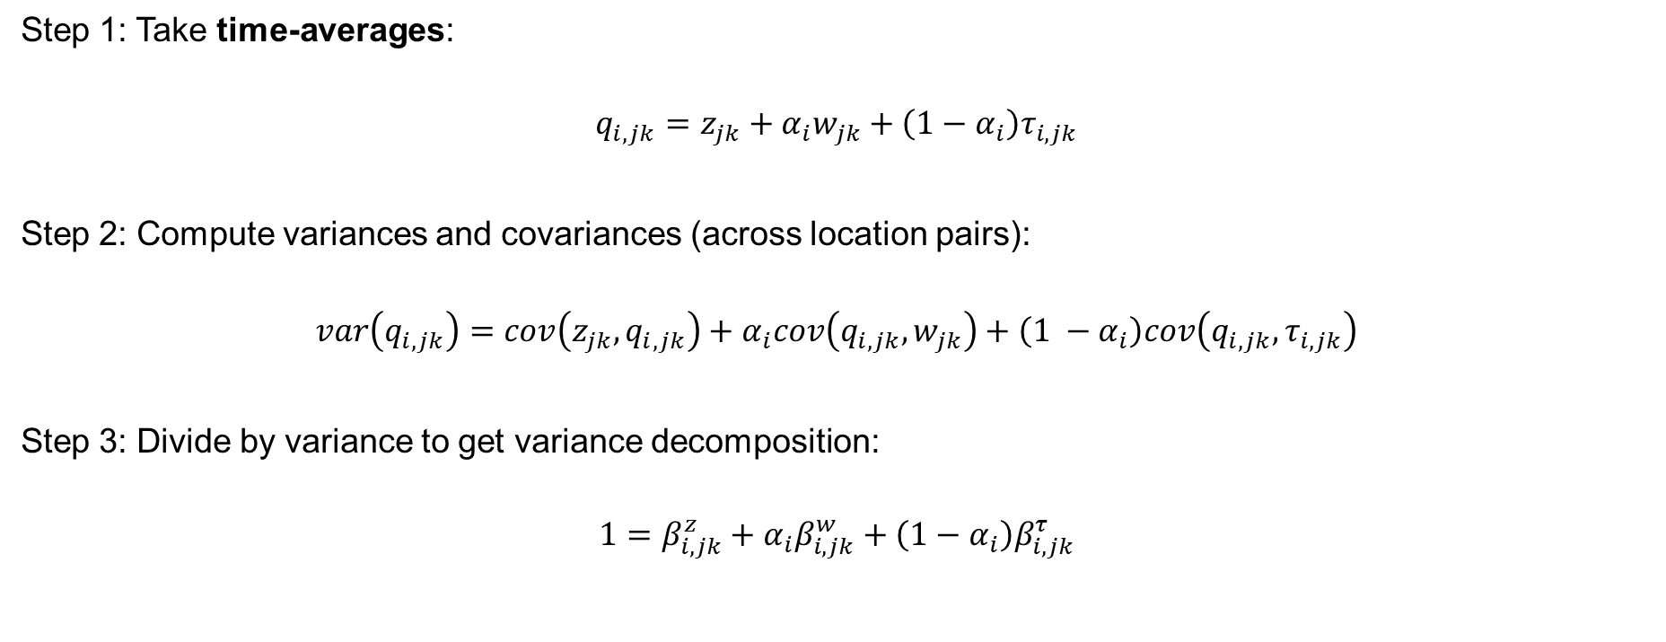
Cross-Sectional Implications
Crucini and Yilmazkuday (2014)
Step 1: Take time-averages:
$$q_{i,jk}=z_{jk}+α_{i}w_{jk}+\left(1−α_{i}\right)τ_{i,jk}$$
Step 2: Compute variances and covariances (across location pairs):
$$var\left(q_{i,jk}\right)=cov\left(z_{jk},q_{i,jk}\right)+α_{i}cov\left(q_{i,jk},w_{jk}\right)+\left(1 −α_{i}\right)cov\left(q_{i,jk},τ_{i,jk}\right)$$
Step 3: Divide by variance to get variance decomposition:
$$1=β_{i,jk}^{z}+α_{i}β_{i,jk}^{w}+\left(1−α_{i}\right)β_{i,jk}^{τ}$$

Slide 23
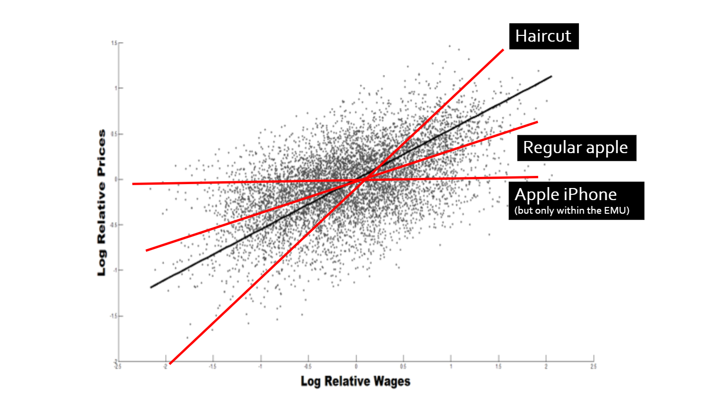
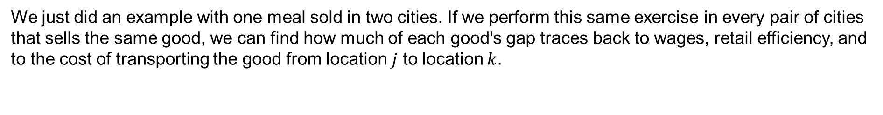
Price Variation as a Function of Wages
We just did an example with one meal sold in two cities. If we perform this same exercise in every pair of cities that sells the same good, we can find how much of each good's gap traces back to wages, retail efficiency, and to the cost of transporting the good from location $j$ to location $k$.

Slide 24
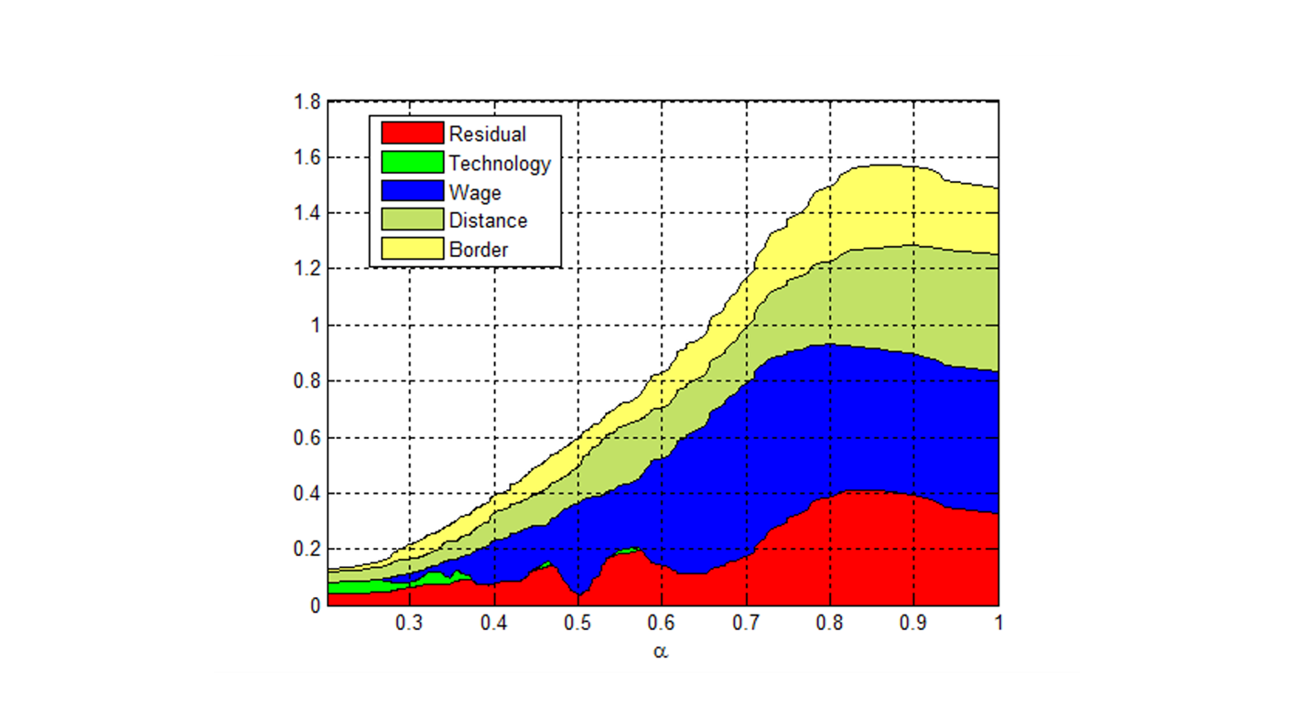
World-wide City Pairs Variance Decomposition
Crucini and Yilmazkuday (2014) also show that it is possible to perform additional variance calculations in order to determine both the magnitude of price variation between city-pairs and what factors cause the observed variation.
The above figure shows the magnitude of price variation that is attributed to technology differences, wage differences, distance between locations and a political border respectively (as well as a residual term for the variation which cannot be explained by any of those factors). Using micro-price data for world-wide city pairs, it is possible to determine to what degree these factors are responsible for price variation at different levels of cost shares for retail and distribution.

Slide 25
Trade in Middle Products
LOP Micro-Price Dispersion, Variance Decomposition​, Crucini-Yilmazkuday (JME, 2014)​
LOP | World​ (across)​ | LDC​ (across)​ | OECD​ (across)​ | Can-US​ (across)​ | Can-US​ (within)​
Price dispersion​ | 58.63​ | 64.83​ | 31.58​ | 18.53​ | 14.19​
Average miles​ | 4054​ | 3944​ | 3216​ | 1134​ | 1083​
Distance​ | 31.6​ | 33.5​ | 38.7​ | 42.8​ | 75.7​
Border​ | 23.9​ | 25.4​ | 29.6​ | 39.5​ | ​
Wages​ | 43.1​ | 24.3​ | 8.2​ | 14.4​ | 1.7​
Productivity​ | 1.3​ | 16.8​ | 23.5​ | 3.3​ | 22.6​
These variance decompositions can be done for any regions which have the prerequisite data available. Thus we can make clean, precise comparisons of the causes of price variation across regions.

Slide 26
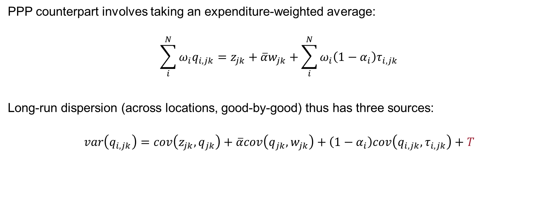
PPP Price Level Dispersion
Crucini and Yilmazkuday (2014)
PPP counterpart involves taking an expenditure-weighted average:
$$\sum_{i}^{N}{ω_{i}q_{i,jk}=z_{jk}+\overline{α}w_{jk}+\sum_{i}^{N}{ω_{i}\left(1−α_{i}\right)τ_{i,jk}}}$$
Long-run dispersion (across locations, good-by-good) thus has three sources:
$$var\left(q_{i,jk}\right)=cov\left(z_{jk},q_{jk}\right)+\overline{α}cov\left(q_{jk},w_{jk}\right)+\left(1−α_{i}\right)cov\left(q_{i,jk},τ_{i,jk}\right)+T$$

Slide 27
Trade in Middle Products (Continued)
LOP vs. PPP Micro-Price Dispersion, Variance Decomposition​, Crucini-Yilmazkuday (JME, 2014)​
LOP vs PPP | World​ (across)​ | World​ (across) | OECD​ (across)​ | OECD​ (across) | Can-US​ (within)​ | Can-US​ (within)​
 | LOP | PPP | LOP | PPP | LOP | PPP
Price dispersion​ | 58.63​ | 15.9​ | 31.58​ | 10.1​ | 14.19​ | 3.5​
Average miles​ | 4054​ | 4054 | 3216​ | 3216​ | 1083​ | 1083​
Distance​ | 31.6​ | 6.7​ | 38.7​ | 20.2​ | 75.7​ | 32.9​
Border​ | 23.9​ | 0.8 | 29.6​ | 2.4​ | ​-- | --
Wages​ | 43.1​ | 95.3​ | 8.2​ | 14.0​ | 1.7​ | 5.7​
Productivity​ | 1.3​ | -2.8 | 23.5​ | 63.4 | 22.6​ | 61.4​

Slide 28
Long-run Price Dispersion​
LOP dispersion in prices for median good:​
1/3 borders​
1/3 distance​
1/3 distribution: wages and retail productivity​
PPP differences​
Almost all distribution​
Difficult to parse productivity and wages​
Averaging-out property LOP to PPP​
Price dispersion falls by a factor or between 3.1 (OECD) to 4.2 (LDC)​
Borders matter much less and wages matter much more​
Distance matters a bit more​
Suggests common long-run real rigidities are wages, distance, not borders​

Slide 29
Empirical Implications ​
Motivation
Why Micro-Price Data?​
Trade in Middle Products​
→ Empirical Implications

Slide 30
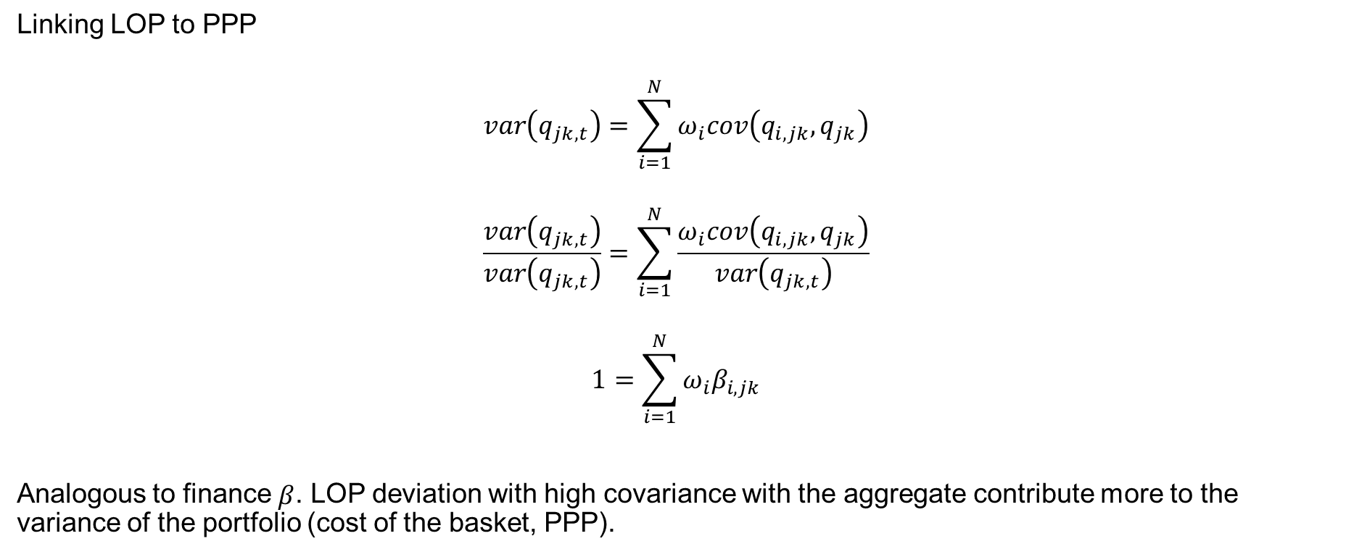
Time Series Implications
Crucini and Landry (2016)
Linking LOP to PPP
$$var\left(q_{jk,t}\right)=\sum_{i=1}^{N}{ω_{i}cov\left(q_{i,jk},q_{jk}\right)}$$
$$\frac{var\left(q_{jk,t}\right)}{var\left(q_{jk,t}\right)}=\sum_{i=1}^{N}{\frac{ω_{i}cov\left(q_{i,jk},q_{jk}\right)}{var\left(q_{jk,t}\right)}}$$
$$1=\sum_{i=1}^{N}{ω_{i}β_{i,jk}}$$
Analogous to finance $β$. LOP deviation with high covariance with the aggregate contribute more to the variance of the portfolio (cost of the basket, PPP).

Slide 31
Classical Dichotomy Benchmark
The overall rate varies over time. All of that variation comes from somewhere
Textbook says: not from apples — you can ship an apple, so arbitrage holds it in line
Apples and things like them are ~40% of what people buy
So the other 60% — haircuts, rent, restaurant meals — has to carry all of the variation
Meaning: every non-traded good varies about 1.7× as much as the overall rate
Prediction: two kinds of good. One that doesn't vary at all, one that varies 1.7× as much. Nothing in between.
Note: for more information on how to classical dichotomy applies to intermediate inputs, see the Accounting for Real-Exchange Rates using Micro-Data” slides.

Slide 32
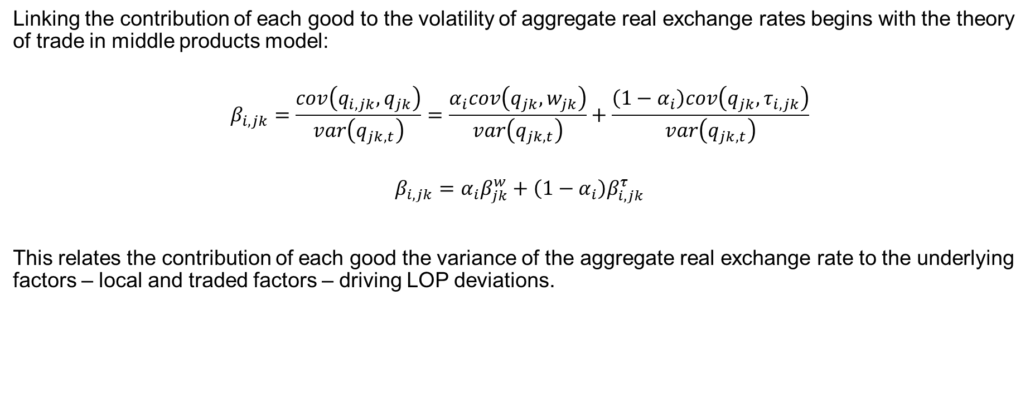
Time Series Implications (Continued)
Crucini and Landry (2016)
Linking the contribution of each good to the volatility of aggregate real exchange rates begins with the theory of trade in middle products model:
$$β_{i,jk}=\frac{cov\left(q_{i,jk},q_{jk}\right)}{var\left(q_{jk,t}\right)}=\frac{α_{i}cov\left(q_{jk},w_{jk}\right)}{var\left(q_{jk,t}\right)}+\frac{\left(1−α_{i}\right)cov\left(q_{jk},τ_{i,jk}\right)}{var\left(q_{jk,t}\right)}$$
$$β_{i,jk}=α_{i}β_{jk}^{w}+\left(1−α_{i}\right)β_{i,jk}^{τ}$$
This relates the contribution of each good the variance of the aggregate real exchange rate to the underlying factors – local and traded factors – driving LOP deviations.

Slide 33
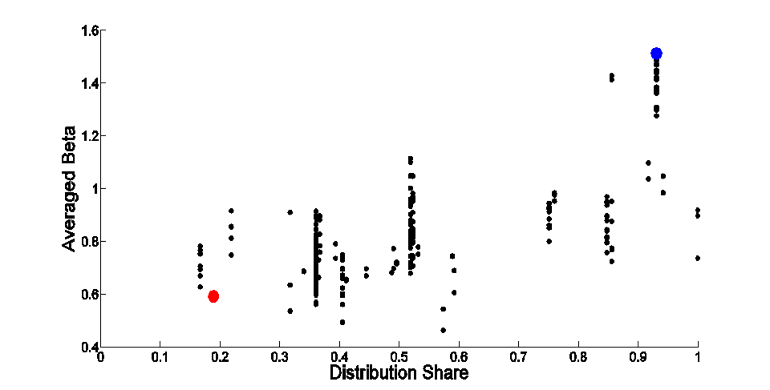



Regression of $β$s on distribution shares gives estimates of local and traded factors, 1
Two-bedroom apartment $β$ is 1.5
Gasoline $β$ is 0.6

Slide 34

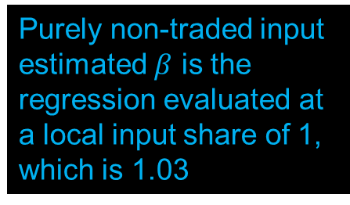
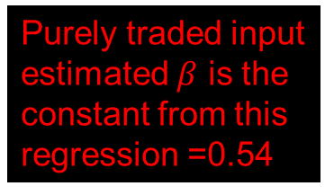
Regression of $β$s on distribution shares gives estimates of local and traded factors, 2
Purely non-traded input estimated $β$ is the regression evaluated at a local input share of 1, which is 1.03
Purely traded input estimated $β$ is the constant from this regression =0.54

Slide 35
Short-run Variance Decomposition​, local and traded factor content by good
Gasoline, iPhones
Haircuts

Slide 36
Classical Dichotomy is Alive and Well When Applied to Trade in Middle Products
LOP variance​
  Anecdotes follow the classical dichotomy, but this is due to their skewed factor content​
  Most final goods have betas clustered around 1 (`all alike’, sticky prices)​
Trade in middle products​
  Traded and local factors, though are very distinct, with betas of 0.54 and 1.03​
PPP variance​
  Using final goods dichotomy 1/3 traded and 2/3 non-traded​
  Using trade in middle products 1/5 traded and 4/5 local factor content​
Engel (1999) is misleading due to arbitrary assignment of covariance term​

Slide 37
References
Ahlin, C., Shintani, M., 2007. Menu costs and Markov inﬂation: a theoretical revision with new evidence. Journal of Monetary Economics 54 (3), 753–784.​
Alvarez, L.J., Hernando, I., 2006. Price setting behaviour in Spain: stylised facts using consumer price micro data. Economic Modelling 24 (4), 699–716. ​
Amirault, D., Kwan, C., Wilkinson, G., 2006. Survey of price-setting behaviour of Canadian companies. Bank of Canada Working Paper 2006-35.​
Alessandria, George, 2004. International deviations from the law of one price: the role of search frictions and market share. Int. Econ. Rev. 45 (4), 1263–1291.​
Alessandria, George, Kaboski, Joseph, 2011. Pricing-to-market and the failure of absolute PPP. AEJ: Macroeconomics. 3 (1), 91–127.​
Andrews, D.W.K., Chen, H.-Y., 1994. Approximately median-unbiased estimation of autoregressive models. Journal of Business and Economic Statistics 12 (2), 187–204.​
Arellano, M., Bond, S., 1991. Some tests of speciﬁcation for panel data: Monte Carlo evidence and an application to employment equations. Review of Economics Studies 58 (2), 277–297.​
Aucremanne, L., Dhyne, E., 2004. How frequently do prices change? Evidence based on the micro data underlying the Belgian CPI. National Bank of Belgium Working Paper, No. 44.​

Slide 38
References​
Baba, C. (2007). 'Price dispersion across and within countries: the case of Japan and Korea', Journal of the Japanese and International Economies, vol. 21(2), pp. 237–59.​
Baudry, L., Le Bihan, H., Sevestre, P., Tarrieu, S., 2007. What do thirteen million price records have to say about consumer price rigidity? Oxford Bulletin of Economics and Statistics 69 (2), 139–183.​
Balassa, Bela. “The Purchasing-Power Parity Doctrine: A Reappraisal.” Journal of Political Economy, 1964, 72(6), pp. 584 –96. ​
Baumgartner, J., Glatzer, E., Rumler, F., Stiglbauer, A., 2005. How frequently do consumer prices change in Austria? ECB Working Paper Series, No. 523. Bergin, P.R., Glick, R., Wu, J.-L. The micro-macro disconnect of purchasing power parity. Review of Economics and Statistics, in press.​
Baumol, William J. and Bowen, William G. Performing arts: The economic dilemma. New York: Twentieth Century Fund, 1966.​
Bergin, P.R. and Feenstra, R.C. (2001). 'Pricing-to-market, staggered contracts, and real exchange rate persistence', Journal of International Economics, vol. 54(2), pp. 333–59.​
Bils, M., Klenow, P.J., 2004. Some evidence on the importance of sticky prices. Journal of Political Economy 112 (5), 947–985. ​
Broda, C., Weinstein, D.E., 2008. Understanding international price differences using barcode data. NBER Working Paper, No. 14017.​
Betts, C., Kehoe, T., 2006. U.S. real exchange rate fluctuations and relative price fluctuations. Journal of Monetary Economics 53, 1297-1326. ​
Bils, M., Klenow, P.J., 2004. Some evidence on the importance of sticky prices. Journal of Political Economy 112(5), 947-985.​
Broda, C. and Weinstein, D.E. (2008). 'Understanding international price differences using barcode data', NBER Working Paper No. 14017.​
Bacchetta, P., van Wincoop, E., 2006. Can information heterogeneity explain the exchange rate determination puzzle? American Economic Review 96 (3), 552–576.​
Bils, M., Klenow, P.J., 2004. Some evidence on the importance of sticky prices. Journal of Political Economy 112 (5), 947–985.​
Blinder, A.S., Canetti, E.R.D., Lebow, D.E., Rudd, J.B., 1998. Asking about prices: a new approach to understanding price stickiness. Russell Sage Foundation, New York.​
Burstein, A., Eichenbaum, M., Rebelo, S., 2005. Large devaluations and the real exchange rate. Journal of Political Economy 113 (4), 742–784.​
Burstein, Ariel, Eichenbaum, Martin, Rebelo, Sergio, 2007. Modeling exchange rate pass-through after large devaluations. J. Monet. Econ. 54 (2), 346–368. ​
Burstein, A.T., Neves, J.C., Rebelo, S., 2003. Distribution costs and real exchange rate dynamics during exchange-rate-based stabilizations. Journal of Monetary Economics 50(6), 1189-1401.​

Slide 39
References
Calvo, G. (1983). 'Staggered prices in a utility-maximizing framework', Journal of Monetary Economics, vol. 12(3), pp. 383–98.​
Carvalho, C., Nechio, F., 2011. Aggregation and the PPP puzzle in a sticky price model. American Economic Review 101 (6), 2391–2424.​
Ceglowski, J. (2003). 'The law of one price: intranational evidence for Canada', Canadian Journal of Economics, vol. 36(2), pp. 373–400.​
Chari, V.V., Kehoe, P., McGrattan, E., 2002. Can sticky price models generate volatile and persistent real exchange rates? Review of Economic Studies 69(3), 533-563. ​
Chen, S., Engel, C., 2005. Does "aggregation bias" explain the PPP puzzle? Pacific Economic Review 10, 49-72. ​
Cheung, Y., Lai, K.S., 2000. On cross-country differences in the persistence of real exchange rates. Journal of International Economics 50, 375-397. ​
Cheung, Y.-W. and Fujii, E. (2008). 'Deviations from the law of one price in Japan', CESifo Working Paper No. 1456.​
Choi, C.Y., Mark, N.C., Sul, D., 2006. Unbiased estimation of the half-life to PPP convergence in panel data. Journal of Money, Credit and Banking 38(4), 921-938.​
Choi, C.-Y. and Matsubara, K. (2007). 'Heterogeneity in the persistence of relative prices: what do the Japanese cities tell us?', Journal of the Japanese and International Economies, vol. 21(2), pp. 260–86.​
Clark, T.E., 2006. Disaggregate evidence on the persistence of consumer price inﬂation. Journal of Applied Econometrics 21 (5), 563–587.​
Chari, V.V., Kehoe, P.J., McGrattan, E.R., 2002. Can sticky price models generate volatile and persistent real exchange rates? Review of Economics Studies 69 (3), 533–563.​
Clarida, R., Galí, J., 1994. Sources of real exchange-rate fluctuations: how important are nominal shocks?. Carnegie-Rochester Conference Series on Public Policy 41 (1), 1–56.​
Cavallo, Alberto, Brent Neiman and Roberto Rigobon. 2014. "Currency Unions, Product Introductions, and the Real Exchange Rate." Quarterly Journal of Economics , 129 (2) .​
Crucini, Mario J., Landry, Anthony, 2012. Accounting for Real Exchange Rates Using Micro-Data. Vanderbilt University, National Bureau of EconomicResearch, Working Paper No. 17812.​
Crucini, M.J., Shintani, M., 2008. Persistence in law of one price deviations: evidence from micro-data. Journal of Monetary Economics 55 (3), 629–644.​
Crucini, M.J., Shintani, M. and Tsuruga, T. (2009). 'The law of one price without the border: the role of distance versus sticky prices', NBER Working Paper No. 14835.​
Crucini, M.J., Shintani, M., Tsuruga, T., 2010. The law of one price without the border: the role of distance versus sticky prices. Economic Journal 120 (544), 462–480.​
Crucini, M.J., Shintani, M. and Tsuruga, T. (2010). 'Accounting for persistence and volatility of good-level real exchange rates: the role of sticky information', Journal of International Economics.​
Crucini, M.J., Telmer, C., 2012. Microeconomic sources of real exchange rate variability. NBER Working Paper, No. 17978. ​
Crucini, M.J., Telmer, C.I., Zachariadis, M., 2005. Understanding European real exchange rates. American Economic Review 95 (3), 724–738.​
Crucini, M.J., Yilmazkuday, H., 2009. A model of international cities: implications for real exchange rates. NBER Working Paper No. 14834.​
Crownover, Collin; Pippenger, John and Steigerwald, Douglas G. “Testing for Absolute Purchasing Power Parity.” Journal of International Money and Finance, 1996, 15(5),​
Cumby, Robert E. “Forecasting Exchange Rates and Relative Prices with the Hamburger Standard: Is What You Want What You Get with McParity?” National Bureau of Economic Research, Inc., NBER Working Papers: No. 5675, 1996.​

Slide 40
References
Dornbusch, R., Fischer, S., Startz, R., 2004. Macroeconomics. McGraw-Hill, New York.​
Dupor, B., Kitamura, T., Tsuruga, T., Integrating sticky prices and sticky information, Review of Economics and Statistics, forthcoming.​
Dumas, Bernard. “Dynamic Equilibrium and the Real Exchange Rate in a Spatially Separated World.” Review of Financial Studies, 1992, 5(2), pp. 153– 80.​
Eaton, J., Kortum, S., 2002. Technology, geography and trade. Econometrica 70 (5), 1741–1779.​
Eichenbaum, M., Evans, C., 1995. Some empirical evidence on the effects of monetary policy shocks on exchange rates. Quarterly Journal of Economics 110 (4), 975–1010.​
Ethier, W.J., 1982. National and international returns to scale in the modern theory of international trade. American Economic Review 72(3), 389-405.​
Ethier, Wilfred. “Internationally Decreasing Costs and World Trade.” Journal of International Economics, 1979, 9(1), pp. 1–24.​
Engel, C., 1999. Accounting for U.S. real exchange rate changes. Journal of Political Economy 107(3), 507-538. ​
Engel, C. and Rogers, J.H. (1996). 'How wide is the border?', American Economic Review, vol. 86(5), pp. 1112– 25.​
Engel, C., Rogers, J.H., 2004. European market integration after euro. Economic Policy 19, 347–384.​
Engel, Charles and Rogers, John H. “European Product Market Integration after the Euro.” Economic Policy, 2004 19(39), pp. 347–75.​
Engel, Charles. “Real Exchange Rates and Relative Prices: An Empirical Investigation.” Journal of Monetary Economics, 1993, 32(1), pp. 35–50.​
Engel, Charles and Rogers, John H. “How Wide Is the Border?” American Economic Review, 1996, 86(5), pp. 1112–25.​
Eurostat. Price structure of the community countries. Luxembourg: Commission of European Communities, Issues from 1975, 1980, 1985, and 1990.​
Evans, Carolyn L. “The Economic Significance of National Border Effects.” American Economic Review, 2003, 93(4), pp. 1291–1312.​

Slide 41
References
Fabiani, S., Druant, M., Hernando, I., Kwapil, C., Laudau, B., Loupias, C., Martins, F., Mathä, T.Y., Sabbatini, R., Stahl, H., Stokman, A.C.J., 2005. The pricing behaviour of ﬁrms in the euro area new survey evidence. ECB working paper, No. 535.​
Fan, J., Gijbels, I., 1996. Local Polynomial Modelling and Its Applications. Chapman & Hall, London.​
Flam, Harry. “Product Markets and 1992: Full Integration, Large Gains?” Journal of Economic Perspectives, 1992, 6(4), pp. 7–30.​
Frankel, J.A., Rose, A.K., 1996. A panel project on purchasing power parity: Mean reversion within and between countries. Journal of International Economics 40, 209-224.​
Froot, Kenneth A.; Kim, Michael and Rogoff, Kenneth. “The Law-of-One-Price over 700 Years.” National Bureau of Economic Re- search, Inc., NBER Working Papers: No. 1532, 1995.​
Ghosal, S., Sen, A., van der Vaart, A.W., 2000. Testing monotonicity of regression. The Annals of Statistics 28 (4), 1054–1082.​
Ghosh, Atish R. and Wolf, Holger C. “Pricing in International Markets: Lessons from the Economist.” National Bureau of Economic Research, Inc., NBER Working Papers: No. 4806, 1994.​
Giovannini, Alberto. “Exchange Rates and Traded Goods Prices.” Journal of International Economics, 1988, 24(1/2), pp. 45– 68. ​
Haskel, Jonathan & Wolf, Holger, 2001. " The Law of One Price--A Case Study," Scandinavian Journal of Economics, Wiley Blackwell, vol. 103(4), pages 545-58, December​
Goldberg, P.K. and Verboven, F. (2004). 'Market integration and convergence to the law of one price evidence from the European car market', Journal of International Economics, vol. 65(1), pp. 49–73.​
Goldberg, P.K., Verboven, F., 2005. Market integration and convergence to the Law of One Price: evidence from the European car market. Journal of International Economics 65(1), 49-73.​
Gopinath, G., Gourinchas, P.O., Hsieh, C.T. and Li, N. (2009). 'Estimating the border effect: some new evidence', NBER Working Paper No. 14938.​
Gorodnichenko, Y. and Tesar, L. (2009). 'Border effect or country effect? Seattle may not be so far from Vancouver after all', American Economic Journal: Macroeconomics, vol. 1(1), pp. 219–41.​
Gorodnichenko, Y., 2008. Endogenous information, menu costs, and inﬂation persistence. NBER working paper, No. 14184.​

Slide 42
References
Harrod, Roy.F., 1933. International Economics. James Nisbet and Cambridge University Press, London.​
Higo, M. and Saita, Y. (2007). 'Price setting in Japan: evidence from CPI micro data', Bank of Japan Working Paper Series E-20.​
Holger. “The Law of One Price—A Case Study.” Scandinavian Journal of Economics, 2001, 103(4), pp. 545–58.​
Holtz-Eakin, D., 1988. Testing for individual effects in autoregressive models. Journal of Econometrics 39, 297-307.​
Holtz-Eakin, D. Newey W., Rosen, H.S., 1988. Estimating vector autoregressions with panel data. Econometrica 56(6), 1371-1395.​
Hummels, David, 2001. Toward a Geography of Trade Costs. Unpublished manuscript.​
Imbs, J., Mumtaz, H., Ravn, M., Rey, H., 2005. PPP strikes back: aggregation and the real exchange rate. Quarterly Journal of Economics 120 (1), 1–43.​
Lee, Inkoo & Park, Sangsoo, 2015. "The law of one price revisited: How do goods market frictions generate large and volatile price deviations?," Journal of Macroeconomics, Elsevier, vol. 46(C), pages 71-80.​
Isard, Peter. “How Far Can We Push the ‘Law of One Price’?” American Economic Review, 1977, 67(5), pp. 942– 48.​
Johri, A., Lahiri, A., 2008. Persistent real exchange rates. Journal of International Economics 76 (2), 223–236.​
Kehoe, P.J. and Midrigan, V. (2007). 'Sticky prices and sectoral real exchange rates', Federal Reserve Bank of Minneapolis Working Paper No. 656.​
Kim, J. 2004. Half-lives of deviations from PPP: contrasting traded and non-traded components of consumption baskets. Review of International Economics 12(1), 162-168.​
Kim, J. and Ogaki, M., 2004. Purchasing power parity for traded and non-traded goods: a structural error correction model approach. Monetary and Economic Studies, 22(1), 1-26.​
Klenow, P. and Kryvtsov, O. (2008). 'State-dependent or time-dependent pricing: does it matter for recent U.S. inflation?', Quarterly Journal of Economics, vol. 123(3), pp. 863–904.​
Knetter, Michael M. “Price Discrimination by U.S. and German Exporters.” American Economic Review, 1989, 79(1), pp. 198 –210.​
Knetter, Michael M. “International Comparisons of Price-to-Market Behavior.” American Economic Review, 1993, 83(3), pp. 473– 86. ​
Kravis, Irving B. and ​
Knotek, E.S., 2006. A tale of two rigidities: sticky prices in a sticky information environment. Federal Reserve Bank of Kansas City Research Working Paper 06-15. ​
Krugman, Paul R. “Pricing to Market When the Exchange Rate Changes,” in Sven W. Arndt and J. David Richardson, eds., Real-financial linkages among open economies. Cambridge, MA: MIT Press, 1987, pp. 49 –70.​
​

Slide 43
References
Lipsey, Robert E. “Toward an Explanation of National Price Levels.” Princeton University, Princeton Studies in International Finance: No. 52, 1983.​
Lutz, Matthias. “Pricing in Segmented Markets, Arbitrage Barriers, and the Law of One Price: Evidence from the European Car Market.” Review of International Economics, 2004, 12(3), pp. 456 –75.​
Mankiw, N.G., Reis, R., 2002. Sticky information versus sticky prices: a proposal to replace the New Keynesian Phillips curve. Quarterly Journal of Economics 117 (4),1295–1328.​
Meese, R.A., Rogoff, K., 1983. Empirical exchange rate models of the 1970's: do they ﬁt out of sample. Journal of International Economics 14 (1–2), 3–27.​
Murray, C.J., Papell, D.H., 2005. Do panels help solve the purchasing power parity puzzle? Journal of Business and Economic Statistics 23, 410-415.​
Mussa, Michael. “Nominal Exchange Rate Re- gimes and the Behavior of Real Exchange Rates: Evidence and Implications.” Carne- gie-Rochester Conference Series on Public Policy, 1986, 25, pp. 117–213.​
Nakamura, E. and Steinsson, J. (2008). 'Five facts about prices: a reevaluation of menu cost models', Quarterly Journal of Economics, vol. 123(4), pp. 1415–64.​
Nakamura, E., 2008. Pass-through in retail and wholesale. American Economic Review 98 (2), 430–437.​
Nickell, S., 1981. Biases in dynamic models with fixed effects. Econometrica 49, 1417-1426.​
Obstfeld, Maurice and Rogoff, Kenneth. “Exchange Rate Dynamics Redux.” Journal of Political Economy, 1995, 103(3), pp. 624 – 60.​
Parsley, D.C. and Wei, S.-J. (1996). 'Convergence to the law of one price without trade barriers or currency fluctuations', Quarterly Journal of Economics, vol. 111(4), pp. 1211–36.​
Parsley, David C. and Wei, Shang-Jin. “Explaining the Border Effect: The Role of Exchange Rate Variability, Shipping Costs, and Geography.” Journal of International Economics, 2001, 55(1), pp. 87–105.​
Parsley, D., Wei, S., 2007. A prism into the PPP puzzle: the micro-foundations of Big Mac real exchange rates. The Economic Journal 117(523), 1336-1356. ​
Parsley, David C. and Wei, Shang-Jin. “How Big and Heterogeneous Are the Effects of Currency Arrangements on Market Integration?” Vanderbilt University, Financial Markets Re- search Center Working Paper: No. 0013, 2003.​

Slide 44
References
Ramsey, J.B., 1969. Tests for specification errors in classical linear least-squares regression analysis. Journal of the Royal Statistical Society B 31 (2), 350–371. ​
Richardson, J. David. “Some Empirical Evidence on Commodity Arbitrage and the Law of One Price.” Journal of International Economics, 1978, 8(2), pp. 341–51.​
Rogers, J.H., 1999. Monetary shocks and real exchange rates. Journal of International Economics 49 (2), 269–288.​
Rogers, John H. “Price Level Convergence, Relative Prices, and Inflation in Europe.” Board of Governors of the Federal Reserve System (U.S.), International Finance Discussion Papers: No. 699, 2001.​
Rogers, John H. and Jenkins, Michael. “Haircuts or Hysteresis? Sources of Movements in Real Exchange Rates.” Journal of International Economics, 1995, 38(3– 4), pp. 339 – 60.​
Rogers, J.H., 2007. Monetary union, price level convergence, and inﬂation: how close is Europe to the USA? Journal of Monetary Economics 54 (3), 785–796.​
Rogoff, Kenneth. “The Purchasing Power Parity Puzzle.” Journal of Economic Literature, 1996, 34(2), pp. 647– 68.​
Salter, W.E.G., 1959. Internal and external balance: the role of price and expenditure effects. Economic Record 35, 226-38. ​
Samuelson, Paul A. “Theoretical Notes on Trade Problems.” Review of Economics and Statis- tics, 1964, 46(2), pp. 145–54.​
Sanyal, K., Jones, R.W., 1982. The theory of trade in middle products. American Economic Review 72(1), 16-31.​
Sercu, Piet; Uppal, Raman and Van Hulle, Cyn- thia. “The Exchange Rate in the Presence of Transaction Costs: Implications for Tests of Purchasing Power Parity.” Journal of Fi- nance, 1995, 50(4), pp. 1309 –19.​
Sims, C.A., 2003. Implications of rational inattention. Journal of Monetary Economics 50 (3), 665–690.​
Steinsson, J., 2008. The dynamic behavior of the real exchange rate in sticky ​
price models. American Economic Review 98 (1), 519–533. ​
Stockman, A.C., 1980. A theory of exchange rate determination. Journal of Political Economy 88 (4), 673–698.​
Stockman, Alan C. and Tesar, Linda L. “Tastes and Technology in a Two-Country Model of the Business Cycle: Explaining International Comovements.” American Economic Review, 1995, 85(1), pp. 168 – 85.​
Svennsson, L.O., van Wijnbergen, S., 1989. Excess capacity, monopolistic competition and international transmission of monetary disturbances. The Economic Journal 99, 785-805.​
Swan, T.W., 1960. Economic control in a dependent economy. Economic Record 36, 51-66.​
Woodford, M., 2009. Information-constrained state-dependent pricing. Journal of Monetary Economics 56 (S1), 100–124.​
Yun, T., 1996. Nominal price rigidity, money supply endogeneity, and business cycles. Journal of Monetary Economics 37 (2), 345–370.​

