Slide 1
Supply Chain Disruption Mitigation
Roy Vasher
Purdue University
Toyota Manufacturing, North America (Retired)
DCMME-GSCMI Krannert School of Management

Slide 2
Supply Disruptions
Root Causes
Crisis Management Process
Reshoring Strategy

Slide 3
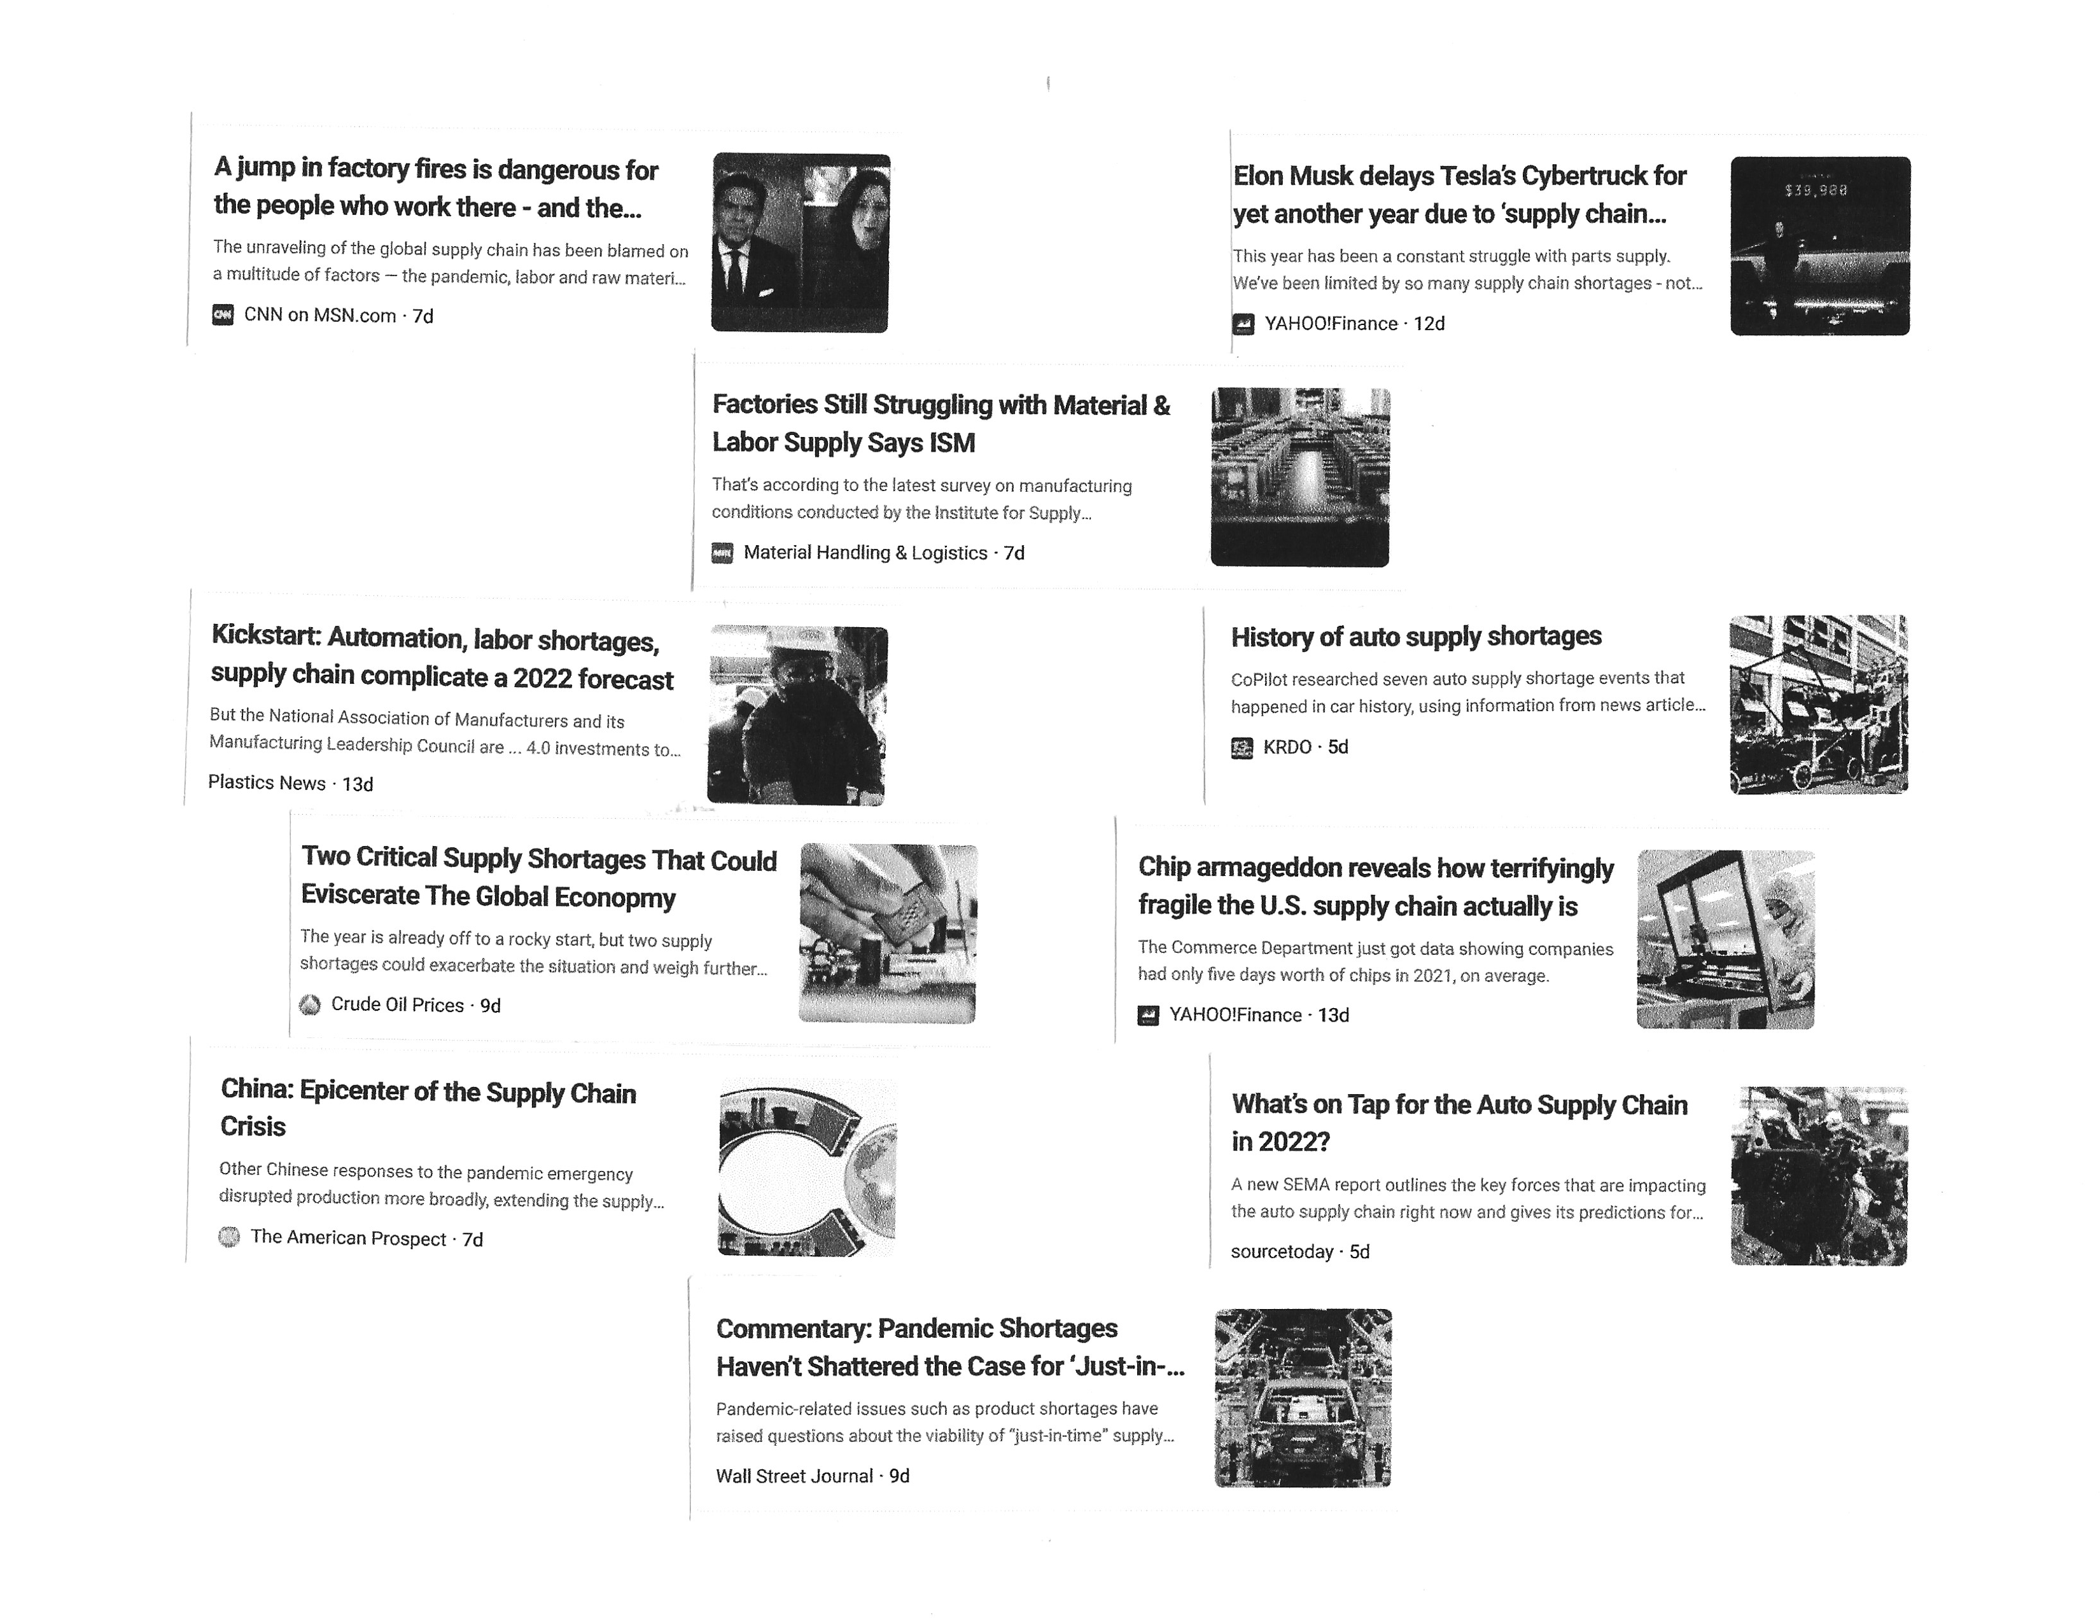
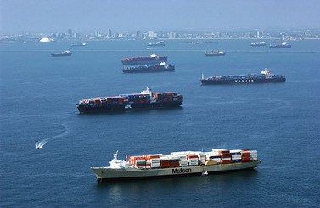

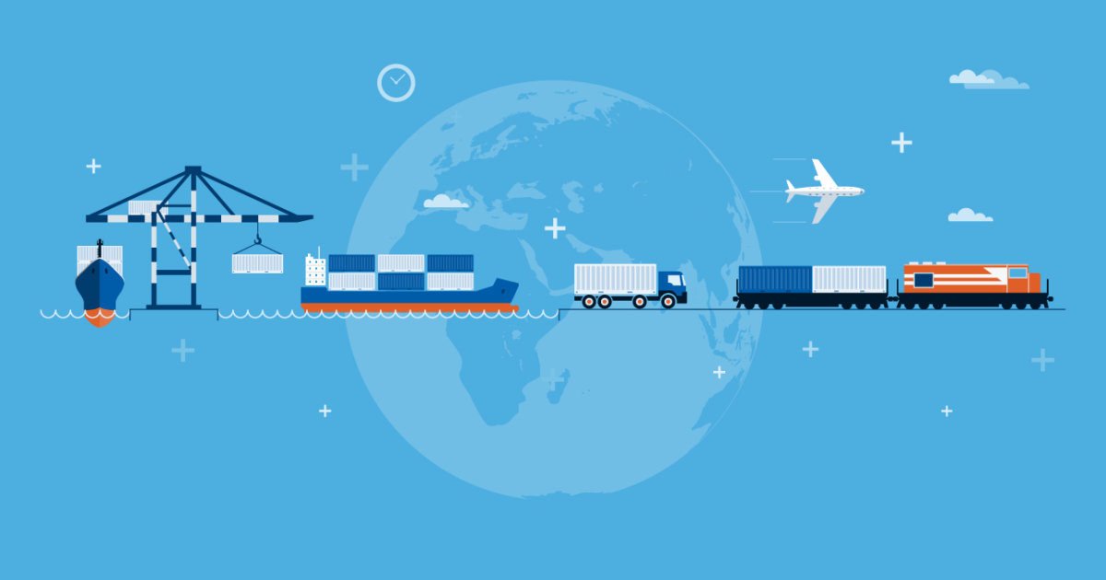
Supply Chain Disruptions
Source: Bing

Slide 4
Root Causes of Supply Chain Disruption
Triggers
  COVID-19
  Container Shortages
  Dock Backlog
  Trucker Shortage
Root Causes:
  Global Supply Chain
  Offshoring >

Slide 5
Crisis Management Process*
Based on Toyota’s Best Practices
* Source: Toyota Supply Chain Management, Ananth Iyer, Sridhar Seshadri, Roy Vasher
Identify the Crisis
  Unexpected Event
  Potential Act
Communicate
Assess Impact
Assign “Crisis Owner”
Assemble Crisis Team
Mitigate
  Short-term
  Long-term
Be Good Corporate Citizen
Reflect >

Slide 6
Reshoring Strategy

Slide 7
Smart Sourcing Thinking
‘The Whole is greater than sum of the parts’
  Strategic Cost Perspective
  Base sourcing decisions on the long-term benefits of local sourcing at scale.

Slide 8
Business Benefits of Reshoring
Indirect Cost Opportunities
Supply Chain – Potential unplanned disruptions of the overseas supply chain can have a major impact on production operations
Inventory – Long lead-times from overseas suppliers, require larger inventories of safety stock that increase costs and increase scrap in event of a parts defect undetected until point of use
Market Response – Long-lead-times make it more difficult to react to sudden market demand changes
Quality Control – Increased ability to monitor compliance to quality standards.
Value Engineering (VE) – Potential to increase suppliers VE, if suppliers are local and can be trusted with IP (3D Printing opportunities)
Intellectual Property (IP) – Many companies tend to source individual parts to China vs. parts assemblies because of risk of loss of IP – May be Strategic Opportunity >

Slide 9
Business Benefits of Reshoring
Outreach Opportunities
Public Relations – The political climate presents a great PR opportunity for companies that aggressively seek reshoring
Tariffs – Current uncertainty of tariffs make planning and forecasting financial impact extremely difficult. This provides a financial incentive to reshore that also reduces the impact of supply chain disruptions.
Government Incentives – investigate potential government incentives. i.e. tax reduction and/or training
Grants– investigate potential grants to promote reshoring
Buy American Initiative – $400+ billion procurement investment >

Slide 10
Thank You

