Slide 1
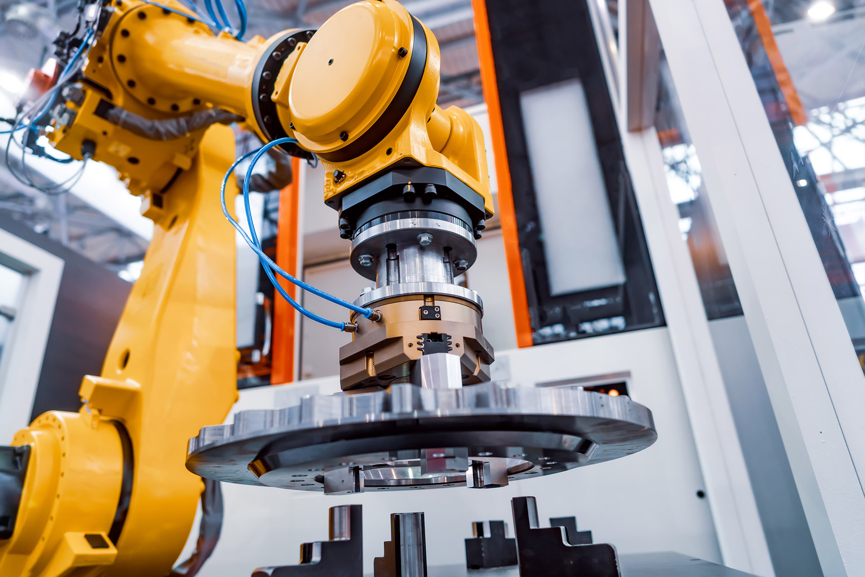
MANAGING SUPPLY CHAIN DISRUPTION
Enable resilient, customer-centric, sustainable enterprises
Rusty Baldwin, SAP
Month 00, 2021
Notes:
Hello everyone. I am very excited to be here today to discuss Supply Chain Disruptions. This is the single hottest topic right now, as we see shortages of some of the simplest things, like ????
My name is Rusty Baldwin, I have been with SAP for over 17 years, I am the Global Solution Owner in Digital Supply Chain at SAP and a Design to Operate lead, which includes Industry 4.0.
Including Industry 4.0 in the Design to operate methodology

Slide 2

Businesses are more dependent on each other than ever before
…supply chains are the center of that dependency.
Customers
Distribution Centers
Distributor
Supplier
Equipment Manufacturers
Logistics Providers
Contract Manufacturers
Service Providers
Notes:
Businesses are more dependent on each other than ever before.
As businesses become more specialized and as customers and competitors raise the pressure on pricing, speed, individualization, and sustainability, already intricate supply chains get increasingly complex.
In an attempt to meet these needs and continuously contain costs, business of all types have assembled networks of suppliers, diverse sales and distribution channels, logistics and delivery providers, contract manufacturers, shippers, and more – a complex network of partners and collaborators organizations, depend on to keep products moving, keep costs down, and keep sales growing.

Slide 3

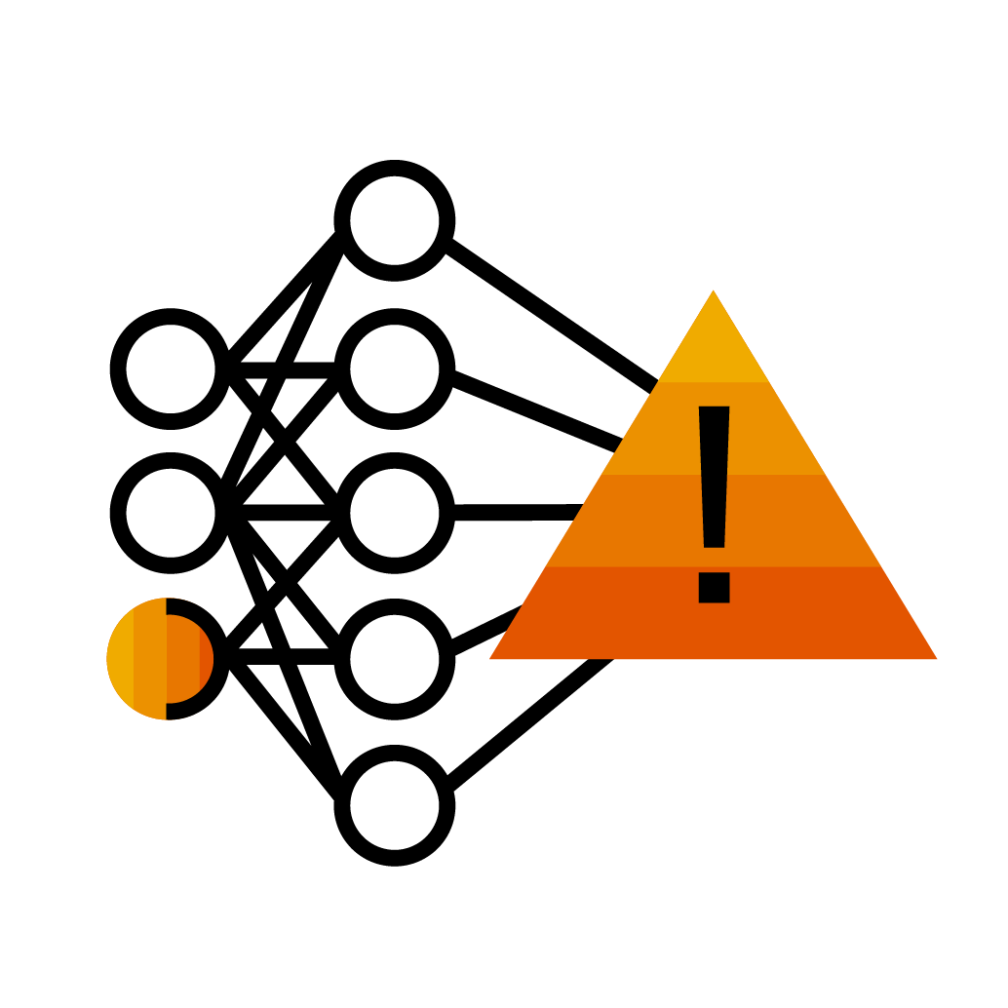
Your supply chain can be a source of strength or vulnerability
52%
A single severe event
that disrupts production for 100 days…could erase almost a year’s earnings in some industries²
of U.S. manufacturing executives have started
buying more supplies in the United States in response to COVID-related supply disruptions¹
¹ Reshoring Index, Kearney, 2020
² Risk, resilience, and rebalancing in global value chains, McKinsey Global Institute, August 6, 2020
Notes:
Your supply chain can be a source of strength or vulnerability.
As we’ve learned in the last year, any disruption – big or small – across the network of suppliers can create a huge disruption for businesses.
In fact, 52% of companies have started sourcing supplies in the Unites States.

Slide 4
Your supply chain is a source of strength or vulnerability
Planning: Supplier consolidation, cost-based sourcing, and added buffer industries
Strategies intended to reduce costs have actually exposed risks:
Production: Global, low cost suppliers and outsourced manufacturers as the predominant choice
Logistics: Preferred and limited transportation providers supplemented by expedited shipping fees
Operations: Reactive service and maintenance, service violation fees, and internal service workforces
Notes:
Let’s take a deeper dive into why “Your supply chain can be a source of strength or vulnerability”
And we’ve all felt the impact of those disruptions and realized how – in some cases – we’ve taken supply chain stability for granted – whether we’re looking for lumber for improvement projects at home and scrambling for back-up suppliers to meet order commitments at work.
Supply chain breakdowns and delivering ongoing resilience have become hot topics of conversation in living rooms and boardrooms around the world.
Here are a few examples of what businesses have done to combat disruption:
Planning: Consolidate and source local suppliers, often based on the lowest price and insulated inventory with extra stock
Production: Manufacturing using JIT inventory principles or outsourced production
Logistics: Incurring expedited shipping fees due to reduced transportation capacities.
Operations: Reacting to maintenance plans as opposed to predicting downtime to avoid service issues all together
So the networks we’ve assembled to grow our business and reduce risks to our businesses have actually stalled growth and created risks in our business.
And these challenges are amping-up the need for resilient supply chains.

Slide 5
Digitalize your operations and supply chain to fortify your business
Handle disruptions better, faster, with less complexity, and at a lower cost
Reactive:
Resilient:
X Insufficient design insights
✓ Collaborative design
X Restricted suppliers
✓ Balanced suppliers
X Increased manufacturing overhead
✓ Manufacturing automation
Disruption
X Excessive safety stock
✓ Optimized inventory
X As-required maintenance
✓ Predictive maintenance
X Ad-hoc service providers
✓ Verified service networks
Notes:
The disruption we’ve all felt and witnessed this year isn’t an excuse to postpone digital transformation, it’s a reason to accelerate it – and accelerate it all across your business.
Companies that have unified cross-functional planning processes into one common environment can respond more quickly to market shifts and regulations.
Digitalized supply chains and operations handle disruptions better, faster, with less complexity, and at a lower cost than reactive value chains.
Disruptions are going to happen, but digital businesses don’t just react and create unnecessary costs and delays – they anticipate and adapt ahead of disruptions to reduce costs and continue to deliver for their customers.
What does that look like? [CLICK]
When urgent design requirements change, instead of reacting with knee-jerk design responses, you can collaboratively design a solution based on a digital model of your product.
When supply is disrupted, instead of reacting with redundant and costly suppliers, you can anticipate issues and rely on a balanced network of suppliers to fill the gap without increasing costs.
When inventory shortages pop up, instead of depending on expensive inventory buffers, you can quickly adapt to fill the gap without adding excess carrying costs.
When assets break down, instead of requiring reactive, delay-inducing maintenance, you can avoid the breakdown altogether with IoT-based indicators and proactive service.
These are a just a few examples of what a better, more stable, more nimble future can look like.

Slide 6


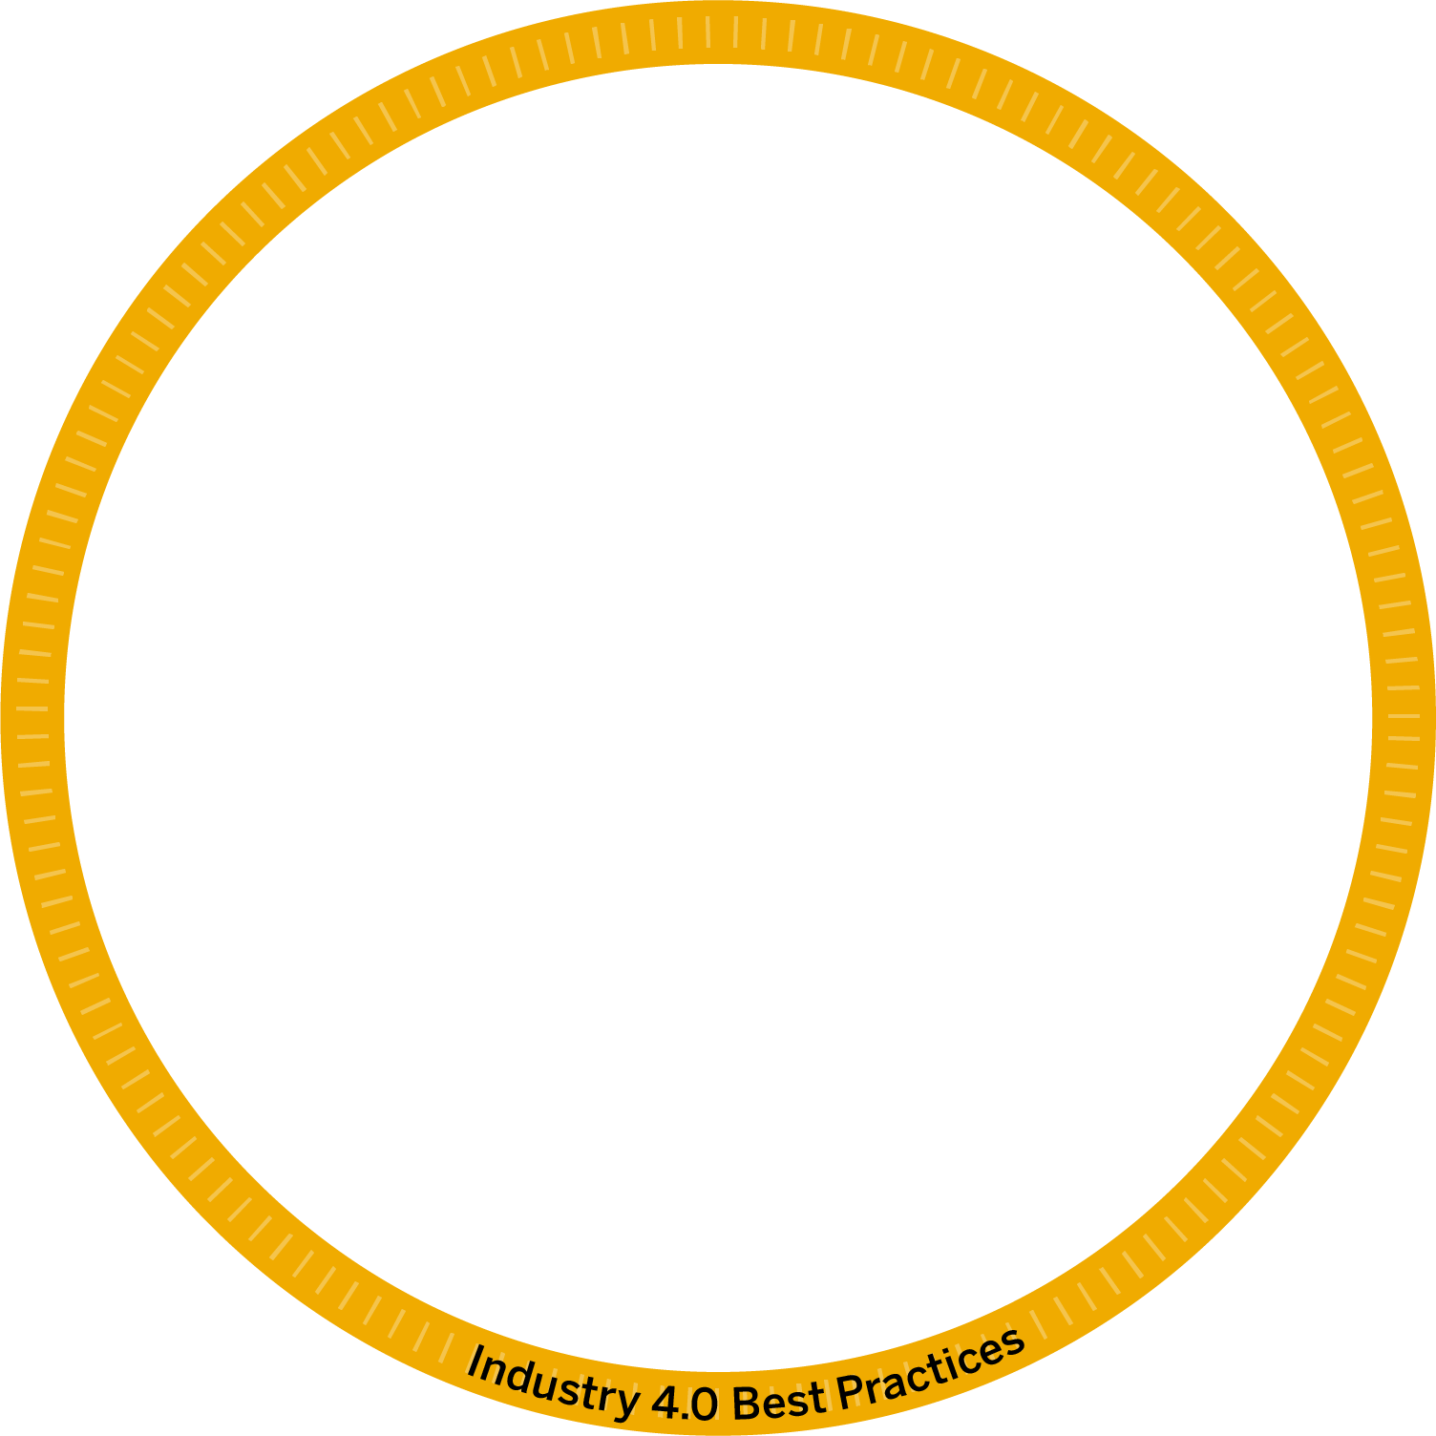
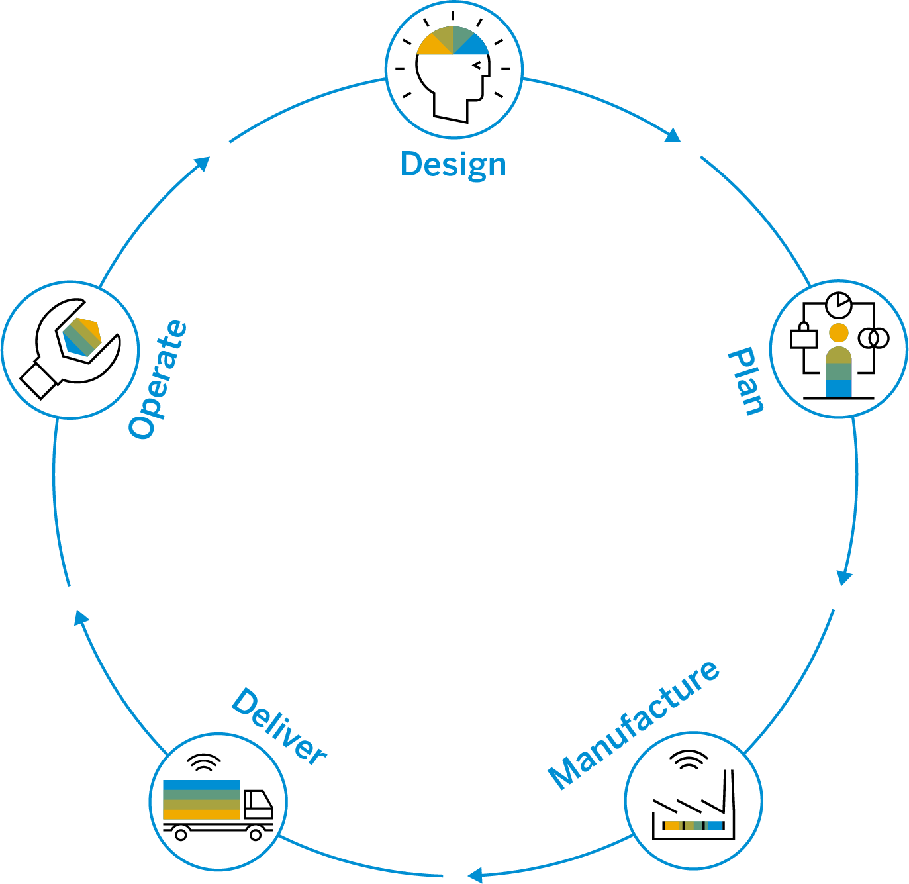
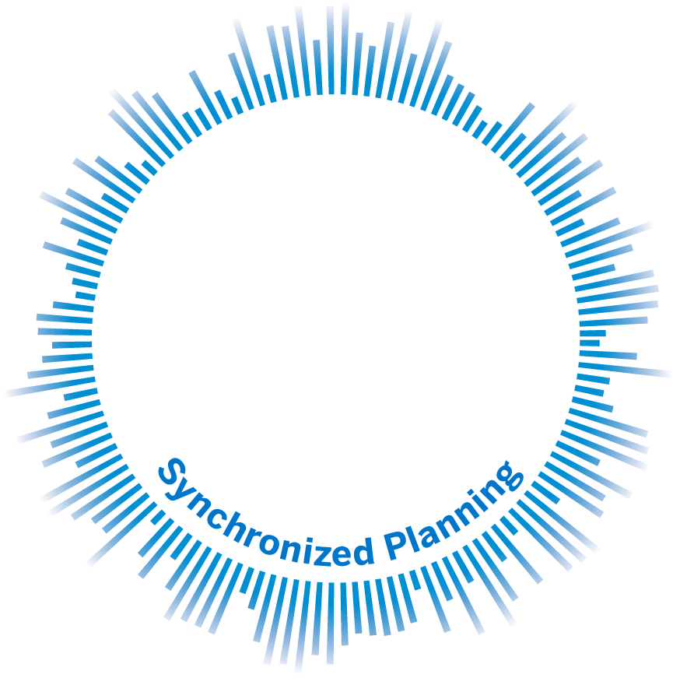
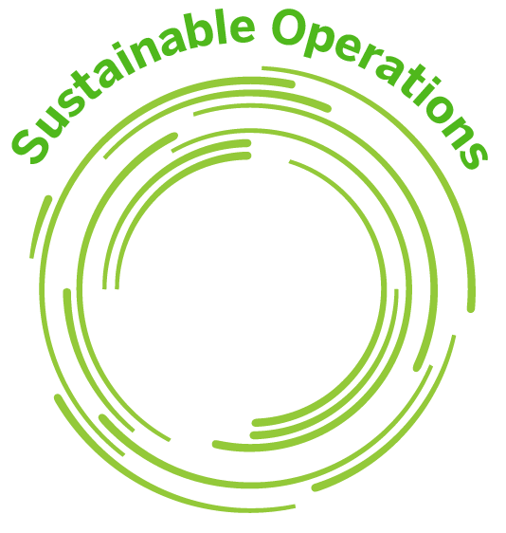
Resilient businesses need digitalized operations and supply chains built for speed and flexibility
Agility
Productivity
Connectivity
Sustainability
Proactively and profitably sense and respond to market dynamics
Deliver high-quality, mass-produced or make-to-order products faster
Unified, collaborative trading partner relationships
Actively manage your environmental and community impact
Notes:
A resilient business is one with digitalized operations and supply chains with 4 capabilities to run with speed and flexibility.
[CLICK]First, they need to proactively sense market and supply chain shifts or disruptions to be able to quickly and profitably respond. That’s the agility they need.
It’s about getting visibility into events as they happen and anticipating disruptions before they happen.
That’s going from being reactive – to responsive – anticipating and mitigating disruption before it impacts operations.
[CLICK] Of course, they also want to increase productivity.
And they can do it by digitalizing industrial processes with Industry 4.0.
That means running highly automated manufacturing operations to increase throughput and reduce production cost.
To deliver high-quality products faster in response to and ahead of customer demand.
And it also means avoiding costly machine breakdowns leading to production loss by monitoring and predicting the health of machines.
[CLICK] Businesses want to improve connectivity with their business partners by digitally linking all the trading partners your busines relies on.
That’s what it takes to enable next-level collaboration.
Interacting with network partners, including suppliers, logistics service providers, maintenance service providers, customers and contract manufacturers to run collaborative business processes to the next level.
[CLICK] And running a sustainable business is central to resilience.
Businesses face demands from regulators, consumers, governments.
They are under pressure to minimize waste, emissions, and reduce their carbon footprint.
To actively manage the impact your products and processes have on the environment and communities all around the world.
And many see sustainable business practices as their guiding purpose.

Slide 7

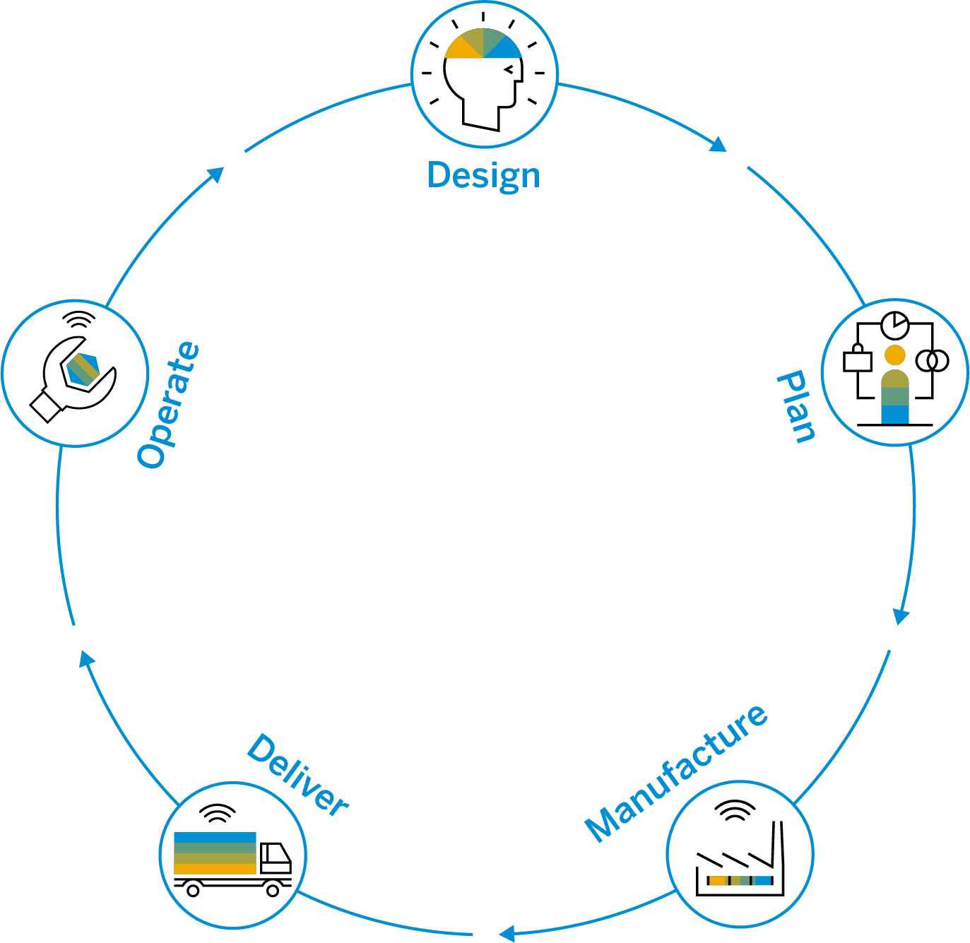
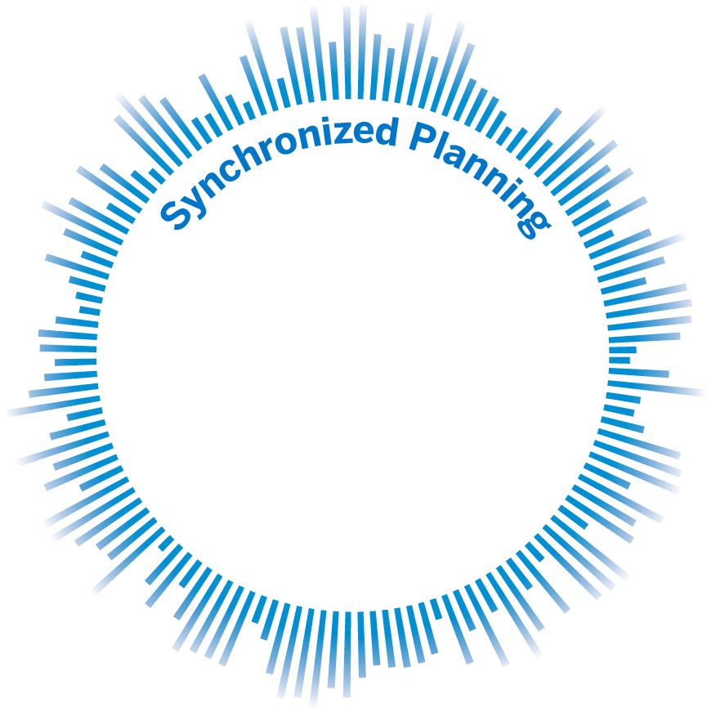
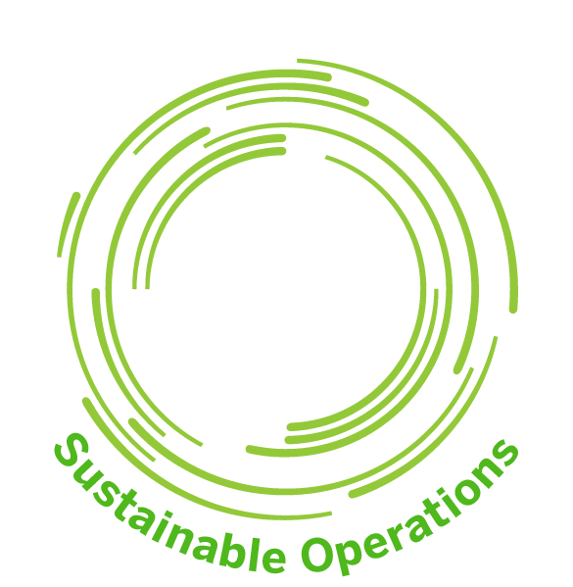
Digital Supply Chains deliver
End-to-End Process Acceleration
Replace the vulnerabilities in your processes and supply chain that create risks and slow you down with the confidence and speed it takes to grow.
Notes:
SAP Digital Supply Chain Delivers End-to-End Acceleration
SAP takes responsiveness and resiliency from boardroom buzzwords to operational reality. With SAP Digital Supply Chain solutions, you can synchronize planning company-wide and use intelligent assets, processes, and Industry 4.0 best practices to link every part of the design-to-operate process together, connect it with the rest of your company, and integrate it completely with all your suppliers. Now, you can combine intelligent manufacturing automation with business execution – continuously improving the pace, quality, and sustainability of production. You can replace the vulnerabilities in your process and supply chain that slow you down with the confidence and speed it takes to grow.

Slide 8
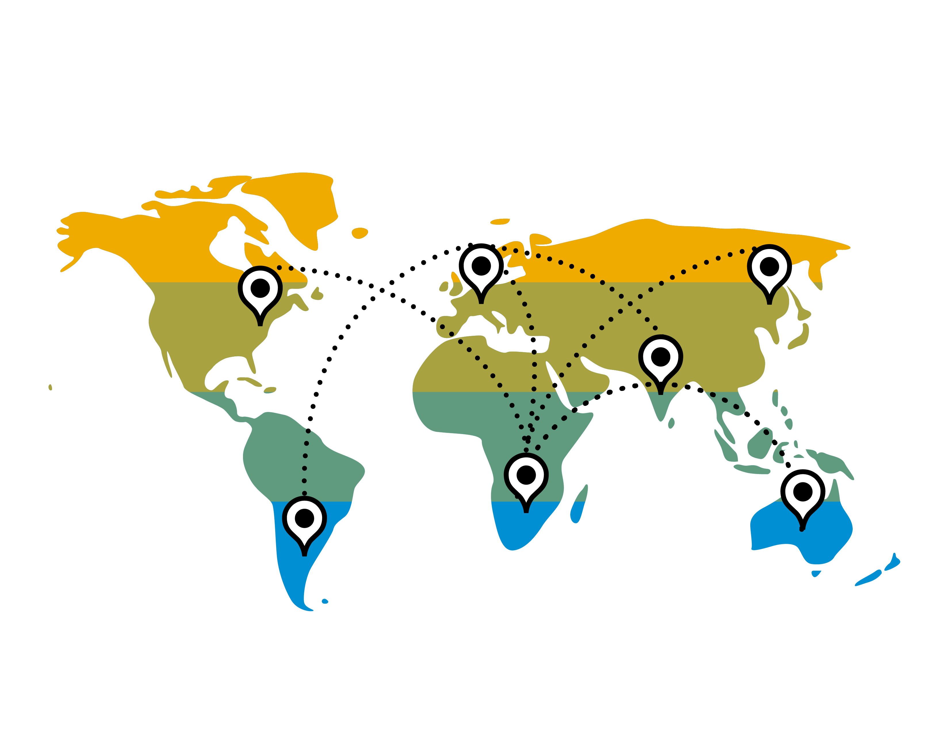
The Impact of Global Disruption
The need for a resilient supply chain
Uncertain supply of critical materials
Demand volatility for goods and services
Constrained capacity in manufacturing & logistics
Human risk of balancing labor shortages
and health and safety of employees
Oversteering – Intensifies the bullwhip effect
Notes:
VV
The world now needs operational, resilient supply chains more than ever before in order bring the needed goods and services to end consumers. However, supply chains are threatened by unprecedented levels of uncertainty and volatility. Supply chain leaders must address how to:
Substitute components in bill-of-material due to shortages
Quickly match uncertain capacity with more variable demand
Repurpose manufacturing sites to product more critical health care items
Distribute products with restrictions in transportation
Ensure that critical assets in supply chain are maintained and available
With the breadth and depth of the SAP DSC portfolio, we can help customers quickly address these types of questions and at the same time strengthen their foundation for future supply chain chocks.
The COVID-19 crisis has also exposed companies to structural weak points in the supply chain. By digitizing the supply chain, companies are better able to address these vulnerabilities. We have an opportunity, perhaps even a duty, to lead our customers through these supply chain challenges right now.
The COVID-19 pandemic has caused commonly occurring supply chain disruptions to become part of a global economic crisis.​
​
Supply disruptions: Uncertain supply of critical materials from affected regions​
​
Demand volatility: Volatile consumer demand for goods and services ​
​
Delayed effects: Supply chain cause-and-effect dynamics may take weeks if not months to play out.​
​
Human capital at risk - In many countries around the world, employees are unable to go to work, either through illness, or enforced “shelter in place” orders. Businesses have an ongoing challenge of balancing labor shortages with ensuring that those considered “key workers” are working in an environment that is safe and secure. In this environment, business as usual is not an option. We now need to:
Have plans to support employee’s wellbeing, health and safety, consistent with the most conservative guidelines.
Communicate with employees with the right level of speciﬁcity and frequency.
Support an agile shift in workforce structure.
Oversteering: Uncertainty over demand and supply will intensify bullwhip-effect making business planning extremely challenging.​
Capacity constraints: Constrained labor and resource capacity in logistics​
​
Volatility in freight market: Regional lock-downs amid response to coronavirus severely constrict freight transportation​
​
Lack of visibility: Manual processes to locate and contract available carriers lead to delays and bottlenecks for critical supplies​

Slide 9




The Impact of Global Disruption | The WHY
Volatility Requires Resiliency
Disruption of Global Supply Chains due to macro-economic impacts, such as trade wars and Brexit & sustainability expectations
COVID-19
demonstrated huge vulnerabilities in Supply Chains
Cost and Productivity Pressure
force companies to shift suppliers, production and labor
Industry 4.0 provides visibility to pro-actively react to changing environments, automation to ensure highest productivity and flexibility to move supply- and production capacities where they are needed most.

Slide 10






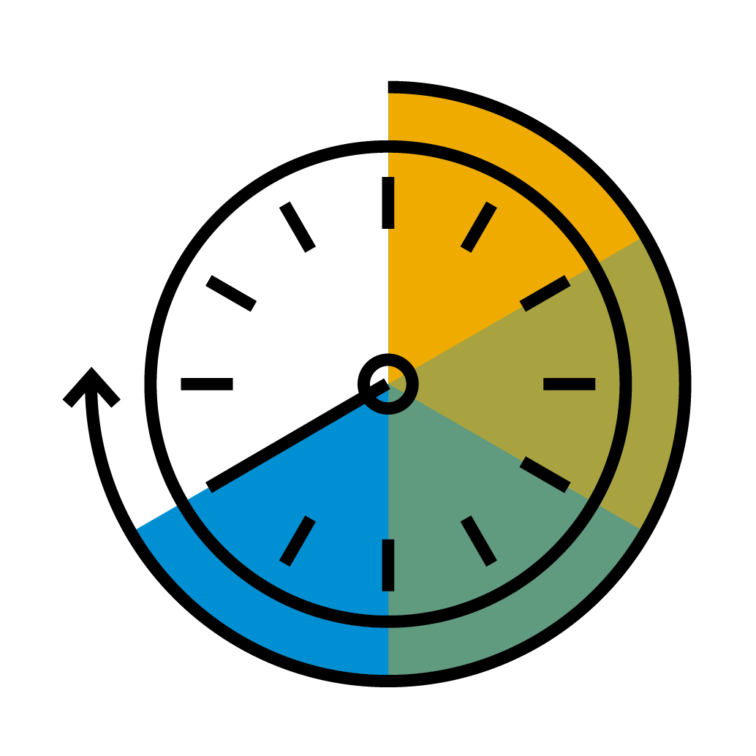
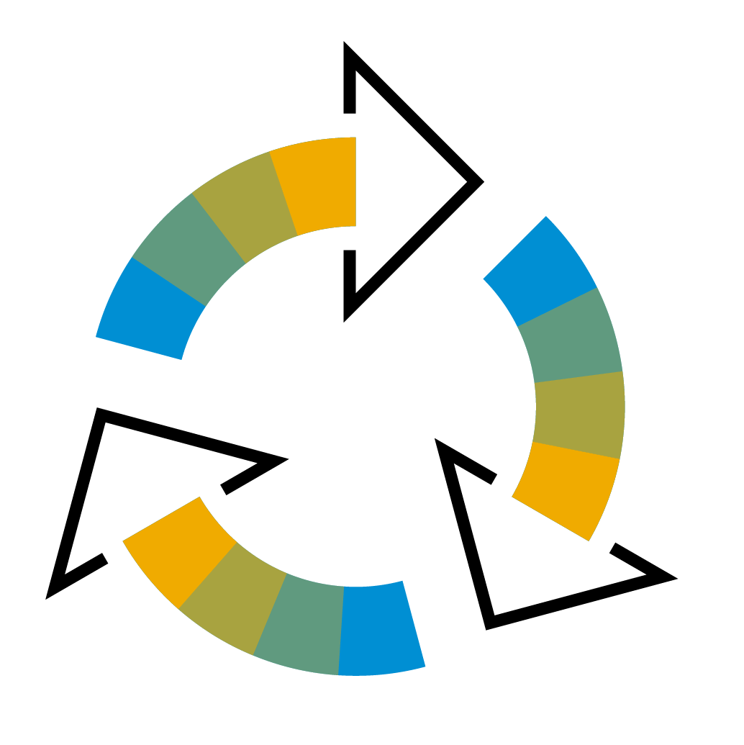

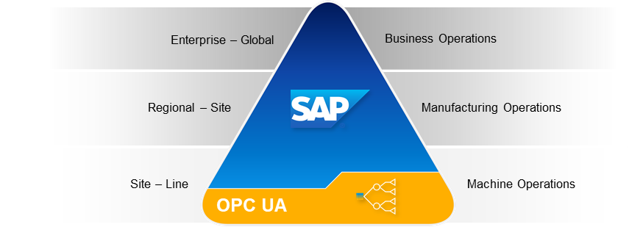

Intelligent is responsiveness
Intelligent Enterprise
Collaboration with factories in real time across plan-to-deliver processes increases resilient supply chain
Better Supply Chain visibility enables improved fill rates, decreased buffer stock, real-time costing and on time delivery
Factory
Factory
Factory
Customer
Transition from push to pull model enables reduced lead times
Standard automated processes drive productivity improvements and product-portfolio rotation
Contract Manufacturer
Factory
Responsiveness and supply continuity enables scaling and time to value
Faster more efficient execution improves throughput, increases quality, and reduces waste
Notes:
The main characteristic of agility in an Intelligent Factory is “closed loop,” data-driven optimization of end-to-end operations. Advanced analytics are first used for decision support, but the ultimate goal is to reach “self-optimizing operations” where the factory network constantly adapts to demand, variations in supply and process deviations.
If we learned anything from changing business conditions – Brexit, trade tariffs, Pandemic – the companies who are successful in navigating thee challenges have the ability to move production to meet demand. Global operations include all 24 plants or 40 plants or in Nestles case 400 plants. How you manage these plants as a global network to deliver on customer expectations will define your success.
Collaboration with factories in real time across plan-to-deliver processes increases resilient supply chain
Better Supply Chain visibility enables improved fill rates, decreased buffer stock, real-time costing and on time delivery
Transition from push to pull model enables reduced lead times
Standard automated processes drive productivity improvements and product-portfolio rotation
Responsiveness and supply continuity enables scaling and time to value
Faster more efficient execution improves throughput, increases quality, and reduces waste

Slide 11
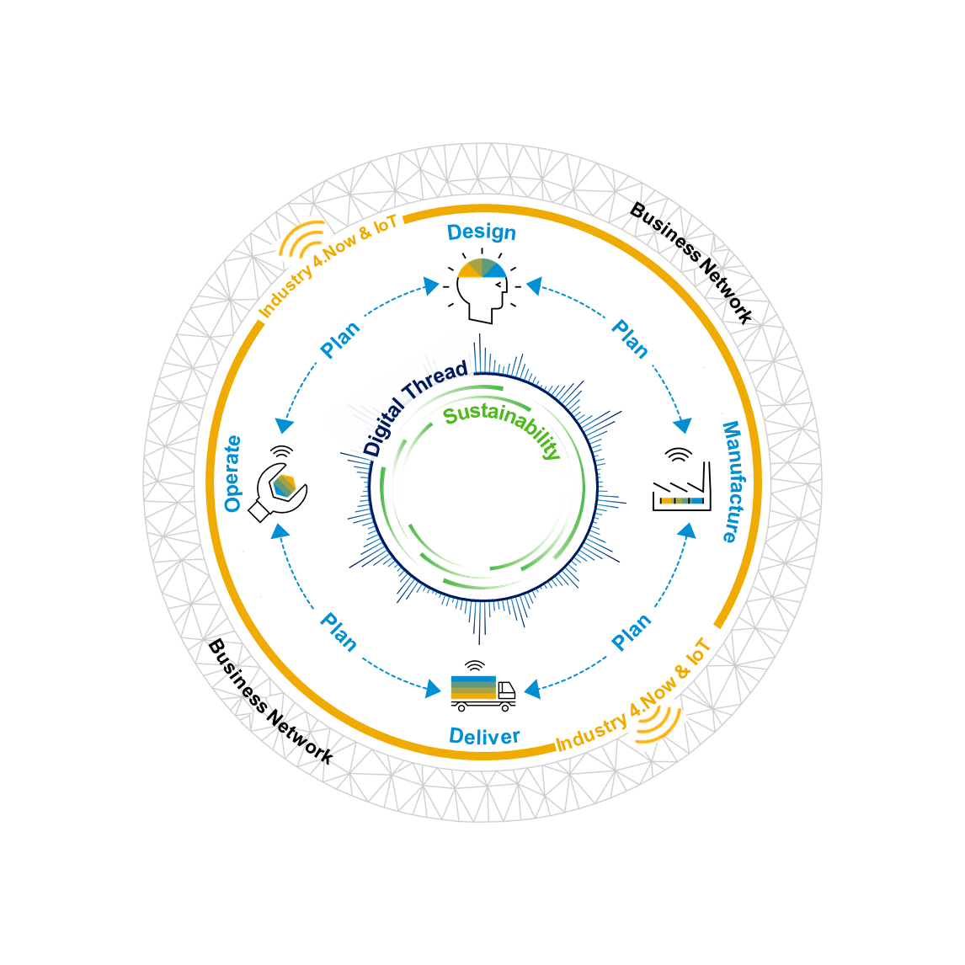
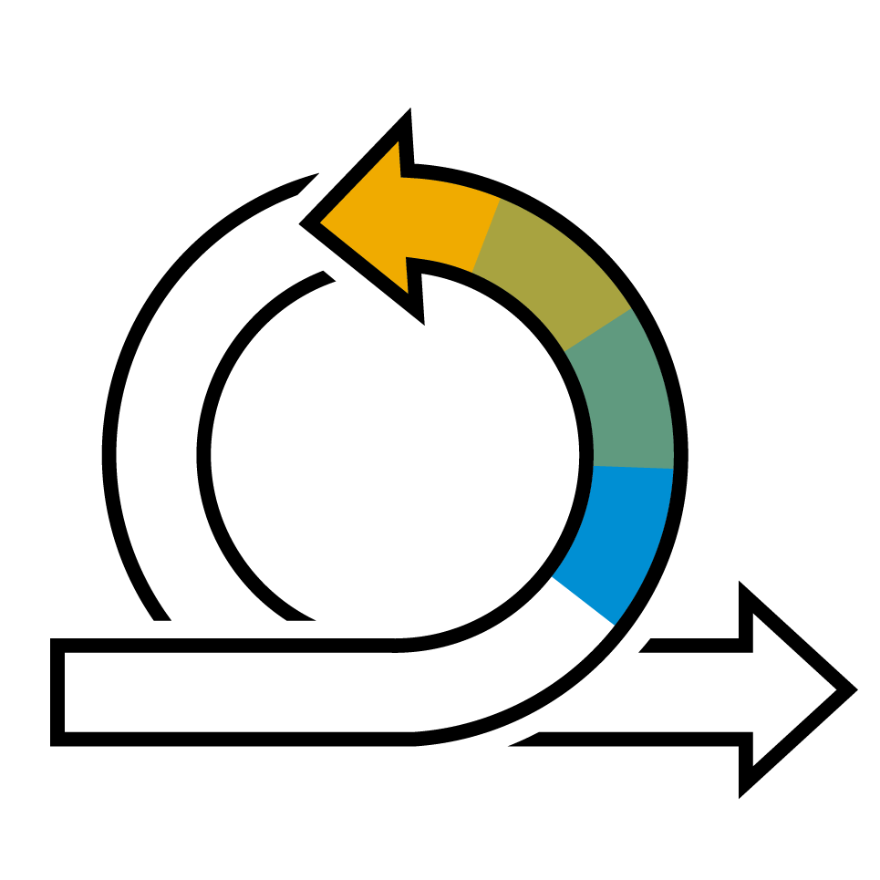

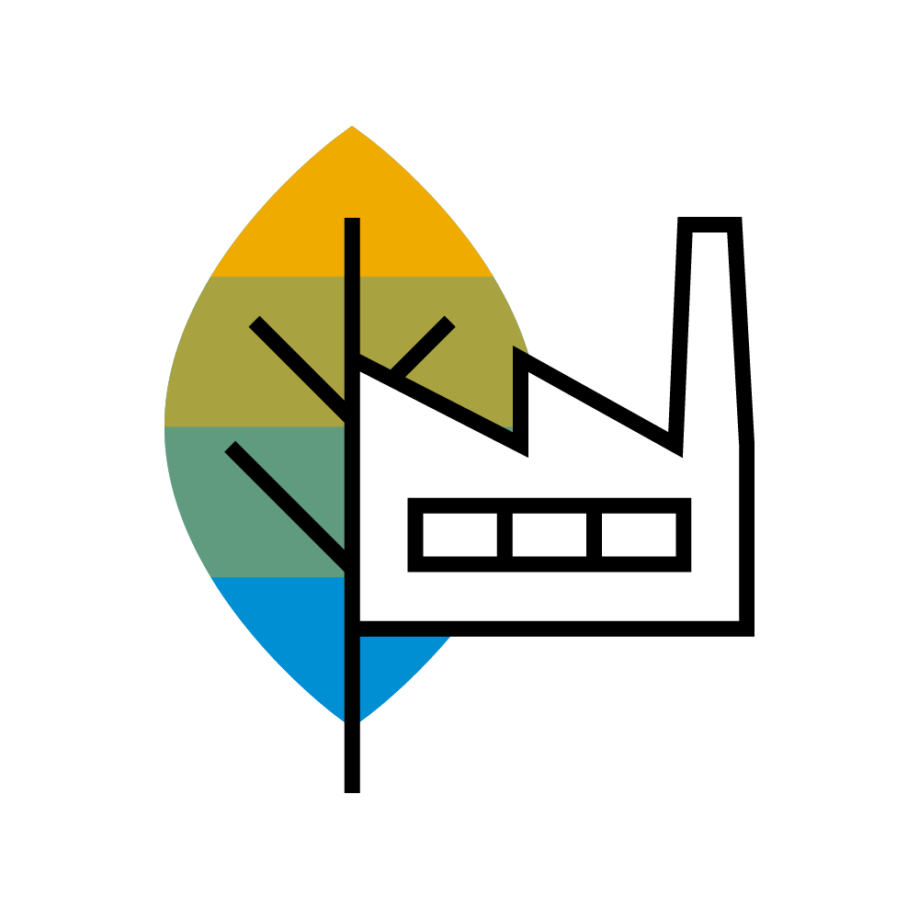
Evolve to a Resilient Supply Chain with Four Winning Strategies in a Holistic Design to Operate Offering | The How
Synchronized Planning
Planning as a continuum across the supply chain
Industry 4.Now
Automate for productivity
Business Networks
Connect for next-level business collaboration
Sustainable Supply Chain
Circular Economy for zero waste
Notes:
Imagine this. 20 years ago companies realized that the best approach to be efficient was to manufacture four products very well, is better than manufacturing 10 products, ok. Connecting devices 20 years ago just wasn’t a thing.
Now the customers are being asked to be more efficient, while at the same time expand the products to reach more customers.
Sustainable connected manufacturing processes
Break down manufacturing silos through single data model and connected and integrated manufacturing processes
Top floor to shop floor visibility
End-to-end
State-of-the-art business processes
Leverage new technologies to identify and enable new business processes with highly flexible UI’s visibility on strategic, tactical and operational level
Foster more efficient execution
Improve throughput, increase quality, and reduce scrap
Advanced analytics and Machine Learning
Leverage business and operational data points to analyze root causes of inefficiencies and predict failures in real time
Agility: Synchronize planning company-wide.
We envision planning as a continuum across the supply and demand network – from design to production, and logistics planning.
Our solutions enable you to get a complete view of your supply chains and evaluate the impact of one stage on another. That’s what’s needed to mitigate risks.
With synchronized planning:
You can support multiple scenarios and the closed-loop process of anticipating, planning, and executing on a continuum across all supply chain stages and time horizons – that’s what it takes to be agile.
Synchronized execution gives you the ability to execute smoothly from order to final delivery.
Productivity: Reinvent production and services.
We help customers reinvent production, intralogistics, quality, maintenance and service processes -- using intelligent and predictive technologies, such as the Industrial Internet of Things, artificial intelligence, Big Data, and by delivering on a strong Cloud-Edge strategy.
As a result, you can enable factory and plant process transformations at enterprise scale with Industry 4.0 best practices that use intelligent assets and processes to increase output and flexibility.
You can create a single digital thread for products and assets – from the design in an engineering department, to production on the shopfloor and finally maintenance and service operations – until an asset is sunset.
Plus, you can:
Orchestrate Digital Manufacturing Operations through end-to-end processes.
Reduce machine downtime that leads to production loss and reduce operating cost by moving from reactive to predictive maintenance and service by using ML of IoT machine data.
Standardize core processes, eliminating non-value add and individualized operations.
That’s what creates a competitive advantage, increases productivity, and – ultimately – improves business performance.
Connectivity: Redefine trading partner collaboration.
We help customers transform their fragmented supply chains into agile, collaborative networks for supply, logistics, asset management, and service.
Ultimately, that gives you visibility and intelligence for your assets, materials, and finished goods.
And you can connect your company beyond its four walls to enable next-level collaboration; process orchestration; and greater visibility with suppliers, contract manufactures, logistics providers, and other business partners across the supply chain network.
And we do it using dynamic workflows and real-time data to increase the pace of business.
Sustainability: Operationalize sustainability.
Sustainable business practices start with responsible design practices.
It’s the reason we have been working hard on creating solutions for ethical sourcing, sustainable manufacturing practices, and safe maintenance and services.
With these solutions, you can reduce environmental impacts and enable circular economy through optimized design, planning, manufacturing, logistics, and outcome-based service.

Slide 12
Thank you.
Contact information:
  James (Rusty) Baldwin
  Global Solution Owner - Manufacturing
  Digital Supply Chain
  rusty.Baldwin@sap.com

Slide 13
3mn conversation
Digitalize supply chains and operations to enable resilient, customer centric, and sustainable enterprises
Agility
with synchronized planning and execution
Productivity
Re-invent production, logistics, and services
Connectivity
Unified, collaborative trading partner relationships
Sustainability
Actively manage environmental and community impact
Notes:
3-minute Talk Track:
Today’s supply chains face unprecedented challenges and scrutiny, especially given that they are often designed and operated to minimize cost. When faced with unanticipated business disruptions and shocks, these supply chains are unable to adapt in a timely and effective manner. Reactive measures, such as excess inventory buffers, expensive expediting, supplier redundancies, unplanned maintenance, use of ad-hoc 3rd parties for servicing, and short-term workforce expansion are undertaken to mitigate adverse effects on customers and consumers. Modern supply chains require a different way of operating to meet the demands of today’s customers.
Customers leverage SAP Digital Supply Chain solutions to digitalize their supply chain and operations processes from end-to-end, including how products are designed, planned, manufactured, delivered, and maintained/serviced. This enables them to handle disruptions better, faster, with less complexity, and at a lower cost, thereby becoming more connected, agile, productive, and sustainable. SAP Digital Supply Chains solutions, which span the Design-to-Operate process (Design, Plan, Manufacture, Deliver, and Operate/Service), uniquely provide these outcomes with best-in-class software solutions that also, and importantly, interoperate across the enterprise.
SAP’s Digital Supply Chain strategy is to deliver best-in-class modular cloud solutions that accelerate time to value, with seamless interoperability to sustain this value over time. The customer benefits from accelerated supply chain digitalization by taking advantage of the latest innovations as they become available. Customers also benefit from SAP’s unique ability to compose differentiated cross-functional processes from these best-in-class solutions to deliver end-to-end value to the customer.
SAP Digital Supply Chain is the solution to become a resilient, sustainable, and customer-centric enterprise.

Slide 14

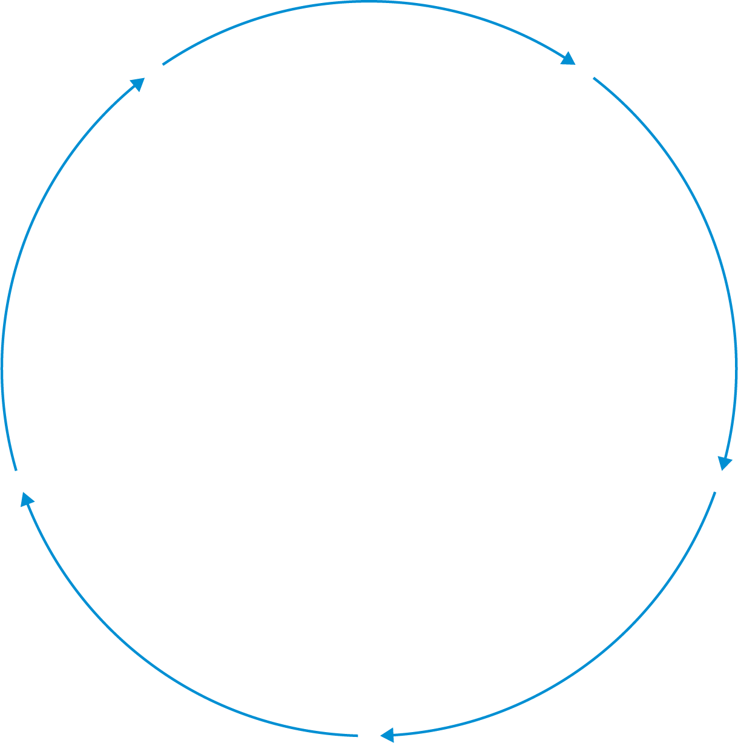

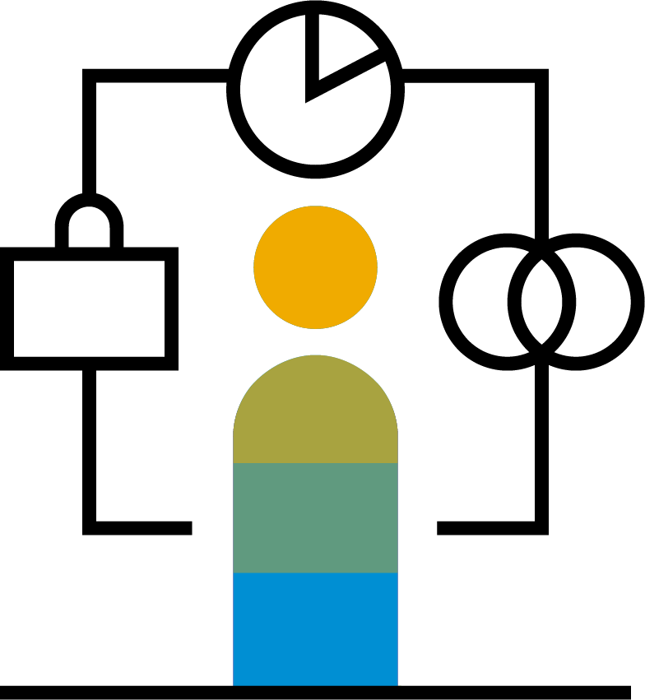
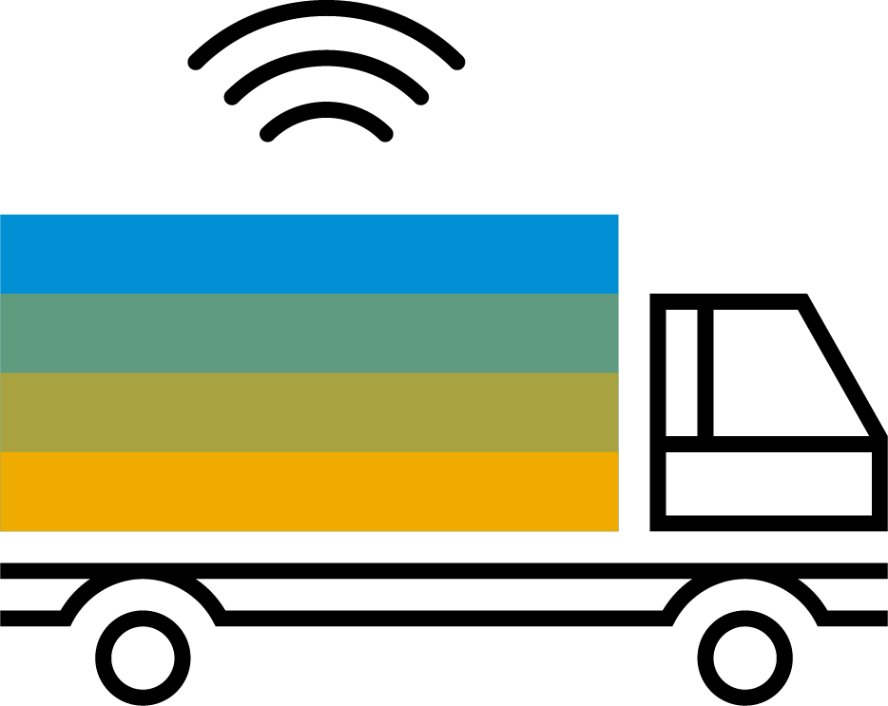

SAP Digital Supply Chain Delivers End-to-End Acceleration
Creating the responsive design-to-operate process and customer-centric supply chain that are the backbone of a resilient business
Agility
Synchronize planning and execution
Design
Productivity
Reinvent production and services
Operate
Plan
Connectivity
Redefine trading partner collaboration
Deliver
Manufacture
Sustainability
Operationalize sustainability
Notes:
So how do we deliver on these needs? We help organizations create the responsive design-to-operate process and customer-centric supply chain that are the backbone of a resilient business.
We look at the entire, continuous design-to-operate process and bring the following four key principles to each and every part:
Synchronize planning company-wide: Integrating customer input, demand signals, finance, sales, service, and logistics across your operation and supply chain to improve your speed and responsiveness.
[CLICK] Reinvent production and services: Using intelligent assets, processes, and Industry 4.0 best practices to increase output, while quickly adapting as demands and priorities shift.
[CLICK] Redefine trading partner collaboration: Connecting every supply, logistics, and asset management provider on a unified business network that uses dynamic workflows and real-time data to increase the pace of business.
[CLICK] Operationalize sustainability: Embedding ethical sourcing and sustainable manufacturing practices and priorities across the design to operate process that help you reach your carbon footprint, equality, and reusability goals faster.
Let’s dive into each of those four a little deeper to get further into the details.

Slide 15
Further Information
Key links
SAP Road Maps | http://www.sap.com/roadmaps
SAP Manufacturing Community | http://www.sap.com/community/topic/manufacturing.html
IT Planning Resources | https://wiki.scn.sap.com/wiki/x/ggvRGg
SAP Innovation Discovery | https://go.support.sap.com/innovationdiscovery/
SAP Help Portal | https://help.sap.com/viewer/p/SAP_DIGITAL_MANUFACTURING_CLOUD
Where to go to provide product feedback and ideas
SAP Idea Place | https://ideas.sap.com
Influence programs | https://www.sap.com/about/customer-involvement/influence-adopt.html
SAP User Groups | http://www.sapusergroups.com/

Slide 16
Glossary
Term | Definition
DMC | SAP Digital Manufacturing Cloud
IT/OT Data | Information Technology (IT) and Operation Technology (OT) data
SFC | Shop Floor Control (SFC): a unique WIP identifier representing a specific instance of the material being built during the manufacturing process. SFCs enable the full traceability of the product.
POD | Production Operator Dashboard
NC | Nonconformance
OEE | Overall Equipment Effectiveness
REO | Resource Orchestration
PCo | SAP Plant Connectivity
PPAP | Production Part Approval Process
For more definitions, please check the SAP Terminology Database SAPterm.

Slide 17
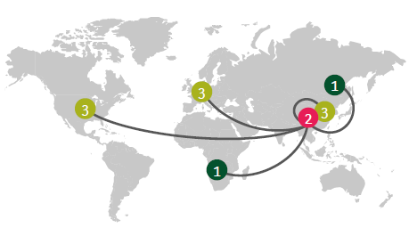
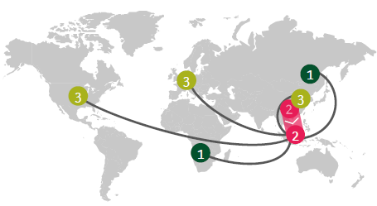
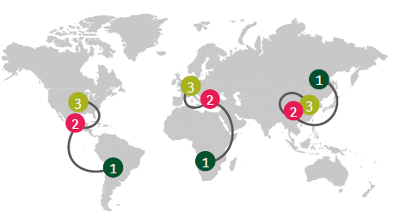
Companies already starting to adapt supply chains; three models emerge
Global supply chains
Migrated supply chains
Regional supply chains
Limited footprint changes due to cost and access constraints; digital enablement for agility
Shift manufacturing to new location to reduce geopolitical risk exposure
Move closer to end-markets, due to government restrictions/incentives
Sourcing
Manufacturing
Distribution
What resilience may look like
Diversified networks
  Back-up suppliers across geographies
  Alternate qualified facilities
Large automated sites (I4.0)
E2E visibility to react quickly
Strong risk management
Large-scale footprint shift
  Rebalance supplier mix, to less exposed geographies
  Moving manufacturing sites
Large automated sites (I4.0)
E2E visibility to react fast
Trained and upskilled workforce
Regional footprint including
  Supplier mix across multiple regions
  Manufacturing sites, incl. backup capacity
Cost-efficient sites (I4.0)
E2E visibility across network
Trained and upskilled workforce

