Slide 1
Capacity Market Model and Agility
Ananth. V Iyer
Director, DCMME
Susan Bulkeley Butler Chair in Operations Management
aiyer@purdue.edu
Funded by the Lilly Endowment through a grant Wabash Heartland Innovation Network (WHIN)

Slide 2
Leveraging Supply Chain Capacity to gain Agility
Individual companies may have pockets of capacity available during a specified period
The capacity comes bundled with labor to deliver performance of specific customer-specified product transformations (e.g., drill a hole of a certain dimensions, finish etc at a specific location in a blank)
Customers want jobs completed during short time windows, and may be willing to pay a premium
But there may not be one company who can do all the steps, so the capacity is in the supply chain
How do we identify possible supply chain configurations to produce products during short time windows at minimum cost ?

Slide 3
We first begin with understanding capabilities
Gather data regarding capabilities of the 280 companies in the WHIN region
Identify the equipment, certifications, tolerances, products made by all companies within the region
Take stock of aggregate capabilities in the 10 counties comprising the WHIN region

Slide 4
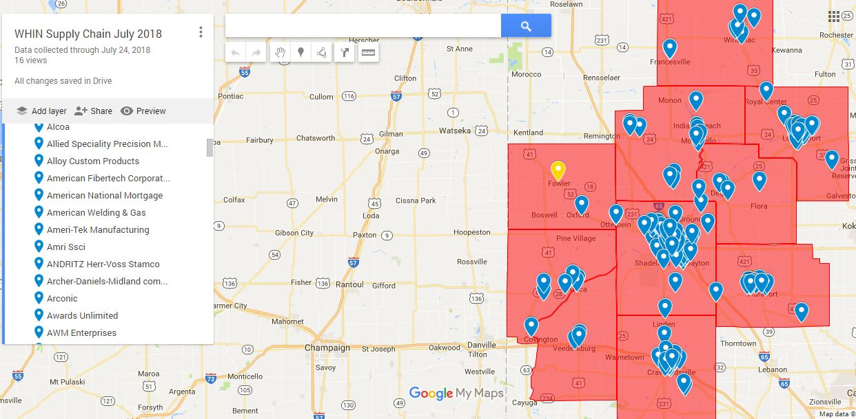
Data Regarding companies can also be accessed via Google maps
Data regarding companies can also be accessed via Google maps
https://www.google.com/maps/d/u/0/edit?hl=en&mid=1wTuZYpUWibidPiNPUe8rycoJN4COUfLd&ll=40.53716688039053%2C-87.73263441406255&z=9

Slide 5
Equipment category by county
Companies/ Equipment | CNC | Press | Weld | Computer | Laser | Hydraulic | Stamp | Cutting | # Companies
Benton | 0 | 0 | 0 | 1 | 0 | 0 | 0 | 0 | 1
Carroll | 0 | 0 | 0 | 0 | 0 | 0 | 0 | 0 | 0
Cass | 6 | 3 | 1 | 1 | 0 | 0 | 0 | 1 | 12
Clinton | 0 | 0 | 1 | 0 | 0 | 0 | 0 | 0 | 1
Fountain | 1 | 0 | 0 | 0 | 0 | 0 | 0 | 0 | 1
Montgomery | 0 | 1 | 1 | 0 | 1 | 0 | 0 | 0 | 3
Pulaski | 0 | 0 | 0 | 0 | 0 | 0 | 0 | 0 | 0
Tippecanoe | 4 | 3 | 4 | 1 | 1 | 0 | 1 | 4 | 18
Warren | 4 | 4 | 3 | 0 | 3 | 2 | 0 | 2 | 18
White | 2 | 2 | 1 | 1 | 1 | 0 | 0 | 0 | 7
Grand Total | 17 | 13 | 11 | 4 | 6 | 2 | 1 | 7 | 61

Slide 6
Capacity Model Outline
Supplier Companies with slack machine capacity offer hours of work at a price
Customer companies have jobs with short deadlines
The model configures a combination of companies, including transport of intermediate product to generate the lowest cost solutions
The benefit – fast response, improved utilization, development of an ecosystem and potential to reduce supply chain leakage

Slide 7
Capacity Market Model
Provide a digital form with information for Supplier input and Customer input
Use the input information to run the mathematical model
Provide candidate assignments to customers and suppliers

Slide 8
Data requirements
Supplier 1 | Lathe | Drilling | Milling | CNC
 | 1 | 2 | 3 | 4
Tolerance | M | H | H | H
Price/hour | 100 | 75 | 50 | 200
Min Hours | 10 | 10 | 10 | 10
Max Hours | 20 | 20 | 20 | 20
Supplier 2 | Lathe | Drilling | Milling | CNC
 | 1 | 2 | 3 | 4
Tolerance | H | M | H | H
Price/hour | 75 | 50 | 100 | 300
Min Hours | 5 | 5 | 5 | 5
Max Hours | 30 | 30 | 30 | 30
Supplier Input
Customer 1 | 100 | units
Process\Stage | 1 | 2 | 3
P1 | 1 | 2 | 3
P2 | 2 | 3
P3 | 4
Customer 2 | 100 | units
Process\Stage | 1 | 2 | 3
P1 | 1 | 3
P2 | 2 | 3
P3 | 4
Customer Input
Process\Stage | 1 | 2 | 3
P1 | 20 | 30 | 10
P2 | 40 | 20
P3 | 40
Process\Stage | 1 | 2 | 3
P1 | 30 | 10
P2 | 20 | 20
P3 | 25
Process\Stage | 1 | 2 | 3
P1 | M | H | M
P2 | M | M
P3 | H
Process\Stage | 1 | 2 | 3
P1 | M | H
P2 | H | H
P3 | H

Slide 9
Customers restrict production using 1 process, and 1 Supplier
Customers restrict production using 1 process, and 1 supplier
Results: Customer 1 – 45 unites produced, 55 not produced
Customer 2 – 72 units produced, 28 not produced
Customer 1 production at Supplier 2, Machines 2 and 3
Customer 2 production at Supplier 2, Machine 4
Cost across customers = $17,200 or $147/unit

Slide 10
Customers permit multiple processes, but require only one supplier to be chosen
Customers permit multiple processes, but require only one supplier to be chosen
Results: Customer 1 has 90 units produced, 10 units not produced
Customer 2 has 100 units produced
Customer 1 production at Supplier 2 Machines 2,3,4
Customer 2 production at Supplier 1 Machines 2,3,4
Total cost across customers 25,608.33 or $134.78/unit

Slide 11
Customer permit multiple suppliers, but restrict to 1 process
Customers permit multiple suppliers, but restrict to 1 process
Results: Customer 1 75 units produced, 25 units not produced
Customer 2 100 units produced, 0 units not produced
Customer 1 production by Suppliers 1 and 2 using Machines 2 and 3
Customer 2 production by Suppliers 1 and 2 using Machines 1 and 3
Customer Cost = 17666.67, Cost/unit = $100.95

Slide 12
Customers permit full flexibility, i.e. multiple suppliers and processes
Customers permit full flexibility i.e., multiple suppliers and processes
Results: Customer 1 100 units produced, Customer 2 100 units produced
Customer 1 production by Supplier 1 (Machines 2,3,4) and Supplier 2 (Machines 2,3)
Customer 2 production by Supplier 1 (Machines 1,3) and Supplier 2 (Machines 1,3)
Total Cost = 21875, Cost/unit = $109.37

Slide 13
Current State and plans
Completed mathematical model and testing
Developed a decentralized input and output system with a server based optimization
The model allows OEMs to use the supply chain capacity to get short time window jobs completed using local capacity
It gives small manufacturers a chance to showcase capacity quality and turnaround to OEMs
It may help decrease Supply Chain Leakage
It helps manufacturers improve their Agility

Slide 14
What’s next
Need your help to test with some sample data
Do you have quick response jobs with low volume but significant margins ?
Are you willing to give a collection of local manufacturers a chance ?
Questions ?

Slide 15
Thank you
Aiyer@purdue.edu

