Slide 1
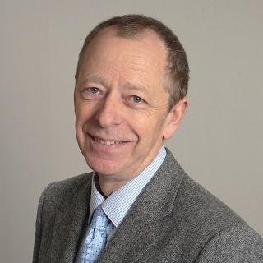
Speaker: Angus McLeod
Angus McLeod
WHIN Education Consultant, VP of Coaching at AMA

Slide 2
AGILE Managing of Change
Dr Angus McLeod
“Most people are afraid of change, but if you look at it like it’s something you can count on, then it can be a comfort.”
[Robert Kincaid (Clint Eastwood), in ‘The Bridges of Madison County’, Warner Bros, 1995].

Slide 3
Things are Moving Faster
The average lifespan of a company listed in the S&P 500 index of leading US companies has decreased… from ‘67 years in the 1920s to just 15 years in 2014’. The prediction for 2020 S&P survival time is just 12 years.
Ref: Professor Richard Foster at Yale University, reported in: ‘Can a company live forever?’ Kim Gittleson, 19 January 2012., BBC News, New York.

Slide 4
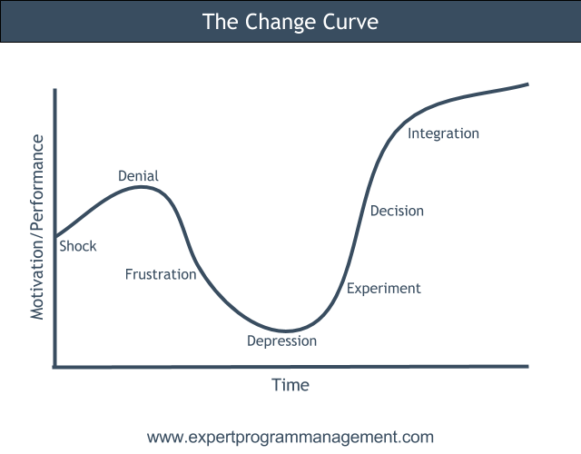
The Psychology of Change

Slide 5
Change: Do it bit-by-bit
Monumental failure is avoided
All stake-holders gain confidence, one step at a time
Success & confidence further encourages technological advance.

Slide 6
Technological Changes 1
Entry-level technological innovation may include:
Drones
3D printing
Paper-to-digital
Virtual Reality (e.g. for training) and
Augmented Reality (e.g. as an efficient aid for assembly workers) & Holo-lens (wide-angle + info).

Slide 7
Technological Changes 2
Intermediate-level technological innovation may include:
ERP
CRP
PLM
Digital-double technology
Robotics/automation
Digital-modelling
Sensors and intelligent data-use for manufacturing efficacy and machine-learning.
ERP = Enterprise Resource Planning.
CRP = Capacity Requirements Planning.
PLM = Product Life-cycle Management.

Slide 8
Technological Changes 3
Advanced-level technological innovation may include:
Big-data
Artificial Intelligence
Integrated IT-OT Convergence
Full IoT
Block-chain.
IT-OT Convergence = Information Technology & Operational Technology Convergence.

Slide 9
Stakeholders & Ownership
‘When leaders ensure that front-line staff members feel a sense of ownership: transformation projects achieve a 70% success, compared with the often-quoted statistic that only 30% of transformation projects succeed.’
Bottom-up knowledge, skills and experience give better solutions & more options for change, than the old top-down approach
Change is smoother & faster with wide-ranging buy-in and ‘ownership’ by stakeholders at all levels
Create a Change-Team of change agents from ALL levels and imply equal status.
Ref: McKinsey: What successful transformations share, March 2010 Survey.

Slide 10
Leveraging Ownership
Healthy communication:
Wide sharing of (relevant) automated data
Improved quality of feedback with real-time coaching
Linking ‘project tasks & reviews’ to actual goals
Shared and individual goal-based system, perhaps using an automated performance management platform, and
Make goals SMART, or better, to leverage all the talent, SMARTIE.
SMARTIE = Specific. Measurable, Attainable, Relevant, Time-based and, Inclusion & Equity.

Slide 11
Support Change: Smart People & Business 1
Leverage ownership with healthy communication:
Technical skills training & certification
Problem-solving skills training
Visual-stream mapping mastery for supervisors and managers
Culture-wide coaching skills for supervisors and managers
1-2-1 professional coaching for the top team
Adopt a healthy feedback methodology as a work-place practice
Acknowledgement & Reward Scheme for beneficial change delivery (safety, quality and financial).

Slide 12
Support Change: Smart People & Business 2
Merit-based promotion
5s, ISO9000 and attaining/maintaining a high safety culture
Underpinning the freedom to comment and feedback, respectfully, on below-ideal practices beyond every worker’s remit & responsibility
Uptick in the quality of the fabric and environment of the work-place, including locker-areas, toilet facilities and canteen areas
Involvement in the community and involvement of worker’s families, especially in activities and at acknowledgement & reward-giving events for staff.

Slide 13
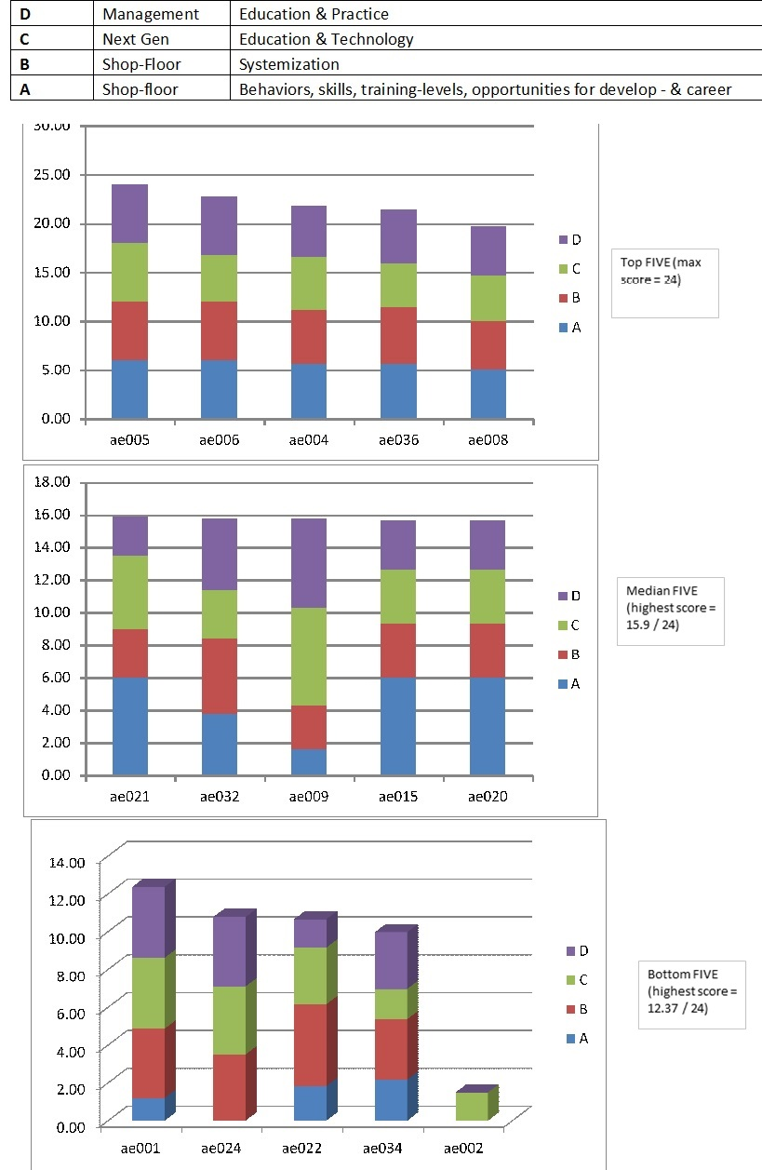
Be Skilled in
Development
Areas 1
Focus on ‘lesser-strengths’ first

Slide 14
Be Skilled in
Development Areas 2
Be Skilled in Development Areas
SMART People
  Shop-floor people skills:
    versatility, accountability, applied knowledge
  Management agility:
    Agile, Disruptive Business Modeling
SMART Business
  Shop-floor systemization:
    safety, 5s, QA
SMART Technology
  From drones to IoT & block-chain.

Slide 15
Communication Strategies:
Key to all Change
Communication Strategies:
Key to all Change
Use questioning-style and listen
Themed and consistent messaging
Team-meetings
Town Halls
Support structures for issues
“What is familiar is no longer scary.”

Slide 16
AGILE Managing of Change 1
Dr Angus McLeod
“Most people are afraid of change, but if you look at it like it’s something you can count on, then it can be a comfort.”
[Robert Kincaid (Clint Eastwood), in ‘The Bridges of Madison County’, Warner Bros, 1995].

Slide 17
Listening & questioning
Listening & questioning
Use Reflective Language – show you heard
Use questions to increase self-managing & to improve focus on continuous improvement
Use questions to create responsibility
  When they suffer, use silence to prolong the pain.

Slide 18
Coaching Skills
Coaching Skills
Assume they are brighter than you think
Ask them what they need from you to perform
Ask questions; do not give direction unless vital
If they do not understand, contextualize, give examples
Make accountable for actions and follow-up.

Slide 19
Feedback & Praise
Feedback & Praise
Habitualize praise, so giving feedback is easy
Set expectations for praising events per shift
Give contextualized developmental feedback.
“When XYZ happened on line B six minutes ago, we lost 7 units, if there was one thing that you could have done better, what is that one thing?”
This format uses our knowledge of neural pathways and McLeod’s ‘Reflective Language’ to produce productive solutions from more people, more of the time.

Slide 20
AGILE Managing of Change 2
Dr Angus McLeod
“Most people are afraid of change, but if you look at it like it’s something you can count on, then it can be a comfort.”
[Robert Kincaid (Clint Eastwood), in ‘The Bridges of Madison County’, Warner Bros, 1995].

