Slide 1
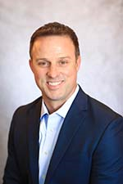
Speaker: Bryce Brumm
Bryce Brumm
President, Standard Industrial Supply & Standard Manufacturing Inc.

Slide 2


Agile Manufacturing

Slide 3
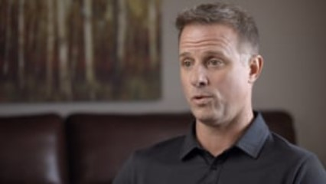
Standard Industrial
Notes:
There are 3 reasons I showed this video
1. To give a “pub” for WHIN I am on the Manufacturing council for WHIN and they rolled this out last week
2. Give you a good overview of what Standard Industrial does and where my heart heart is
3. It fills 2 minutes in a 25 minute presentation
Like double spacing and reducing margins on a paper to get to 10 pages
As Stated in the Video my name is Bryce Brumm and I am blessed to lead our Team at Standard Industrial in Winamac.
Some info about WHO I AM
A follower of Jesus
A husband of 23 years to wonder woman and Purdue grad
A father to a son who attends Liberty University, a freshman daughter here at Purdue, and a 6th Grade daughter phenom
A Purdue Grad
And I work for the employees of Standard Industrial and their families as they are my motivation for doing what I do every day.
What I am not:
A professor
A subject matter expert
Or a motivation speaker (as you will soon realize)
Do you still have comm 114? Thumbs down!
Aren’t I supposed to envision all of you naked in order to calm my nerves?
When Asked to speak about Agile Manufacturing, I gave my standard answer to every question – YES
I then had to google the definition of “Agile Manufacturing”
*** Next Slide***

Slide 4
Definition
Agile manufacturing is a term applied to an organization that has created the processes, tools, and training to enable it to respond quickly to customer needs and market changes while still controlling costs and quality.
Notes:
Process, Tools, Training, Quickly, Controll Cost, Quality
In order for me to understand things, I have to have an analogy – so I go with my sports analogy for you.
Example of Traditional Manufacturing

Slide 5
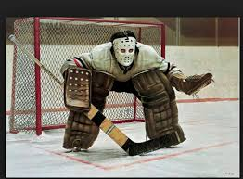
Traditional
Manufacturing 1
Stop the Puck!
Notes:
Example of Traditional Manufacturing
Show a picture of a hockey goalie
Has very specialized Equipment (bulky pads, wider stick, facemask)
Limited range (stays in the crease)
Has a very specific purpose (stop the puck)

Slide 6
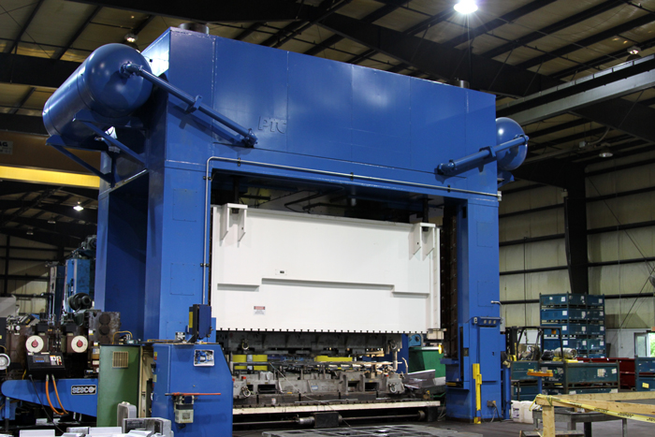
Traditional
Manufacturing 2
Notes:
An Example of Traditional Manufacturing – 1,500 – Ton Stamping Press
Very large footprint
Very specific job
Very limited flexibility

Slide 7
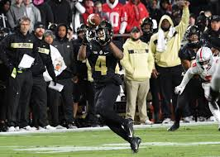
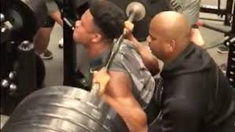
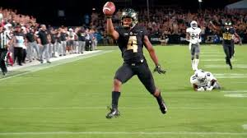
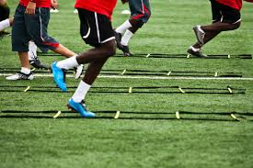
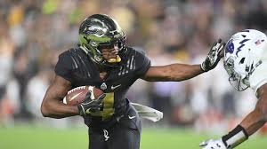
Agile
Manufacturing 1
Training
Multiple Processes
Tools
Notes:
In Contrast to this example of Agile Manufacturing (Show a picture of Rondale Moore)
Trained Up
Strength (174 pounds squatting 600#)
Agility definition – ability to move quickly and easily
Ability to perform Multiple Jobs
Has to know countless plays for multiple positions (Receiving, Running Back, Punt Returner (Multiple Processes)
2018 Paul Hornung Award recipient as the nation’s most versatile player.
Has equipment more suited to perform multiple jobs (catching, running, returning kicks) (Tools)

Slide 8
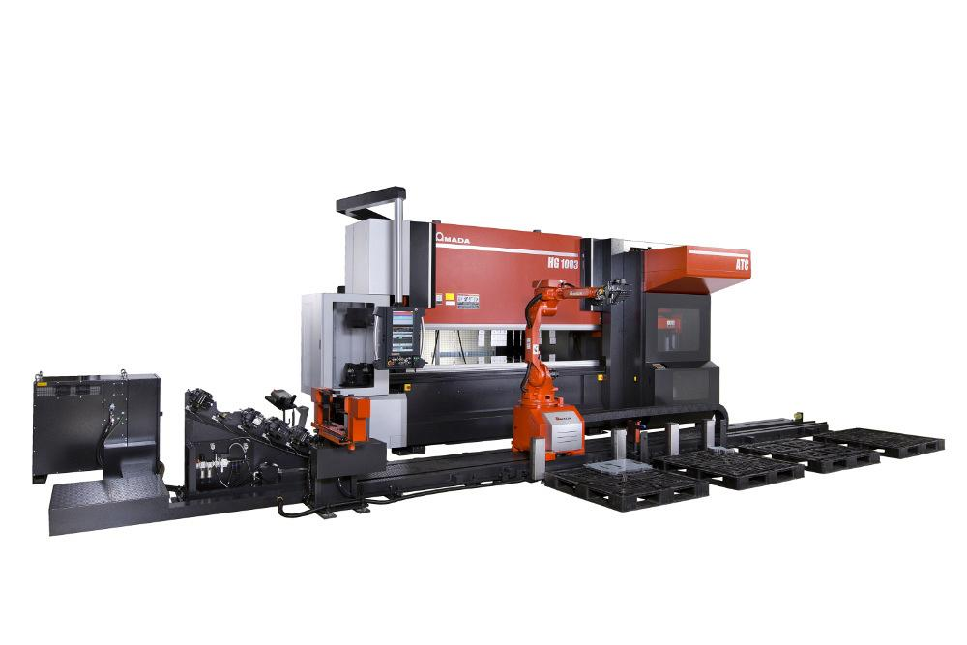
Agile
Manufacturing 2
Notes:
Quick change robotic heads
Automatic Tool changer
Sensing eye for picking up various parts
Comes at a price
Part of the definition of Agile Manufacturing is “contolling cost”

Slide 9
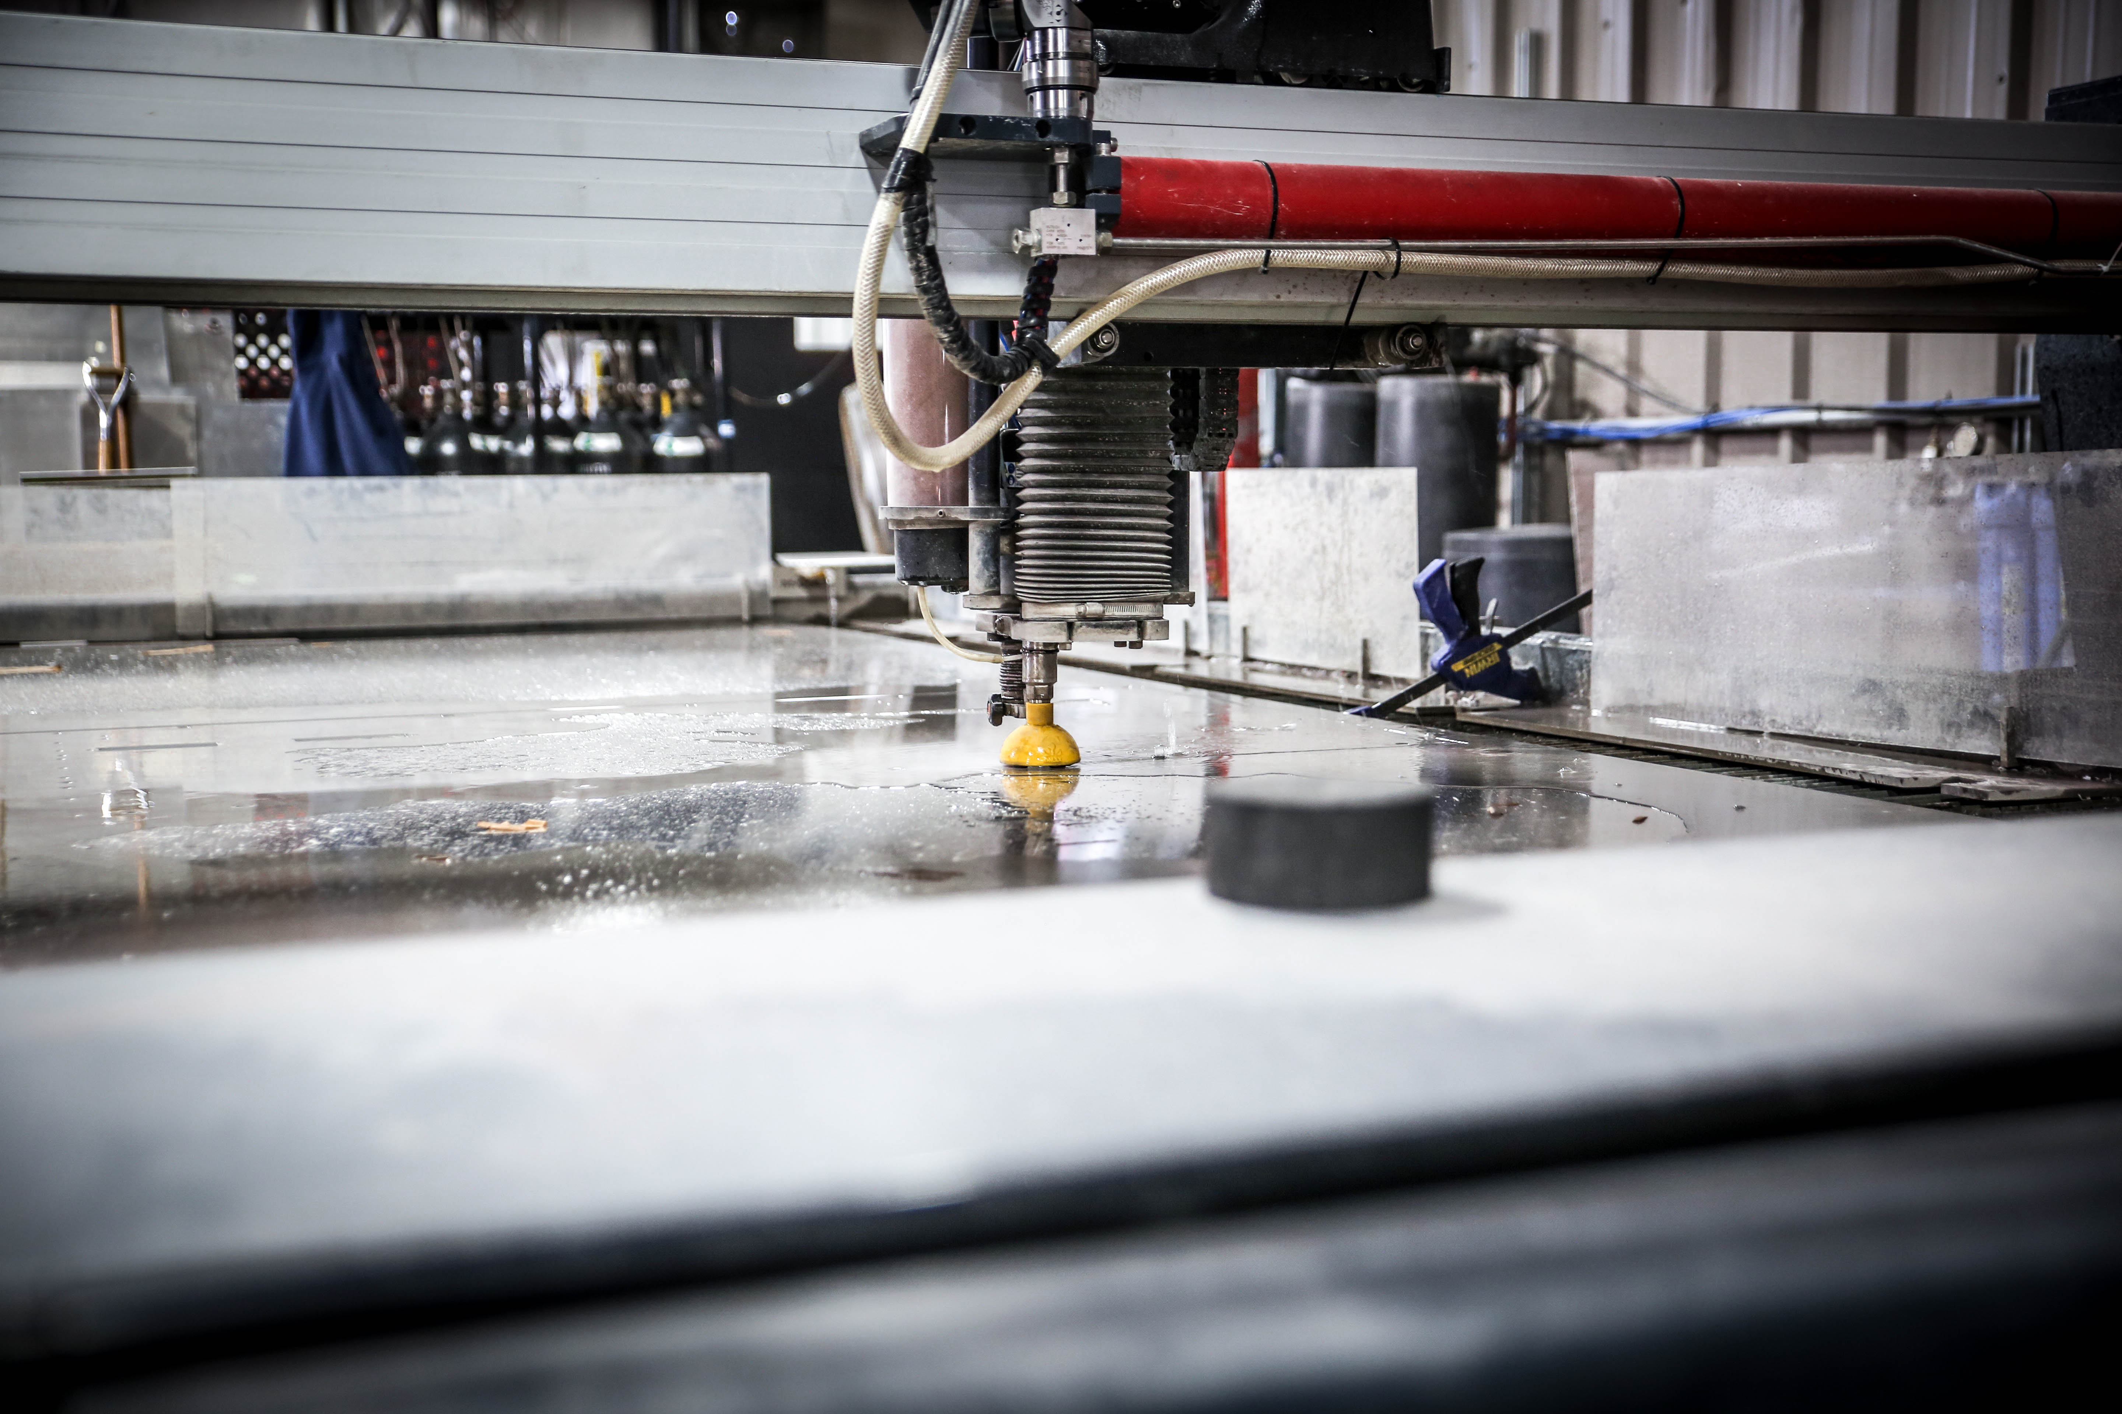
Tools 1
Waterjet
Notes:
Can cut any material (except tempered glass) and steel up to 3” thick

Slide 10
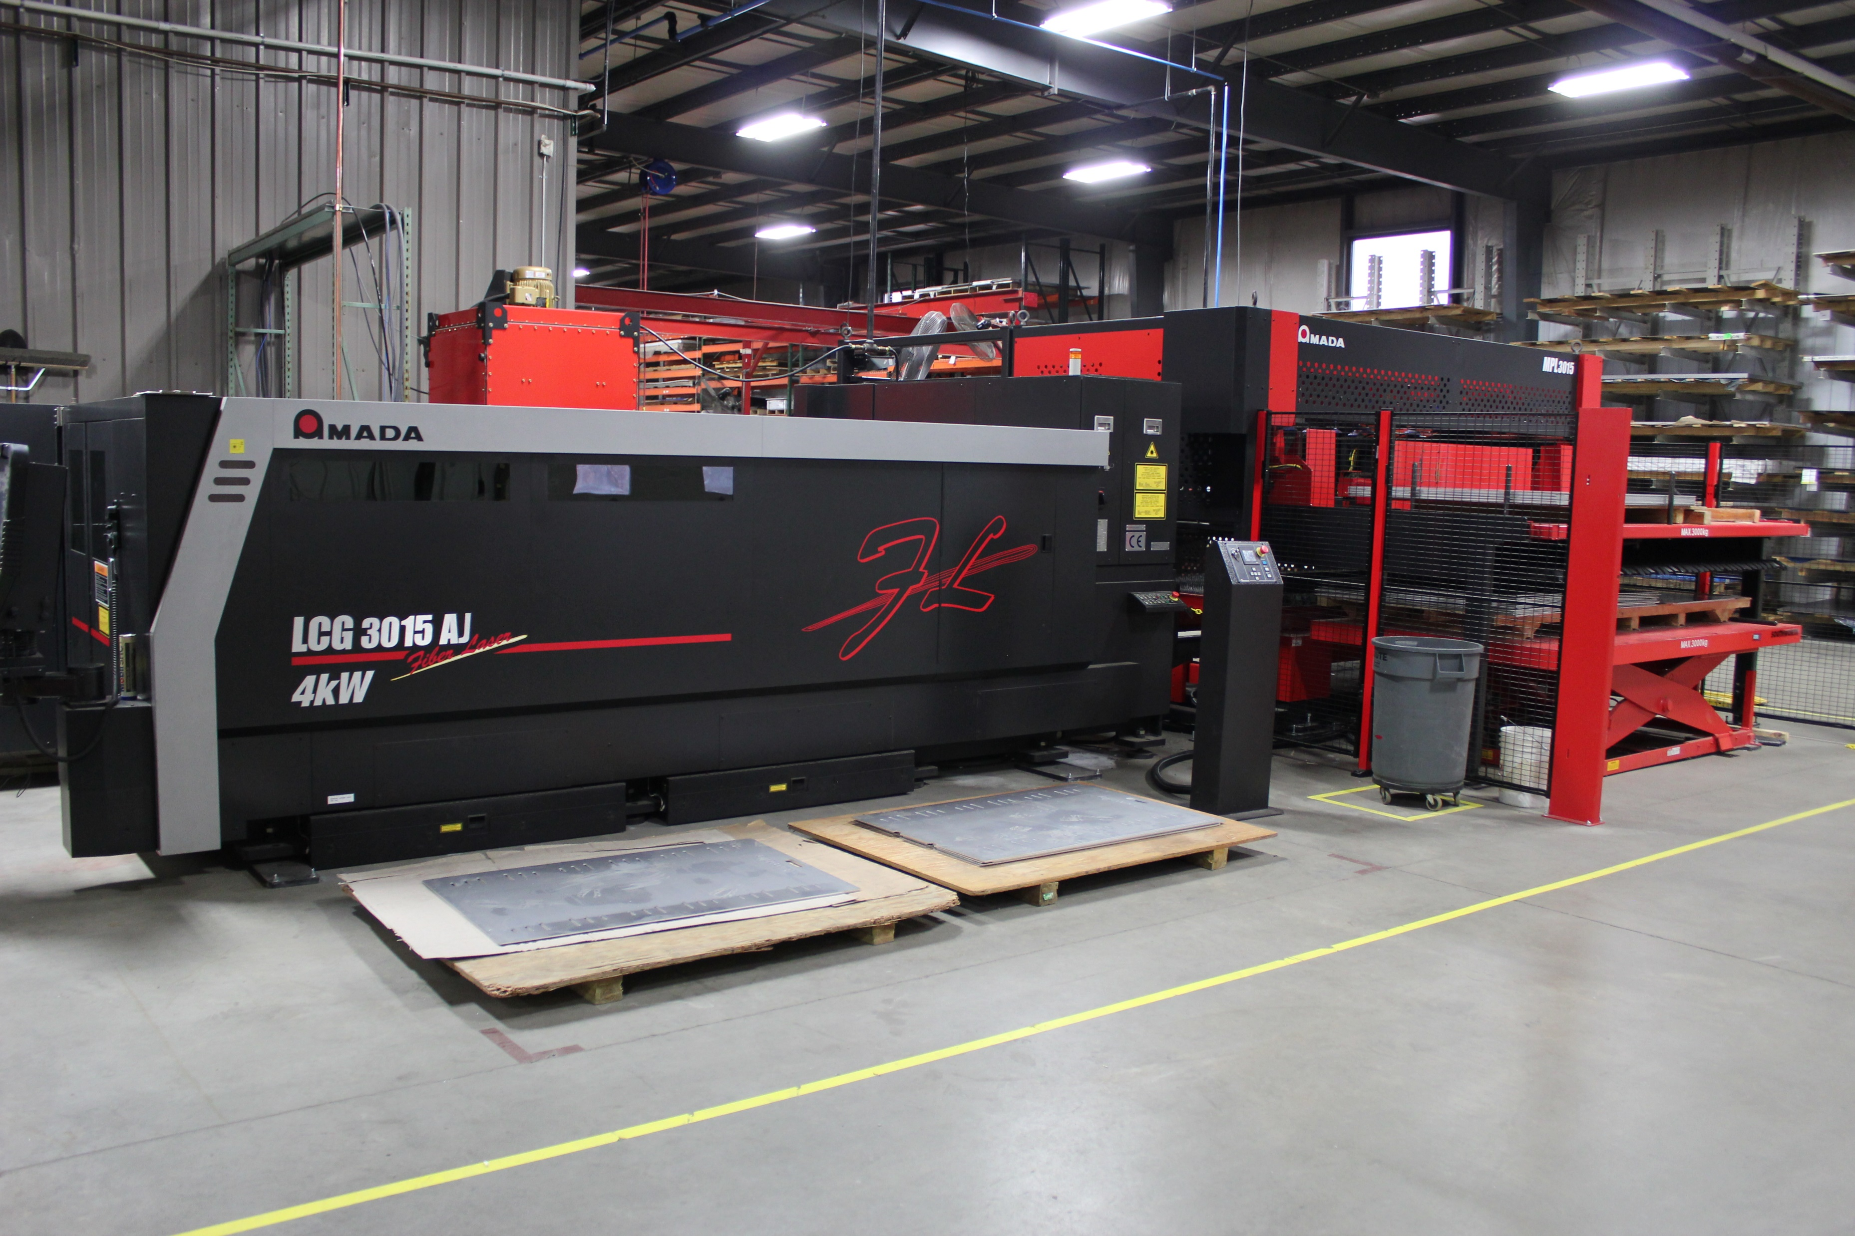
Tools 2
Waterjet
Fiber Lasers
Notes:
2 – 4000 Watt Fiber Lasers with automated sheet load and part unloading

Slide 11
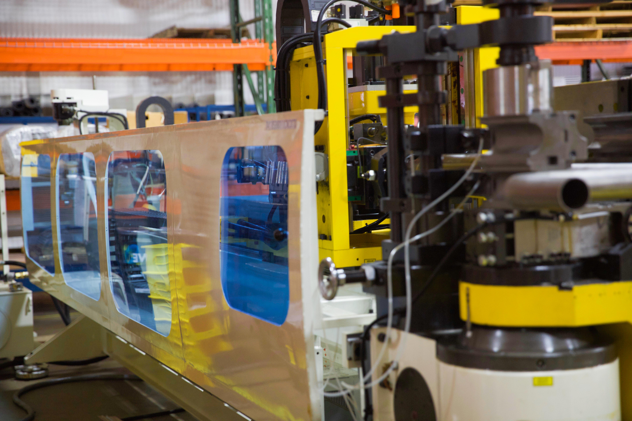
Tools 3
Waterjet
Fiber Lasers
Tube Bending
Notes:
Exhaust pipe and Handrails

Slide 12
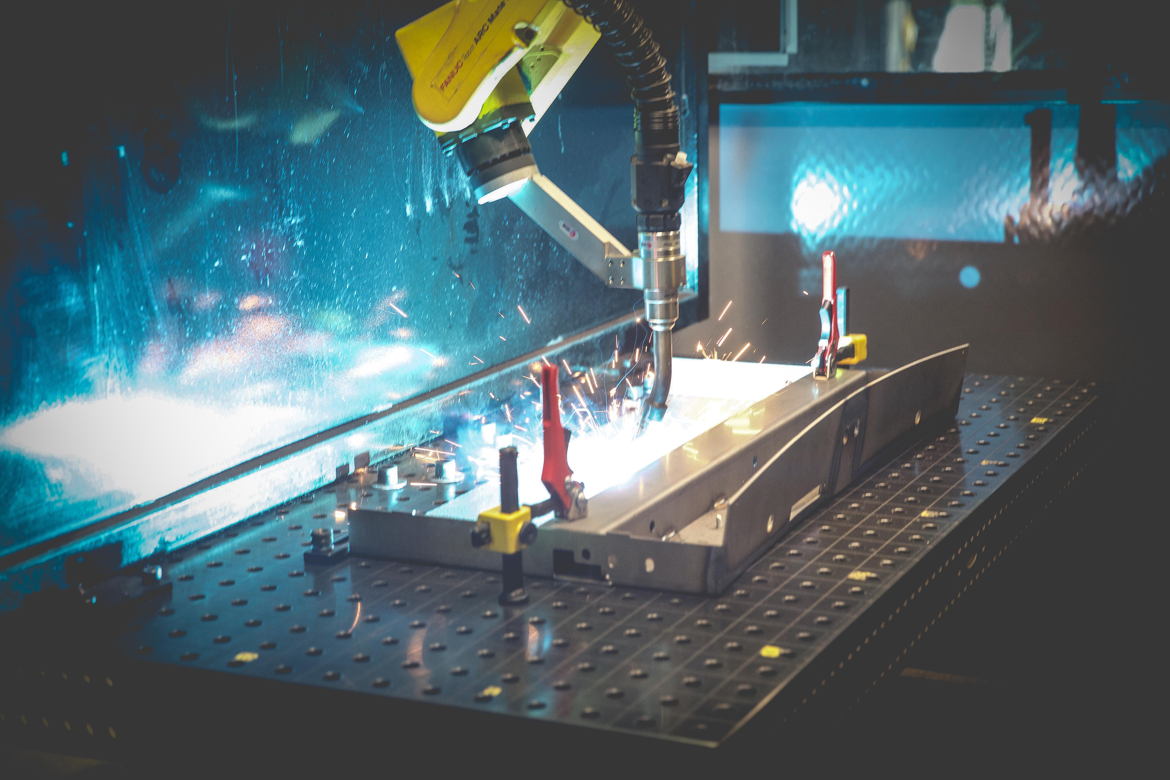
Tools 4
Waterjet
Fiber Lasers
Tube Bending
Robotic Welding
Notes:
Uses a machined table with holes every inch allowing us to insert fixtures and configure them based on the part we are running
We would need 2 fixtures for every part which cost approximately $2000 each
And the space needed to store them
The table rotates allowing 1 operator to load the components and unload the welded parts

Slide 13
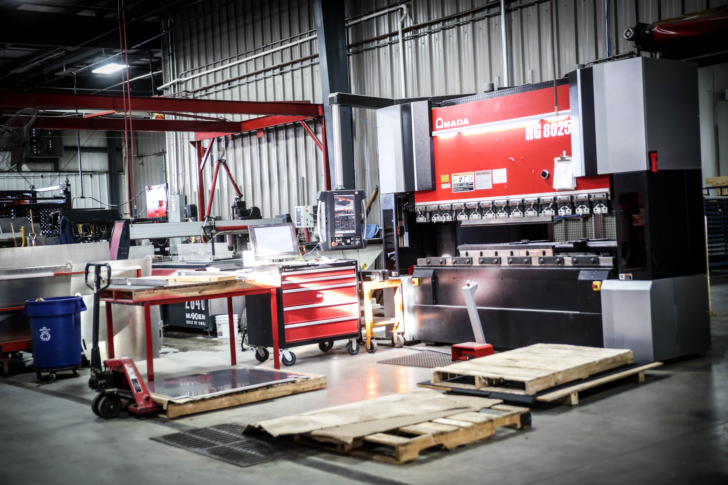
Tools 5
Waterjet
Fiber Lasers
Tube Bending
Robotic Welding
Press Braking
Notes:
120, 80, 50 Ton Brakes

Slide 14
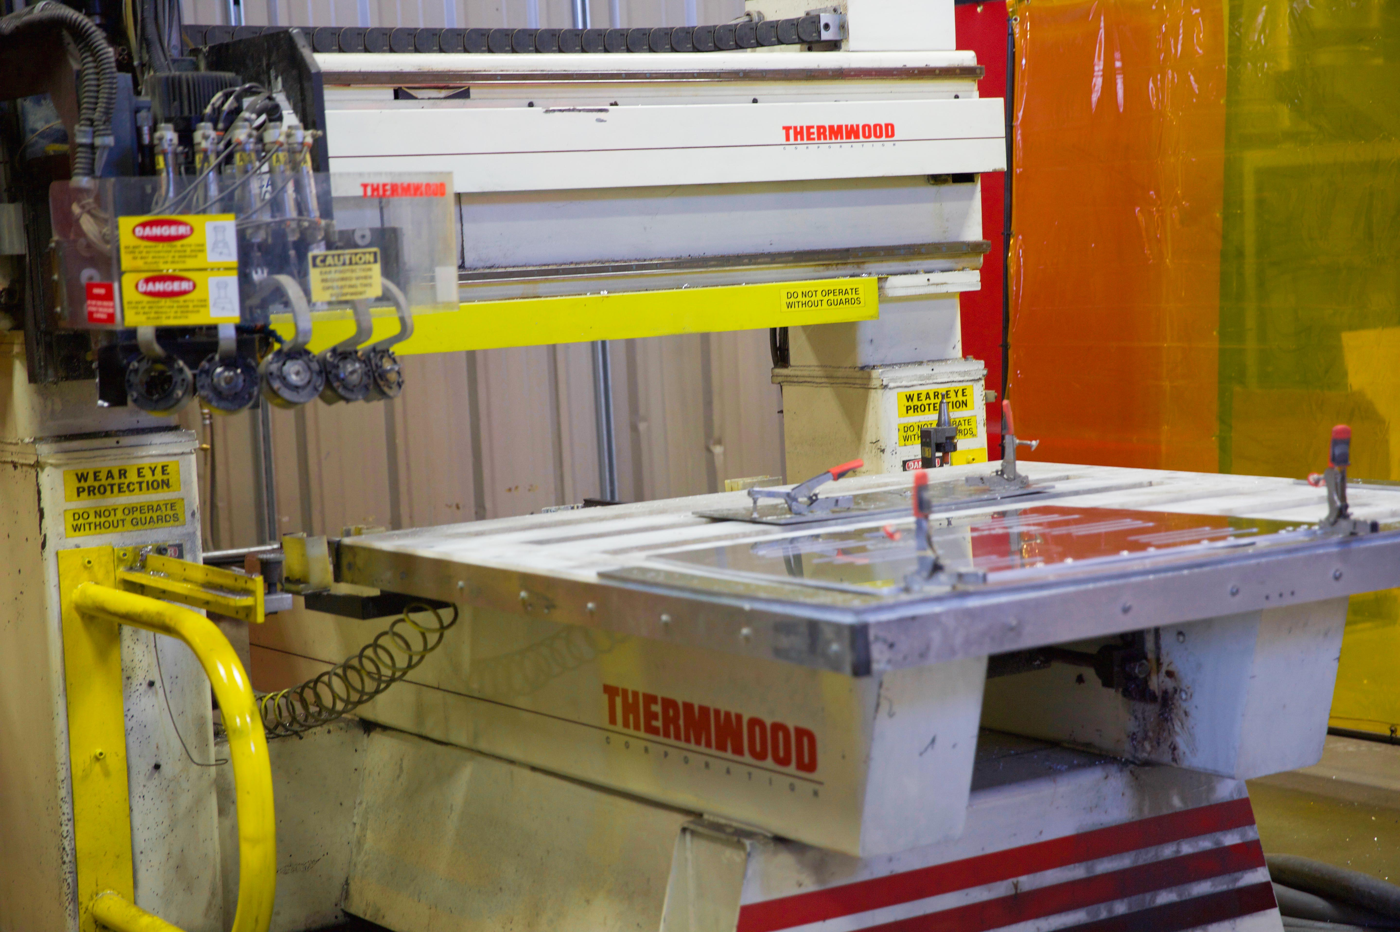
Tools 6
Waterjet
Fiber Lasers
Tube Bending
Robotic Welding
Press Braking
Routing
Notes:
Wood, Plastic, and Aluminum on 3 machines

Slide 15
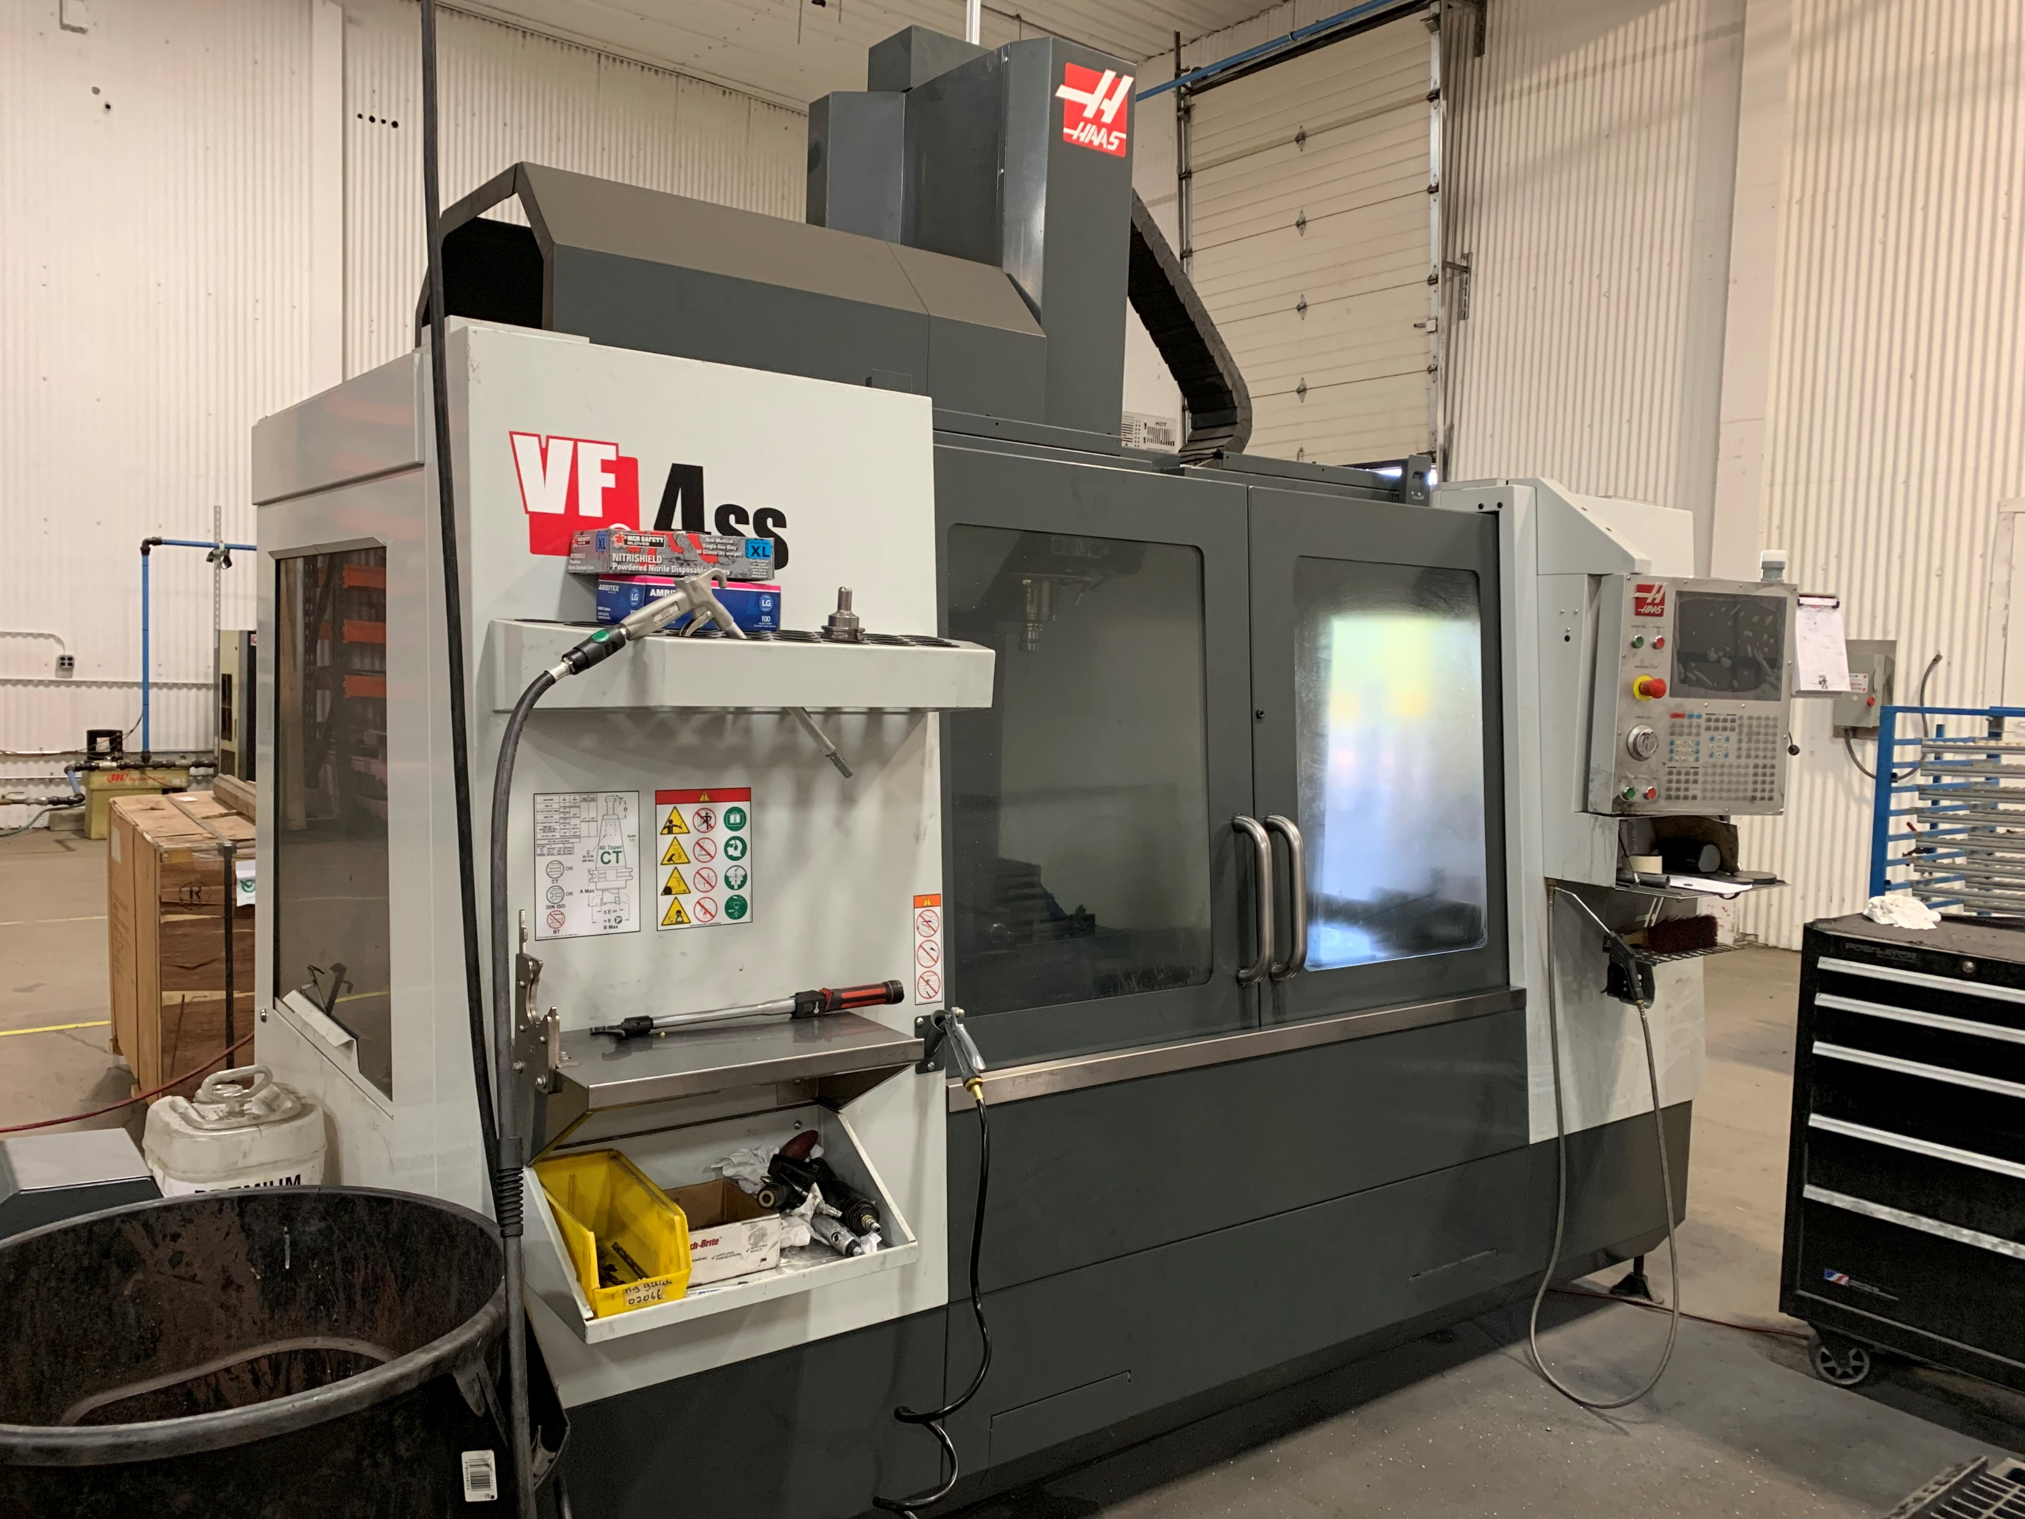
Tools 7
Waterjet
Fiber Lasers
Tube Bending
Robotic Welding
Press Braking
Routing
Milling
Notes:
Wood, Plastic, and Aluminum on 3 machines

Slide 16
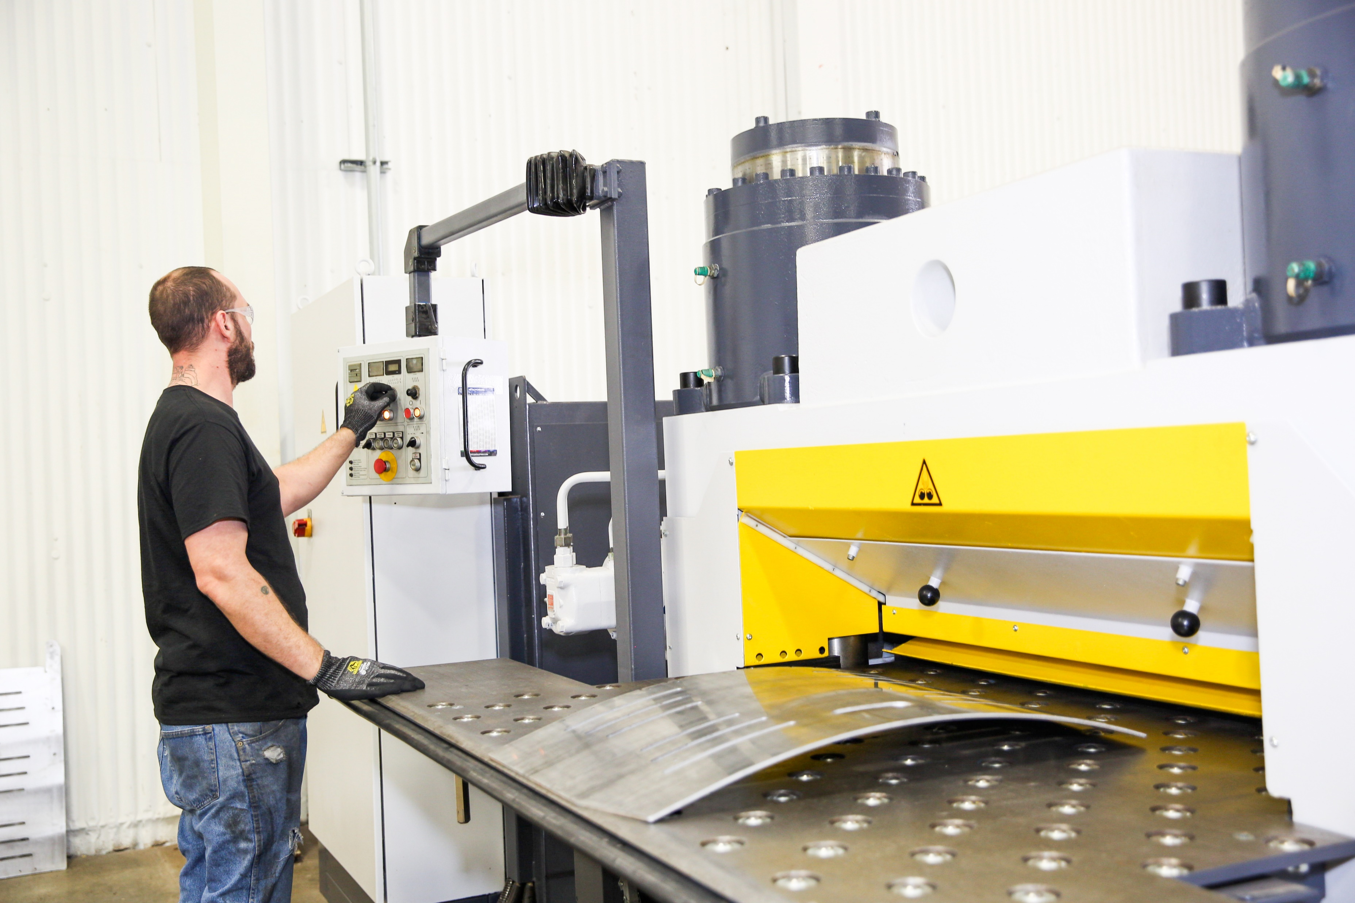
Tools 8
Waterjet
Fiber Lasers
Tube Bending
Robotic Welding
Press Braking
Routing
Milling
Leveling
Notes:
Can level up to ¾” thick steel 48” wide by 120” long
Probably the most difficult piece of equipment to buy as we bought it out of a need for 1 customer
Will grow into contract leveling

Slide 17
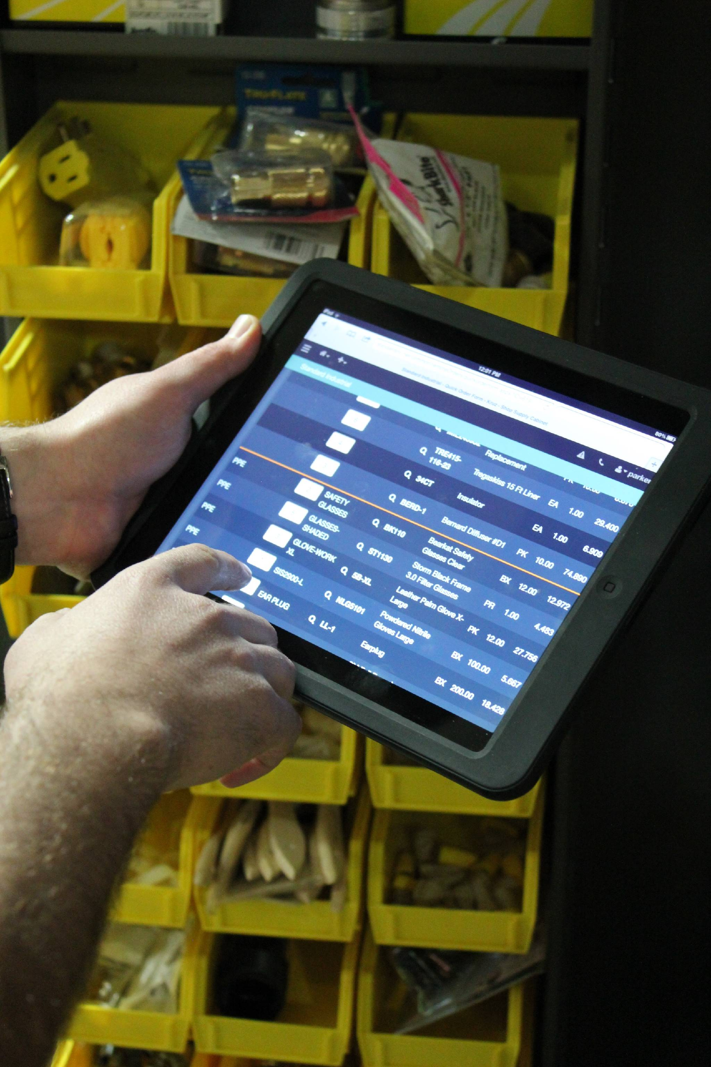
Tools 9
Waterjet
Fiber Lasers
Tube Bending
Robotic Welding
Press Braking
Routing
Milling
Leveling
ERP System
Notes:
Is the Glue that binds everything together
Give detailed info about the Job (costing and time), employee productivity, real time KPI’s

Slide 18
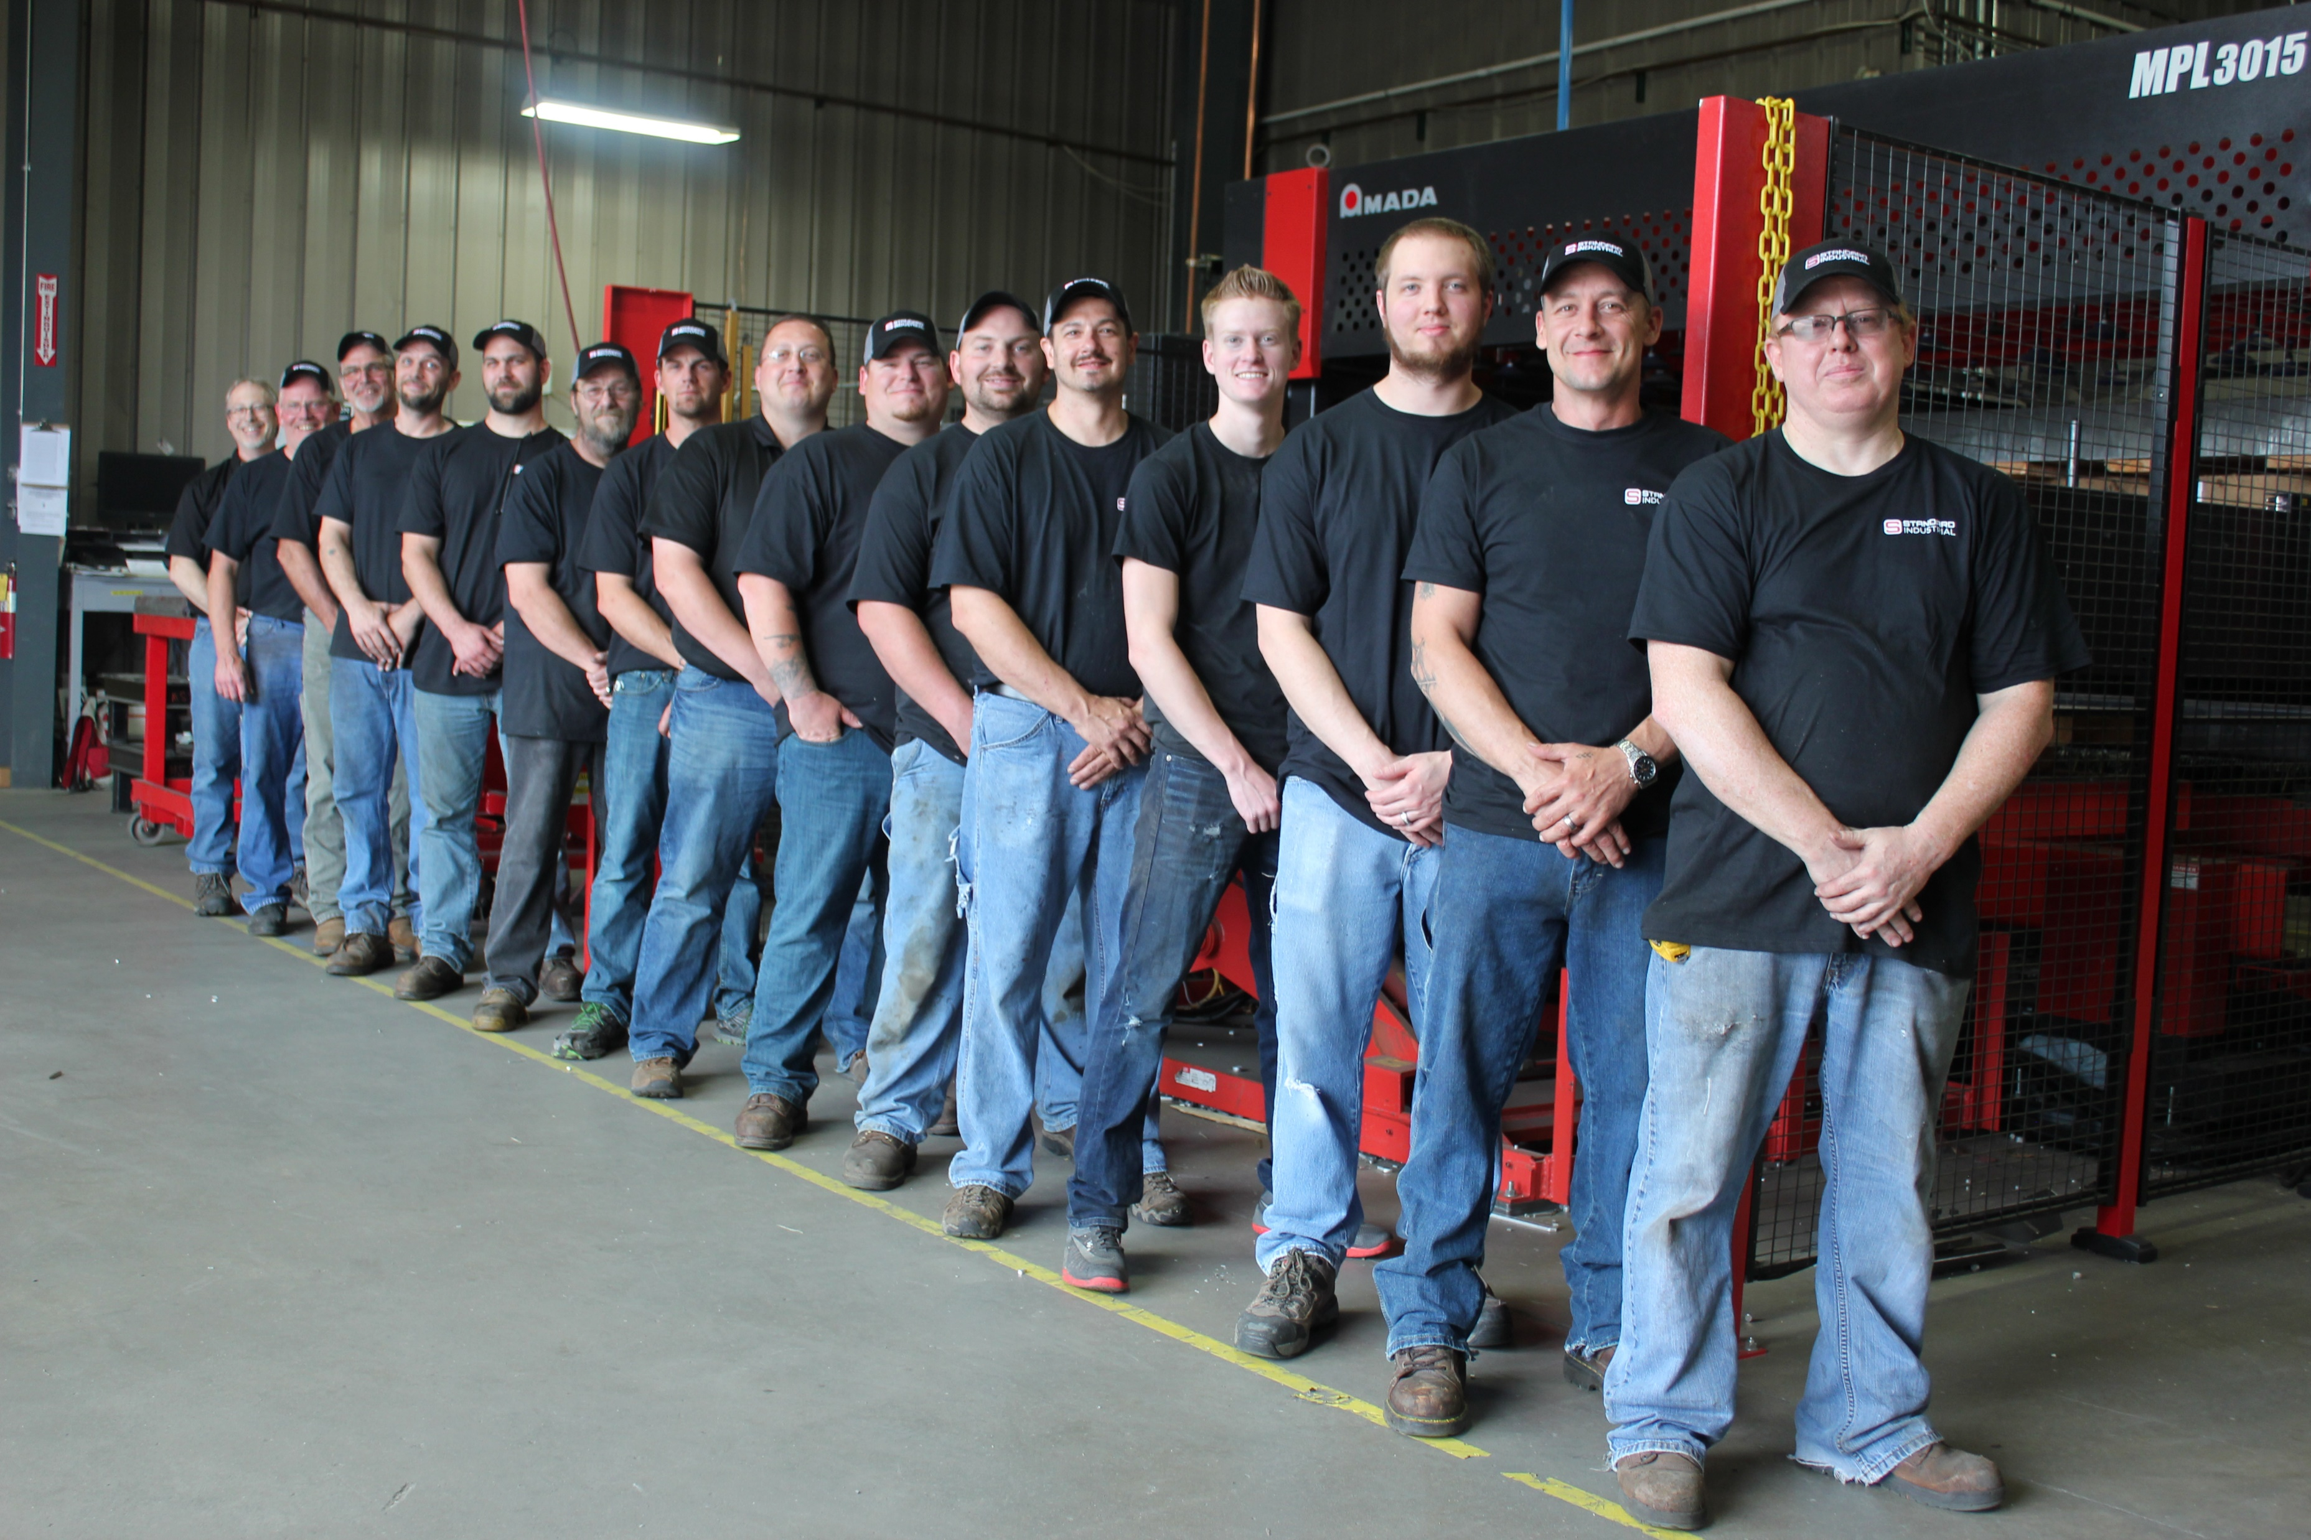
Tools 10
Waterjet
Fiber Lasers
Tube Bending
Robotic Welding
Press Braking
Routing
Milling
Leveling
ERP System
PEOPLE
Notes:
Without them, you have an expensive work-shop

Slide 19
Processes
Lean Manufacturing
  5S
    Sort
    Set
    Shine
    Standardize
    Sustain
ISO 9001
Notes:
Sort – Eliminating whatever is not needed by separating needed tools, parts, and instructions from unneeded materials
Set – Organize whatever remains by neatly arranging and identifying parts and tools for ease of use
Shine – Clean the work area by conducting a cleanup campaign
Standardize – Schedule regular cleaning and maintenance by conducting sort, set, and shine daily
Sustain – Make 5S a way of life by forming the habit of always following the first four S’s
Benefits:
Improved Safety
Higher Equipent Availability
Lower Defect Rates
Reduced Costs
Increased production agility and flexibility
Improved employee morale
Better Asset utilization
Enhanced enterprise image to customers, employees, and management

Slide 20
Training
Computer
  CNC Programming
  ERP
Cross Training on Equipment
Executive
  Scaling Up
  Monthly Executive Group
Notes:
It took our executive team pushing all in on the time and resources it took to make this happen
Scaling Up material with a Consultant for a years
Monthly Meeting with an executive group
Best Practice and accountability
There has to be company wide buy-in for it to be sustainable

Slide 21
Company
Culture
Purpose
  To provide products and solutions to help businesses achieve greater profitability while staying true to our Core Values.
Core Values
  COMMITMENT – we are committed to faith, family, and each other
  SERVICE – we help our customers, communities, and families
  PERSERVERANCE – we are unwavering in a steadfast effort
  INITIATIVE – we celebrate individual and team achievements
  ENCOURAGEMENT – we inspire hope, support, and confidence
Strategy
  Be our customer’s most valued business partner.
Brand Promise
  Right Product, Right Price, Right Time
Notes:
Has to be in your DNA as an organization and a person or it will never work
Embrac
You will have an expensive hobby shop

Slide 22
How to Start
Why
  Purpose
Work
  Smart
FIO
  Figure it out
Stay
  Ever Grateful, Ever True
Notes:
Why
Know you Why
What is your purpose
Ours is to serve our employees, customers, and our community
Work
“Smarter” not “Harder”
FIO
“Figure It Out”
Used it on my kids the past few years and now they are putting it right back on me
There are unlimited resources available to learn from
Someone is always posting on youtube
Audio books
Seminars
Stay
You have had some success up to this point so don’t change what’s got you here or who you are when success comes your way.
Stay Hungry, Stay Humble
Ever Grateful, Ever True

Slide 23

Boiler Up!
Notes:
Insert a P

