Slide 1
Krannert Online MBA Program
Dilip Chhajed

Slide 2
Krannert Online MBA Program
Focus on Technology and Innovation
Program Experience
High ROI
High Engagement
Experiential Learning
Superior Service
Krannert Online MBA

Slide 3
Krannert Online MBA Program Plan of Study
Start
(Jan, May, Aug)
Foundation 8 cr
Graduate
22 cr
Fall Core
Spring Core
Summer Core
Capstone
2 cr
Specialization
10 cr
Electives, 6 cr

Slide 4
Specializations
Business Analytics
Leadership, Negotiation, and Change Management
Innovation and Technology Commercialization

Slide 5
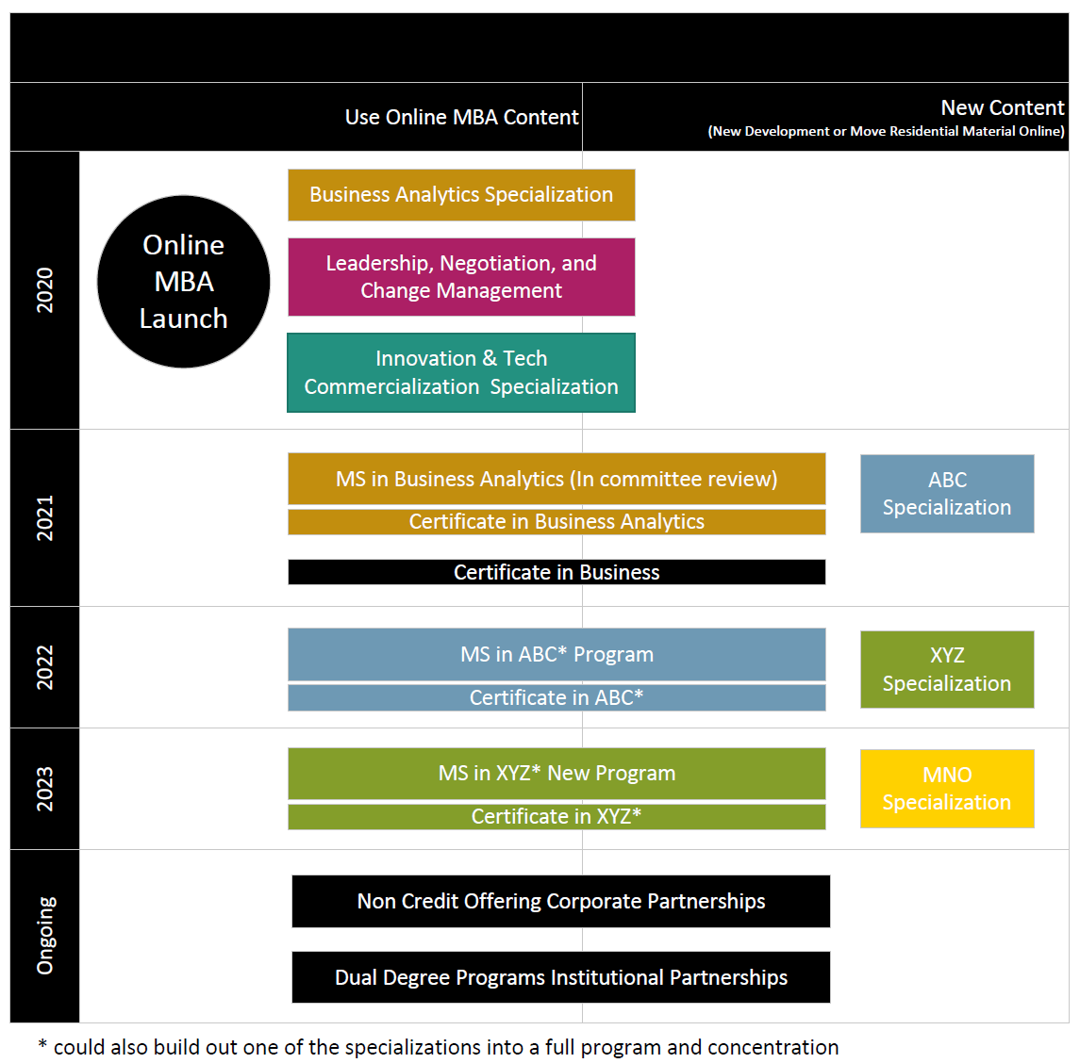
Krannert Online MBA Program Content

