Slide 1
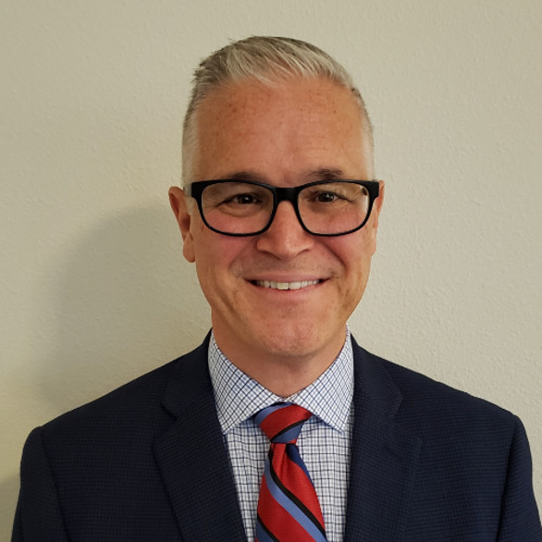
Speaker: Mike Ryba
Mike Ryba
Senior Manager, RPA Practice Lead, Centric Consulting

Slide 2



Manufacturing a Case for
Robotic Process Automation
Mike Ryba
Presented to DCMME – Purdue University
September 27, 2019
NOTICE: PROPRIETARY AND CONFIDENTIAL
This material is proprietary to and contains trade secrets and information which is solely the property of Centric Consulting, LLC. It is solely for the Client’s internal use and shall not be used, reproduced, copied, disclosed, transmitted, in whole or in part, without the express consent of Centric Consulting, LLC. © 2019 Centric Consulting, LLC. All rights reserved.

Slide 3

Agenda
Introduction and Centric Consulting Overview
Robotic Process Automation (RPA)
Demo
RPA Vendors
Use Cases
Cost / Benefits
Question and Answer Session

Slide 4
Introduction and Centric Consulting Overview

Slide 5




We bring firm-wide support to local delivery
We bring firm-wide support to local delivery
We think of ourselves as a big company with a small company feel—a local player with global reach that combines business, technology and industry expertise.
12 U.S.
20 Years
62
U.S.
in Business
Locations
Fortune 500 Clients
1 Offshore
900+
5,000+
INDIA
Location
Consultants
Projects

Slide 6



We often get noticed for our growth and culture.
TOP-RATED CEO
Dave Rosevelt named among
Highest Rated CEOs
on Glassdoor
We often get noticed for our growth and culture.
BEST CONSULTING FIRM
Ranked in Forbes among
Best Management
Consulting Firms 4 times
BEST PLACE TO WORK
Ranked among
Best Places to Work
29 times by multiple outlets
FASTEST GROWING
Recognized as an
Inc. 5000 Fastest Growing Company 8 times
6

Slide 7
Robotic
Process Automation
(RPA)

Slide 8

Robotic Process Automation
Tom
What is Robotic Process Automation (RPA)?
RPA technologies help fill the gap for system integration challenges.
Eliminate Repetitive Tasks
Login to and Integrate with Internal and Third-Party Systems
Data Entry with Increased Quality
Enhance Development Cycle Time
Speed to Market
Leverage Existing System Assets
Improve Internal and External Customer Experience
Behaving as a participant in a process, Robotic Process Automation (RPA) software can replicate human behavior to perform routine, repeatable, rules-based system interactions and integrations.

Slide 9
Robotic Process Automation continued…
Tom
Whether you are looking to augment the user experience with a helping hand or knock out back office tasks, there’s an automation option available.
78 percent of shared services organizations are implementing or planning to deploy RPA.
ATTENDED BOTS:
Runs on Users Machines as a Task Helper
Augments User Experience by Aiding in Repetitive Tasks
Accelerates Time on Task
UNATTENDED BOTS:
Back Office Task Automation
Centrally Controlled
and Maintained
Tasks Queued or Scheduled for Robot Execution
Reduce Process bottlenecks
— Everest Group

Slide 10


Robotic Process Automation continued… 1
Tom
Understanding those processes that are viable opportunities for automaton are key to a successful and sustainable automation initiative.
Three R’s of Automation Assessment:
Routine
Repeatable
Rules-based
“Rule of Five”
No more than 5 decision points
No more than 5 integrations
No more than 50 clicks

Slide 11
Robotic Process Automation…continued 2
Automation Continuum
LIMITED
AUTOMATION
ROBOTIC PROCESS
AUTOMATION
AUTONOMICS
COGNITIVE
COMPUTING
ARTIFICIAL
INTELLIGENCE
Humans
with tools
Humans augmented
by Robots
Robots augmented
by Humans
End-to-end Robots with
Human oversight
Fully automated with
no Human interventions

Slide 12
Demo

Slide 13
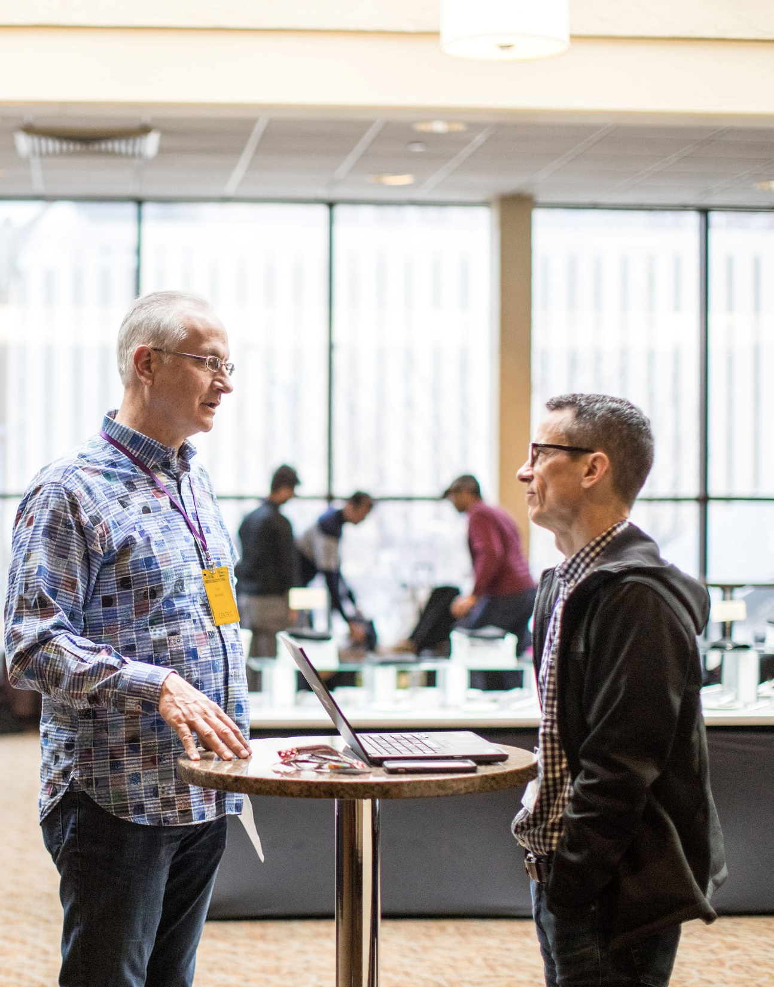
Demo: Insurance Company
BACKGROUND
Retrieve a daily report from Nexus (vendor), identify policyholders that are up for audit, send the report to key stakeholders, forward each policy individually into workflow to be worked, and notate the account in Nexus that this task has been performed
Currently, highly manual and repetitive process
CURRENT CONDITIONS
The report contains 47 policy holders per day, on average, to be worked
The process takes an average of 4 minutes per policy holder; approximately 188 minutes to complete (i.e. 15 hours per week for 1 FTE)
Nearly 100% of the agent / policyholder incoming phone calls are going into voice mail; creating dissatisfaction for agents/customer and creating additional work for the associate
GOAL OF BOT
Goal is to reduce the processors time by 90% and free up resources to answering incoming phone calls from agents & policyholders

Slide 14
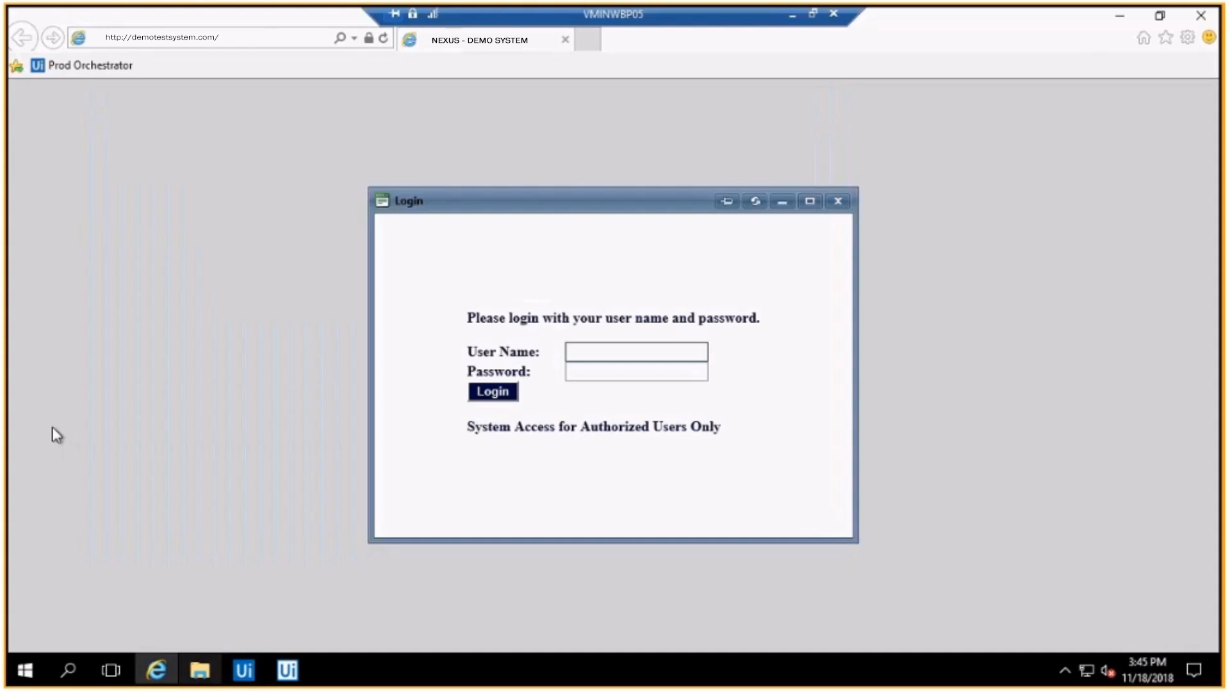
Demo: Login

Slide 15
RPA Vendors

Slide 16

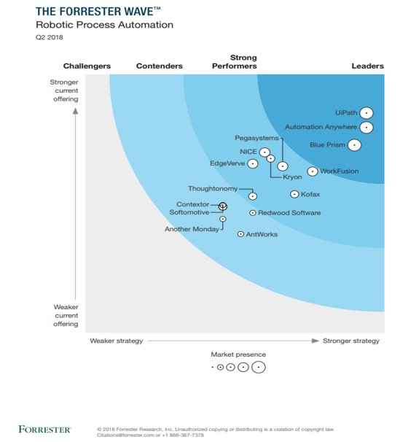
The Forrester Wave: Robotic Process Automation
Tom
The Forrester Wave: Robotic Process Automation
Challengers
Contenders
Strong Performers
Leaders
STRONGER Current Offering
UiPath
Automation Anywhere
NICE
Blue Prism
EdgeVerve
Kryon
Pegasystems
Thoughtonomy
Work Fusion
Softomotive
Contextor
Kofax
Redwood Software
Another Monday
AntWorks
Market Presence
WEAKER Current Offering
WEAKER Strategy
STRONGER Strategy

Slide 17

RPA “a-ha” Moments
Tom
Or what the vendors may not share with you
“It’s so easy, anyone can do it.”
  A level of technical acumen is recommended
“That’s how I run through the process each and every day.”
  Do a deeper dive. There are going to be some user nuances.
“It’s slower than I expected. What’s up with that?”
  Target system issues
  Need to slow down the bot
“Let’s throw another bot at the process to improve the performance!”
  Design for usability and scalability
  Bots calling bots
“The bot isn’t working. Did someone make application changes?”
  Communication! Communication! Communication!

Slide 18
Use Cases

Slide 19
Manufacturing Use Cases
Manufacturing Use Cases
Business Area: Finance and Accounting
  Invoice Payment
  AP Automation
  Freight Rating and Payment Auditing
Business Area: Customer Service
  Quote Creation
  Order Correction
  Product Registration Approval
Business Area: Operations
  Inventory Re-ordering
  SKU Updates
  Inventory, AP, Sales, Pipeline and Pricing Report Creation
  MES Integration
Business Area: Compliance
  GDPR-required Customer Record Updates

Slide 20


Process: Financial Operations
Department
Procurement and Supply Chain
Industry
Manufacturing
PROCESS
Financial operations
CHALLENGE
The company envisioned their future of finance to combine human insights with intelligent automation to create a digital workforce. They had been investing in data analytics, predictive modeling, process improvement, data science, and robotic process automation in order to replace their manual, time-consuming financial operations processes.
SOLUTION
RESULTS
The HP Finance branch developed templates and tools for business units and created a process to integrate subject-matter experts and technical teams with the process owners. These best practices have delivered bottom-line benefits and a culture of innovation. UiPath deployed 109 Robots to drive their RPA development.
62,560 hours saved by the end of 2017
$1.6 million saved by the end of 2017

Slide 21
Process: Processing Purchase Requests
Global automotive supplier
Location:
Germany
Department
Procurement and Supply Chain
Industry
Manufacturing
PROCESS
Processing purchase requests
CHALLENGE
The company had a manual process that required employees use SAP, email, Excel, and a desktop web portal. The workflow was frustrating to their team, and took them an average of three hours to handle each of the 30 purchase requests (PRs) they received each week. It was structured by rule- and decision-based logic and included interactive support from users. Because of the large amount of manual work required, the process was wasting staff time and creating errors in processing.
SOLUTION
RESULTS
Implemented within 5 weeks
100% of effort was automated
ROI in 8 months
0% error rate
Processing time reduced by 78%
Manual effort was reduced to 5%
Paper was replaced with a simple, user-friendly web portal that fed purchase requisitions into the UiPath Robot. The Robot then entered the information in SAP, checked for approvals via email, and created the purchase orders automatically. This improved employee experience by reducing the amount of manual work required and accelerated the benefits from digital transformation.

Slide 22
Process: Predicting Maintenance for Locomotives
Logistics company
Location:
Germany
Department
Finance, Accounting and Tax
Industry
Manufacturing
PROCESS
Predicting maintenance for locomotives
CHALLENGE
Faced with predicting vital maintenance for locomotives, two departments within the company spent 30 minutes a day doing cumbersome, manual work. The process required they use five applications on desktop, web, and SAP.
SOLUTION
RESULTS
Implemented in 3 weeks
100% of efforts automated
ROI in 3 months
0% error rate
Manual effort was reduced to 10%
50% reduction in processing time
The UiPath Robot checked various tools and files from SAP to gather maintenance data for the cargo locomotives and consolidated it in Excel files. This helped the customer to predict maintenance needs with higher accuracy.

Slide 23
RPA In Action
RPA In Action
Processes to consider for automation
HR Services
Supply Chain
Data Entry
Inventory Management
Payroll
Demand & Supply Planning
Onboarding/Offboarding
Time & Attendance/PTO Mgmt.
Invoice/Contract Mgmt.
Benefits Administration
Work Order Management
Recruitment (back office)
Return Processing
Compliance & Reporting
Personnel Administration
Freight Management
Procure to Pay (Accounts Payable)
Software Deployment
Order to Cash
Server & Application Monitoring
Record to Report
Maintenance & Monitoring
Supplier Mgmt.
Email Processing & Distribution
Collections
Batch Processing/Job Kick-off
Incentive Claims
Password Reset/Unlock
Sales Order
Backup & Restoration
Finance & Accounting
IT Services

Slide 24
Costs / Benefits

Slide 25
Costs to Consider
Costs to Consider
Vendor Selection Process (RFP/Contracting, Proof-of-Value/Proof-of-Concept)
Product Licensing (BOTs, Developer Seats)
BOT Implementations (Process Evaluation/Design, Change Mgmt., Infrastructure, Development)
Training (RPA Developer, RPA Users/Super-Users)
On-going Support (BOT Maintenance Team/Super-Users, Support Team)

Slide 26

Benefits Potential
Benefits Potential
Tangible
Intangible
  Headcount Re-allocation
  Hiring Avoidance For New Processes
  Productivity Returned
  To Line-of-Business
  Recruiting, Training,
  Facilities Cost Avoidance
  Process Metrics
  Increased Revenue
  Data Quality
  Customer Experience
    Lower Customer Turnover Rates
    Increased Revenue Opportunities
    Faster Time To Market
  Compliance and Security
    Fraud Reduction
    Industry Regulation Compliance
  Flexibility
    Replace/Supplement Traditional IT Lifecycle
    Leverage Existing Infrastructure
    Intermediary Processes
  Employee Satisfaction

Slide 27


Thank you
Thank you
centricconsulting.com

Slide 28
Appendix

Slide 29


Mike Ryba
INNOVATIVE TECHNOLOGY & PROCESS EXCELLENCE LEADER
mike.ryba@centricconsulting.com | linkedin.com/in/mikeryba
BACKGROUND
35+ years in IT, specializing in Software Development, IT Service Management and Robotic Process Automation
Trusted IT advisor, consultant and change leader, providing oversight of domestic and global teams in the Finance, Insurance, Healthcare, Retail and Travel industries
Expertise in the identification, analysis and resolution of diverse operational issues, continuously maintaining top performance while offering superior services
Skilled presenter, communicator, and mentor with excellent team leadership and business relationship management skills
Robotic Process Automation (RPA) specialist designing and deploying automation solutions with the governance required for a scalable digital workforce
PARTNERS: Leverages strong leadership and relationship-building capabilities to meet immediate and long-term goals
SAMPLES OF TANGIBLE BUSINESS OUTCOMES
Led business process observation, guidance, documentation, and oversight to standup an initial RPA Center of Excellence within a large, multibillion-dollar financial institution. This included Business Leader education, change control procedures, testing and deployment of robotic solutions
Lead RPA developer role as well as RPA program oversight, for a mortgage loan validation process at a large financial services firm, reducing loan review time from 45 minutes to 5 minutes.
Provided oversight to an RPA team that developed a solution for a large insurance company whereas the closure of claims from a legacy system saved over 160 hours per FTE involved in the process
Provided leadership oversight to RPA developers and analysts, creating an innovative solution to accepting new referrals in the hospice healthcare space, increasing revenue and referrals for a large Miami-based institution. Referral acceptances went from minutes to 5 seconds or less.
Participated in the tool implementation, process creation, and staff training of a new IT Service Management program for a global automotive manufacturing organization
Created an RPA Workshop and Training program to espouse the use of RPA throughout an organization
Migrated more than 50% of medical coding volume to an automated solution within a 4-month period for a national insurance claims provider
DELIVERS: Brings an executive-level and genuine hands-on commitment to delivering tangible results
TRUSTED: Reputation for sound judgement, thoughtful approach and ethical standing. Places the needs of others first.
17

Slide 30

Motorists Insurance Group
Centric Delivers
Centric helped the Motorists Insurance Group team complete a Proof of Concept utilizing UiPath RPA software to successfully automate this function with an Attended Robot running along-side a specialist.
Centric employed a best-practice approach and design thinking to RPA to enable not only a working solution in days, not weeks; but a robust design to allow the Consumer Experience team to adjust and apply continuous improvement to vet the functioning solution from POC to Production.
Improving Consumer Connections
with RPA
Automating Notifications
Customer correspondence and notifications are a large part of any insurance business. Unfortunately, sometimes these notifications are in regard to late payments and/or lapse in coverage notifications to customers. An important and time-sensitive message to deliver.
The Consumer Experience department in Motorists Insurance Group had several users dedicated to the tedious task of producing these notifications and getting a notice out to the appropriate recipients. Through a serious of repetitive tasks to query their insurance platform, determine recipients, lookup account managers, produce templated email notifications, etc.; all while leveraging several excel spreadsheets in an effort to make this tedious job maintainable. These workers were bogged down with these required and ever-increasing tasks; seemingly not-scalable to their growing customer base.
Motorist Insurance Group recognized the viability of RPA software to provide the automation necessary to accelerate this process, eliminate the human error element and improve the timeliness and consistency of this effort; producing better business outcomes!
The Results
Eliminating the need for multiple spreadsheets and leveraging existing platforms for one true source of data, this process is faster, self-contained and more accurate than ever before.

Slide 31
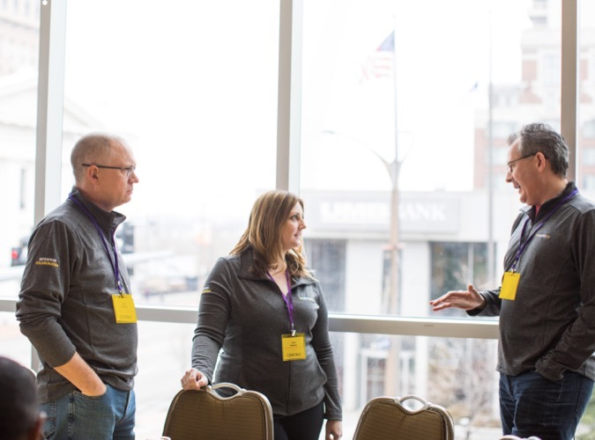
We are considering this a huge success and have promoted it as such. We are in the process of purchasing licensing and finding a true owner of this technology. I appreciate everything Centric did to make this possible!
We are considering this a huge success and have promoted it as such. We are in the process of purchasing licensing and finding a true owner of this technology. I appreciate everything Centric did to make this possible!
-Jeff Martin
AVP Consumer Experience
31

Slide 32

Regional bank turns around loans faster
Business and Automation Transformation
The bank was not just looking for a system implementer, but a partner to help them improve business processes, recommend automation opportunities, mentor staff on how to use automation tools, educate users on what RPA is and isn’t, and be on-site to collaborate and deliver results.
The Centric National PEX team helped the bank to identify what role automation could play in the loan process and how those changes would result in improved customer service and maximized employee productivity. Our approach included:
Moving the organization towards an agile development perspective versus the traditional waterfall approach
Documenting current processes through on-site visits and video recordings, using a BPM tool to maintain the documentation.
Working side-by-side with the BOK Automation Manager to provide RPA tool mentoring and guidance while performing the necessary development, training, and implementation activities.
Regional bank turns around loans faster
By utilizing Robotic Process Automation (RPA), a regional bank can save time and resources and deliver quicker loan decisions to their customers
A Russell 1000 Index bank
Many Loans, Few Resources, Greater Needs
Our client, a Russell 1000 Index bank holding company, was looking for ways to more efficiently and effectively process loan requests, including ordering appraisals, titles, and other documents necessary for making loan decisions. In order to stay competitive, the bank was looking to reduce the time to process these requests, while also improving the customer experience by focusing on customer value-added activities.
The bank entered in discussions with Centric’s Columbus office and Process Excellence (PEX) practice to identify how this process could be transformed to reduce manual effort and shorten processing times. The Centric team decided to use Robotic Process Automation (RPA) to process high volume requests.
In essence, by using RPA, the bank could utilize automated capabilities to perform some of the more standard, rules-based tasks. These automations could run any time of the day or night, thereby improving throughput and allowing the remaining activities of the loan process to be completed sooner.
Working Smarter, Delivering Faster, Reducing Costs
By using RPA, the bank reduced 2-3 days from the full loan lifecycle. Bank staff is now able to focus more time on the loans that require greater time and attention, while delivering faster and more efficient service to their customers.

Slide 33

Healthcare organization can better serve customers through automation
Enter Centric
Corridor had identified the report download and upload process as a significant impediment to future growth and an area of their business that needed to be reviewed for optimization. Corridor asked Centric to recommend potential options for improving this process.
Centric recommended a dual approach. Robotic Process Automation (RPA) would be used for the daily download of client coding data. To handle the processing of the reports, Centric suggested a solution utilizing SSIS (SQL Server Integration Services) which would automate the manipulation of client coding data into a standard format and upload to Corridor’s internal work management system for coding assignment.
Centric worked with the Corridor business and IT stakeholders to build out a proof of concept to ensure the solution would be flexible enough to meet the varying and dynamic needs of their clients and be able to scale to meet the processing demands of Corridor’s ever-growing coding services. UiPath was selected as the RPA engine based on a variety of factors including ease of training,
Once the proof of concept environment was in place and candidate processes for RPA download and SSIS processing had been completed and signed-off, full scale build-out of the solution began in earnest. Centric worked with Corridor to prioritize client processes to shift over to the new automated process to maximize ROI.
Healthcare organization can better serve customers through automation
Addition of Robotic Process Automation allowed Medical Coding Services provider to maintain accelerated growth and better serve their clients in the process.
The Business Need
Corridor, one of the nation’s leading medical coding services providers, was inundated with spreadsheets. Each business day, members of Corridor’s Health Information Management (HIM) team were logging into client Electronic Medical Record systems to download reports containing each day’s medical coding requests for upload into Corridor’s work management system.
In addition to the manual download process, each report needed to be manually manipulated before upload into the work management system. Sometimes, this process involved processing upwards of 40 reports for a single client and the team was often working around the clock to keep up with demand.
The Results
Corridor has been able to achieve sustained high growth within their medical coding services group. (46% in the first 6 months of 2018). HIM staff members which had been tied down with tedious manual duties have been increasingly freed to focus on problem records and onboarding new clients, and Corridor has not had to add any additional HIM staff to handle the vastly increased volumes. Over the course of 4 months, more than half of Corridor’s daily medical coding volume has been shifted to the new automated solution.
As an added benefit, automation and data integration on the backend have resulted in increased visibility of data anomalies and errors which prevent downstream re-work and lost productivity.

Slide 34

Simply put, we couldn’t be where we are today without Centric’s help. The deep technical expertise that every Centric team member has demonstrated, combined with Centric’s partnering approach, has established a foundational RPA capability for Corridor which we can continue to leverage for further growth.
Simply put, we couldn’t be where we are today without Centric’s help. The deep technical expertise that every Centric team member has demonstrated, combined with Centric’s partnering approach, has established a foundational RPA capability for Corridor which we can continue to leverage for further growth.
Des Varady
CEO
34

Slide 35

Vendor Profile: Automation Anywhere
Tom
Sales / Customers:
$250M Capital raised
$1.8B Valuation
~ 1,000 customers (worldwide)
Core Strengths/Messages:
IQ Bot wins “Hot Technology Award” in 2018 IT World Awards
Focus Markets:
Banking and Capital Markets
Telecom
Healthcare & Pharma
PROFILE
STRENGTHS
Private company
~ 700 employees
Concerns/Watch Points:
Issues with Citrix integrations
User-interface not user-friendly
Requires more technical expertise
Interface issues with SAP
Product Offerings:
Automation Anywhere Enterprise
IQ Bot
Bot Insight
Bot Farm
Bot Store
CONCERNS
PRODUCTS

Slide 36

Vendor Profile: blueprism
Tom
Sales / Customers:
$29M Revenue
$69M Cash & Equivalents
93% Recurring License Revenue
~ 700 customers (worldwide)
Core Strengths/Messages:
Gartner Group recognized
as a “Cool Vendor”
Alliance with Deloitte and their clients
90 partners (22 certified)
~ 5,000 accredited developers
Microsoft and Google cloud collaborations
Ranked 1st for Functionality,
Security and Compliance by
HfS Research Ltd (2018)
Focus Markets:
Banking & Financial Services
Retail
Electronics
Aviation
Healthcare
PROFILE
STRENGTHS
Public company (UK-based)
~ 300 employees (34% US-based)
Concerns/Watch Points:
Licensing costs
No trial product availability
Limited resources if not a partner
Surface Automation and OCR needs to be more robust
IE only supported browser
Product Offerings:
Blue Prism (MS, .NET framework)
CONCERNS
PRODUCTS

Slide 37

Vendor Profile: UiPath
Tom
Sales / Customers:
$100M Recurring Revenue Annually
$30M Series A Capital raised
$153M Series B Capital raised
$1.1B Valuation
~ 1,500 customers (worldwide)
Core Strengths/Messages:
‘RPA Industry Leader’ (by Forrester Q2 2018)
Free community edition of product
UiPath Online Training Academy
PROFILE
STRENGTHS
Focus Markets:
Finance & Banking
Insurance
Healthcare
Telecom
Manufacturing
Private company
~ 820 employees
Product Offerings:
UiPath Studio
UiPath Orchestrator
UiPath Robot
Concerns/Watch Points:
User interface not user-friendly
Requires more technical expertise
Rapid growth-slow response to customers
Will IPO cause changes in services/costs?
CONCERNS
PRODUCTS

Slide 38
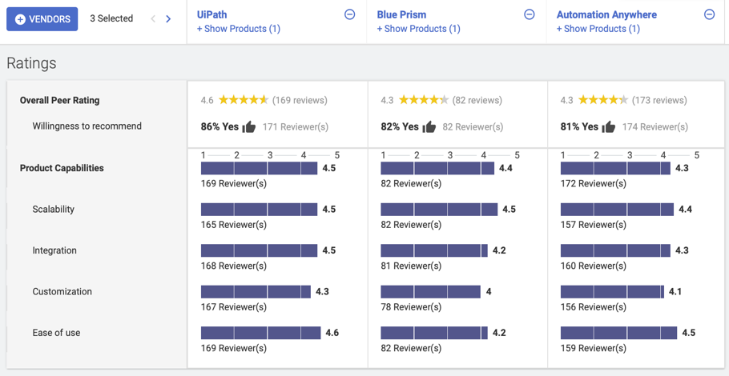
Peer Insights
The top 3 vendors are quite close in comparison as reviewed by product users

Slide 39
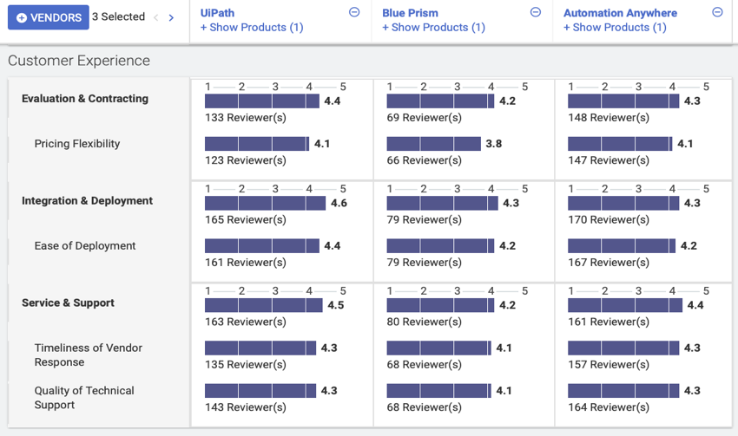
Peer Insights continued…

Slide 40







Automation Technologies
Structured Data Interaction
Integration is through the exchange of well-structured information (APIs)
Machine Learning
Systems that learn through handling variations that are not anticipated upfront
Natural Language Generation
Helps generate text as we speak or write from structured information such as fields and numerals
AI Decision Systems
Systems that employ an array of technologies, algorithms and models to solve complex and inter-related problems to make decisions
1
2
3
4
5
6
7
Robotic Process Automation
Automation of standard, rule-based activities
Natural Language Processing
Learning algorithms to analyze text and unstructured information to understand the meaning, sentiment and intent
Chatbots and Virtual Agents
Systems that can interpret voice/text in free form (chat) to simply respond with standard predefined answers

