Slide 1

Speaker: Natalie Heustis
Natalie Heustis
Manager Employee Initiatives, Skillful Indiana

Slide 2

Skillful Indiana
Skillful Indiana
Natalie Heustis
Manager of Employer Initiatives
September 27, 2019

Slide 3

Skillful on the ground in Indiana
Skillful on the ground in Indiana
Data and Higher Education
Employers
Customized Skillful Employer Toolkit for IN
Support scaling of skills-based credential & employment platforms
Delivering Skillful Talent Series to businesses
Enable informed educational choices, linked to career opportunities
Embed skills-based practices
in company programs
Support programs to prepare Hoosiers for emerging occupations
Public Sector
Career Coaches
Key partner and collaborator for effective and sustainable systems change
Indiana Skillful Governor’s Coaching Corps
Enhances existing efforts through skills-based practice change
Skillful Coaching Community of Practice
Helps to ensure equitable access of information
Develop standards of quality for career coaching
3

Slide 4
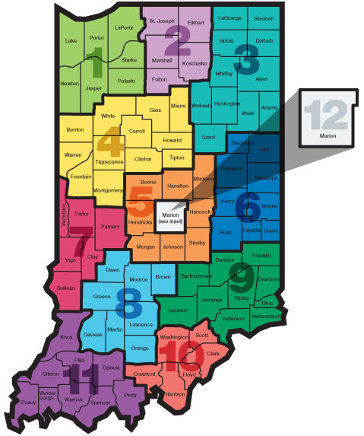
Skillful Talent Series Train-the Trainer Bootcamps
Skillful Talent Series Train-the Trainer Bootcamps
4 bootcamps with 6 regions represented
43 trainers from 11 unique organizations across the state
Trainers represent diverse roles:
  17 Business Service Representatives
  9 Managers
  4 Recruiters
  4 Veterans Business Representatives
  4 Directors
Workforce system, economic development, and chambers of commerce
4

Slide 5
A Skills-Based Approach Can Be Applied Across the Talent System
A Skills-Based Approach Can Be Applied Across the Talent System
  Hiring
  Sourcing
  Job postings
  Skills assessment
  Workforce planning
  Defining skills & roles
  Career-pathing
Workforce planning
Hiring
  Talent Excellence
  Partnering with external education / training ecosystem
  Engagement & retention
  Coaching & advising
Engagement & retention
Talent excellence
Apprenticeship & upskilling
  Apprenticeship & upskilling
  Pre-employment training
  Youth Apprenticeships
  Employee training
  Evaluation & advancement
  Evaluation
  Succession Planning
Evaluation & advancement
  Talent system practices and their differentiated skills-based approaches

Slide 6



Skillful Talent Series
Attract the Right Talent
SKILLFUL® Talent 101

Slide 7

SKILLFUL® Talent Series Overview 1
SKILLFUL® Talent Series Overview
SKILLFUL® Talent Series Workshops:
Standalone Workshop
Workshops are dependent on one another (in order)
101: Attract the
Right Talent
102: Candidate Evaluation
103: Selection and Onboarding
104: Employee Retention

Slide 8

Methodology
Methodology
1
Remove credential requirements when possible
2
Use competencies specific to the job
3
Reduce bias

Slide 9


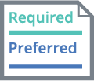



SKILLFUL® Talent Series Overview 2
SKILLFUL® Talent Series Overview 2
The First Step in Transitioning to Skills-Based Employment Practices
A Skills-Based Job Posting
A Pedigree-Based Job Posting
Uses Skills
Uses Proxies
Uses skills to make sure that candidates can do the job
Ensures employees are developing the right skills
Distinguishes Qualifications
List of Qualifications
Clearly distinguishes between required and preferred qualifications
Includes a laundry list of requirements and preferences without specificity on how they apply to the position
Reduces Bias
Unintentional Bias
Uses thoughtful language to reduce bias and create an inclusive, inviting job posting to all qualified readers
Uses language that may contain unintentional biases that discourages qualified applicants from applying

Slide 10
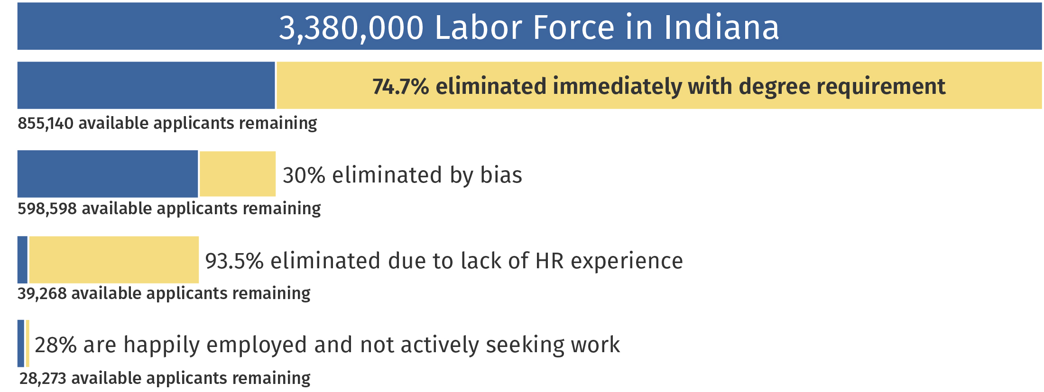

Talent Loss in Pedigree Hiring
Talent Loss in Pedigree Hiring

Slide 11

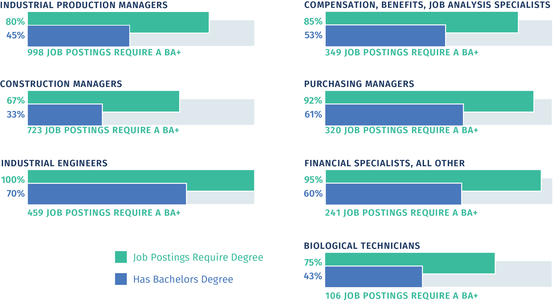
The Skills Gap Is Made Worse by Degree Inflation
The Skills Gap Is Made Worse by Degree Inflation

Slide 12

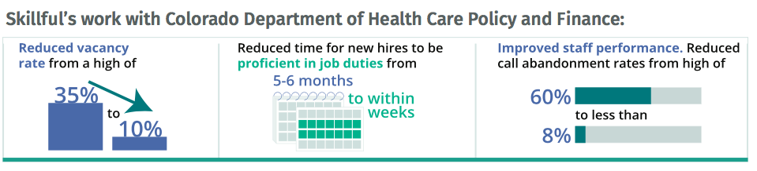
Why Skills-Based Hiring
Why Skills-Based Hiring
A Michigan State University Study found:
Skillful’s work with Colorado Department of Health Care Policy and Finance:

Slide 13

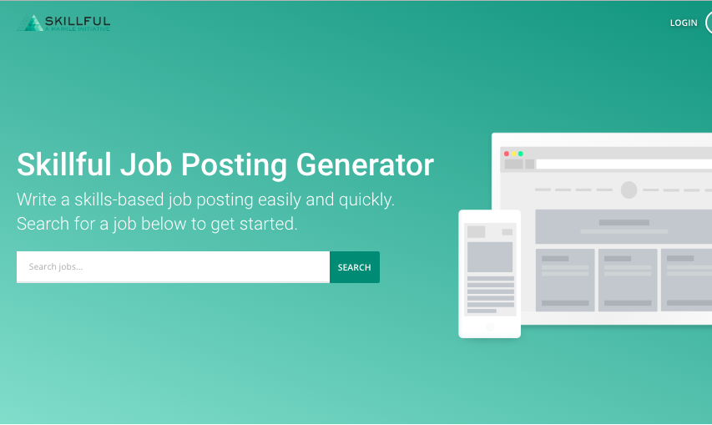
The Skillful Job Posting Generator 1
The Skillful Job Posting Generator
Generator.Skillful.com

Slide 14
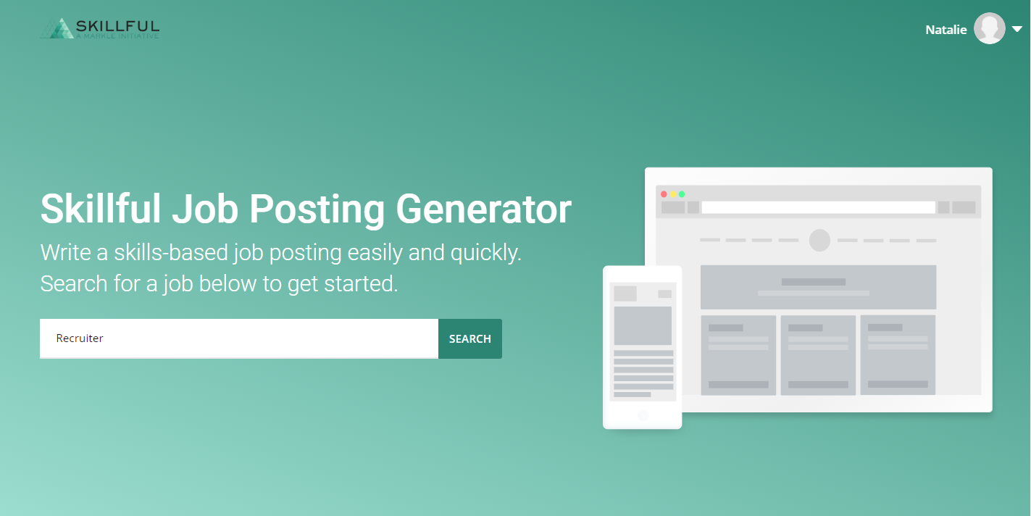
The Skillful Job Posting Generator 2
The Skillful Job Posting Generator
Generator.Skillful.com

Slide 15
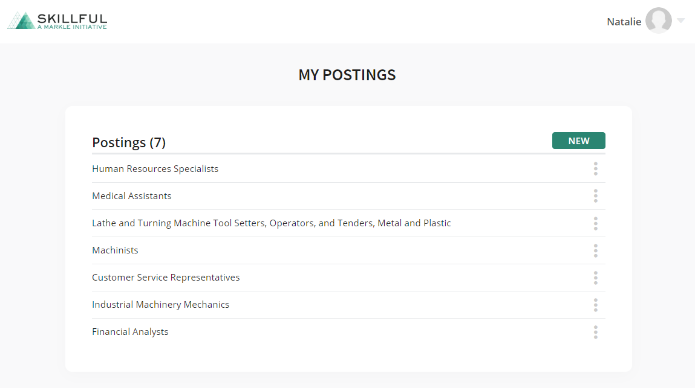
The Skillful Job Posting Generator 3
The Skillful Job Posting Generator
Generator.Skillful.com

Slide 16
The Skillful Job Posting Generator 4
The Skillful Job Posting Generator
Generator.Skillful.com

Slide 17
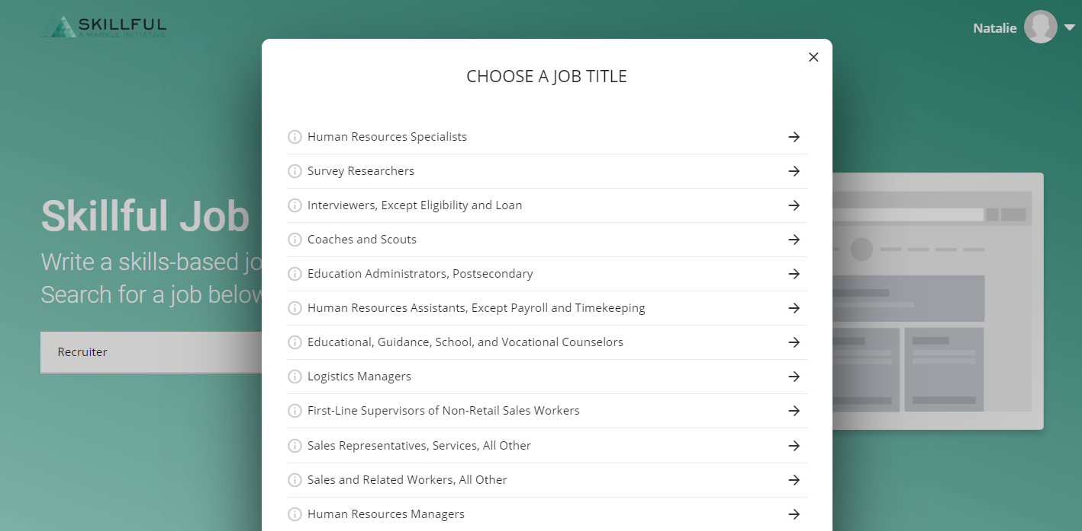
The Skillful Job Posting Generator 5
The Skillful Job Posting Generator
Generator.Skillful.com

Slide 18
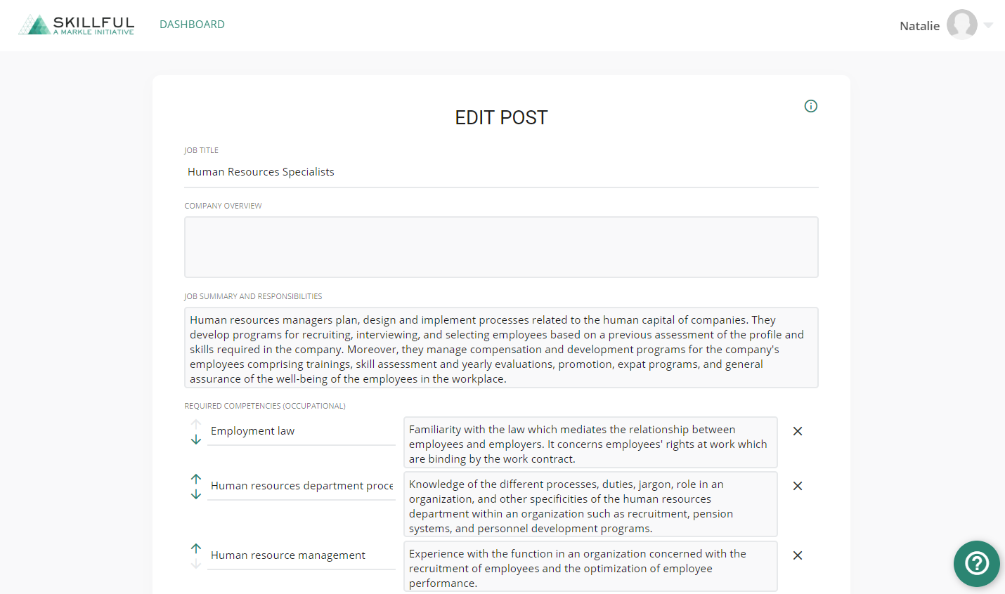
The Skillful Job Posting Generator 6
The Skillful Job Posting Generator
Generator.Skillful.com

Slide 19
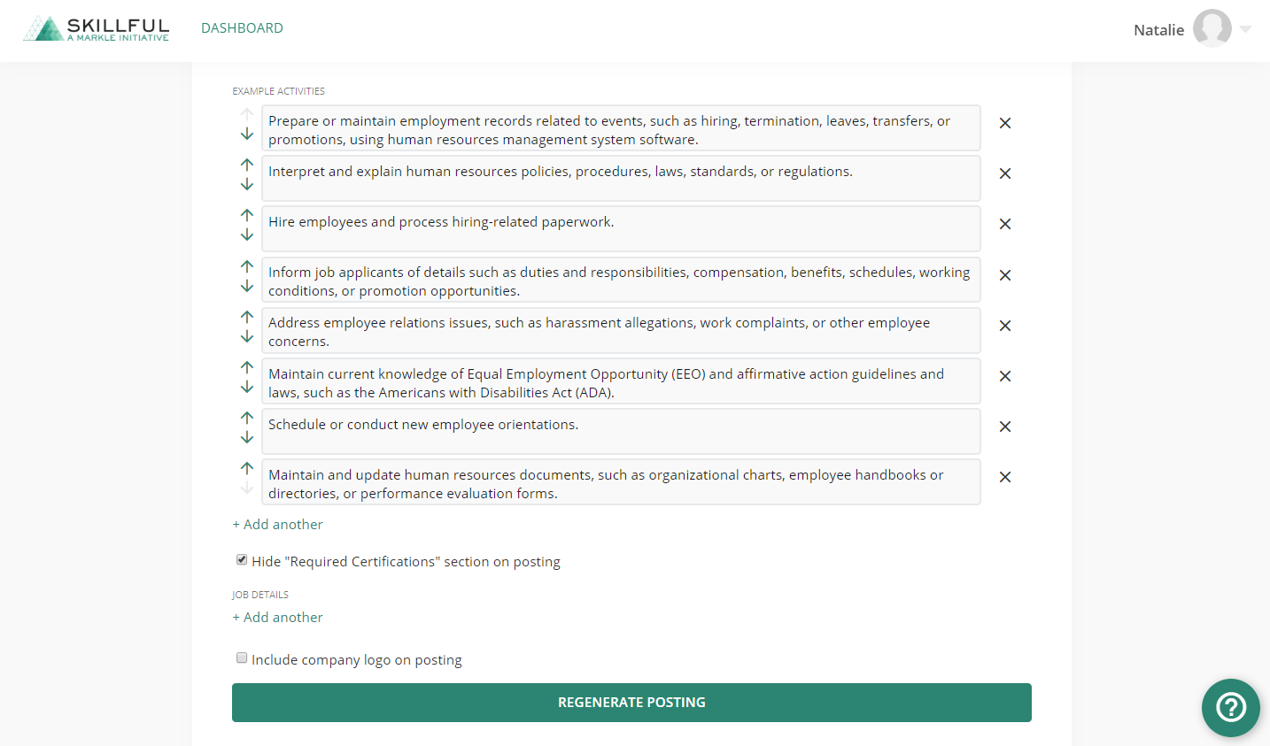
The Skillful Job Posting Generator 7
The Skillful Job Posting Generator
Generator.Skillful.com

Slide 20
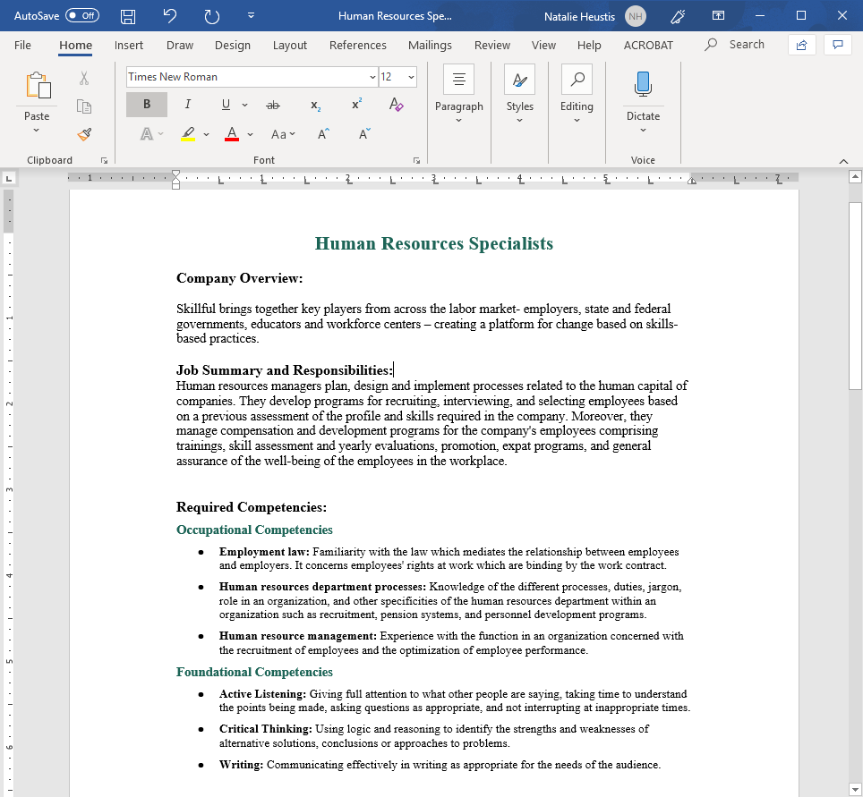
The Skillful Job Posting Generator 8
The Skillful Job Posting Generator

Slide 21


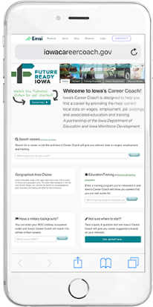
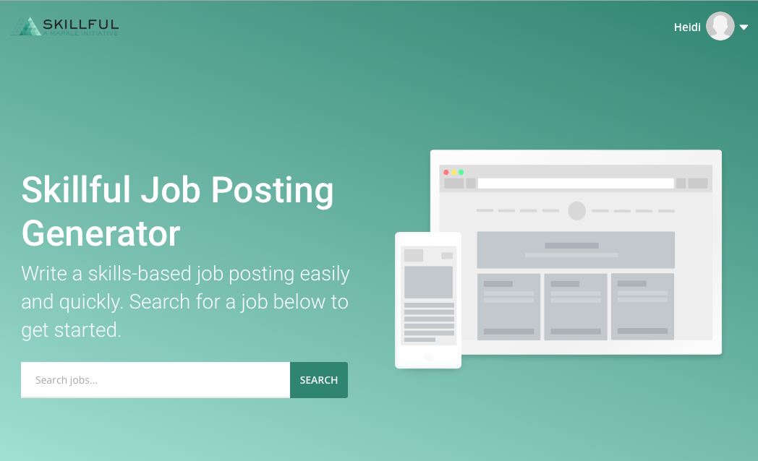

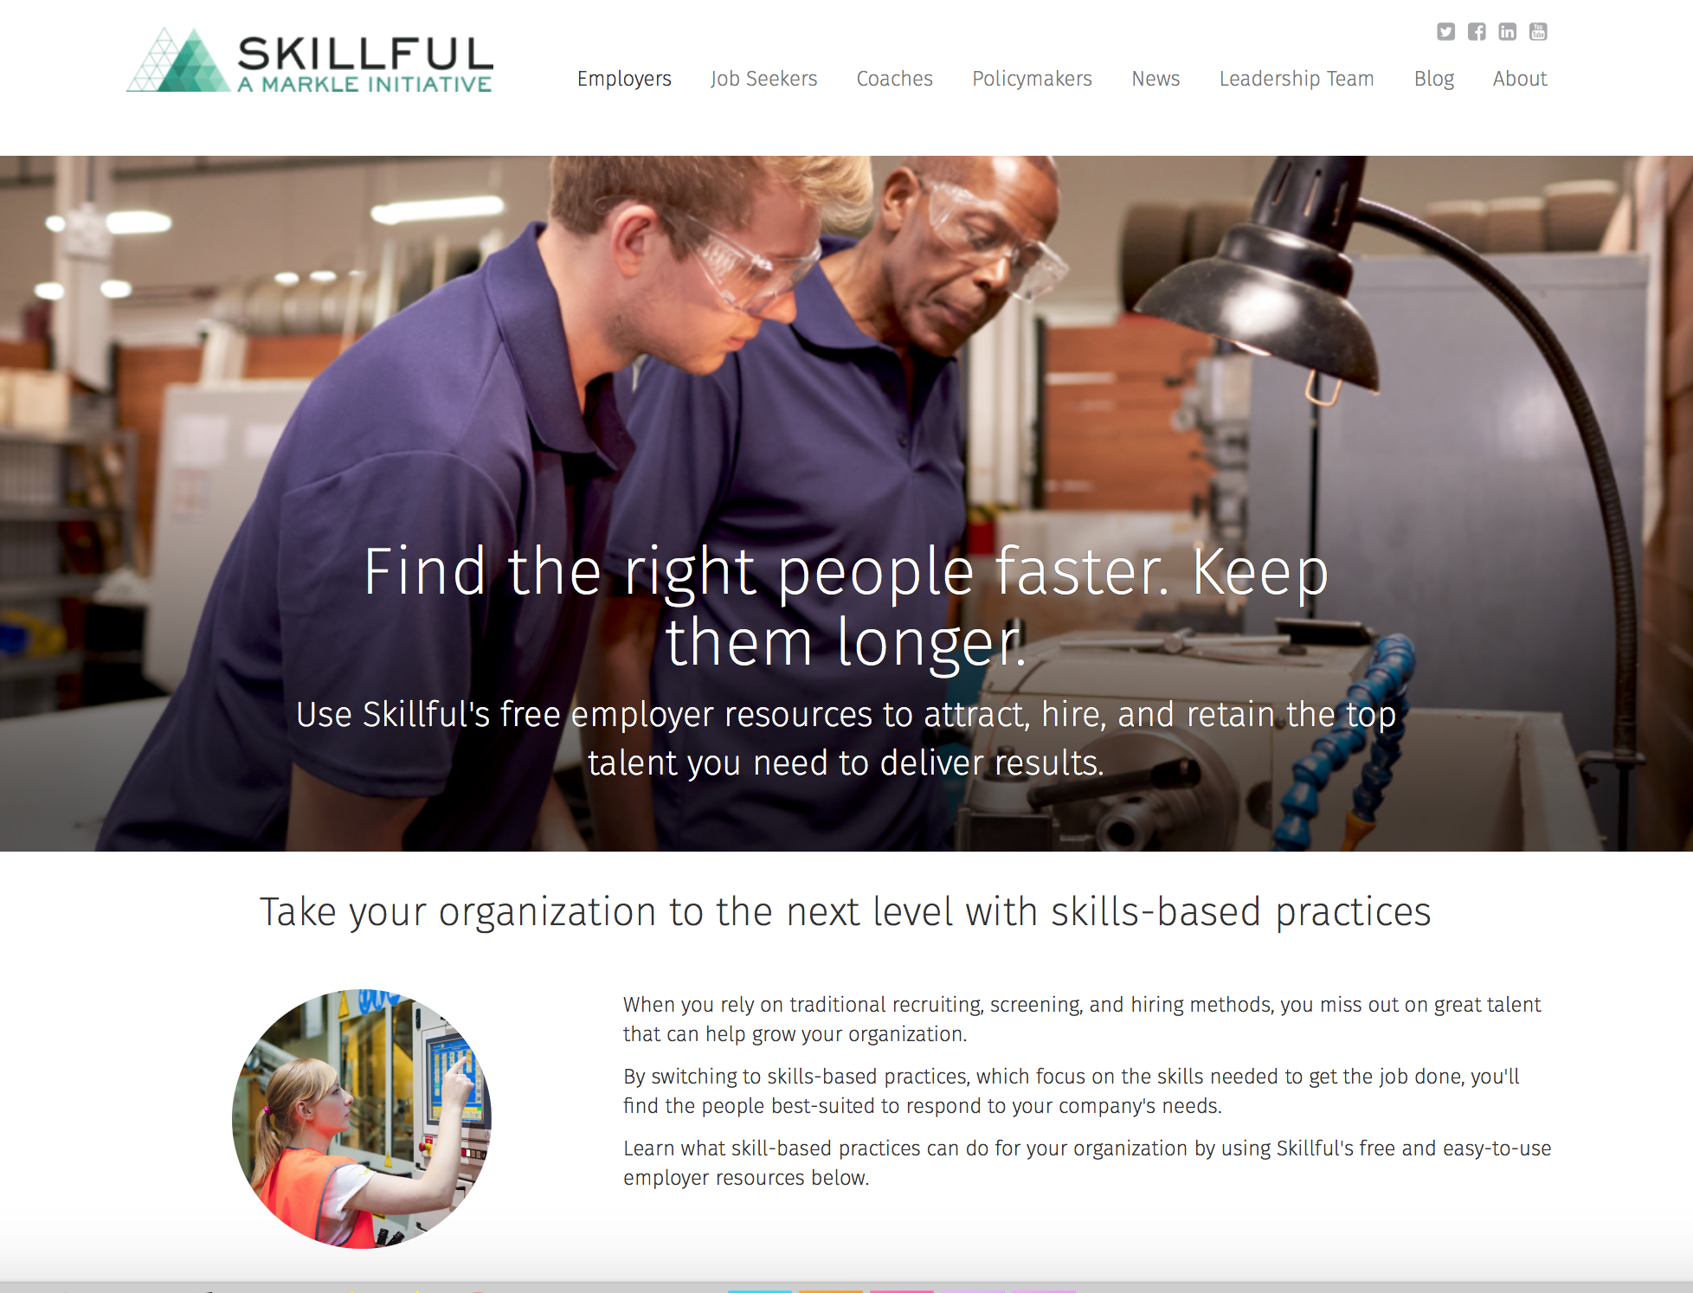
The Skillful Job Posting Generator 9
Learn More About Skills-Based Practices
Contact Natalie Heustis for more information.
Manager of Employer Initiatives
Phone: (317) 670-0142
nheustis@markle.org
Check out the Skillful Job Posting Generator
Generator.skillful.com
For more resources visit
skillful.com/employers

