Slide 1
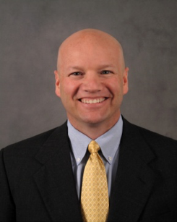
Speaker: Tim Lawrence
Tim Lawrence
Senior Vice President, Operations at Hill-Rom Holdings Inc.

Slide 2
Driving Agility with the
“Operations Management System”
September 27, 2019

Slide 3
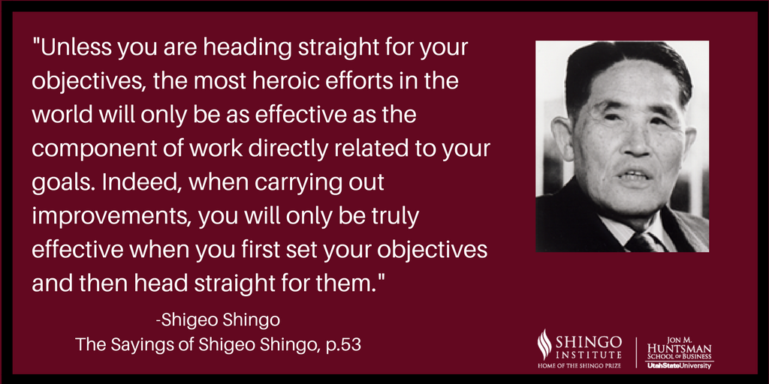
Shigeo Shingo Quote

Slide 4
Hillrom Global Operations
True North
Play to Win
Be Great Team Players
Do The Work & Improve The Work
Know Your Customer and Meet Expectations
People
Build a Zero-Harm Workplace
Create a Culture of Diversity, Inclusion, and Performance
Quality
Constant Audit Readiness
Relentless Focus on Zero Defects
Improve Our Quality Sub-Systems
Delivery
Create A Robust Planning System
Optimize The End-to-End Network
Achieve Inventory & Service Level Targets
Cost
Achieve Year Over Year Cost Improvements
VIP/VOP > 5% Annually

Slide 5
What is the “Operations Management System”
What is the
“Operations Management System”
A series of integrated processes, tools & “daily” routines, with clearly defined and aligned goals, deployed across the enterprise to drive superior results

Slide 6
Why a disciplined operating system is imperative
It defines the work habits, practices and routines we use to run our business
It specifies how things are done in all areas of our business
Sustainable change can only come from executing a sound operating system
It makes it easy to detect abnormal results & requires actions to address them
It creates the common language required for horizontal learning
It creates intense momentum & is difficult to change (A Flywheel)

Slide 7



Our Management Systems Creates The Culture
In the long term this
builds the
organizations culture & ability to compete at the highest levels
Deliberately
practice
the new
behavior
Over time
this changes
peoples
mindsets
Constant
practice & repetition
Forms & solidifies
new habits
The new norms must deliver measurable results
7

Slide 8
You don’t change your mindset then have a new behavior
You don’t change your mindset
then have a new behavior
You practice a new behavior,
and over time
that changes your mindset..

Slide 9
The Global Operations Management System
People
Quality
True North
Delivery
Cost
Improvement Visits ● Self Assessments ● PDCA
Strategy Deployment
Performance Culture
Daily Management System
5S
VIP
Problem Solving
HEAD
HEART
GUTS

Slide 10

A Key To Remember
Improvement is not about the tools. It is about leadership & teaching people to see & think
You must know the “right” tool to use in order to solve your most significant business problems

Slide 11



How We Measure Progress
Three Levels of Maturity
  System (Yes / No)
  Bronze
  Silver
  Gold
System
Yes
No
Logical Progression from Level to Level

Slide 12
Follow a methodical & disciplined deployment approach
Plants Conduct
Baseline
Self-Assessments
“Improvement Visits” to Calibrate & Validate
Self-Assessments
Plants Receive
Formal Feedback
Plants Execute Improvement Plans,
Benchmark Best Practices & Improve Management System
An ongoing, continuous cycle of improvement
Baxter Proprietary Information – For Internal Use Only

Slide 13
Disciplined Operating Mechanisms
Execute the Daily Management System at the plant level
Quarterly self assessments at the plant level
Annual On-Site Improvement Visits
    Smaller visit teams to validate, teach, learn, calibrate and improve
    CI lead, alternating PM’s and QD’s from other plants
Senior Management Overview
    Standard Work during all plant visits
    Quarterly formal reviews w/ VP
    Review current state, next target condition & key actions forward

Slide 14
The Operations Management System
Take-Away Foundations
Extreme Ownership
Simple, simple, simple. Mature over time through crawl, walk, run
Create the common language & tool set required for horizontal learning
Strategy Deployment ensures clear direction, alignment & prioritization
All activities obsessively focused on moving towards True North
Go & See Leadership: Lead from the front, not the office or a conference room
Our Job = “Do the Work” + “Improve the Work”
PDCA in all we do: Don’t study too long & know it will be wrong. Go do it!!!
Not about a score. About getting better than yesterday

Slide 15
This is not hard to understand,
It is hard to do!

