Slide 1



DCMME Manufacturing Conference
September 18, 2020

Slide 2

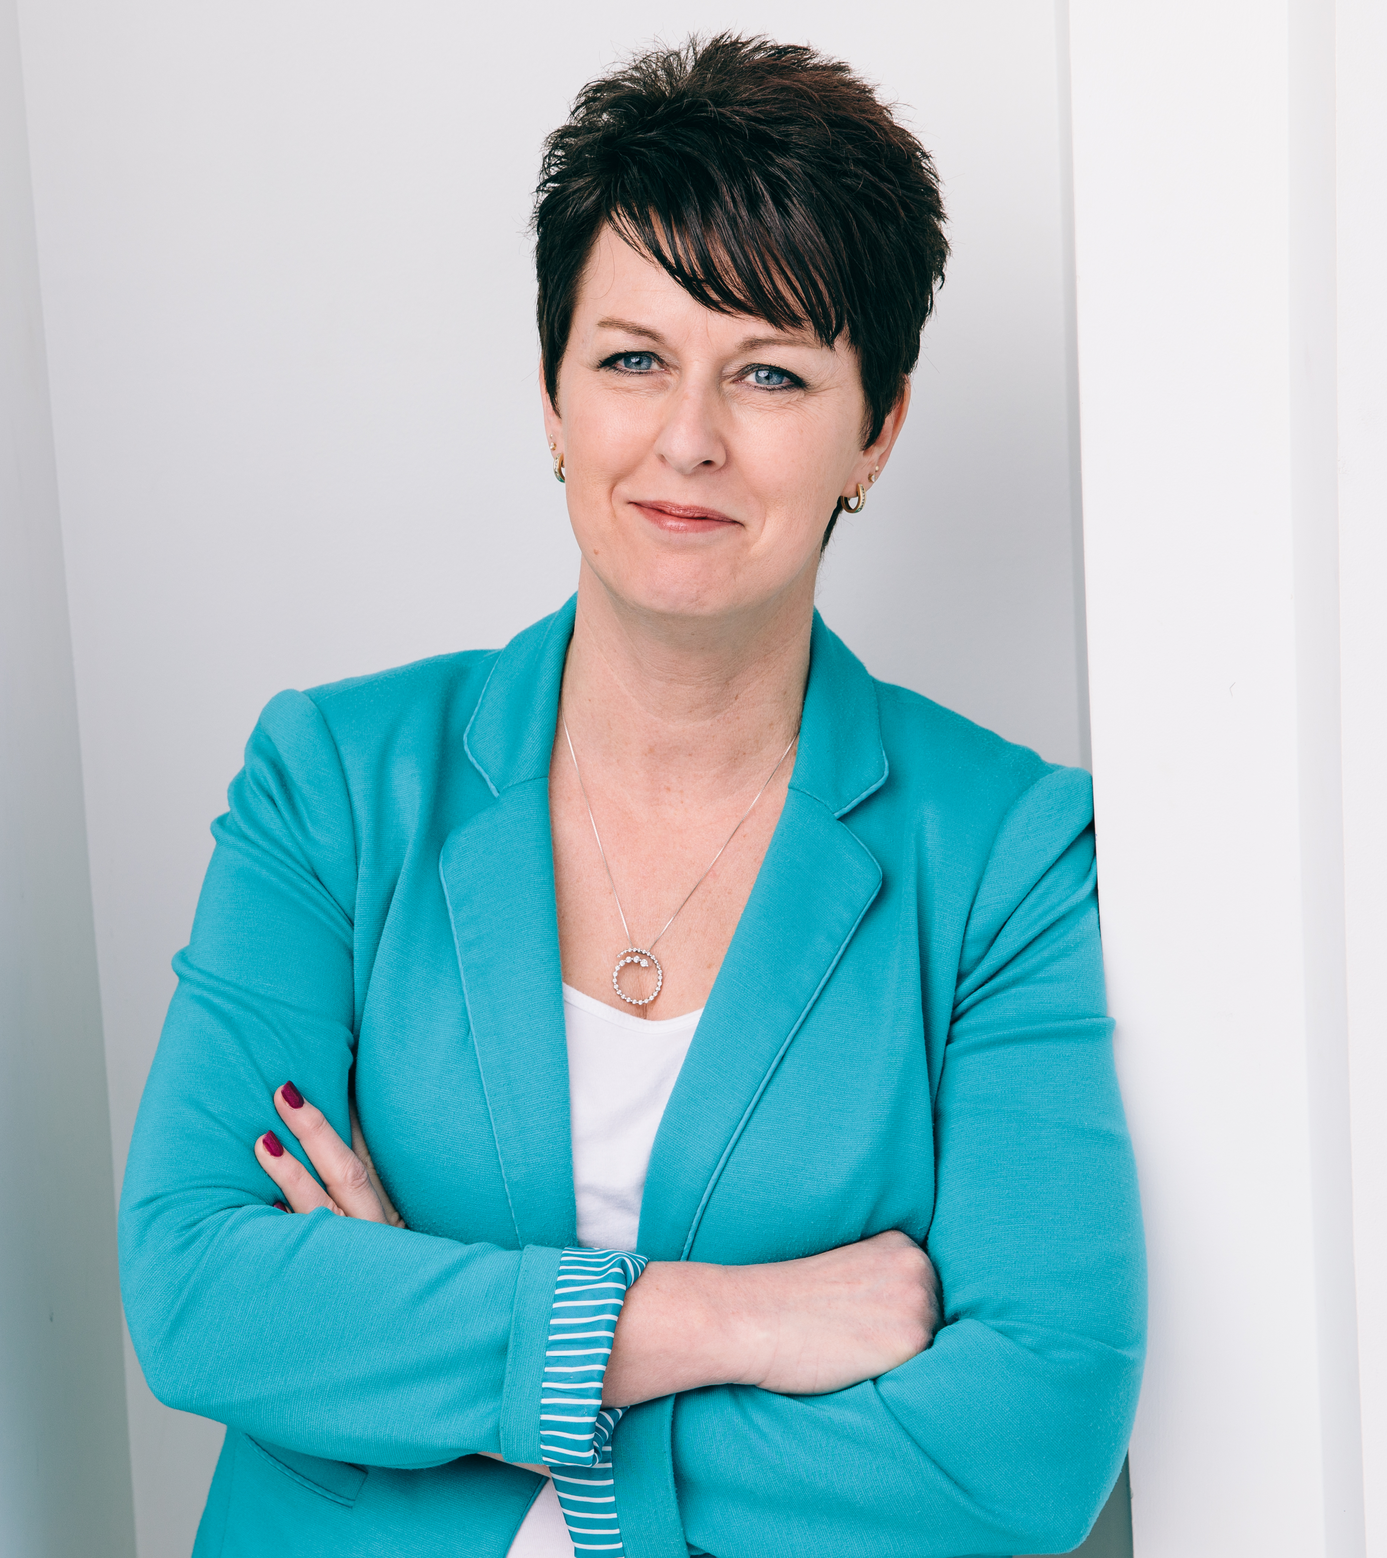
The Community in which we serve

Slide 3


Tipmont REMC/Wintek
Established Electric Provider – mission
Establish Fiber Provider
The Perfect Match

Slide 4
Learn to adjust and Provide Opportunity
Electric
Headquarters lobby closed
Disconnects
Payment plans

Slide 5
Learn to adjust and Provide Opportunity
Fiber
Wifi hot spots
Learning and working from home

Slide 6
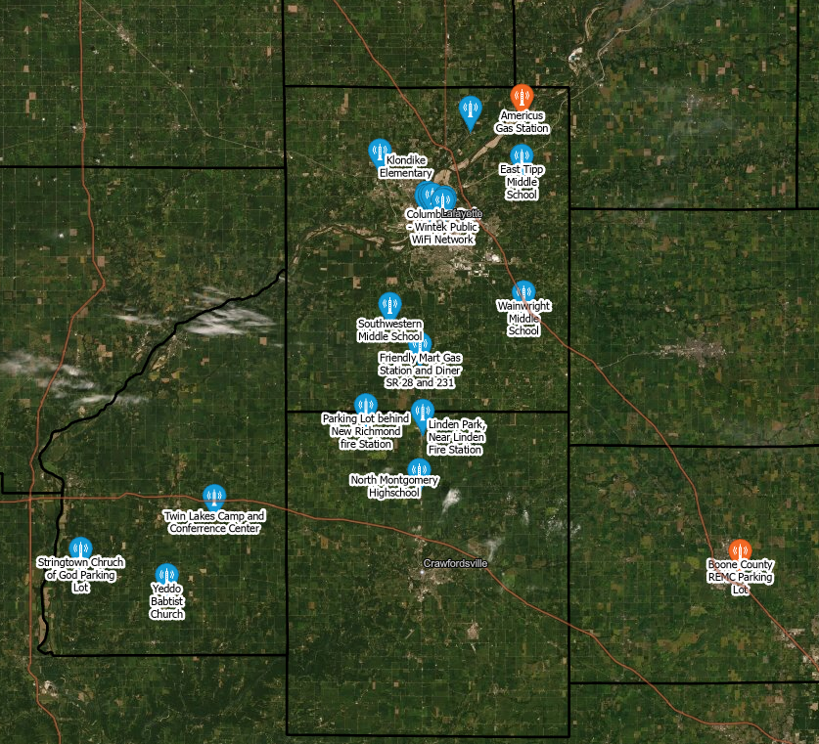
WiFi Hotspots
Tippecanoe
Montgomery
Fountain
Boone

Slide 7
Learn to adjust and Provide Opportunity
Fiber
Increased speeds for business
Installers
DIY installs

Slide 8
Moving FoRward
Next Level Connections Broadband Grant program
  $16M
  2 years to complete
  7 Co-ops
Study - PCRD
  Healthcare
  Education
  Economic Development

Slide 9
Thank you
Jody Hamilton
Business Development Director
jhamilton@Tipmont.org
(765) 426-2748

