Slide 1
VSMI to Mitigate Infection Risks
Roy Vasher, Purdue-WHIN Education Consultant

Slide 2
What is VSMI?
VSMI is an acronym for Value Stream Mapping plus Infection risk mitigation.
The VSM methodology was initially used by Toyota to eliminate waste and is now a vital tool that is used by Lean practitioners everywhere.
A VSMI map provides a visual representation across the plant floor to enable you to identify potential areas of Infection risk

Slide 3
VSM Material and Process Flow Map – Logical View
Factory Operations
Types of Waste
Transportation
Inventory
Motion
Waiting
Over Production
Over Processing
Defects
Receiving
INV
Cutting
Notch
Form
Weld
Buff
INV
Shipping
VA
2 min
2 min
NVA
2 min
2 min
4 hr.
5 min
1 day
New Concern
Infection Risk

Slide 4


Factory Floor Flow – Aerial View – Prior Mitigation
Receiving
Aisle
Less than 6 Ft
Shipping
Steel
Cutting
Notch
Form
Weld
Buff
Supervisor
Less than 6 Ft
Mobile worker
Two-way aisle way
Aisle

Slide 5
Factory Floor Flow – Aerial View – With Mitigation
One-Way
Aisle
Receiving
Aisle
Sensor to Quarantine incoming parts
Move Worker
Shipping
Steel
Cutting
Notch
Form
Weld
Buff
Supervisor
Wear Sensor
Make aisles one-way
One-Way
Aisle

Slide 6
Next VSMI Step
CAD* Software Model
  Use a CAD type software to translate the VSM logical flow into an aerial view of the factory floor using actual dimensions of floor plan as well as machines and workstations.
  CAD software can be used to create a 3D view and used to simulate relocation of machines and workstations
  Also, analyze traffic floor around the factory floor and redesign flow to keep workers separated by 6 feet when walking around – for example create one-way routes and either side of the wide aisles.
VISIO
  If you do not have access to CAD, the next best option is to use VISIO
Computer Aided Design

Slide 7
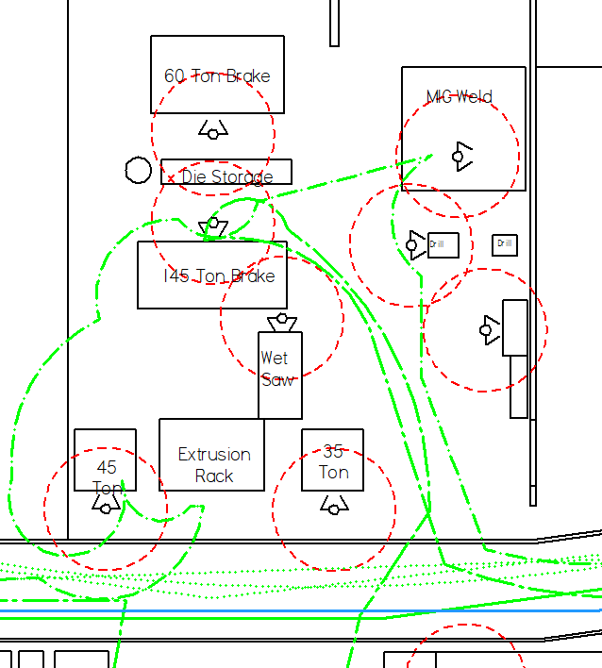
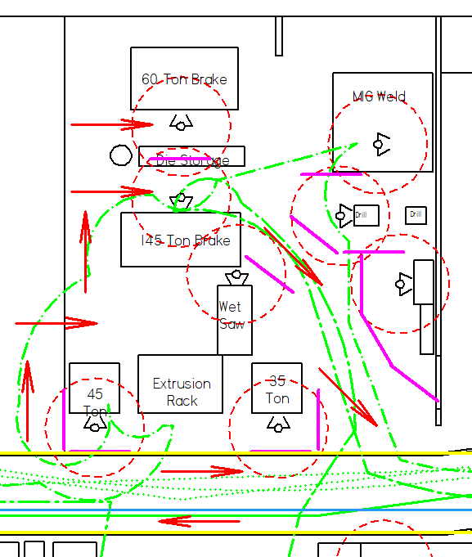
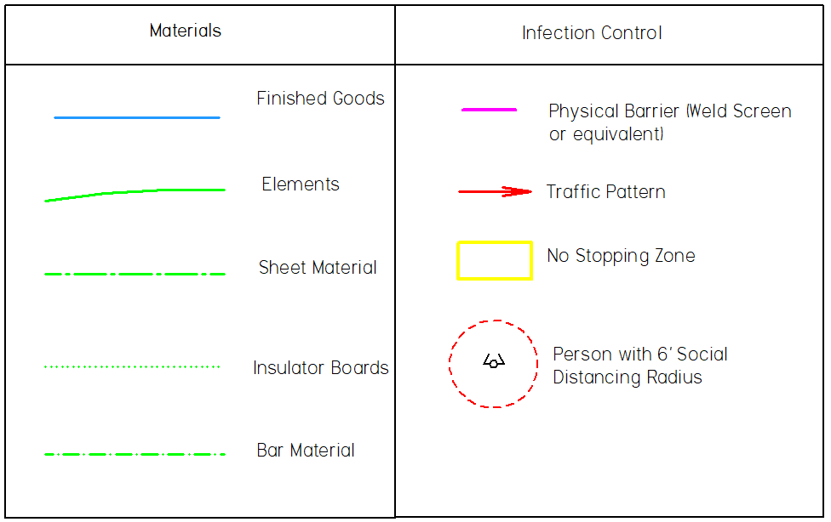
Actual Company Example
Focus Area - Fabrication
38’ x 44’ area
.00479 personnel/sq. ft density
Operators work close to one another
High traffic volume for small area
VSMI
Before
After

Slide 8
Future Opportunity
Short-term: Introduction of Infection Mitigation may have a negative impact on being “Lean” or efficient
Future: Redesign the factory to not only be safe but more efficient by strategic adoption of smart technology

Slide 9
Example of AI Driven Solutions for VSMI
Video Analytics at Purdue
  To create scans to enable creation of accurate Factory Floor Plan
Robotic Dogs at Ford
  To create 3D scans to enable creation of accurate Factory Floor Plan
  https://mashable.com/video/ford-boston-dynamics-robot-dog/

Slide 10
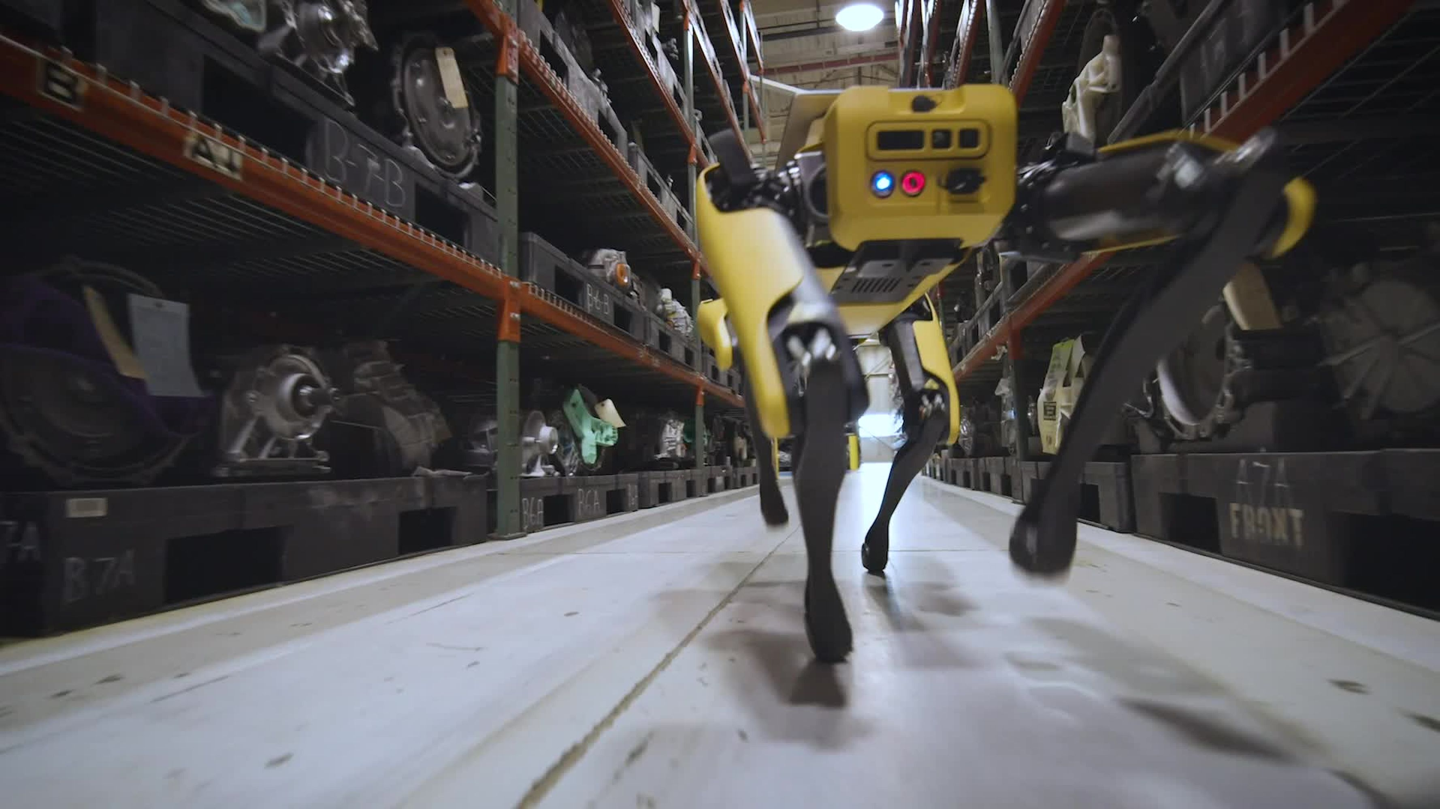
Robotic Dogs at Ford

Slide 11
VSMI to Mitigate Infection Risks
The end
Roy Vasher

