Slide 1
Rich Sherman, Senior Fellow, Supply Chain CoE
Aaron Benningfield, Blockchain Strategist
Leveraging Supply Network Collaboration & Blockchain Technology for Ethical Supply Chain Management
Tata Consultancy Services (TCS)

Slide 2
How important to your organization are supply chain “ethics?”
Extremely important 53%
Not at all important 1%
Not very important 4%
Somewhat important 12%
Very important 30%
Source: Loyola University, Supply Chain Management Review, Peerless Research Group & APICS 2018

Slide 3
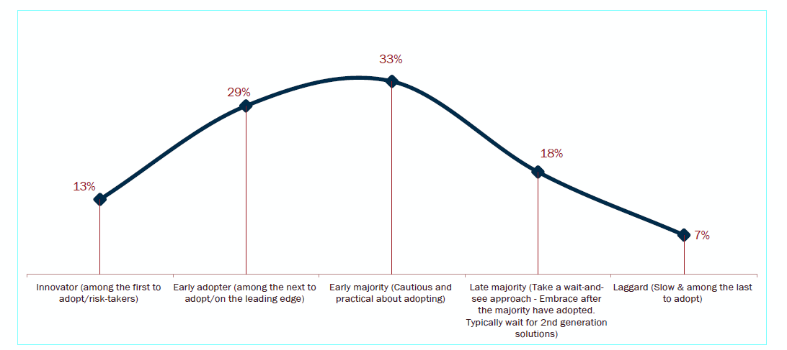
How would you best describe your organization as an adopter of strategies related to ethical supply chain practices?
Source: Loyola University, Supply Chain Management Review, Peerless Research Group & APICS 2018

Slide 4
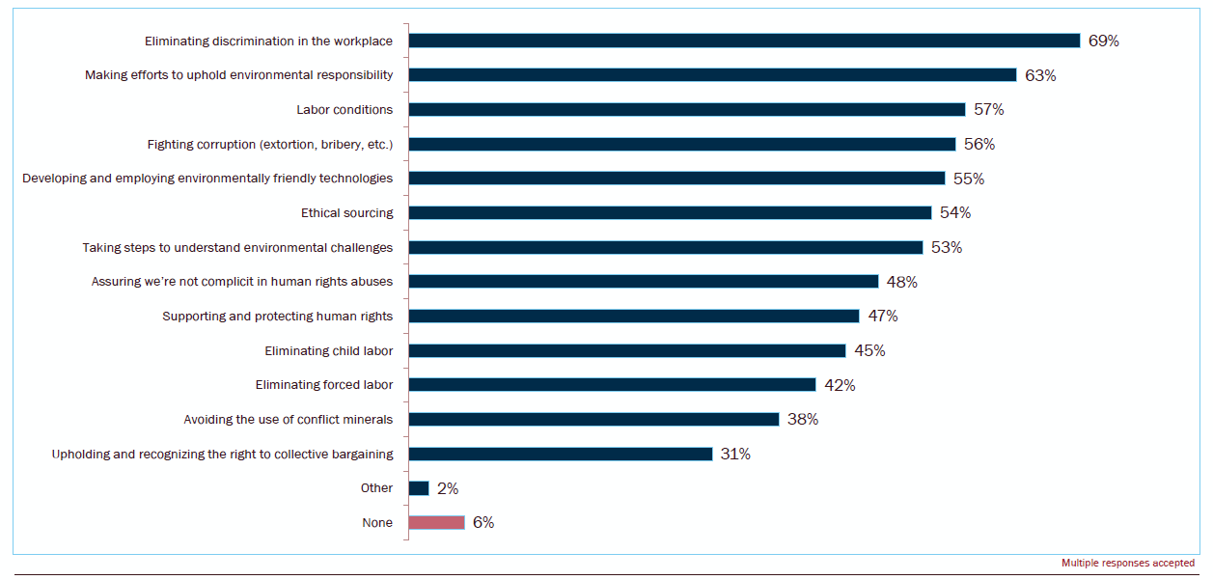
Which of the following practices/principles is your organization now following?
Source: Loyola University, Supply Chain Management Review, Peerless Research Group & APICS 2018

Slide 5
What is Ethical Supply Chain Management (ESCM)?
ESCM is a component and perhaps the driver of Strategic Sourcing –
ESCM – is comprised of Ethical business practices, corporate social responsibility, performance management, sustainability, regulatory compliance, and risk management- financial, operations, and brand.
Proof of Compliance/Auditability is a problem – especially upstream
Supplier Lifecycle and Relationship Management are critical features of the technology infrastructure.
Supply Network Collaboration and ESCM begin with on boarding suppliers and continuously monitoring, auditing, and improving operational compliance and information sharing across 3 Dimensions: Economic, Environmental, & Ethical.
SOME monitoring is a critical component of ethical and risk management
Master Data Management (MDM) is foundational to improving procurement maturity
Supply Management Technology is required for managing complexity, cost, compliance, and collaboration

Slide 6
Traditional Thinking about Collaboration: Sequential and Siloed
Supply chains are viewed as disparate functions and collaboration is often enabled through point to point integration
Internal Collaboration
Customer Collaboration
  POS forecast
  Promotions
  Inter affiliate forecast
  Inter affiliate supply
  Inter affiliate inventory
Contract
Manufacturer
DC
External Supply
Collaboration
  Forecast
  Inventory
  Purchase orders
  Invoices
Retailer
Assemblers
Manufacturer
RDC
Whole seller
Quality Collaboration
Suppliers
Channel Collaboration
  Quality conformance
  Quality assurance
  Channel forecast
  Channel inventory
  Replenishments

Slide 7
Collaborative Supply Networks – Value Drivers
Collaborative value drivers are focused on end to end value chain improvements
Traditional Collaborations are transaction oriented
Approach
VMI, consignment collaboration
Invoice
collaboration
Quality
collaboration
Customer collaboration
Transportation collaboration
Value Drivers
Inventory cost optimization
Accounting cost
optimization
Conformance compliance
Customer service levels
Freight cost reduction
Collaborative Ecosystems are strategically oriented
Approach
E2E collaborative supply network
SOME & supply network collaboration
Integrated supply network management
Analytics based
trade-offs
Value Drivers
Total cost to serve optimization
Ethical SC Management & analytics
Harmonized measurements
across enterprise & supply network ecosystem
E2E ESCM process improvements: cost & compliance

Slide 8
Ethical Supply Management is an Ecosystem of Collaborative Networks
Collaborative networks are integrated around internal and customer facing journeys.
Banks
Settlements
OEM
Credits
Service Center
Banks
Division
Logistics Provider
Contract Manufacturer
DC
Enabling Network
Core
Supporting Network
Assemblers
Retailer
Industry Standard Organization
RDC
Customers
Suppliers
Manufacturer
Whole seller
Customers’ Customer
Government Authorities
Value Flows
Raw Material Supplier
Information Flow
Material & Services Flow
Component Supplier
Licensing
Money & Credit Flow
Licensing
Insurance

Slide 9
Leveraging the SCOR® Framework to Facilitate End to End Digital Ethical Supply Chain Digitalization & Collaboration
SCOR® - E will include ESCM Criteria for Economic, Ethical, and Environmental Supply Chain Management
Plan/Enable
Source
Make
Deliver
Deliver
Source
Make
Deliver
Source
Make
Deliver
Source
Return
Return
Return
Return
Return
Return
Return
Return
Your Company
Customer’s
Customer
Suppliers’
Supplier
Supplier
Customer
Internal or External
Internal or External

Slide 10





Collaborative Supply Networks – Technology Considerations
Technologies with a digital pivot will drive the future of collaborative networks
Machine to machine collaboration
Efficient
on-boarding
Ideation Collaboration
Rapid value creation
Process digitalization &
automation
v
Improved
governance & compliance
Analytics &
Insights
Connectivity/Accountability – utilizing on Blockchain Technology
ESCM/Social Media Collaboration
IoT collaboration
Supply Network Ecosystem
E2E Supply Network Collaboration

Slide 11
An Example of Supply Network Collaboration:
Blockchain Coffee Consortium

Slide 12










A Real World Issue….
Relevant Use Case
Key Requirements
Successful Outcome
Ownership is through the tree and is why he needs to track provenance against the tree.
The need for a coffee consortium enabling a multitude of parties to access the network.
Enablement of provenance certification to meet Auditing standards!
Auditing Body
A Nicaraguan coffee farmer needs to prove his trees (organic) provenance to attract buyers for expanding his business.
X
Seed Producer
Farmer
Nursery
Plant Producer
The farmer has minimal technical knowledge - ease of use and minimal system interaction is critical.
Notes:
Speaker Notes:
This use case helps to demonstrate how a a 3rd world farmer can grow economically using Blockchain as the underlying technology enabler. In this particular use case, this farmer does not have land ownership, ownership is tracked through the track. The farmer wants to expand his business through growing organic coffee. An Auditing Body (NGO) has agreed to provide the resources and funding. A critical requirement is being able to track the organic coffee plant from seed to the farmer. An NGO would need to host and facilitate the Blockchain network along with additional infrastructure.

Slide 13





Enabling the Coffee Consortium
Auditing Body (e.g., NGO)
Monitors and manages certification throughout the coffee plant’s lifecycle
Hosts & manages the technical expertise for the Blockchain enabled authentication mechanism
Facilitates the Coffee Consortium’s trusted information flow
Farmer
Seed Producer
Coffee Consortium
Grows the coffee crop and meets Consortium standards for certifications
Obtains and maintains organic certification approval from the Auditing Body for expansion.
Harvests and packages the organic seed in accordance with Consortium standards
Provides harvesting, packaging and pertinent data to the Consortium.
Nursery
Plant Producer
Grows the organic trees for farmers to produce the coffee crop
Obtains and maintains organic certification approval from the Auditing Body in accordance with Consortium Standards.
Provides pertinent data and information on the organic plants in accordance with Consortium standards
Automates processes and requests generating speed and value of information.
Notes:
Speaker Notes:
When you think of Blockchain, to be truly successful you will need to develop an Ecosystem or Consortium for the participants. In this case we use the term coffee consortium.
In this diagram we lay out what each roles responsibilities will be.
There are five roles identified in this use case. However, a particular entity can encompass multiple roles. For instance a organization may choose to harvest seeds and package them along with choosing to grow the coffee plant.
The underlying assumption for each of the roles is that Blockchain enablement (whether via a Web UI or a scanner etc.) enables each of the roles to carry out their responsibilities so the Blockchain capabilities are noted in the next slide.

Slide 14


Blockchain’s Role in Enablement of the Consortium
Functionalities
Information immutability
Public and private channels
Smart contract functionality
Unique product identification
Disintermediation simplifying transactions for greater efficiency
Information availability across the consortium network
Business process management engine
Automated workflow enablement
Product traceability across the consortium partners
User interface designed for interaction with the Blockchain technology
Electronic asset storage
Notes:
Speakers Notes:
There are a plethora of capabilities demonstrated by Blockchain, a number of which are listed here.

Slide 15

Key Blockchain Takeaways
Consortium Enablement
Likely the most difficult part of building your network
The more partners the better, incentivizing participants is critical.
Strategy Development
A large amount of effort needs to be invested in developing the long term strategy
Technical implementations are similar to other web application implementations
Need to incorporate competing business drivers and the multitude of regulatory requirements.
Data Provenance
Information is not immutable if input data has been corrupted or changed
Mechanisms for ensuring data provenance of input data must be planned for.
Technology Ecosystem
Blockchain is a great tool but like any other tool it should be used appropriately (don’t use a knife to tighten bolts)
Where will IoT, offchain processes, big data, machine learning, data oracles and more fit into your Ecosystem and how can you extract optimal value?
Privacy
Blockchain enabled privacy technologies continue to evolve
Providing the right amount of privacy to the right participants must be appropriately applied (privacy by design).
Notes:
Speakers Notes:
These are a few key takeaways. There are many more but the ones listed above are common areas of discussion we have with clients, not just for purposes of the use case.

Slide 16
The Path Ahead
Value based models and digital technologies combined with ESCM value centric approach are shaping the future of supply network collaboration.
Joint Value Creation: Economic, Environmental & Ethical
Leveraging Data and Insights to Mine Value
End to End ESCM Value Focus
Real Time Visibility & Auditability
Supply Network Collaboration Roadmap

Slide 17
Rich Sherman, rich.sherman@tcs.com
Aaron Benningfield, aaron.benningfield@tcs.com
Questions?

