Slide 1
InTek Freight & Logistics Ethical Global Supply Chains
“Big Enough To Make A Difference, Yet Small Enough To Care”

Slide 2
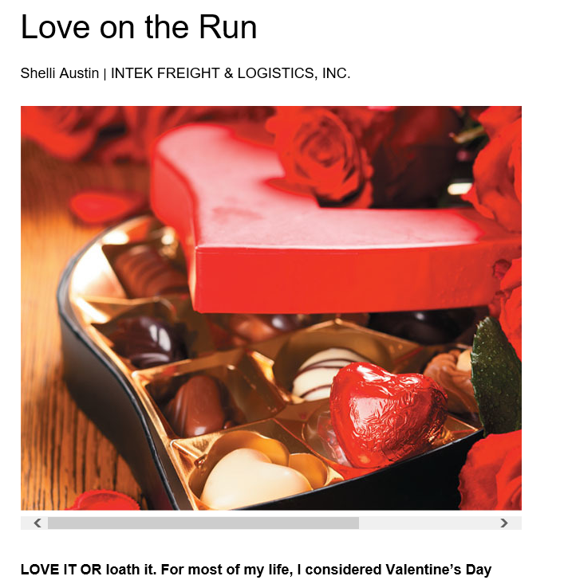
Intek – supply chain management

Slide 3
Ethics in the supply chain 1
“Today’s supply chains are global and truly caring about how those global decisions are made along with the repercussions to those within their path is a responsibility that all corporations and stakeholders should be mindful of as they execute their sourcing and operational strategies. ” … Chris Brach Vice President – Radiant Clipper
“Regardless of your position in logistics and transportation, ethics is the most important trait that lives with you for a lifetime.
You want to look in the mirror, everyday, and say: Today, I did all the right things.
In business, you only win, if both sides win.”… Jeff Brashares Senior Vice President - Suntecktts

Slide 4
Ethics in the supply chain 2
Is it questionable ethics or lack of knowledge?
Pricing
Back Selling
Invoice Payment
Liability

Slide 5
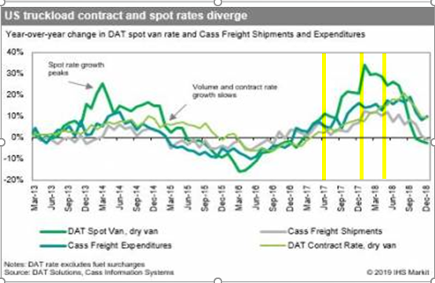
Pricing - Disruptions in the market
“Don’t leave money on the table”
“Ride the wave”
Hurricanes of 2017
ELD’s – Electronic Logging Devices
International Tariffs
Precision Railroading

Slide 6
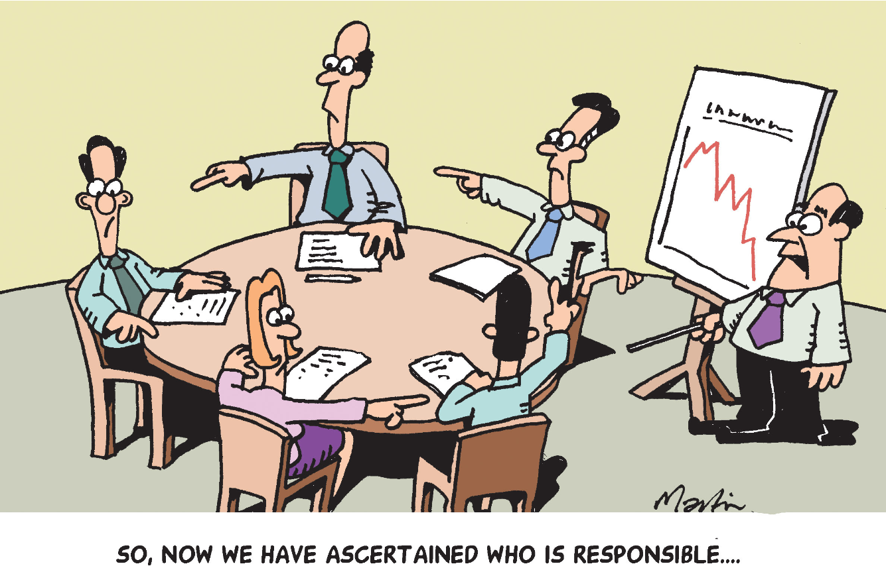
Back Selling and Liability
SunteckTTS

Slide 7
To sum it up…
Be intentional with every decision made in the supply chain!
Constantly focus on making your end customer look good. Internal customer and/or External customer
Know that the right decision is not always the profitable decision
Strive to go home each day feeling you made the best ethical decisions for you, your company and your customer!
SunteckTTS

