Slide 1
Supply Chain Overview & Our
Corporate Perspective on Ethics

Slide 2




WHO ARE WE
13 LOCATIONS
2+1
2,000+
BUSINESS UNITS
ASSOCIATES
$707M
ESTABLISHED IN
1985
Certified Minority Business Enterprise*
REVENUE FY2018
2
Telamon Confidential & Proprietary

Slide 3
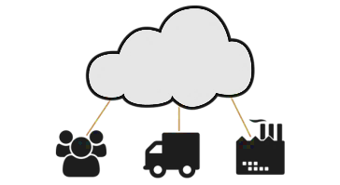


TELAMON BUSINESS UNITS
TELECOM SOLUTIONS
Supply Chain, Deployment Ready Solutions, Field Services, Wireless, Fiber Optics
INDUSTRIAL SOLUTIONS
Wire Harness Assembly, Secondary Harness, Switch Assemblies, Light, Industrial Assembly, Kitting & Packaging
TELAMON ENTERPRISE VENTURES
Solar Design, Development, Engineering, Project Management & Building Automation
4
Telamon Confidential & Proprietary

Slide 4
COMMON THEMES ACROSS OUR BUSINESSES
FIELD SERVICES
  End to end solutions from product procurement to deployment, construction and optimization.
DEPLOYMENT READY SOLUTIONS
  Custom kitting, assembly, & integration, pre-configured software downloads, inventory staging & management
SUPPLY CHAIN
  Centralized purchasing, warehousing and shipping of material, inventory staging and management
Supply chain management is the foundation of our business units and ethics
are the foundation of those supply chains
6
Telamon Confidential & Proprietary

Slide 5
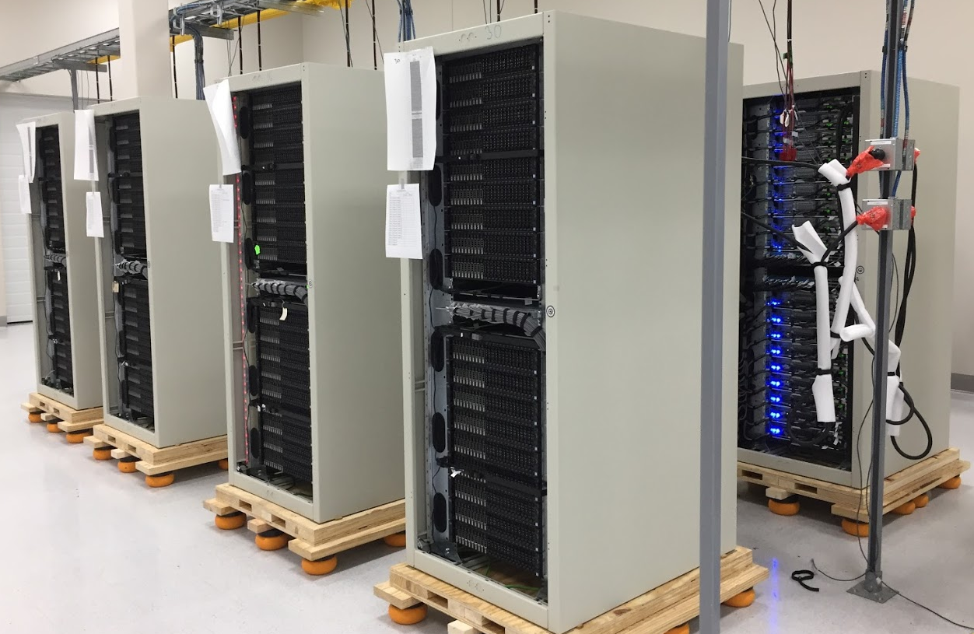
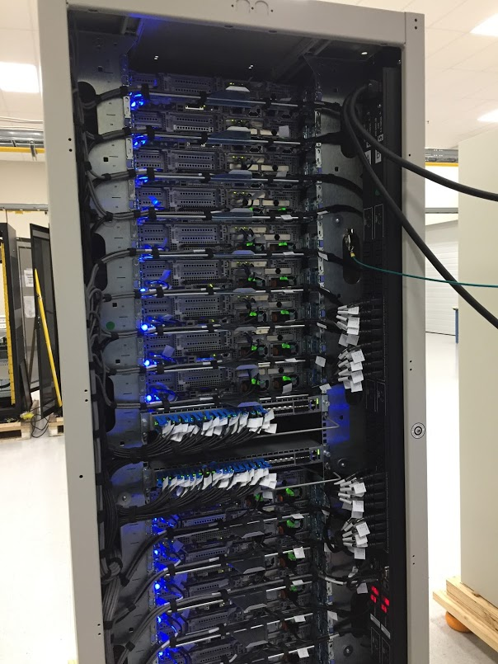







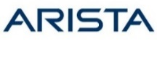




TELECOM SUPPLY CHAIN &
PRODUCT INTEGRATION
50 Cabinets 741 Servers
1.5 Miles of Power cables
3.5 miles of Cat6 cables
3.5 miles of Twinax cables
800 fiber runs
2100+ Optical Pluggable (10G to 100G)
Assembly timeframe < 41 days
Fully Commissioned & Provisioned = Plug & Play
1500+ boxes of material
Total weight is estimated at 45 tons of equipment = 3 semis
Greatest Challenge: Design Changes – 16 versions
Shock resistant pallets & encasements
11
Telamon Confidential & Proprietary

Slide 6
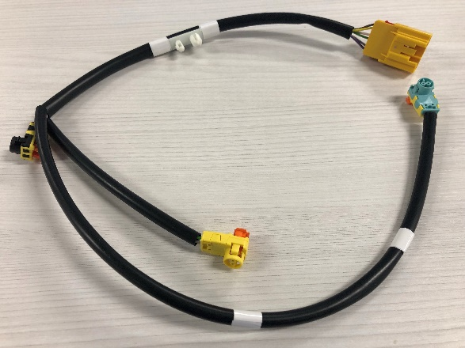
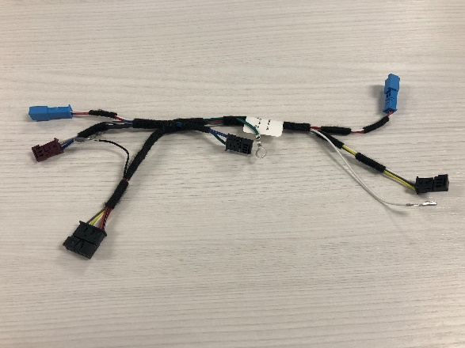
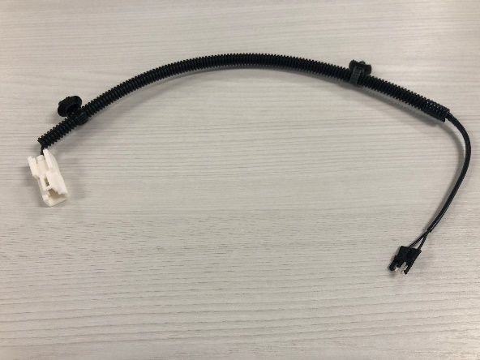
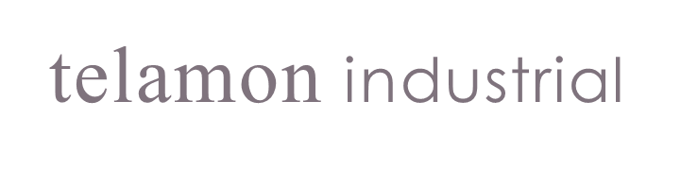
WIRE HARNESS BUSINESS LINE
Product line
  High volume, high quality automotive supplier
  24M+ parts shipped annually
  Wire harness applications:
    Airbag, steering wheel, seat belt
    Powertrain, door, seats, mirrors
    Lighting, eShifter/eBrake, instrument panel
Quality driven organization – 0 ppm
  ISO 9001:2015 / IATF16949 Certification
  Failure Mode Effects Analysis (FMEA) driven systems
  Advanced Product Quality Planning (APQP) driven flawless launch
Passenger Airbag Harness
Steering Wheel Harness
Seat Belt Harness
18
Telamon Confidential & Proprietary

Slide 7
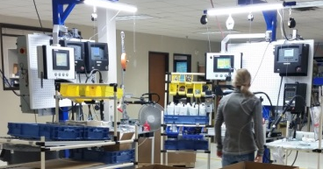
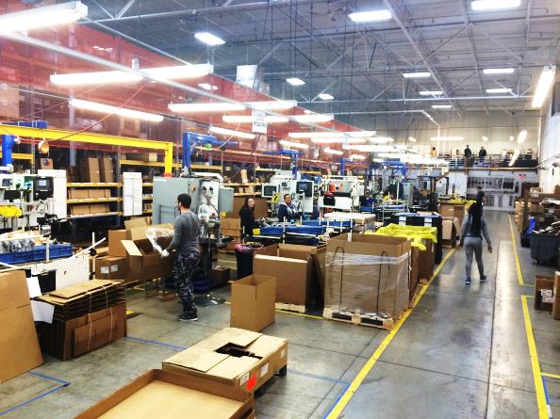
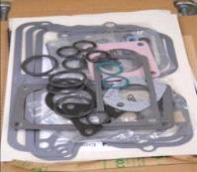
KITTING & ASSEMBLY BUSINESS LINE
Light Industrial Kitting and Assembly
IATF 16949:2016 Certification
Kitting
  400+ unique kits
  2,000+ components
  Low volume/high mix capability
  Custom packaging capability
Assembly
  Air intake assemblies
  Filter head assemblies
  Valve cover assemblies
  Camshaft gear assemblies
  Other light duty sub-assemblies
19
Telamon Confidential & Proprietary

Slide 8
SUPPLY CHAIN
Factors & the Impact of
Ethics
INBOUND – Managing Suppliers
Quality
Safety
Value vs. Costs
Ethics vs. Compliance
OUTBOUND – Being A Supplier
Warranties
Liability
Productivity
OTD
PPM
In our business ethics translates into performance and
reliability and more often than not safety; there is no room for compromise
6
Telamon Confidential & Proprietary

Slide 9
Impact of Regulatory & Federal Policy on Ethics
GOOD POLICY - Vetted
Sets fair standards across the board
Accents the right way to do business
Levels the playing field for all players
May have short term cost impacts, but drives a new and better standard for the long game
Compliance = Ethics
POOR POLICY* – Unvetted
Could affect costs either way
Could make life easier or more complex
Could provide fewer or greater constraints
May tempt one to take short cuts and do the wrong thing for short term gains
*The “right” choices will benefit your business over the long run;
the ball is in your court. Make the right call even if it’s not required.
6
Telamon Confidential & Proprietary

Slide 10
Thank You
2
6
Telamon Confidential & Proprietary

