Slide 1
Are you prepared for the supply chain of the future?
Carmen Collier
Amazon Program Management- CS ACES Learning & Methodology

Slide 2
Agenda
Why so many Supply Chain Disruptions?
Are you prepared for Innovation and Technology?
How is your data quality?
What’s does the future hold?

Slide 3
Why so many Supply Chain Disruptions?

Slide 4
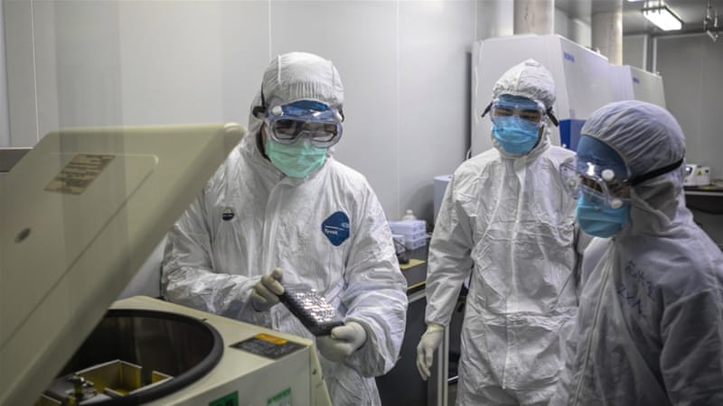
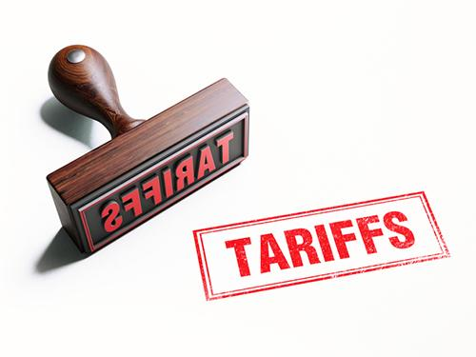
Disruptions

Slide 5
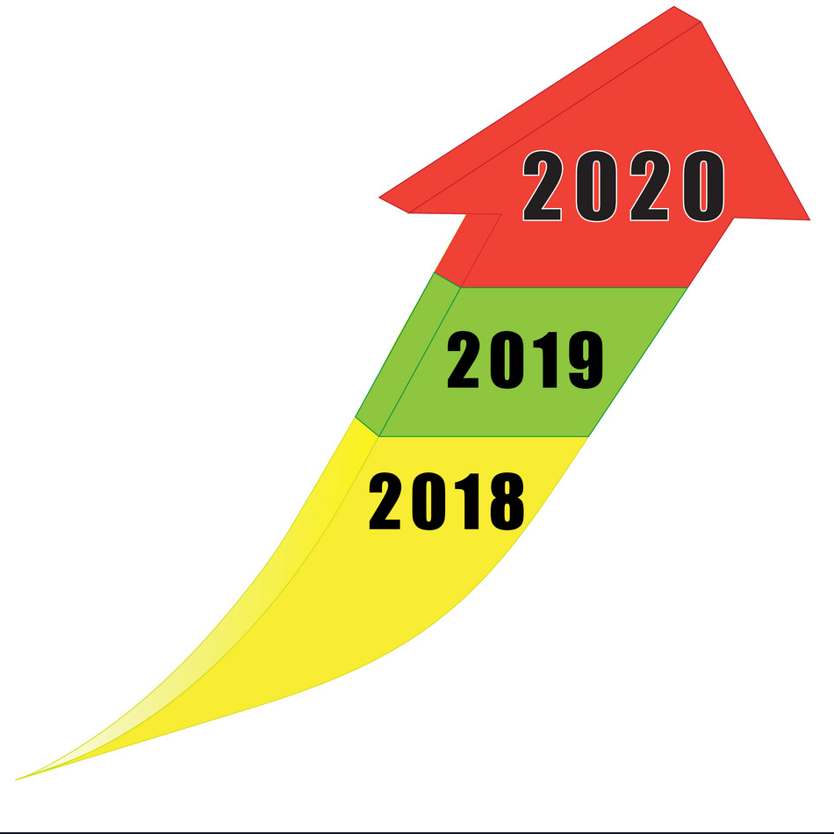
Supply Chain Trends and Impacts
Geopolitical unrest
Climate change and resource scarcity
Sustainable supply chains
Changes and variation in customer demands
Innovation and Technology
SUPPLY CHAIN DISRUPTIONS

Slide 6
Are you prepared for Innovation and Technology?

Slide 7
Innovation
IOT
Robotic Process Automation

Slide 8
How is your data quality?

Slide 9
How are you using your data?
Real Time Data
Advanced Analytics

Slide 10
What’s does the future hold?

Slide 11
IS this the Future Supply Chain?
Increased Complexities
Scalability & Agility Demands
Key Metrics
Efficiency
Effectiveness
WHAT DO YOU THINK THE FUTURE IS GOING TO BE?

