Slide 1

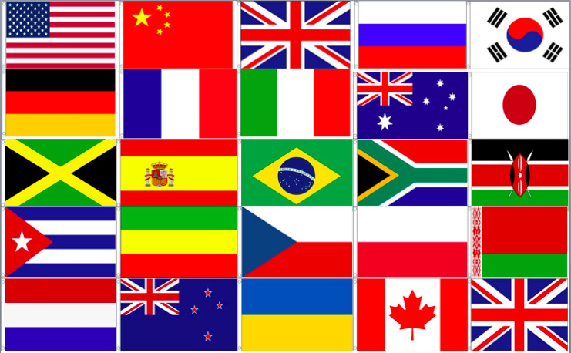


A Comprehensive Review of Global Supply Fain Risks
`
A Comprehensive
Review of Global
Supply Chain Risks
-Michael Musleh BB/TPM/TPS

Slide 2
Global Supply Chain Risks
Global Supply Chain Risks
A lot has changed since I sat in chairs of Lilly, Math building, Krannert.
Many of the risks we now know about weren’t written back in the 90’s
What I will talk about today are risks that I have witnessed in my various
positions in the last 20 years
I am no expert in all risks, but I will state I have been in the following
Industries and should provide a wide breadth of knowledge
Automotive; 10 years
Ag/on highway off highway vehicles: 10 years
Medical implants/instruments: 5 years
I have managed supply chains as small as 100M to 700M in spend.
They have been in close to 32 countries.

Slide 3
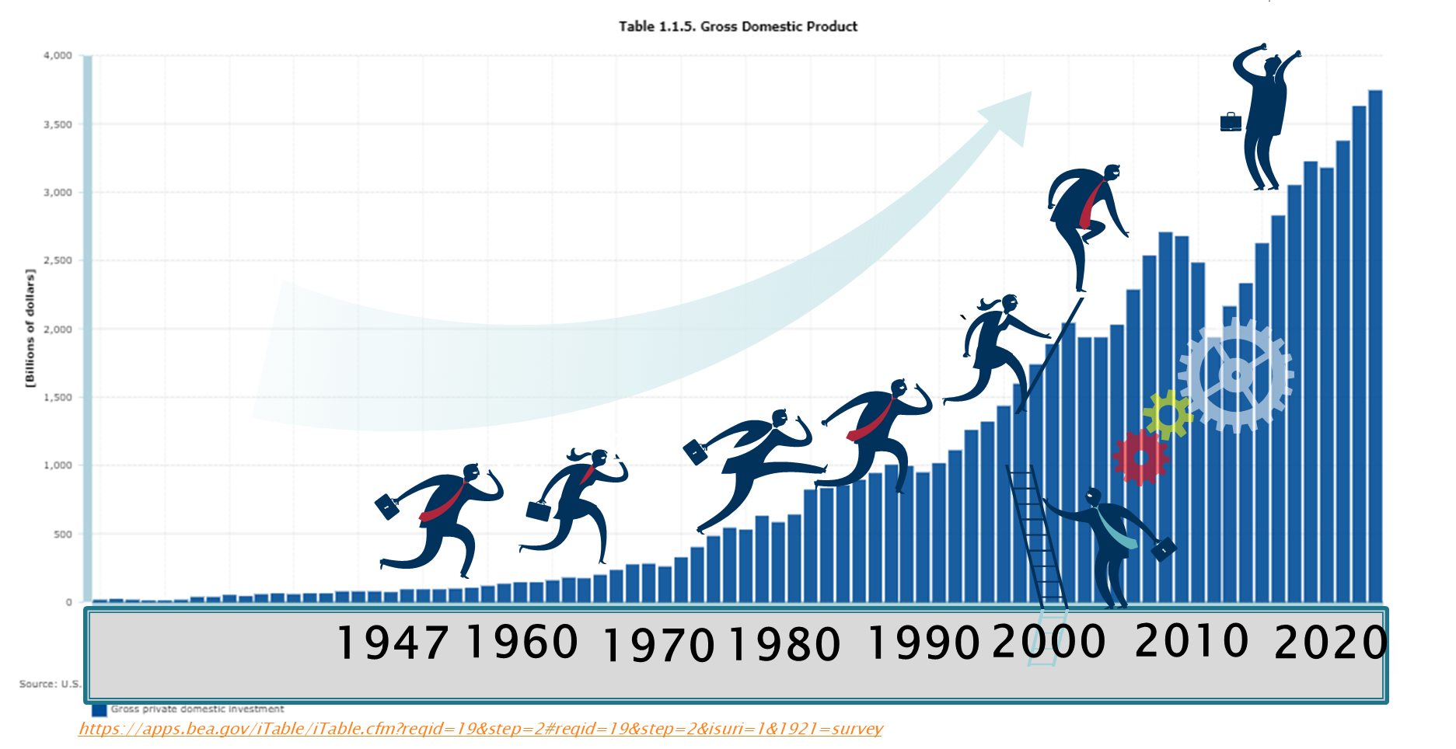
GD&P USA 1945 TO 2019
GD&P USA 1945 to 2019

Slide 4
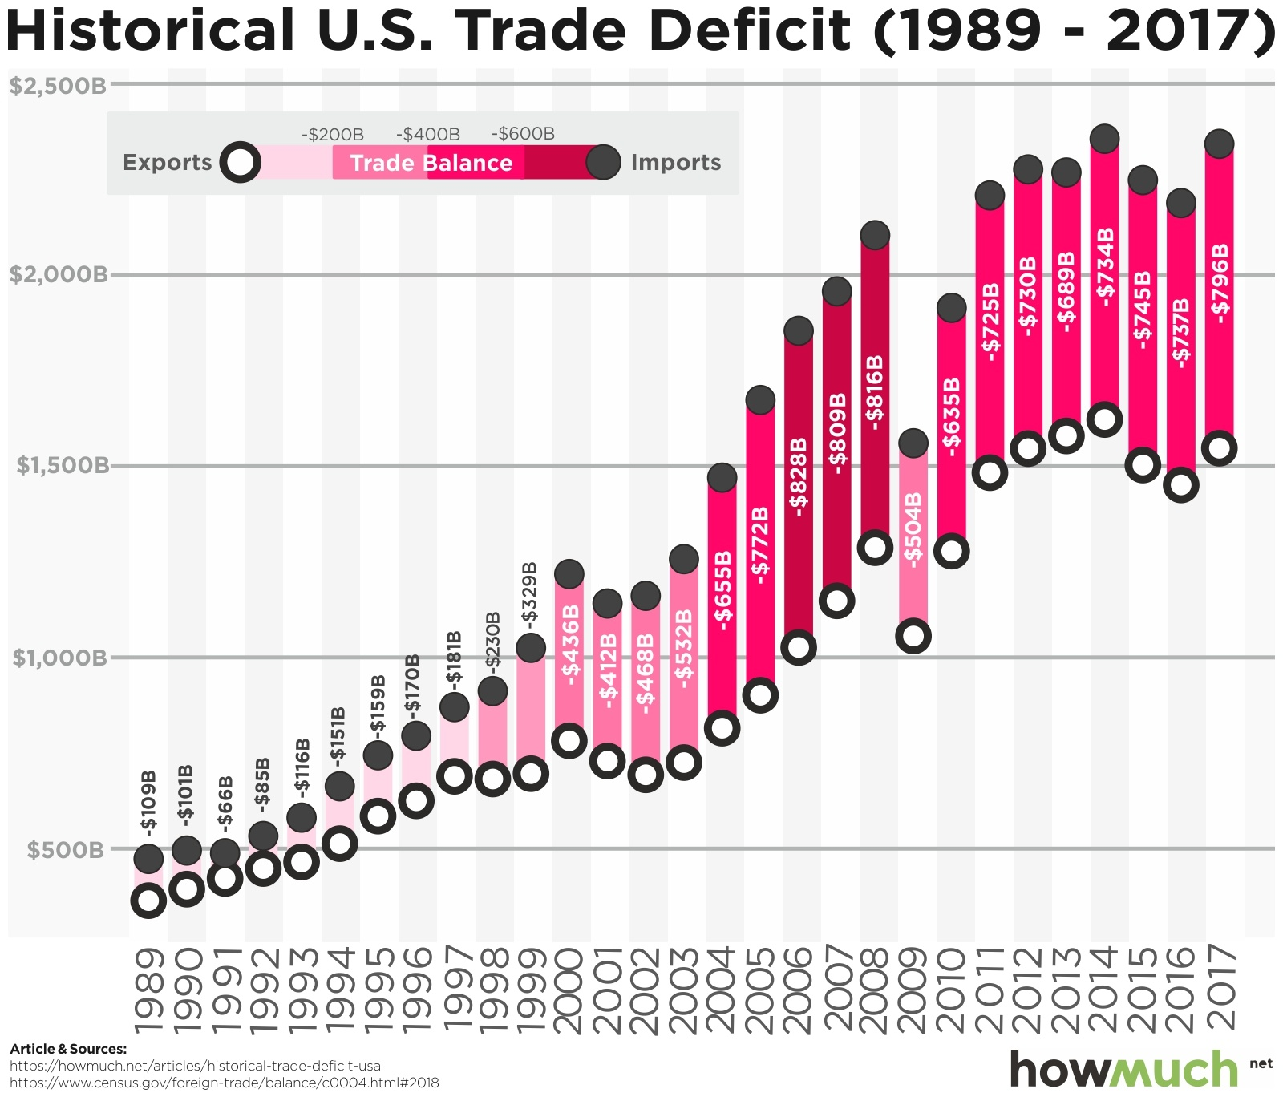
Historical Trade 1
Historical Trade

Slide 5
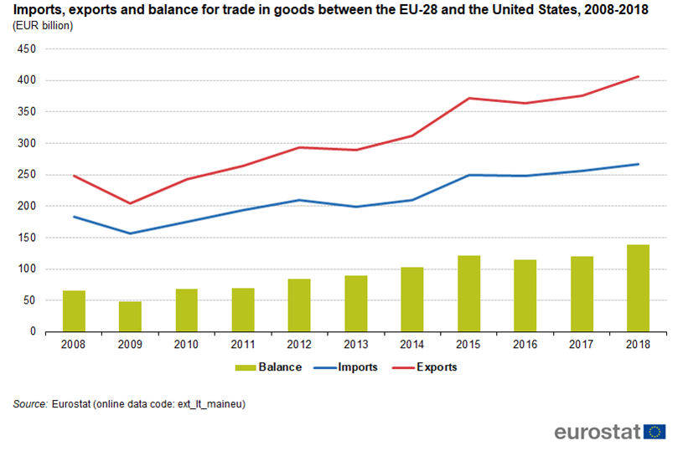
Historical Trade 2
Historical Trade
150% -200% from 2008 to 2018

Slide 6
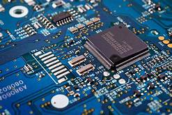
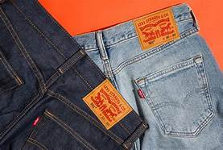
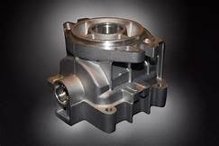
Are Global Supply Chains a good thing?
Are Global Supply chains
a good thing?
In terms of price and long term
quality for the
End user normally YES
PC and many other
prices are lower now than
10 years ago.
In terms of your company, it
depends. Today I will outline
many of those situational
positions.

Slide 7
What about Mechanical Issues:
What about Mechanical Issues:
For the purposes of this discussion we will call anything that
normally is a result of the supply chain length (Mechanical in nature)
The more obvious issues that must be overcome
Normal Leadtime in Country: 33 Days:
APAC: 87 Days
Vendor
Leadtime
30 Days
Transit
3 days
Vendor
Lead
Time
35
Export controls
5 Days
Boat
45
Port
3 Days
Customs
3 Days
Final
Transit
1

Slide 8
Mechanical Issues: Supply Chain Length 1
Mechanical Issues: Supply Chain Length
  Leadtime changes (87-33 days)
    Port closures, strikes, weather
      Ex: Counter measurer: Inv. buffer
    Every step in the supply chain is a risk now
    Potential quality and obsolescence issue
      Ex: Counter measure: Contractual w/customer
  Cash / Liability Cycle
    54 more days of liability on the books.
    Having FOB your dock doesn’t shield you from
    that risks.
In Country
33 Days
APAC
87 Days

Slide 9
Mechanical Issues: Supply Chain Length 2
Mechanical Issues: Supply Chain Length
Counter measures:
Lead Time: Inventory days for port / strike risks
Liability Cycle: Contractual / legality clauses

Slide 10
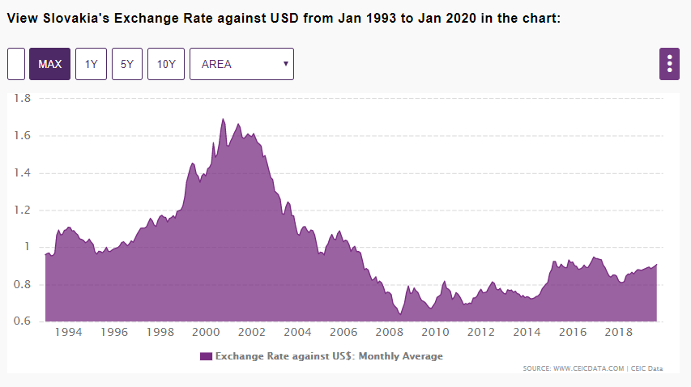
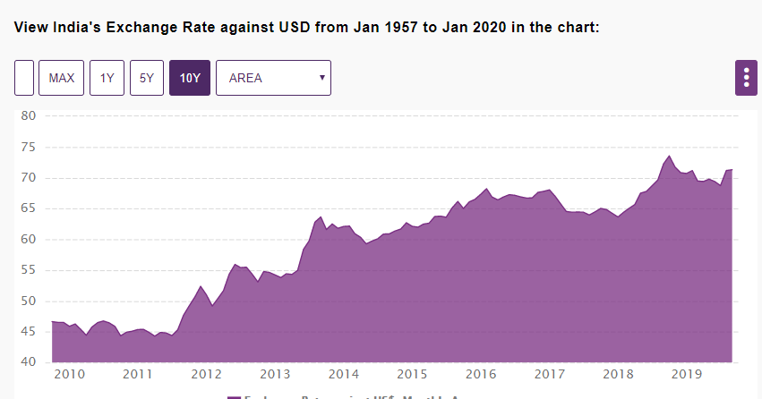
Mechanical Issues: Currency 1
Mechanical Issues: Currency
There are no winners
long term in currency
Exchange in a supply chain
2002 $1 USD to $1.6 SKD
2008 $1 USD to $.8 SDK
Unfavorable
$4.3M sales 2004=
$5-6M by 2008
Favorable
2010 $1 USD to $45 RUP
2019 $1 USD to $70 RUP

Slide 11
Mechanical Issues: Currency 2
Mechanical Issues: Currency
Counter measures:
Natural hedge
Contract
Hedging Currency

Slide 12
Mechanical Issues: Proprietary 1
Mechanical Issues: Proprietary
What about Mechanical Issues:
  Proprietary risks
North America and EMEA has strong intellectual integrity policies,
laws, and such to protect intellectual interests
Many countries in APAC doesn’t. Many companies are networked and
share intellectual, costing, and other trade secrets like they are candy.

Slide 13
Mechanical Issues: Proprietary 2
Mechanical Issues: Proprietary
What about Mechanical Issues:
Assume nothing
Contractual (Minimum counter measure and assume isn’t perfect)
Never provide drawings or math data that provides “complete modules/assemblies to supplier”
Redact all prints
If you can only provide partial value add to a key part from one company do it.
Dual source all items
Good commodity management will help here

Slide 14
Geo –Socio-Political: 1
Geo - Socio-Political:
What about Mechanical Issues:
  If countries are not in favored nation status :
Tariffs:
-Knee jerk reactions to opposing country leaders
Good-will between countries:
-Media impacts can’t be under-estimated
Unethical governmental abuses:
-Bribes, etc.
Illegal Activities
-Kidnapping, vandalism, etc.
Local taboos
-You have all heard of the misc. social cues
-Shaking wrong hand in India
-Not finalizing contracts at dinner etc.

Slide 15
Geo - Socio-Political: 2
Geo - Socio-Political:
What about Mechanical Issues:
Assume nothing
Do your research on tariffs. Companies like FedEx love to help in that. Share risks in contracts.
Don’t go to countries that are at odds with yours
Be prepared to “legally manage” corrupt governments
Life insurance companies do a good job releasing high risk areas of the world. Pay attention to them.
Don’t go into a foreign nation without boots on the ground to support, educate, and guide you.

Slide 16
Other risks
Other risks
I have over 7 more pages of risks, but only 20 minutes
However, supply chain risks go much further than inventory,
savings, and lead time.
Example of some larger risks that were published:
Child Labor impacting company’s (Gap, Guess, etc.)
Blood diamonds/metals (Phone companies)
Overseas governmental influences (Apple/Google/etc.)

Slide 17
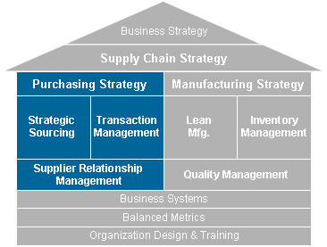
Most Important first step: 1
Most Important first step:
Company Structure and Balance

Slide 18
Most Important first step: 2
Most Important first step:
Company Structure and Balance
The responsibility of these decisions are often managed
by purchasing
What checks and balances do you have on global decisions?
Is there a group that works with manufacturing and purchasing
to make a balanced approach?
Do you have a group to monitor the health of the company,
quality, and cash health
5. If not ask a simple question:
  a. Would you and your “C” suite trust the person making these
  decisions with their own personal finances

Slide 19
These aren’t all the risks: RIGHT!
These aren’t all the risks: RIGHT!
Risk Categories:
Dollar Impact
Sales Impact
Proprietary Impact
Good-will with Customers
Etc.
The risk of a automotive
brake company is
different than
a company that makes
yard supplies
There is no answer without risks. The key is understanding them,
making counter measures for them, and monitoring via a cross
functional team. There is no company that is successful without some
supply chain risks

Slide 20
Measure, Analyze, Agree, Act
Measure, Analyze, Agree, Act

Slide 21

Thanks and
Thanks and

