Slide 1
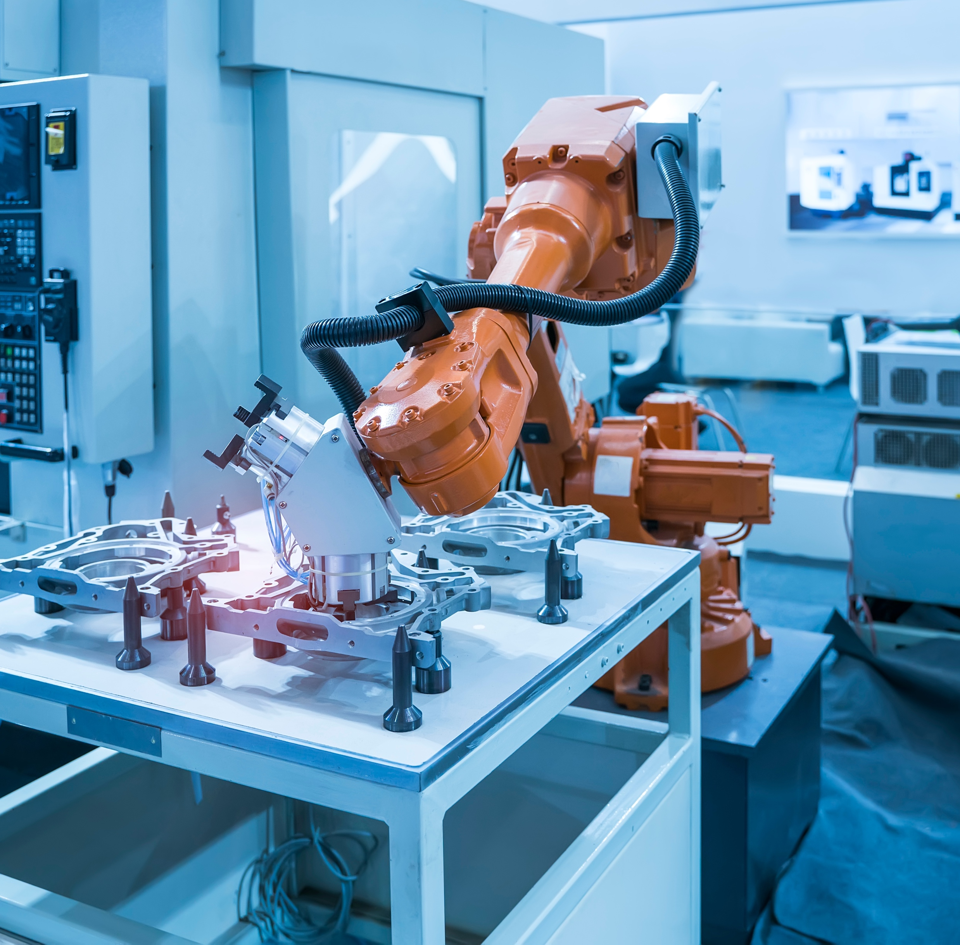


GSCMI Supply Chain Conference:
Supply Chain Resilience in the COVID Age

Slide 2
Framework of Discussion
Key Points
Indiana as a leader in advanced manufacturing and logistics
Short Term Impacts on Supply Chains
Short Term Challenges & Opportunities
Long Term Challenges & Opportunities

Slide 3
AML Drives the Hoosier Economy
Advanced manufacturing and logistics are key to Indiana’s economy.
#1
+500,000
$98b
Manufacturing intensity
Hoosiers are employed in industry
Indiana goods exported each year
30%
+10,000
of IN GDP from making goods
Companies comprise industry in Indiana
$650b
Indiana > Hawaii
goods traveling through IN each year

Slide 4
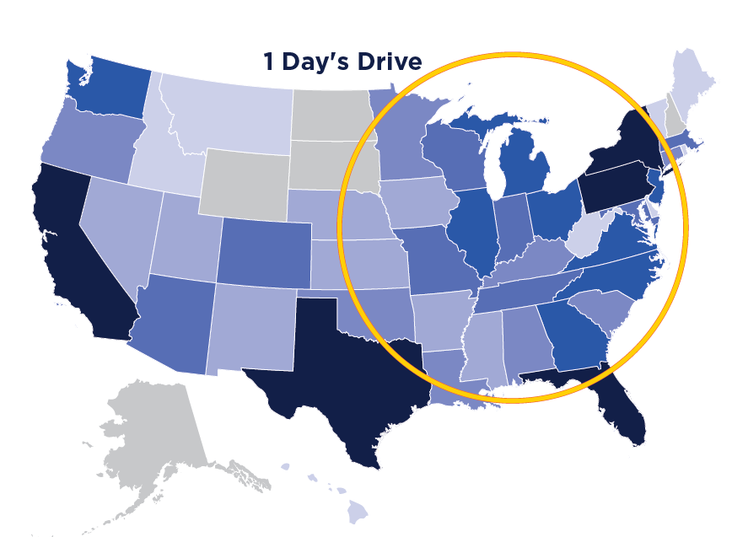
The Nation Moves Through Indiana
Indiana has best in-class connectivity bringing our goods to the world
Shortest distance to median center of U.S
1st
3rd
Pass-through highways
Total freight railroads
2nd
6th
Largest FedEx air hub
Largest cargo facility nationwide
2nd
8th
Largest dry barge cargo fleet
Truck tons originated & truck tons received

Slide 5
Short Term Supply Chain Impacts
Indiana, like the rest of the world, was impacted by COVID-19.
Transportation
Dramatic reduction in passenger vehicle traffic
  April saw a 40% drop in commuter traffic due to stay at home guidance
  At the same time, truck traffic increased 20%
Trucking demand became extremely volatile due to unreliable manufacturing operations
Trailer capacity, which delivers 80% of goods Indiana, became scarce with rates rising 13%
Truck operators fell into higher risk category

Slide 6
Short Term Impacts of COVID contd.
Manufacturing
Facilities coming on and off-line
  Essential vs. non-essential
  Instability in supplier operations and access
  Incomplete supplies
  Scarcity of cleaning materials
Fragmented workforce
  Furloughed workers
  Contract tracing
  2x rate of people leaving the workforce

Slide 7
Short Term Challenges & Opportunities
Challenges
Real trends vs. false trends
Reduced and inconsistent labor pools
Cost of doing business exponentially higher than expected
Lack of visibility in supply chains
Opportunities
Accelerated deployment of technology
Redeploy/realignment of workforce
Capture disconnected service industry workers
Ability to add verticals to business offerings
Capture portion of e-commerce market - grew 45% in Q2 ’20
Strengthen understanding of supply chain with digital tools

Slide 8
Long Term Challenges & Opportunities
Challenges
Recalibration of supply chains
  Rapid shift in consumer reliance on e-commerce changing business models
  Understanding how international supply chains will adapt
  As manufacturers seek to eliminate instability, what services will disappear
  How will inventory levels change
  What safeguards will customers require

Slide 9
Long Term Challenges &
Opportunities contd.
Challenges
Ability for real estate market to keep up with changing demand
Search for political stability in international markets
Labor availability for entry level supply chain roles
Public sector
  Ability to support remote work through digital infrastructure
  Recapture foreign direct investment - 40% reduction in 2020

Slide 10
Long Term Challenges & Opportunities
Opportunities
Supply chains
  Accelerate tech adoption/deployment
  Adapt business services to new landscape
  Changes in commuting patterns creating interstate capacity for freight
  Better balance within modes
Workforce
  On-shoring/near equals more U.S. jobs
  Integrate technology to create better, more fulfilling roles within advanced manufacturing and logistics
  Increased awareness of criticality of supply chain

Slide 11
Looking Forward
Challenges
Right-sizing and re-skilling talent
Calibrating services to changing customer demands
Changing well-tuned, multi decade processes
Sourcing/approving new suppliers
Opportunities
Shorter, less complex supply chains
Accelerate digital adoption
Capture business from changing behaviors
Build more efficient and more transparent business processes

Slide 12
Thank you,
Bryce Carpenter
Vice President, Industry Engagement
Conexus Indiana bcarpenter@conexusindiana.com
317-504-6559

