Slide 1
Insights from Projects at GSCM
Ananth V Iyer
Susan Bulkeley Butler Chair in Operations Management
Academic Director, GSCMI
aiyer@purdue.edu

Slide 2
Agenda
Future: The future trajectories for growth (now to 2050) and global supply chain impacts
DOE Projects: The impact on Electric Vehicle demand, thus batteries and magnets, thus critical materials. Supply/ Demand forecasted issues
INDOT Projects: Impact at the county level in Indiana and projects to enable growth
Summary

Slide 3
Scenarios – Thinking about the future
SSP – Shared Socio-Economic Pathways
SSP 1: predicts a world of sustainability-focused growth (RCP 5.5)
SSP 2 is the middle of the road, follows historical events (RCP 6.7)
SSP 3 represents a fragmented world/ Regional rivalry (RCP 7.2)
SSP 4 is a world of ever-increasing inequality (RCP 5.8)
SSP 5 is a world unconstrained growth Fossil-fueled Development (RCP 8.5)
RCP – Representative Concentration Pathways - levels of greenhouse gases and regulatory constraints on the emission
RCP2.6 is a stringent regulation allowing ~450 ppm CO₂ emission. (Paris Agreement)
RCP4.5 allows ~660ppm CO₂ emission so less stringent mitigation efforts, etc.
Why does the SSP-RCP regime matter ?

Slide 4
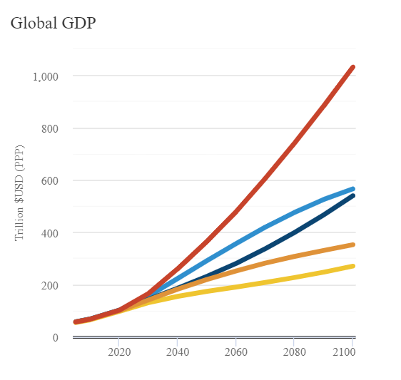
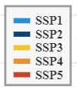
All SSP data available at
https://tntcat.iiasa.ac.at/SspDb/dsd?Action=htmlpage&page=20
Scenario | Region | 2050 | In US $2005 billions/year
SSP1 | World | 284564.683
SSP2 | World | 229718.399
SSP3 | World | 177283.735
SSP4 | World | 219216.134
SSP5 | World | 360926.061
SSP impacts world GDP significantly

Slide 5
Department of Energy Project
Analyze the impact of supply chain constraints for Critical Materials
Understand Electric Vehicle (EV) volumes
Project demand for batteries and magnets
Understand the associated demand at the materials level
Project supply demand mismatches
Explore opportunities to fix those gaps

Slide 6
Note that SSP5 with RCP spans most of the EV forecasts by consultants
SSP5-ECP 2.6
SSP5

Slide 7
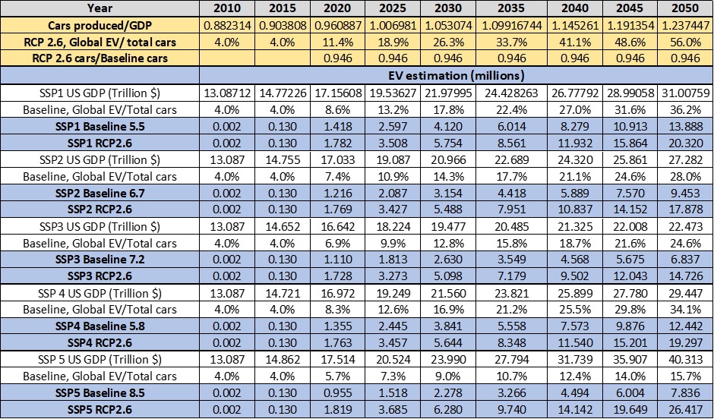
EV demand in millions of units by SSP and by RCP

Slide 8
Battery Scenarios in the Future
Battery Technologies are evolving – and use different mix of materials
To find the content for each element till 2050, we use a regression based estimate.

Slide 9
Cobalt

Slide 10
Cobalt – Baseline Without Recycling
SSP baseline demands are not met by the respective supplies
SSP2 baseline demand for 2050 is 52 k-tonnes and the supply is 18 k-tonnes.
SSP5 baseline demand in 2050 is 43 k-tonnes and supply is 26 k-tonnes

Slide 11
Cobalt - Baseline with Recycling
Baseline supply including recycling fulfills demand at collection rate of 100%
SSP2 baseline/CR 1, the total 2050 supply is 57.38 k-tonnes and the demand is 52.7 k-tonnes.
Collection rate 60%, then in 2050 there is a shortage for SSP2, and just enough supply for SSP 5

Slide 12
Cobalt – RCP 2.6 with Recycling
For RCP scenarios, collection rate of 100%, there is a shortage for SSP2 and SSP 5.
In 2050, for SSP2 and SSP5 the supply is 80kt and 104kt whereas the demand is 99kt and 147kt respectively.
If the collection rate is 60%, then the gap increases further.

Slide 13
What have we learned
The global political relationships matter for world GDP
The RCP (emissions control) matters – it does not impact GDP much, but it does impact use of EVs (and Wind Turbines)
In the absence of recycling, material shortages and thus difficulty attaining target emissions reductions
With recycling, most of the supply gap is decreased
Thus, a robust recycling system, combined with technology improvement can enable a stable supply chain

Slide 14
INDOT Project
How will Indiana and its counties grow in the future ?
What road capacity increases will be needed to support economic growth ?
Use the same SSP-RCP scenario approach to project county GDP growth
Capture county level industries, truck volume intensity
Identify congestion in roads
Project a priority for new projects

Slide 15
INDOT PROJECT OVERVIEW
Ramp infrastructure planning tool for INDOT
Anticipating future traffic increase due to industry growth
Comparing current level of service
Facilitating congestion free expansion of industries in Indiana

Slide 16
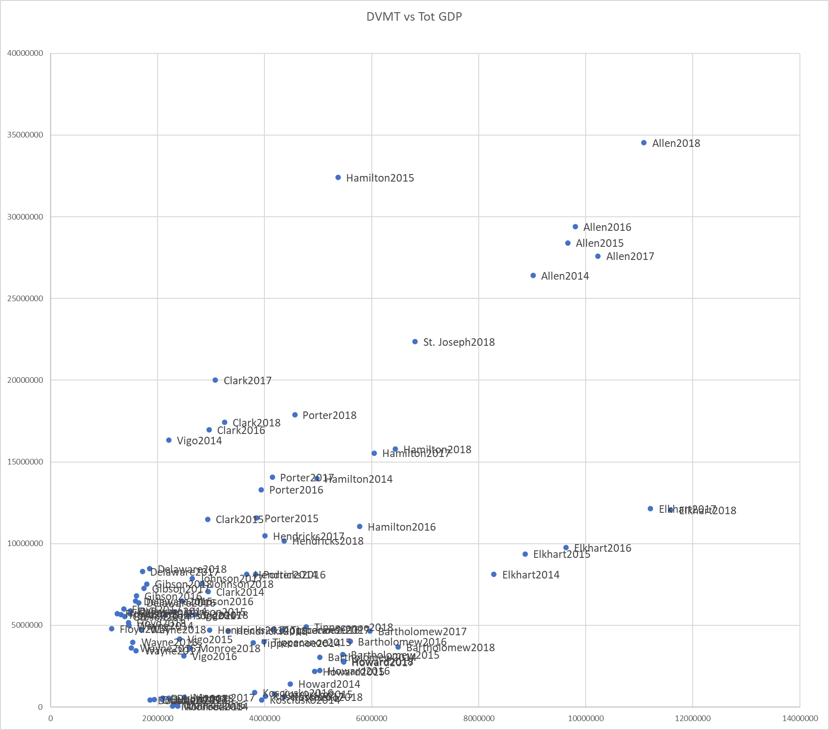
CLUSTERING USING TOTAL GDP
DVMT – Daily Vehicle Miles Travelled
Clustering was conducted using Total GDP* (Aggregate of Manufacturing, Wholesale, Retail, Transportation, Construction)
Conducted stepwise regression independently for each cluster
As in the previous model each cluster had a moderately good linear fit with an exception of Dubois, Monroe and Kosciusko
A separate cluster was created for said counties
Cluster 1 | Cluster 2 | Cluster 3 | Cluster 4
Bartholomew | Allen | Delaware | Dubois
Elkhart | Clark | Floyd | Kosciusko
Howard | Hamilton | Gibson | Monroe
Tippecanoe | Hendricks | Johnson
 | Porter | Vigo
 | St. Joseph | Wayne
Moderate growth in DVMT with increase in Mfg. GDP
High growth in DVMT with increase in Mfg. GDP
No apparent trend
Very low GDP resulting in minimal increase in DVMT

Slide 17
Tippecanoe county GDP forecasts
Scenario | Region | 2020 | 2025 | 2030 | 2035 | 2040 | 2045 | 2050
SSP1 | Tippecanoe | 7.787 | 8.634 | 9.505 | 10.377 | 11.214 | 12.002 | 12.720
SSP1-26 | Tippecanoe | 7.787 | 8.634 | 9.505 | 10.377 | 11.214 | 12.002 | 12.720
SSP2 | Tippecanoe | 7.743 | 8.474 | 9.144 | 9.757 | 10.339 | 10.887 | 11.393
SSP2-26 | Tippecanoe | 7.733 | 8.453 | 9.112 | 9.706 | 10.269 | 10.793 | 11.276
SSP3 | Tippecanoe | 7.604 | 8.167 | 8.613 | 8.972 | 9.272 | 9.515 | 9.680
SSP3-34 | Tippecanoe | 7.601 | 8.156 | 8.595 | 8.855 | 9.064 | 9.243 | 9.349
SSP4 | Tippecanoe | 7.721 | 8.532 | 9.355 | 10.161 | 10.901 | 11.571 | 12.164
SSP4-26 | Tippecanoe | 7.722 | 8.540 | 9.369 | 10.167 | 10.900 | 11.568 | 12.160
SSP5 | Tippecanoe | 7.914 | 8.986 | 10.221 | 11.576 | 12.981 | 14.466 | 16.035
SSP5-26 | Tippecanoe | 7.914 | 8.956 | 10.164 | 11.418 | 12.733 | 14.081 | 15.519

Slide 18
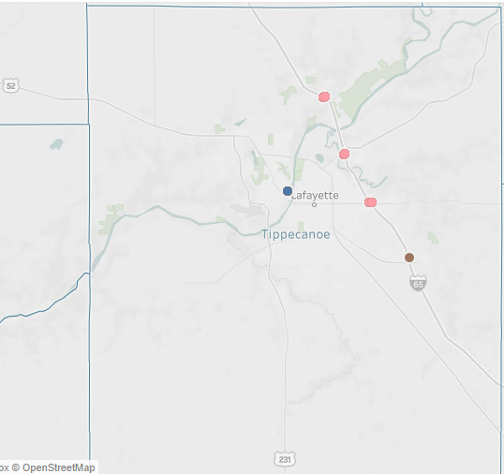
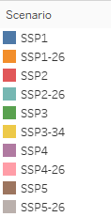
Tippecanoe county forecasted ramp congestion
Tippecanoe county congestion grows from 1 ramp to 8 ramps in 2050 under SSP5
Congested Ramps in Tippecanoe

Slide 19
Summary
Future growth forecasts are impacted by geo-political outcomes
Tippecanoe county’s growth is impacted by these global issues
Unless we plan, ramps get congested
It is important for the micro level choices to be synchronized with macro level shifts
Being quantitative gets us to realize the urgency and make choices

Slide 20
Thank you
Ananth V Iyer
aiyer@purdue.edu

