Slide 1
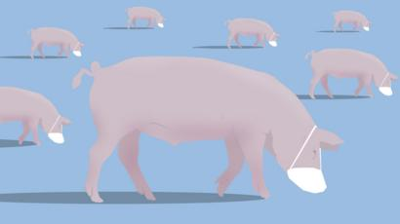
Supply Chain Resilience in the Covid Age
National Pork Board
February 2021

Slide 2

Kevin Sheehan
Director Processor Engagement

Slide 3

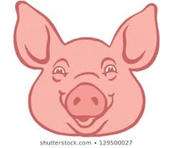
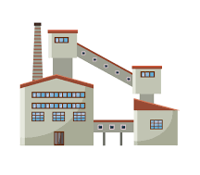
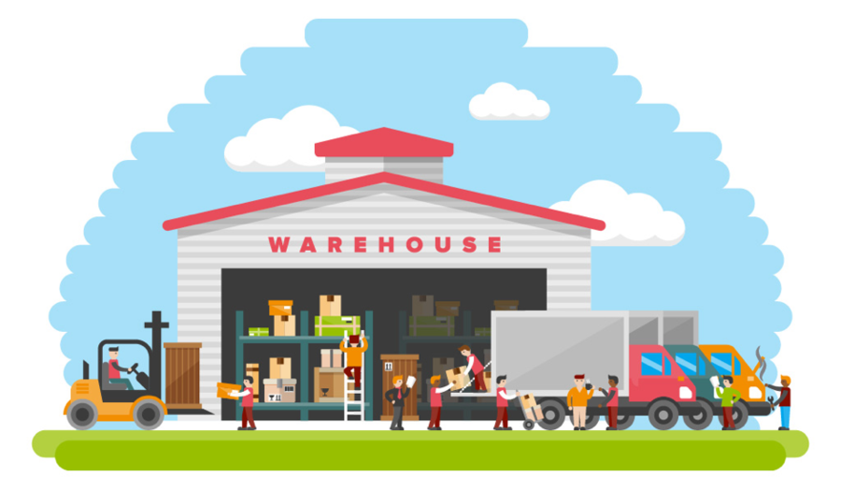
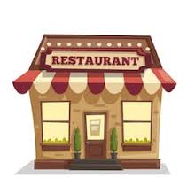
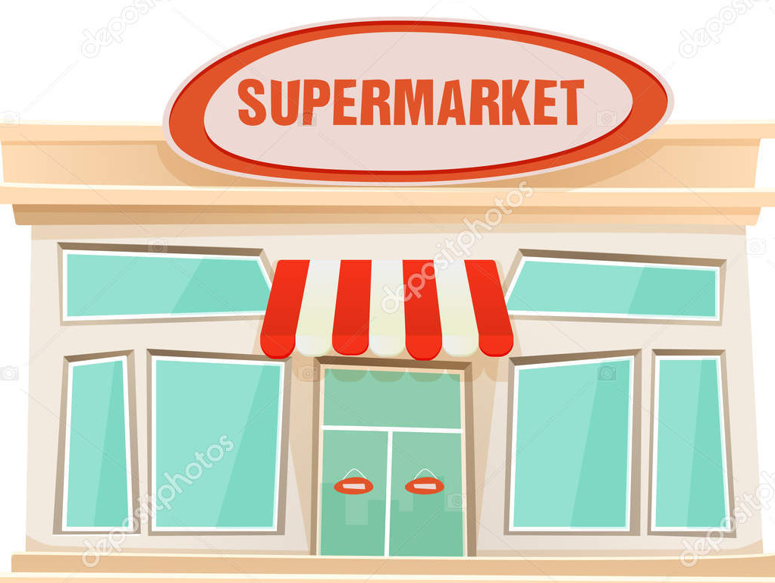
SUPPLY CHAIN
Warehouse
Consolidates product
Customer is Walmart, Kroger, Sysco, McDonalds etc.
Delivers to Restaurant
grocery store
Producer
Grows live hogs
Packer Creates finished goods
Just In Time Delivery
DEMAND CYCLE
These orders dictate the number of hogs needed
Creates orders to the plants
Creates orders to the warehouse
Consumer demand at retail and food service

Slide 4
2020
Like No Other Year

Slide 5
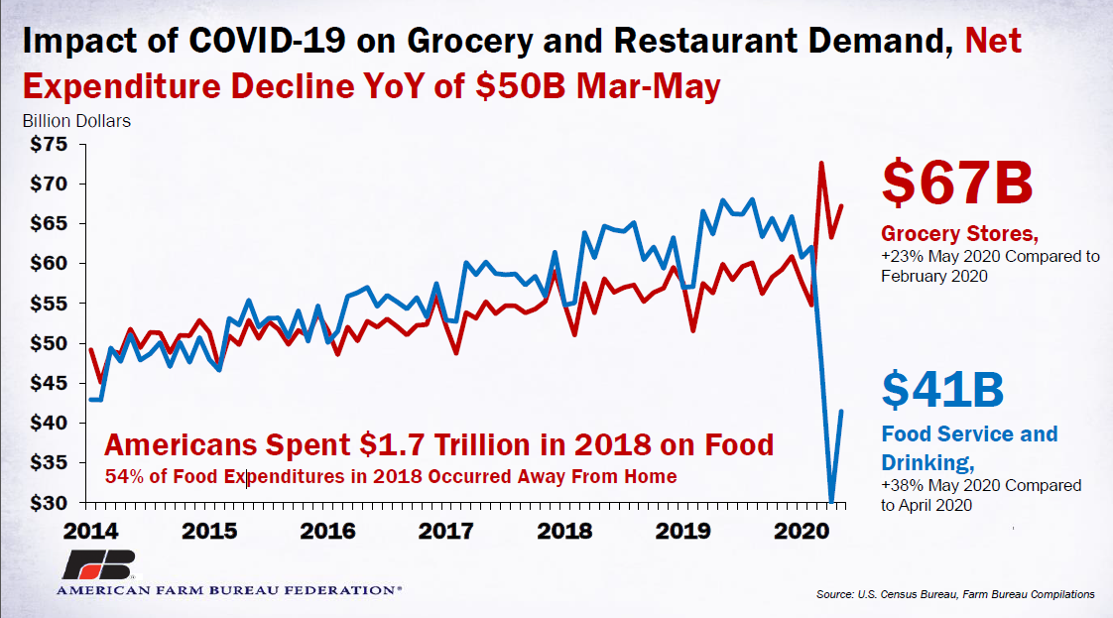
COVID Challenge:
Changing Production from Foodservice to Retail
Notes:
Groups worked with FSIS at USDA on labeling and packaging flexibility.
It took some time to change production lines from foodservice to retail. Pork Belly example.
All of this happened basically in one day

Slide 6
COVID Challenges
Changing Production from Foodservice to Retail & Panic Buying
Protecting and Supporting Workers
Opening Facilities to Make Food
Oversupply of Livestock
Notes:
Covid illness caused packers to run at 55% capacity
Moved workers from the cut floor to the kill floor
Packers spent hundreds of millions, billions of dollars to retro fit plants
Grocery stores were empty, and barns were full and the public didn’t understand why

Slide 7
COVID CHALLENGE:
Protecting and Supporting Workers
Engineering
Social Distancing
Administrative
Promote Social Distancing
Cohorting
Notification in several languages
Barriers or Partitions
Ventilation
Hand Hygiene
Sanitation
Attention to Non-Food Contact Areas
Carpooling
Stagger shifts
On-site testing
Notes:
Protections include engineering changes to facilities and administrative measures like staggering shifts and educating employees on COVID best practices.

Slide 8
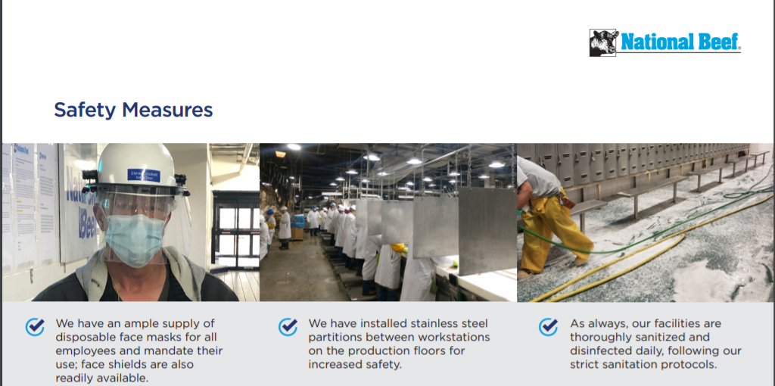
Example of PPE, Barriers and Sanitation
Notes:
PPE, Dividers, extra sanitization

Slide 9
COVID CHALLENGE: Protecting and Supporting Workers
Removing vulnerable populations from facilities, offering full pay and benefits
Requiring sick employees to stay home from work, with pay
Waiving short-term disability waiting periods
Providing free 100% preventative care to all employees
Providing paid sick leave
Increasing pay
Bonus pay
Notes:
Examples of Administrative support for workers.

Slide 10
Plant Closures and Slowed Production
Despite worker protections and support, employee fear drove high absenteeism from March-May
Facilities were forced to slow production
To stop spread of virus, some plants were closed for two weeks, others two days, some were unaffected
Executive Order allowed local health authorities to work with companies, USDA and CDC on reopening plants once worker protections were verified

Slide 11
COVID CHALLENGE:
Over Supply of Livestock=Hog Farmers Suffer
Notes:
COVID disruptions came at a bad time for the producers. Peak demand for beef and pork is between Memorial Day and Labor Day so meat production and livestock demand is typically strongest leading into the Summer, but COVID impacted packing plants in April and May when demand for cattle (and hogs) would normally be at seasonal high. Many hog producers were forced to euthanized.

Slide 12
Where are we now?

Slide 13
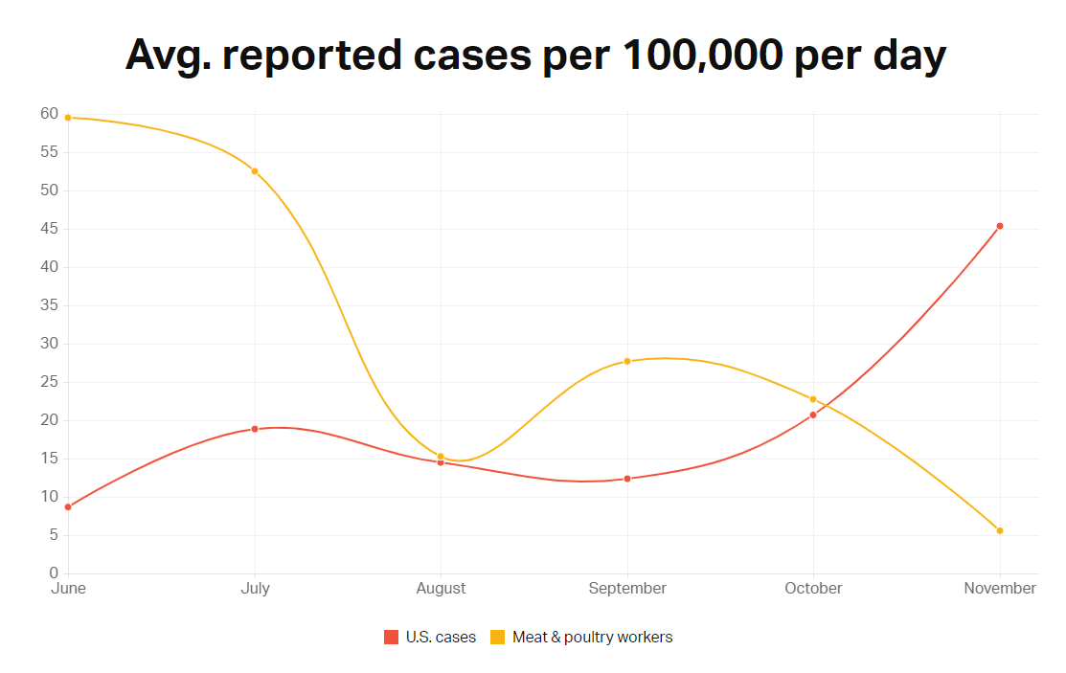
Notes:
US Cases vs. Meat and Poultry plant cases per 100,000 per day
We are doing a good job.
The latest data was from November.

Slide 14
Lessons Learned
Robust communication along the supply chain
Outreach to avoid panic buying, Media, Retail
Outreach to local officials about COVID safety measures in the processing facilities
Workforce communications about how to stop the spread in communities
Testing protocols need to be robust and consistent, not one and done
The consumer showed us that they were willing to change the way they shopped

Slide 15
What is in the Future?

Slide 16
Outlook
Automation, sanitization and ventilation systems
New plant configuration?
Labor for live production and plants
Alt Protein – do we compete or participate?
Notes:
Tyson Foods has invested $500 m over the past 3 years technology innovations over the past three years, including the Tyson Manufacturing Automation Center (TMAC) in downtown Springdale
Media reports of illness at packing plants
New administration

Slide 17
Dealing with a new administration
  Regulations
    Inspection Modernization
    Food Safety – Pathogens like Salmonella
    Worker Safety – 6-foot social distance and line speed
    Liability protection for business
  Labeling – Country of Origin Labeling
  New Dietary Guidelines
  Regulation of genetically modified livestock
  Trade and Trade Policy
    Trade Promotion Authority
    Existing Agreements
    China and Japan Phase 1 agreements
    WTO
  Climate

