Slide 1
Teamwork making the Dreamwork
Sheila Beutel, Associate Director Sales & Operations Planning

Slide 2
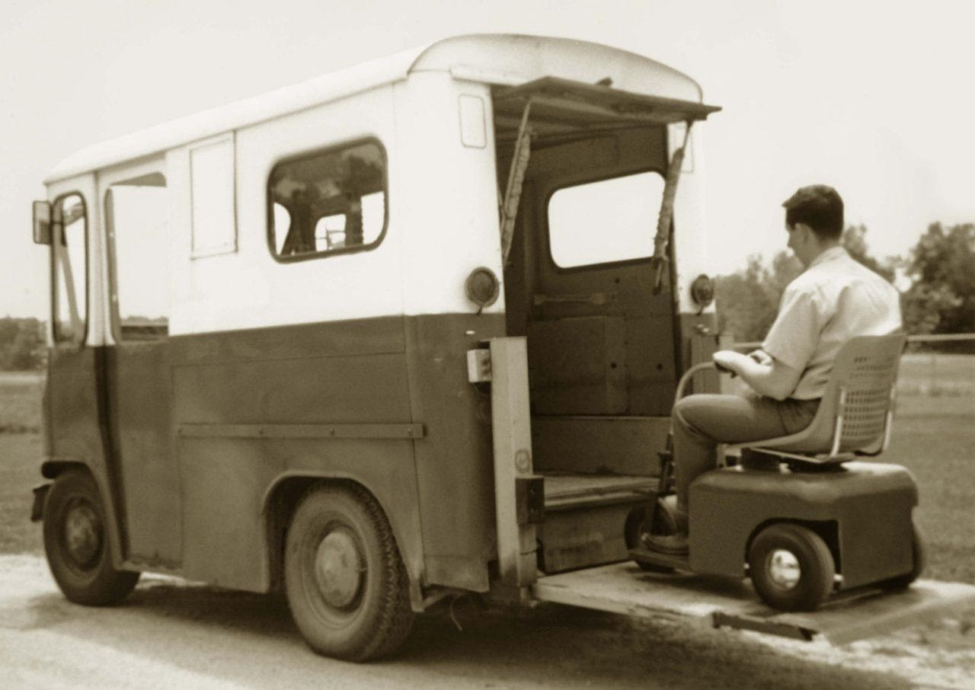

Slide 3
OEM’s
Purchasing
Quality
Engineering
Quality
Sales
Production
Vendors
Logistics
Scheduling

Slide 4
Parcel interception at hubs
Suppliers extended lead times, sometimes 2x pre-COVID
Suppliers dropped our low volume business
Part pick ups in personal vehicles
Build without when it made sense
Part Deviations
Supply chain visibility is very poor
Suppliers had office staff work on the floor
Shared material with suppliers to reduce spot buys
Insourced when outsourced suppliers couldn’t keep up
Networked within our supply base to help another supplier out
Tier 1 suppliers constantly supplied by sub-tier part shortages

Slide 5
Chassis
Actuators
Fuel Tanks

Slide 6
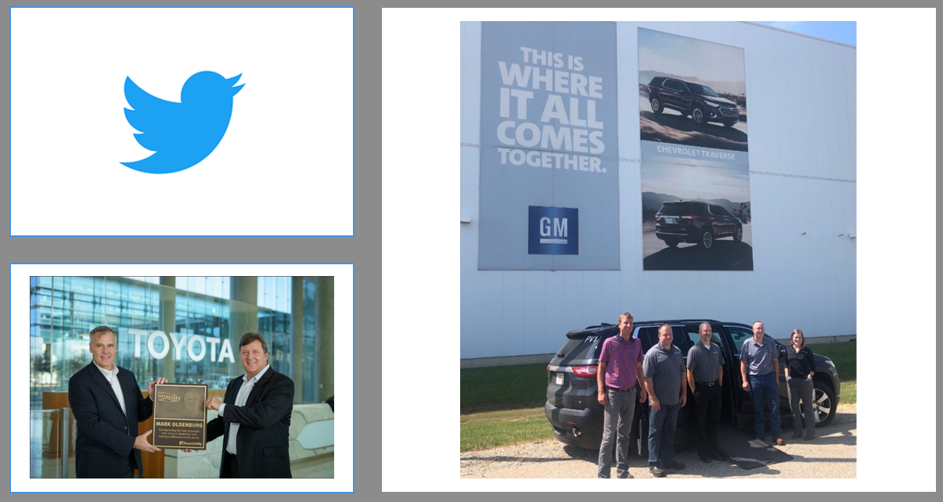

Slide 7
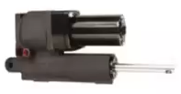

Slide 8
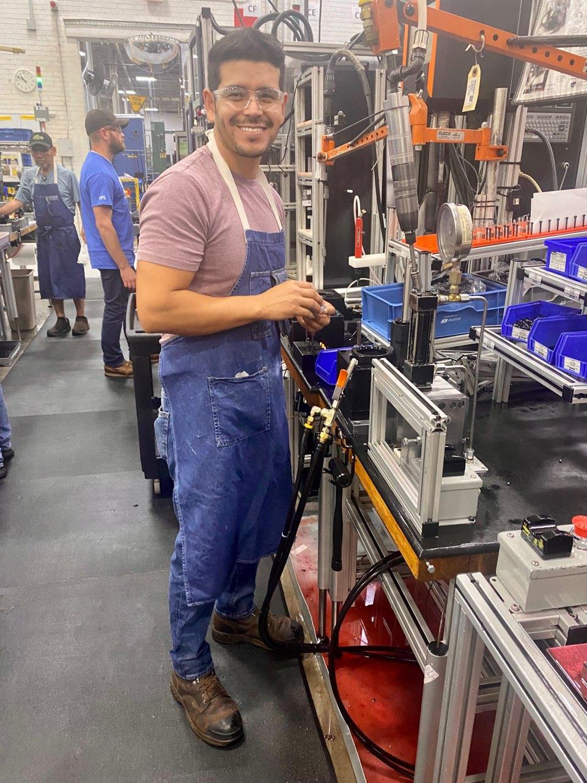
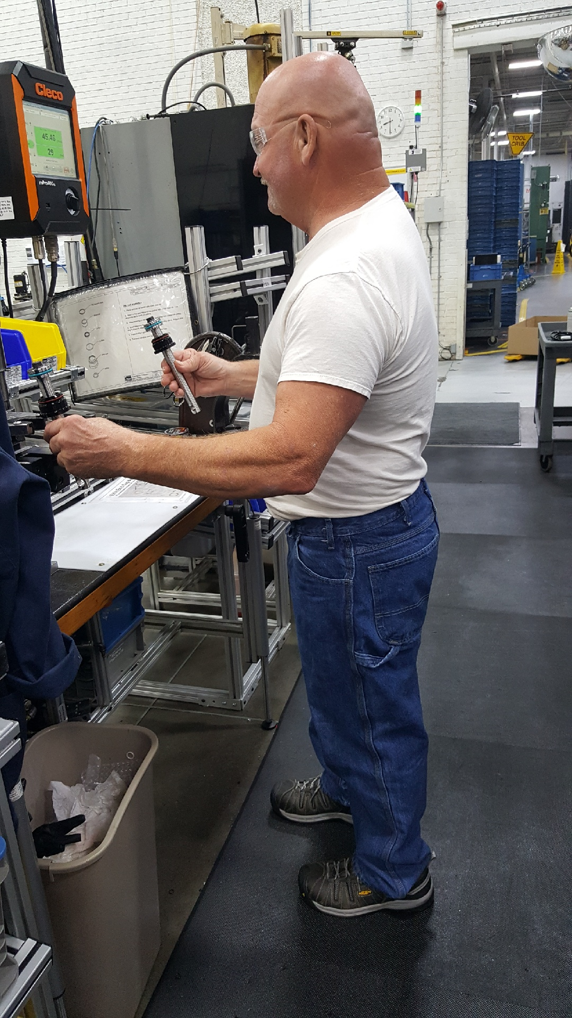
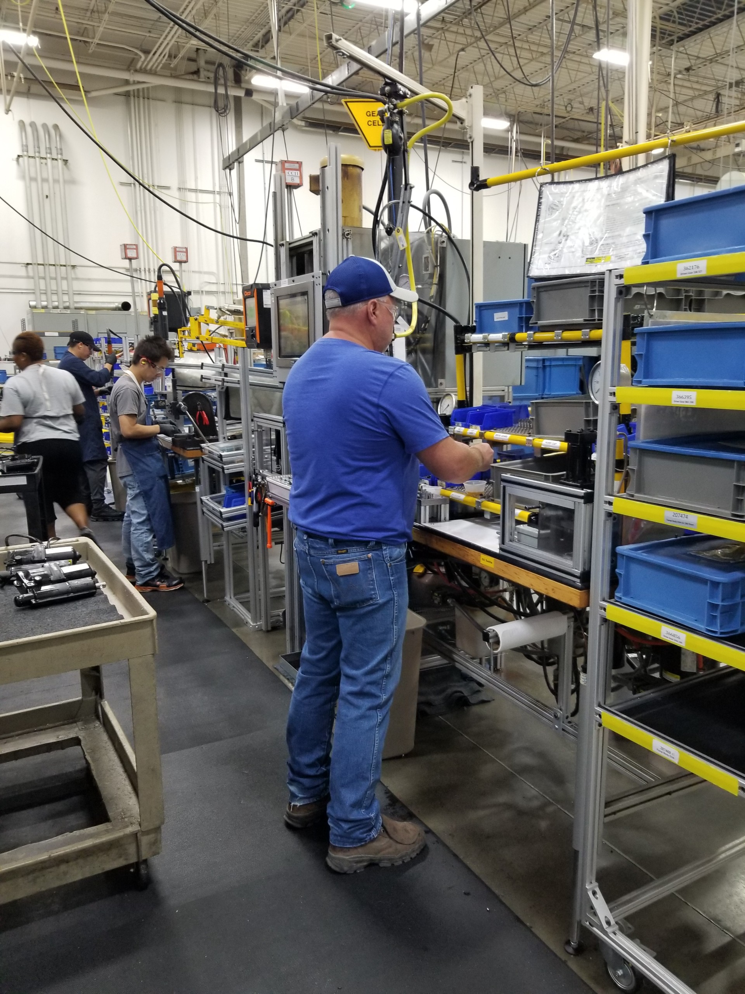
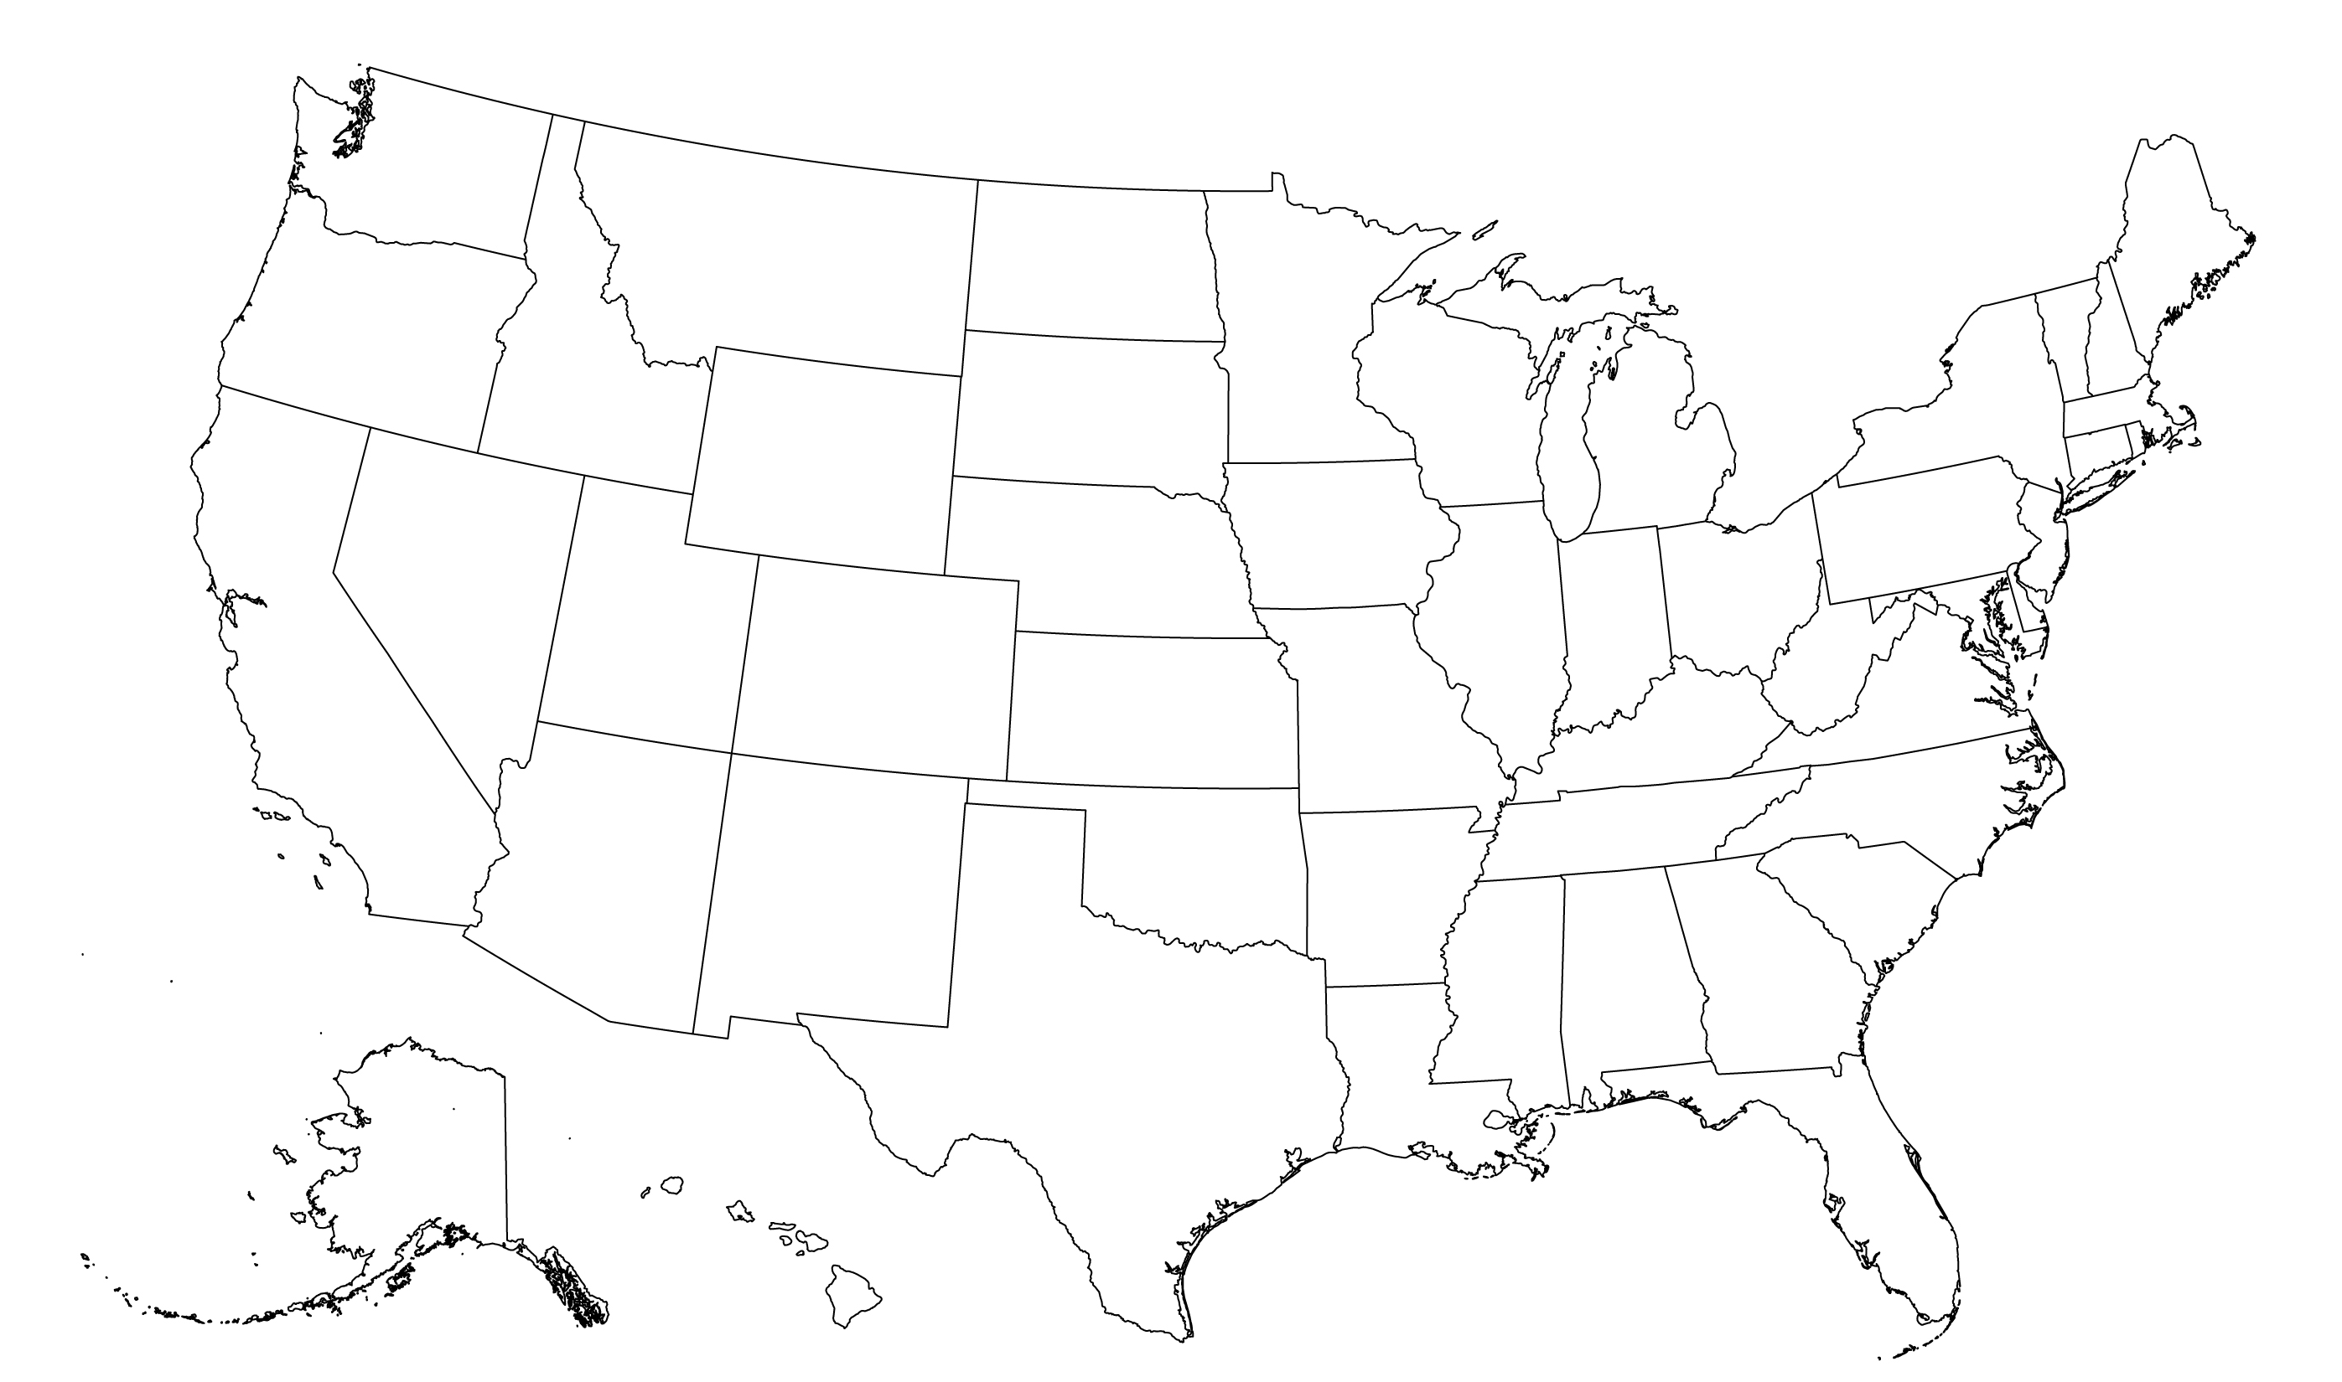
Laboring over Labor Day
Lakeville, MN
Winamac, IN

Slide 9
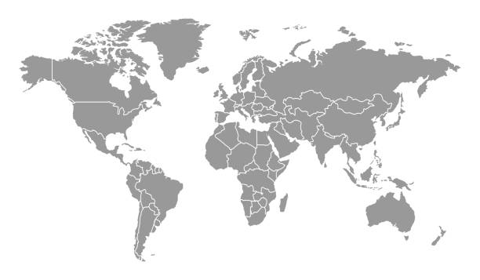
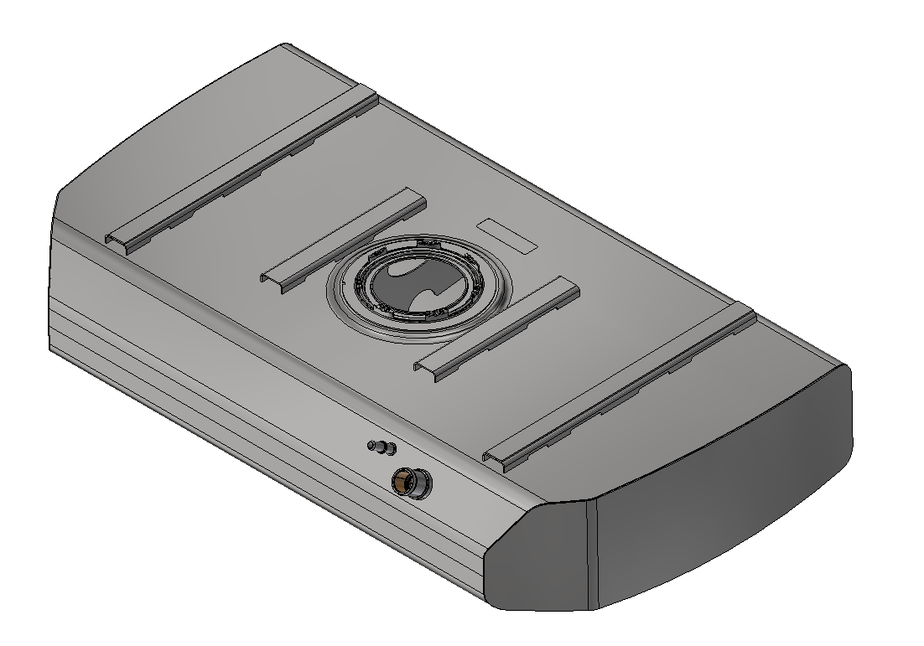
500 miles turned to 4,500
Canadian Supplier
French Supplier
Winamac, Indiana

Slide 10
Can Do
Communication
Candor
Clarity
Consensus

Slide 11
