Slide 1
Managing Supply Chain Disruptions
Ananth V Iyer
Susan Bulkeley Butler Chair in Operations Management
Department Head, Management and Senior Associate Dean
Academic Director, DCMME and GSCMI
Krannert School of Management
Purdue University
West Lafayette, IN 47907
Aiyer@purdue.edu

Slide 2


Slide 3
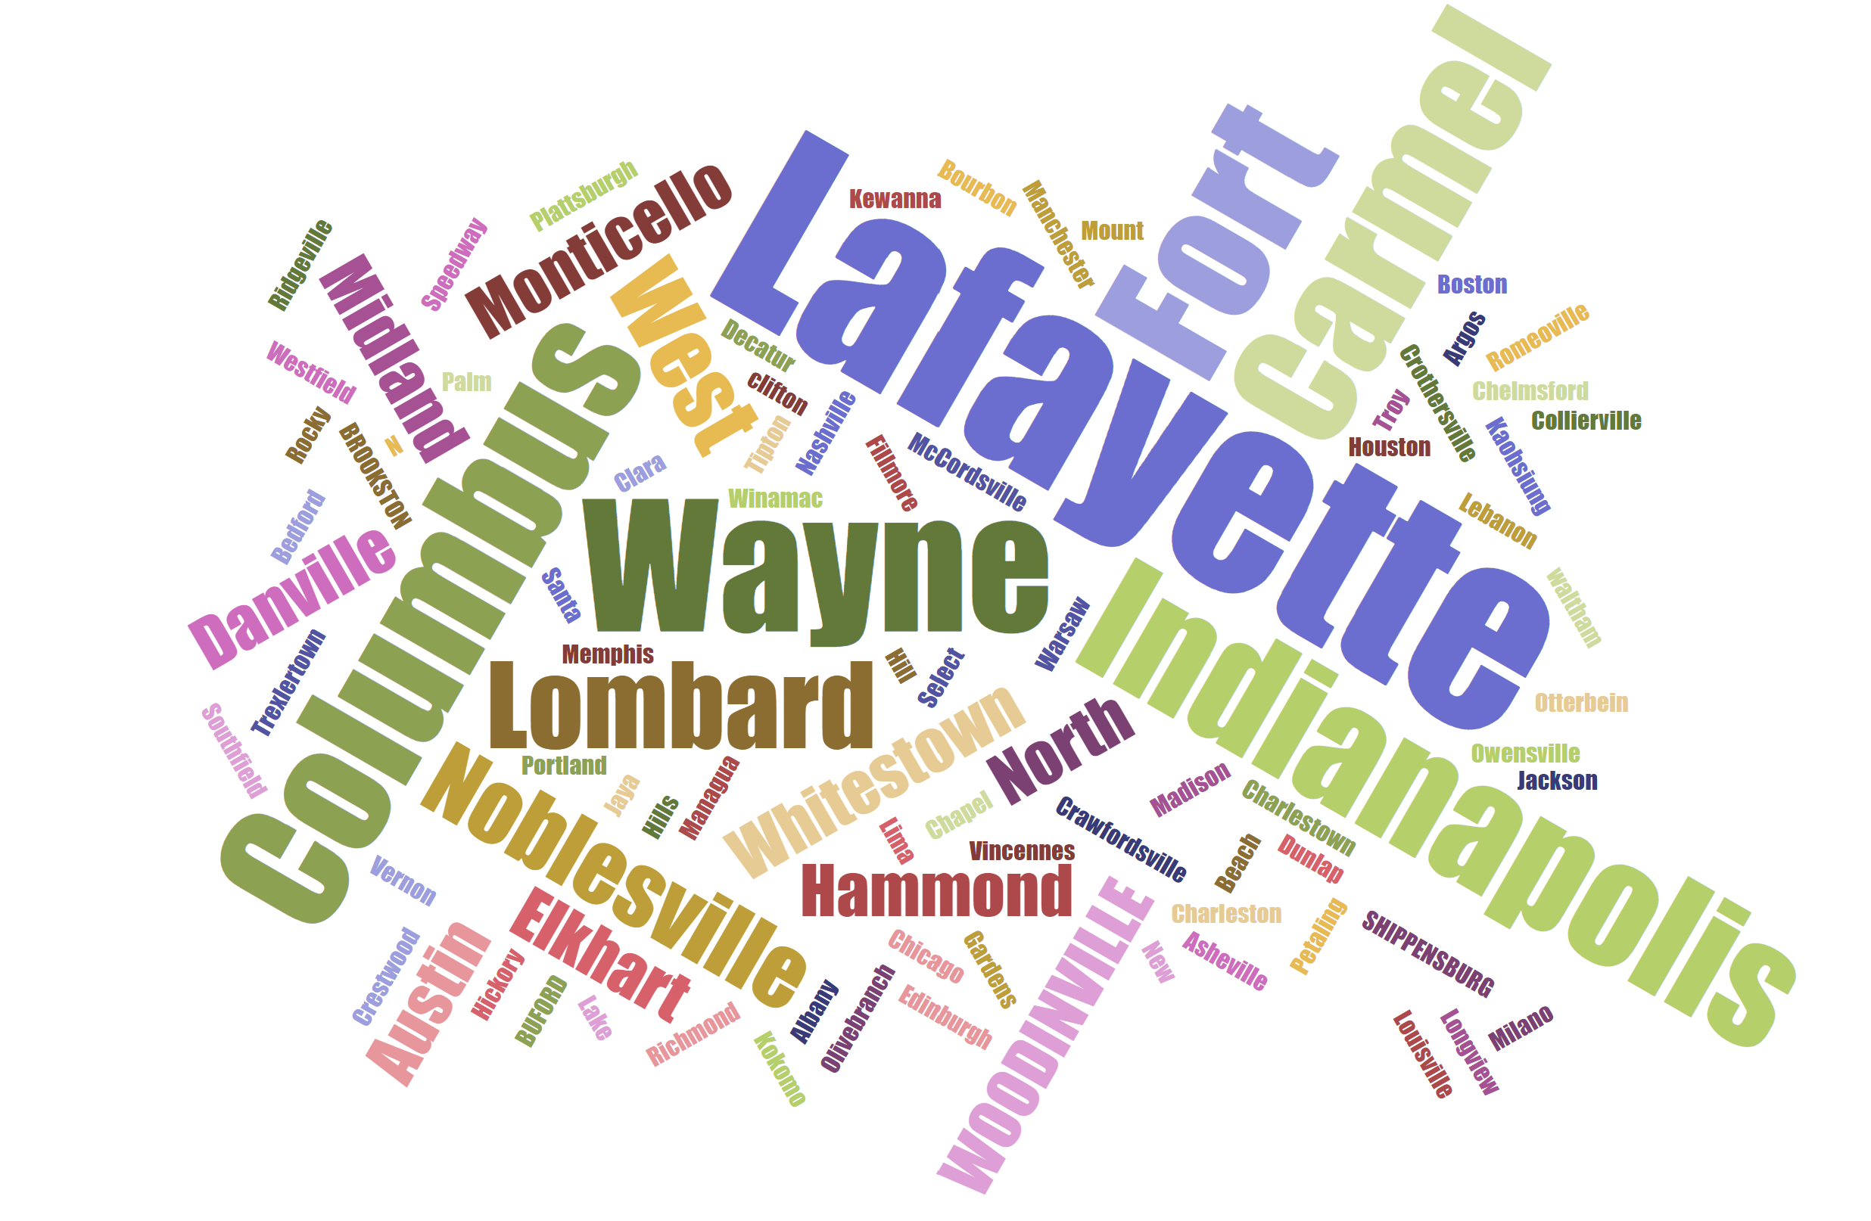
WOODINVILLE, WA
MILAN. ITALY
SANTA CLARA, CA
LIMA, PERU

Slide 4
