Slide 1
Purdue University | Wabash
Managing Supply Chain Disruption
GSCMI Supply Chain Conference
Richard J. Mansilla
VP, Global Procurement

Slide 2





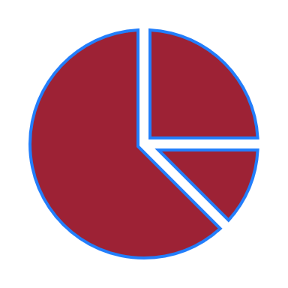


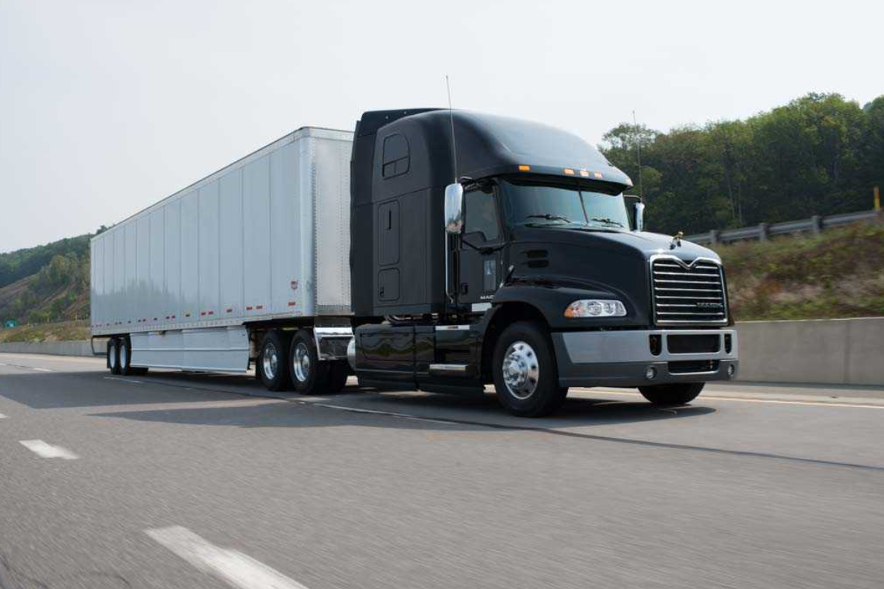
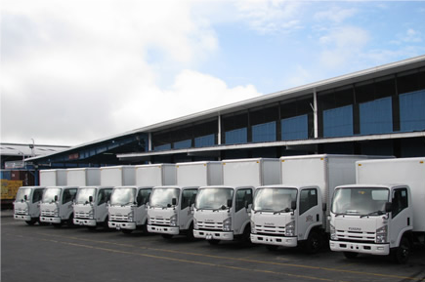
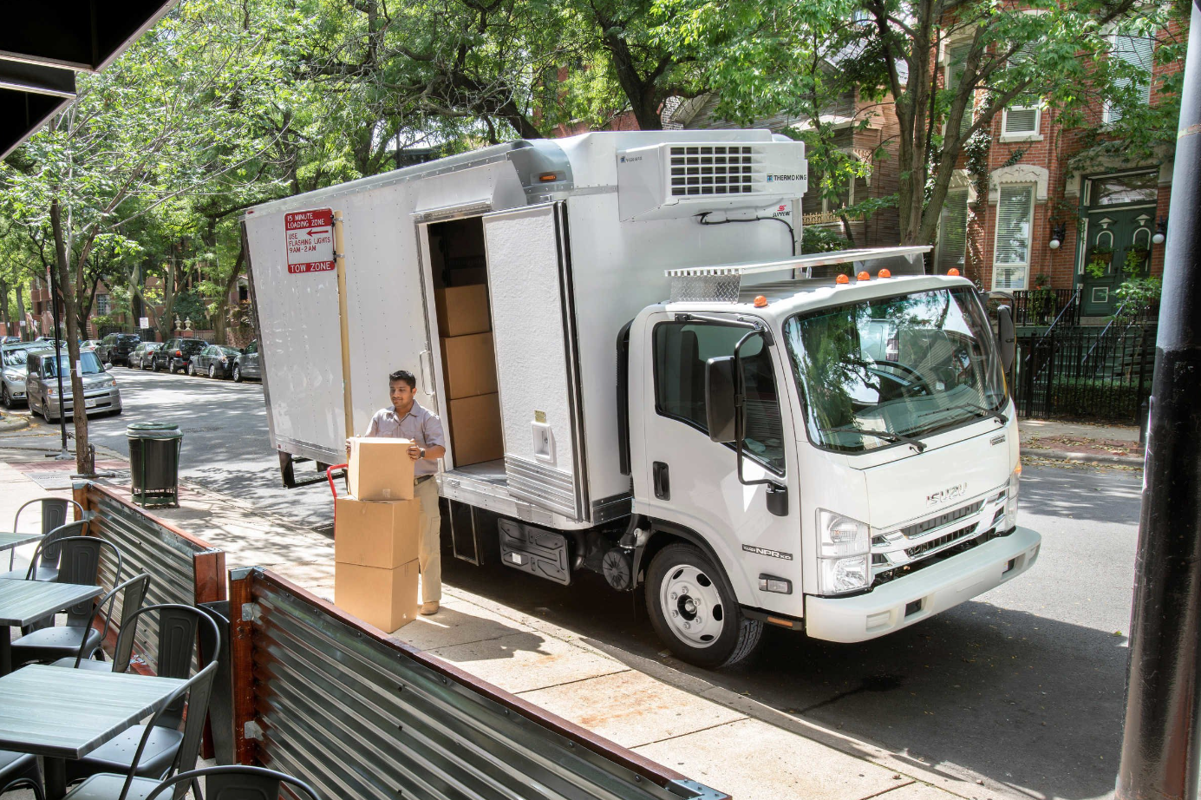
Wabash at a Glance (NYSE: WNC)
Introduction
1985 | Lafayette, IN | ~$850M¹ | ~6,000 | 13 | $1.8B | 3.5% | $104M
Founded | Headquarters | Market-cap | Global Employees | Manufacturing Locations | 2021 Revenue | 2021 Adjusted Operating Margin² | 2020 Free Cash Flow³
FIRST MILE
MIDDLE MILE
FINAL MILE
Long-haul routes of goods
Driven by freight activity
Products moved into or redistributed among fulfillment centers
Driven by strategic positioning of goods to allow for 2-day delivery or less
Delivery of goods to home or final destination
Driven by strong growth in ecommerce
Leveraging the Industry’s Broadest Portfolio Across All Phases of Transportation
¹ As of 11/29/2021
² 2021 Operating Margin includes an adjustment for the impact of the divestiture of Extract Technology in Q2 2021. A reconciliation of adjusted operating income to operating income is included in the appendix to this presentation.
³ A reconciliation of free cash flow to cash (used in) provided by operating activities is included in the appendix to this presentation.
2
Notes:
For some quick background, we were founded in 1985 with our headquarters in Lafayette, IN with sales in 2019 of $2.3B
One thing I’d like to call out on this slide relates to my earlier comment on Wabash being a fundamentally different company: if you look at our 2019 revenue by segment, you can see the diversification that has been achieved as our company was effectively the Commercial Trailer Products organization going back 10-15 years ago

Slide 3

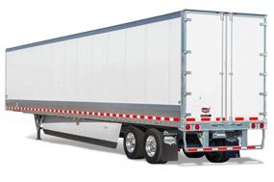
Wabash Brand History
Introduction
1985
Wabash was founded as a semi-trailer company…doing business in a single product category… and under a single company brand

Slide 4





Wabash Brand History
Introduction
1985–2017
Since then, Wabash has acquired several world-class brands to enrich its portfolio. These acquisitions significantly expanded the breadth of the company’s product categories—covering the full range of transportation from first to final mile

Slide 5




Strategic Shift in Brand Strategy
Introduction
From
To

Slide 6
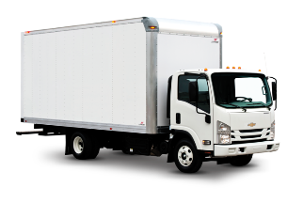
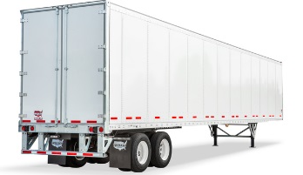
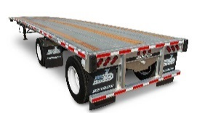
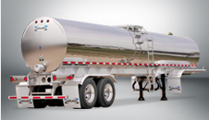
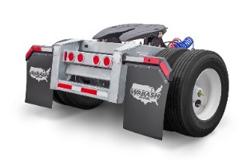
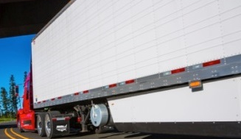
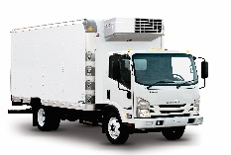
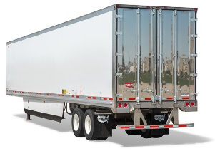
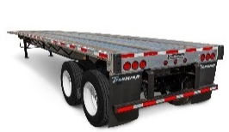
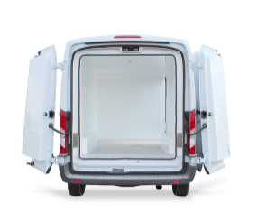
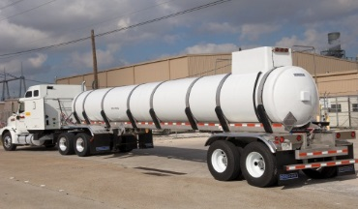
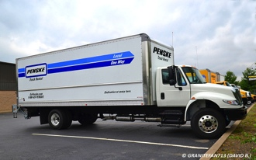
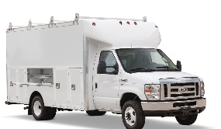
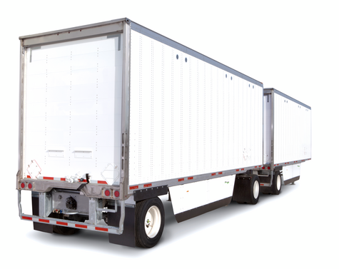
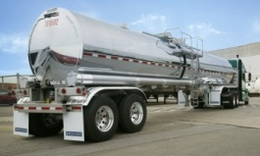
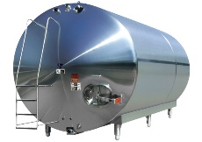
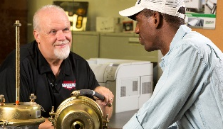
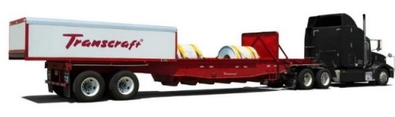
Industry Leader, Serving First to Final Mile
Introduction
Truck Bodies
Van Trailers
Platform Trailers
Tank Trailers
Parts
& Services
Dry Truck Body
DuraPlate Dry Van
Aluminum Trailer
Sanitary Trailer
Converter Dollies
Aerodynamic Fairings
Refrigerated Truck Body
Refrigerated Van
Steel & Combo Trailer
FRP Trailer
Final Mile Upfit Solutions
Truck Body Panels
Service Body
DuraPlate Pup Trailer
Coil Haul Trailer
Chemical Trailer
Storage Tanks
Service Centers
View the complete Wabash portfolio at: onewabash.com

Slide 7

















Customer Segments
Introduction
        Strategic Accounts
        Strategic Dealer Accounts
        Regional & Specialty Sales

Slide 8
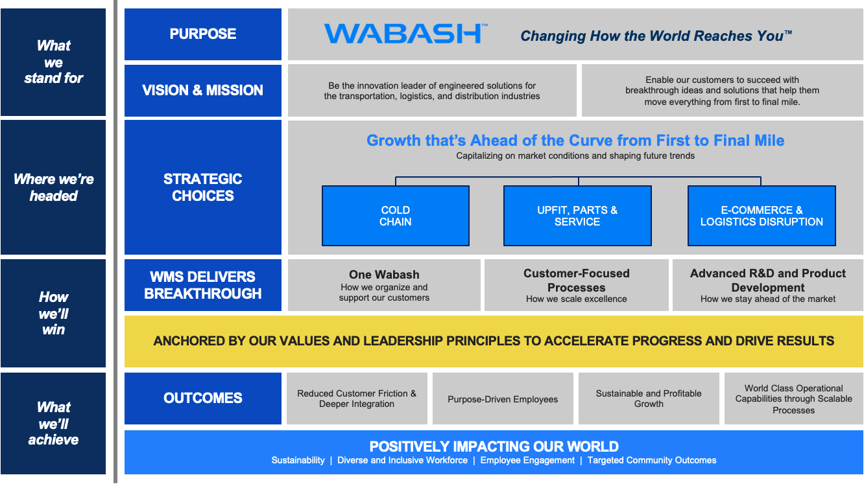
Wabash 2022: Who We Are and What We Do
introduction

Slide 9
Global Procurement

Slide 10
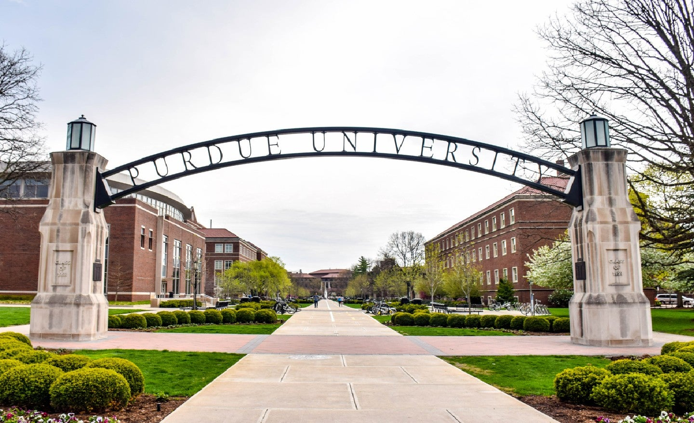
Wabash Global Procurement
Global Procurement
$1.8 Billion Total Supply Chain Spend
EQUIVALENT TO
180,000* Purdue Tuitions
*Reflects In-State tuition fees

Slide 11

Wabash Global Procurement
Global Procurement
605 Million Pounds of Material
EQUIVALENT TO
108,000 Elephants

Slide 12

Wabash Global Procurement
Global Procurement
33.5 Million Miles of Freight
EQUIVALENT TO
1,348 trips around the Earth
Notes:
And the good news is that we have a lot of opportunities to work on together .
1348 Trips around the Earth or a One way ticket to Mars

Slide 13
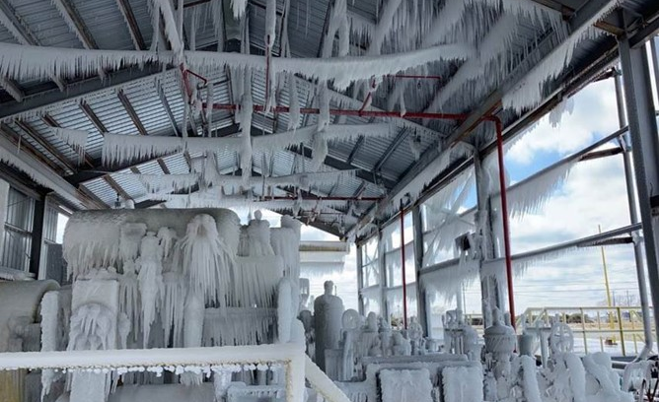
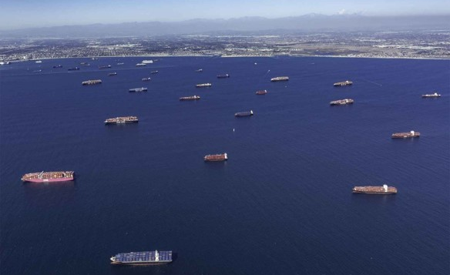
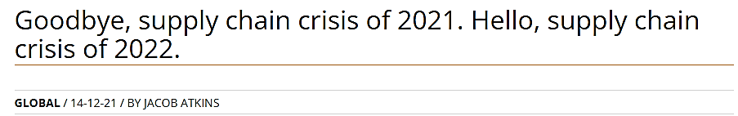
Supply Chain Constraints
Global Procurement
Adaptability and Perseverance During an Unprecedented Time

Slide 14
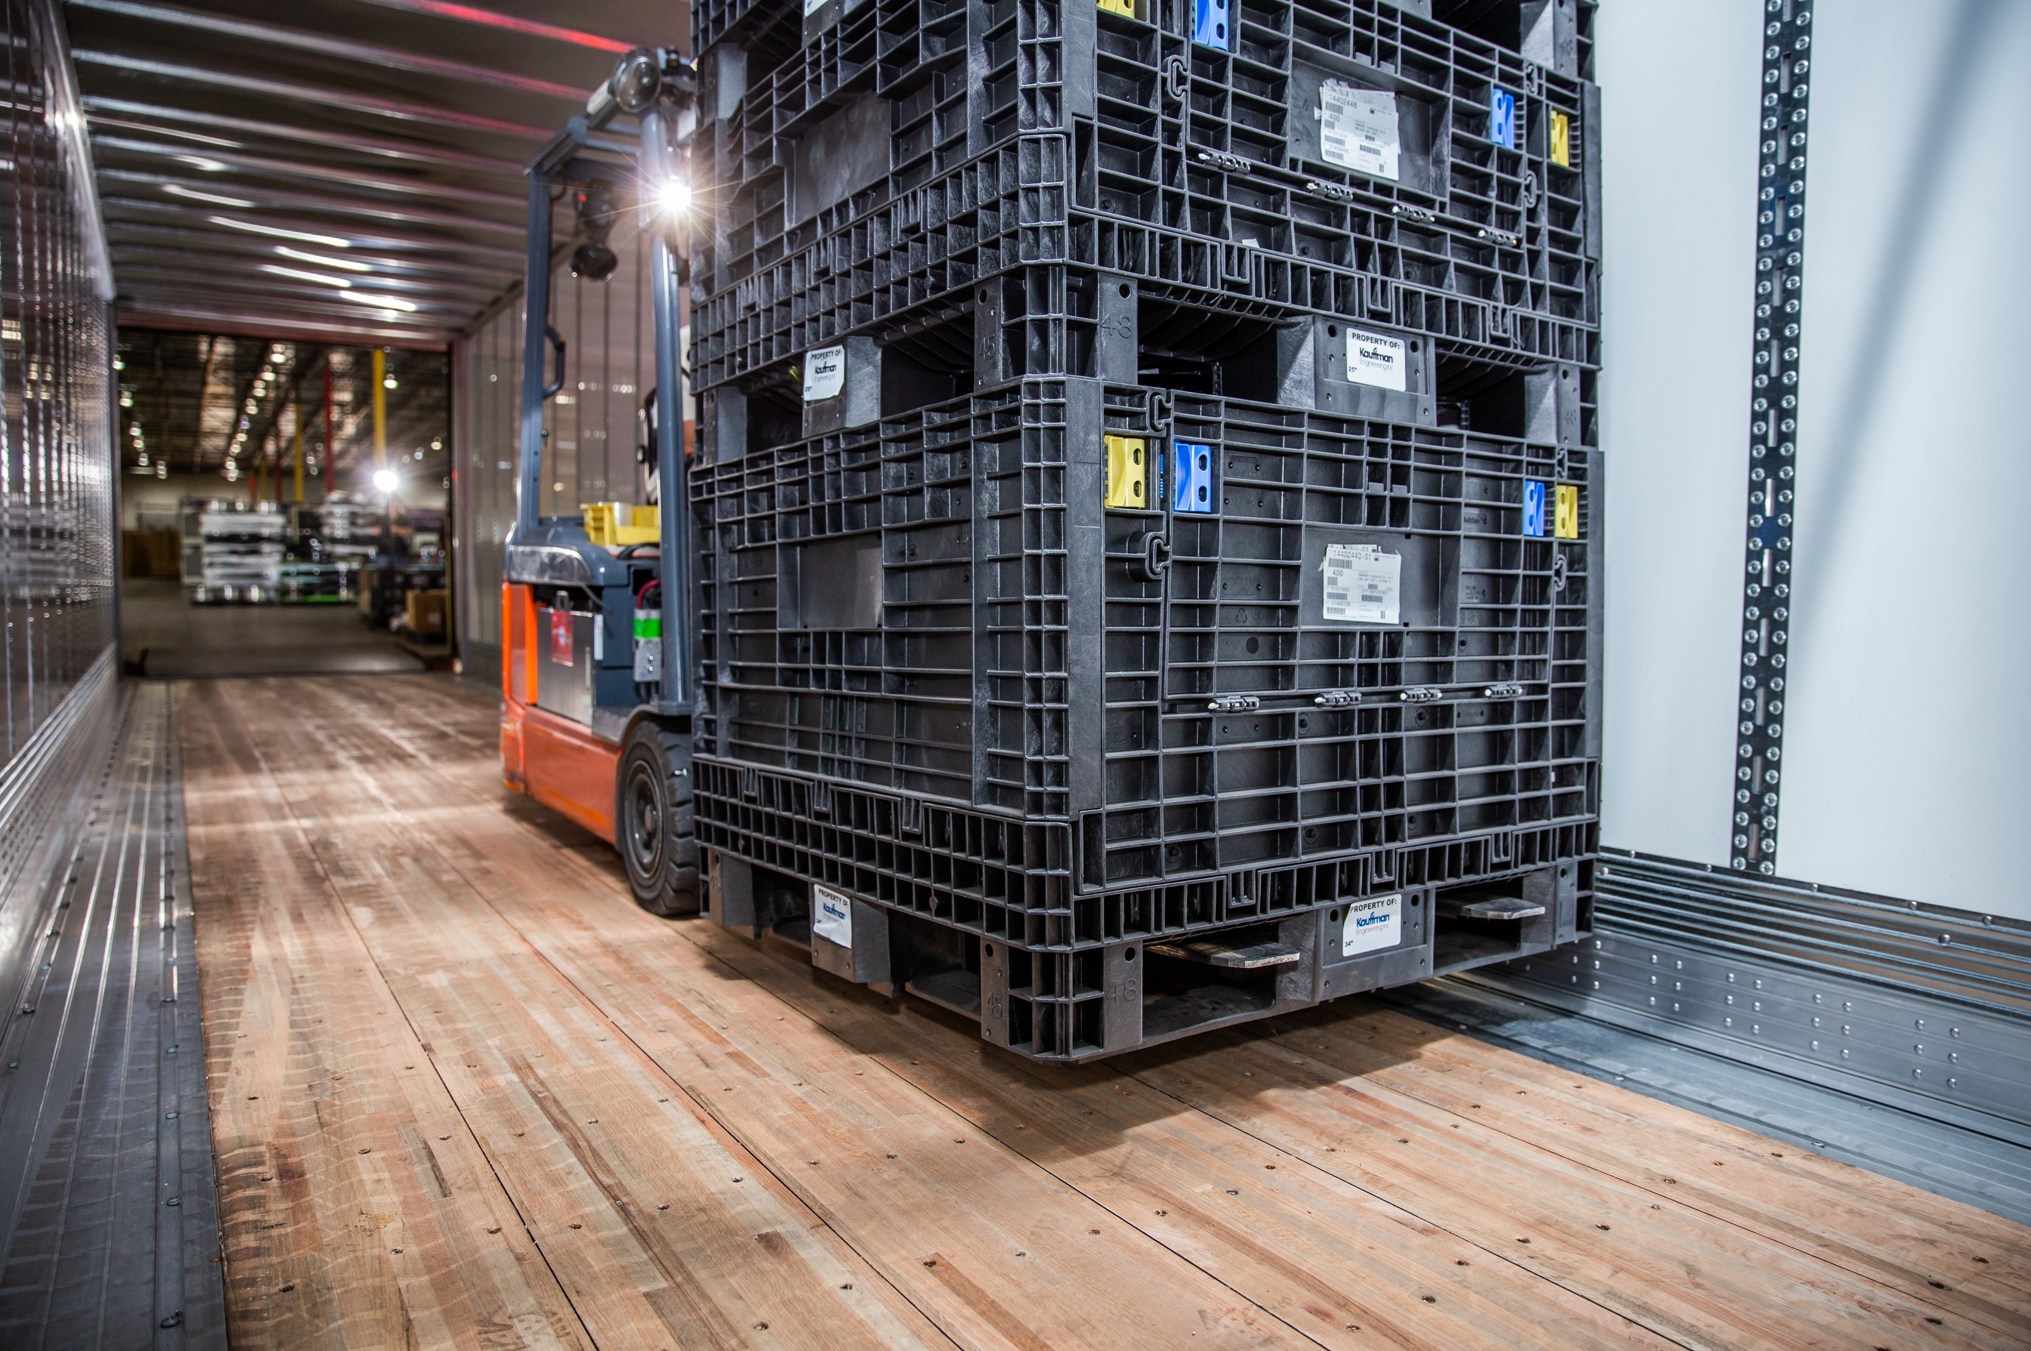
Global Procurement Focus
Global Procurement
Ensure we procure the best Quality components/sub assemblies with leading Technology at the best Cost from suppliers that provide best in class Service.
Make sure there are zero disruptions in material flow from our suppliers to our plants.

Slide 15




Global Procurement Direction
Global Procurement
Supplier Relationship Management
Extracting more value from supplier relationships by becoming
more integrated with key suppliers
Be the Customer of Choice
Streamline Supplier Engagement
Maintain Nearshoring Strategy
People Management
Strategic emphasis on everything we do
Establish Training Curriculum
Diversity, Equity, Inclusion
Develop future leaders
COMPLEXITY
Material Cost
Collaborating with Finance, Engineering, Sales, and Suppliers to optimize our product portfolio
VA/VE Workshops
Total Cost of Ownership Mentality
Supplier Cost Reduction Roadmaps
Capacity Planning
Proactively identifying supply
chain constraints
Proactive Risk Mitigation
Weekly Supplier Reviews
Utilize Digital Supply Chain Tools
TIME

Slide 16
Global Category Strategies
Global Procurement
Category Definition
What are we sourcing?
Balanced Scorecard
Measure and focus our suppliers on key KPIs
Cross-Functional Engagement
Who will execute the plan?
Technology Roadmap
Do we have a supply base to support Product Development’s plan?
Develop supplier partnerships to create disruptive technologies
Spend Analysis | Market Intel
Supplier, region, SBU, sub-category
industry and competitor data
STRATEGY
DEVELOPMENT
Cost Management
VA/VE, Rebates, Price Reductions, Freight, Hedging
Portfolio Analysis
Segmenting categories and suppliers
Business Over Time
Ensure continuity of supply over time
Should Be Cost
Knowledge of cost structure prior to receiving quotes

Slide 17


Sourcing Strategy
Global Procurement
Unlock Breakthrough Technology and Innovation
Past
Present
Future
Transactional
80%
60%
20%
Strategic
20%
35%
70%
Relational
0%
5%
10%
Transactional
Strategic/Relational
Short-term, tactical
Adversarial negotiations
Rigidly defined terms
Discourages collaboration and investment
Long-term, strategic
Shared vision and mission
Focused on mutual benefits
Defined process for dealing with the unexpected
Notes:
We are changing the way we manage our suppliers.
In the past we’ve had a general transactional approach that did not prioritize key/strategic suppliers.
We would have equal strategic engagement with all suppliers primarily during the contract renewal phase but, once the contract was consummated those discussions would lose momentum.
Now we are sustaining the strategic engagements throughout the year with a focused set of key/strategic suppliers.
A cadence of communication with our suppliers will lead to: secured capacity, unlocked technology sharing, breakthrough product innovation, enhanced service (on time delivery), improved quality, cost reduction roadmap

Slide 18





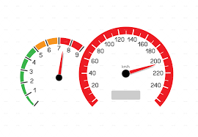
Nearshoring Strategy
Global Procurement
Procuring components/sub assemblies in close proximity to our manufacturing plant
Recommendation
Sourcing closer to our manufacturing plants may not necessarily mean the products are manufactured in the US
Suppliers Closer Geographically
Partner with suppliers to set up facilities near our plants, creating a leaner supply chain
Achieve LCE competitive pricing by working with suppliers with global networks
Lower Hidden Costs
We may market test elsewhere, but the savings that can be generated could be trivial
Travel, freight, warehouse, communication
80/20 Approach
80% Nearshore
20% Offshore/through Tier 1
Need for Speed
Same time zone allows for quick, efficient communication - resolving SCM, Quality, Engineering, Manufacturing, etc.
95% of our Tier 1 spend is localized

Slide 19







Digital Transformation
Global Procurement
Integrate with Suppliers, Operations, & Customers
Core Supplier Partnerships
Collaboration
Digital Supply Chain
End-to-End Data Transparency & Analytics
World Class Logistics
Network
Optimization
Autonomous
Process Standardization
Material Planning

Slide 20


Corporate Responsibility – Stakeholders and Value
Global Procurement
Invest resources where we do business, local leadership, shape culture.
One story, impacting all stakeholders.
Corporate Responsibility
Employees
Customers
Suppliers
Community
Investors
Board of Directors

Slide 21
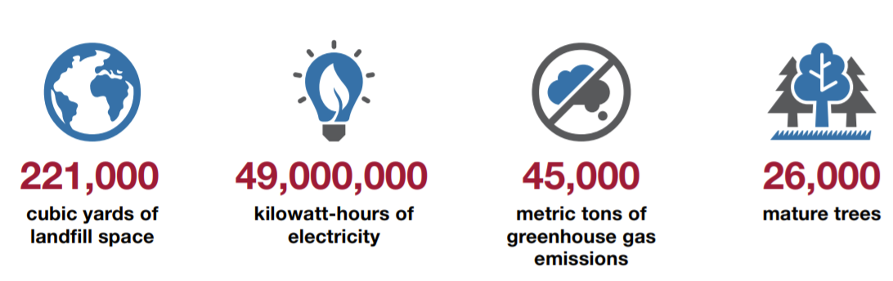
Wabash Sustainability
Global Procurement
Promoting environmental stewardship in every aspect of our business
In 2020, Wabash’s recycling programs and use of recycled materials saved:

Slide 22

What Wabash Global Procurement Offers
Global Procurement
Allows you to set the pace
Strategic and tactical experience
Ability to make an impact
Fun learning environment

