Slide 1
Managing Supply Chain Disruptions
Ananth V Iyer
Susan Bulkeley Butler Chair in Operations Management
Department Head, Management and Senior Associate Dean
Academic Director, DCMME and GSCMI
Krannert School of Management
Purdue University
West Lafayette, IN 47907
Aiyer@purdue.edu

Slide 2
Agenda
Managing Supply Chain Disruptions – issues and ideas
Supply Chains, reasons for disruptions
How are we connected to the world
Suez Canal – how long, impact
Ports and backups
Chips and the auto industry
Grocery supply chains
FedEx, Tesla, Toyota, WalMart
Ideas to manage supply chain disruption

Slide 3
Supply Chain and bottlenecks
Upstream – Supply
Downstream – Demand
Processing Entity – Retail, Manufacturing, Distribution…..
Supply
Processing Entity
Demand
Disruption Reasons:
Demand Increase
Supply Decrease
Processing Rate Decrease

Slide 4
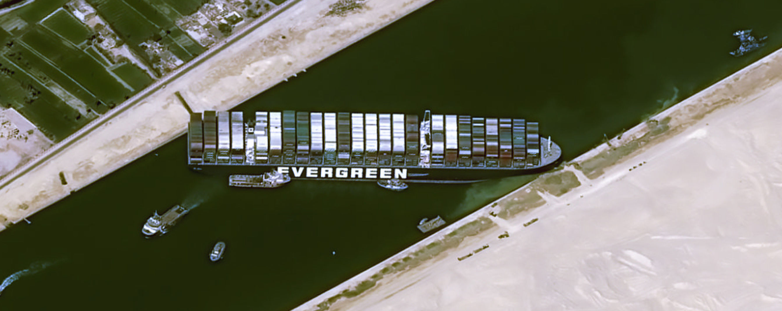
Suez Canal

Slide 5
Suez Canal blockage
Suez Canal: 120 mile canal, some regions 300 feet wide
Ever Given had 20,000 containers
19,000 ships crossed the Canal in 2020, 39 ships daily (maximum 106 ships)
13% of global maritime trade and 10% seaborne oil shipments
Bottleneck lasted 6 days ending March 29 2021 – no traffic during that period
360 ships waiting to cross at the end of the blockage
Additional 3 days to clear backlog at the Canal…….

Slide 6
US: Imported TEUs each month from 2019 to 2021
2021
2019
TEUs imported
Year | TEUs in millions
2019 | 30.45
2020 | 29.85
2021 | 35.63
Month

Slide 7
Some Data
Los Angeles Port
6 ships Nov 2020 to over 70 waiting by Nov 2021
Wait of 18 days to unload from 1 day a year earlier
Containers on dock waiting over 5 days increased from 5% to over 30%
Empty return containers exported from 60 to 80%
China to west coast per TEU, $2k to $10k, rates increased by a factor of 5
Transit time from China to Los Angeles, 25 days to over 60 days
Volume of total US imports - 29 million 2019 to 35 million 2021

Slide 8
Containers in 2021
Growth from 30 to 35 million TEUs from 2020 to 2021 (and from 2019)
Capacity issues in terms of unloading
Shutdowns in Vietnam
Turnaround times in China ports
Shortage of trucks to unload at US ports
Delays in unloading
The result ? Disruptions, unless managed appropriately…..

Slide 9
What did FedEx Logistics do?
FedEx logistics started using empty containers from the port of Humen in China to the port of Hueneme (100 miles from Los Angeles port)
Port Hueneme is a US Navy Terminal
300 units 53 ft containers per sailing
48 hour ship unloading at Port Hueneme
Solution – alternate ports, higher rate per trip but lower total logistics costs

Slide 10
What did WalMart do ?
Earlier, WalMart cargo split across many different ships
This means that rerouting to a different port not feasible
Charter own vessels to carry cargo
Smaller sized vessels, accommodated by many different ports
Use Seattle port instead of LA, Long Beach
Divert to the port with the least delays
Pay greater trucking costs but low overall costs
WalMart claimed to have 11% higher inventory at the start of December 2021

Slide 11
Chips for automobiles
Usually chip inventory at 40 days, decreased to 5 days
Ford, GM had to curtail production
Prices of cars on the lot increased, profits increased for automakers
Toyota carried 6 months of chip inventory – minimal impact in 2020
Chip manufacturers claim auto manufacturers used older generation chips, not current generation
Ford, BMW now plan to work directly with chip manufacturers
Intel plant in Ohio
What did Tesla do to ship 82% more cars in 2021 ?

Slide 12
Tesla
More vertically integrated than other automakers
Tesla controls the entire design
Greater hardware software integration – shift boundary as needed
Use current generation chips
Managed to reconfigure existing chips to maximize output and postpone some functionality
Greater use of automation for production
Shipped 82% more product in 2021 than 2020
Tesla Fremont plant is now the most productive auto plant in the world, ahead of Toyota

Slide 13
Grocery
Historically, 80 to 120 days of finished goods inventory in the supply chain
However, pandemic caused shift in product volumes from commercial to retail
Difficult to shift production sizes, volumes, distribution
Products - Toilet paper, paper towels, disinfectant, pasta ...
Result - Shift to basics using an 80/20 rule
Decrease in variety
But ... The virus also created variability in retail staff, warehousing staff, drivers etc.
So customers had to be flexible to get their demands satisfied

Slide 14
Ideas to manage disruption
Capacity, Inventory, Lead time – how are they used ?
People, process, products, technology – Smart TP3
Cross training, people capability for flexible deployment
VSMI - plan operations to minimize exposure by ensuring distancing
Technology – remote forklifts, AR glasses, sensors, cobots
Exploring capacity in the supply chain (can adhoc supply chains enable supply?)
Supply Chain Awareness – what are the possible options across the supply base ?

Slide 15
Ideas
Reshoring
Nearshoring
Regionalization

Slide 16
Thank you
Ananth Iyer
Aiyer@purdue.edu

